Slide 1
Principles of
Volumetric Analysis
titration
titrant
analyte
indicator
equivalence point vs. end point
titration error
blank titration

Slide 2
Principles of
Volumetric Analysis
primary standard
1. High purity 100.02%
2. Stability toward air
3. Absence of hydrate water
4. Available at moderate cost
5. Soluble

Slide 3
Principles of
Volumetric Analysis
standardization
standard solution
Methods for establishing concentration
direct method
standardization
secondary standard solution

Slide 4
Volumetric
Procedures and Calculations
relate the moles of titrant to the moles of analyte
# moles titrant = # moles analyte
#moles_{titrant}=(V*M)_{titrant}
=
#moles_{analyte}=(V*M)_{analyte}

Slide 5
EXAMPLE: What is the molarity of an HCl solution if it took 39.72 mL of the 0,09782 M NaOH solution to titrate 25.00 mL HCl solution?

Slide 6
EXAMPLE: What is the molarity of an HCl solution if it took 39.72 mL of the above NaOH solution to titrate 25.00 mL HCl solution?
at equivalence point:
# moles_{acid} = # moles_{bases}
V_{acid} x M_{acid} = V_{base} x M_{base}

Slide 7
EXAMPLE: What is the molarity of an HCl solution if it took 39.72 mL of the above NaOH solution to titrate 25.00 mL HCl solution?
at equivalence point:
# mL_{acid} x M_{acid} = # mL_{base} x M_{base}
# mL_{base} x M_{base}
M_{acid} = ------------------------
# mL_{acid}

Slide 8
EXAMPLE: What is the molarity of an HCl solution if it took 39.72 mL of the above NaOH solution to titrate 25.00 mL HCl solution?
at equivalence point:
# mL_{base} X M_{base}
M_{acid} = ------------------------
# mL_{acid}
(39.72 mL)(0.09782 M)
= ------------------------------- = 0.1554 M
(25.00 mL)

Slide 9
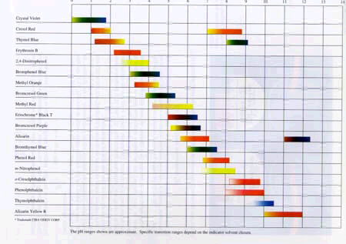
Acid-Base Indicators

Slide 10
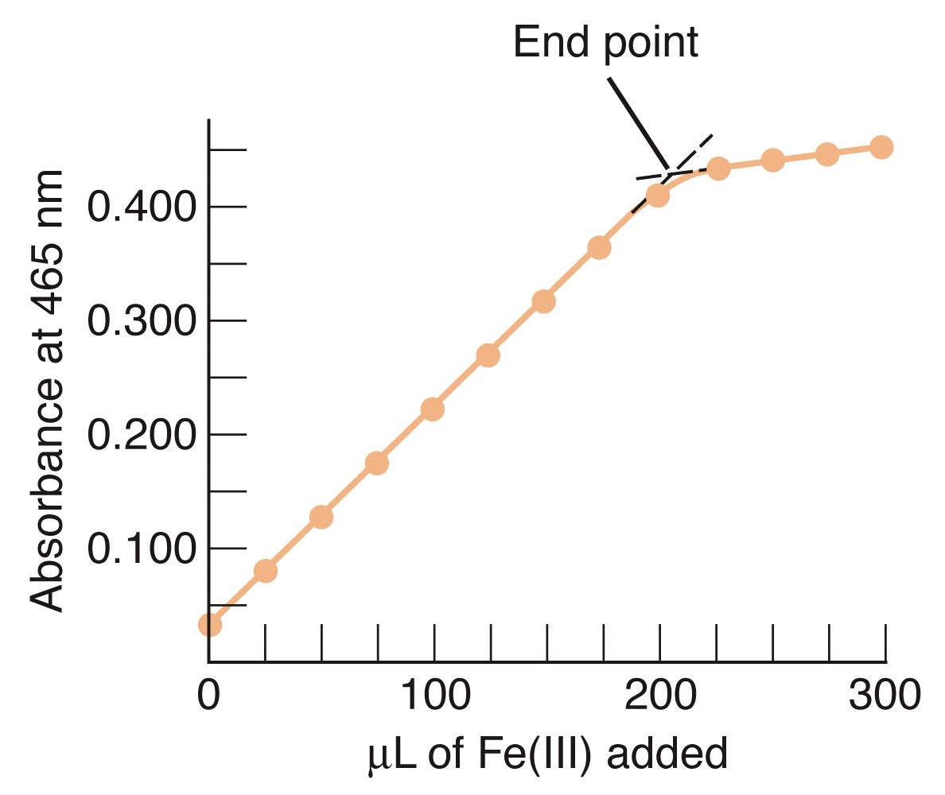
Figure 7.5 Spectrophotometric Titration

Slide 11
Precipitation Titration Curve
p-function pX = - log₁₀[X]
precipitation titration curve
four types of calculations
initial point
before equivalence point
equivalence point
after equivalence point

Slide 12
Precipitation Titration Curve
EXAMPLE: Derive a curve for the titration of 50.00 mL of 0.00500 M NaBr with 0.01000 M AgNO₃.
titration curve => pAg vs. vol. AgNO₃ added

Slide 13
EXAMPLE: Derive a curve for the titration of 50.00 mL of 0.00500 M NaBr with 0.01000 M AgNO₃.
titration curve => pAg vs. vol. AgNO₃ added
initial point
after 0.0 mL of AgNO₃ added
at the initial point of a titration of any type, only analyte is present, no titrant is present, therefore pAg can not be calculated.

Slide 14
EXAMPLE: Derive a curve for the titration of 50.00 mL of 0.00500 M NaBr with 0.01000 M AgNO₃.
before equivalence point
pAg can be accurately calculated only after some AgBr has started to form. This may take a few mL of titrant

Slide 15
EXAMPLE: Derive a curve for the titration of 50.00 mL of 0.00500 M NaBr with 0.01000 M AgNO₃.
before equivalence point
after 5.0 mL of AgNO₃ added
V_{NaBr}*M_{NaBr} - V_{AgNO3}*M_{AgNO3}
M_{NaBr unreacted} = -------------------------------------
V_{NaBr} + V_{AgNO3}

Slide 16
EXAMPLE: Derive a curve for the titration of 50.00 mL of 0.00500 M NaBr with 0.01000 M AgNO₃.
before equivalence point
after 5.0 mL of AgNO₃ added
V_{NaBr}*M_{NaBr} - V_{AgNO3}*M_{AgNO3}
M_{NaBr unreacted} = -------------------------------------
V_{NaBr} + V_{AgNO3}
(50.00mL*0.00500M) -(5.00mL*0.01000M)
M_{NaBr unreacted} = -------------------------------------------------------
(50.00 + 5.00)mL

Slide 17
EXAMPLE: Derive a curve for the titration of 50.00 mL of 0.00500 M NaBr with 0.01000 M AgNO₃.
before equivalence point
after 5.0 mL of AgNO₃ added
(50.00mL*0.00500M) -(5.00mL*0.01000M)
M_{NaBr unreacted} = ------------------------------------------------------
(50.00 + 5.00)mL
M_{NaBr unreacted} = 3.64 X 10⁻³M

Slide 18
EXAMPLE: Derive a curve for the titration of 50.00 mL of 0.00500 M NaBr with 0.01000 M AgNO₃.
before equivalence point
after 5.0 mL of AgNO₃ added
M_{NaBr unreacted} = 3.64 X 10⁻³M
[Br⁻]_{total} = [Br⁻]_{NaBr unreacted} + [Br⁻]_{dissolved AgBr}

Slide 19
EXAMPLE: Derive a curve for the titration of 50.00 mL of 0.00500 M NaBr with 0.01000 M AgNO₃.
before equivalence point
after 5.0 mL of AgNO₃ added
M_{NaBr unreacted} = 3.64 X 10⁻³M
[Br⁻]_{total} = [Br⁻]_{NaBr unreacted} + [Br⁻]_{dissolved AgBr}
[Br⁻]_{total} = 3.64 X 10⁻³M + [Ag⁺]_{dissolved AgBr}
where [Br⁻]_{dissolved AgBr} = [Ag⁺]_{dissolved AgBr}

Slide 20
EXAMPLE: Derive a curve for the titration of 50.00 mL of 0.00500 M NaBr with 0.01000 M AgNO₃.
before equivalence point
after 5.0 mL of AgNO₃ added
[Br⁻]_{total} = 3.64 X 10⁻³M + [Ag⁺]_{dissolved AgBr}
where [Br⁻]_{dissolved AgBr} = [Ag⁺]_{dissolved AgBr}
except very near the equivalence point,
3.64 X 10⁻³M >> [Ag⁺]_{dissolved AgBr}

Slide 21
EXAMPLE: Derive a curve for the titration of 50.00 mL of 0.00500 M NaBr with 0.01000 M AgNO₃.
before equivalence point
after 5.0 mL of AgNO₃ added
[Br⁻]_{total} = 3.64 X 10⁻³M + [Ag⁺]_{dissolved AgBr}
except very near the equivalence point,
3.64 X 10⁻³M >> [Ag⁺]_{dissolved AgBr}
thus [Br⁻]_{total} ~ 3.64 X 10⁻³M

Slide 22
EXAMPLE: Derive a curve for the titration of 50.00 mL of 0.00500 M NaBr with 0.01000 M AgNO₃.
before equivalence point
after 5.0 mL of AgNO₃ added
[Br⁻]_{total} ~ 3.64 X 10⁻³M
pBr = - log₁₀(3.64 X 10⁻³) = 2.44

Slide 23
EXAMPLE: Derive a curve for the titration of 50.00 mL of 0.00500 M NaBr with 0.01000 M AgNO₃.
before equivalence point
after 5.0 mL of AgNO₃ added
K_{sp} = [Ag⁺][Br⁻] = 5.2 X 10⁻¹³M²
- log K_{sp} = - log[Ag⁺] - log[Br⁻]
= - log(5.2 X 10⁻¹³)
pK_{sp} = pAg + pBr = 12.28

Slide 24
EXAMPLE: Derive a curve for the titration of 50.00 mL of 0.00500 M NaBr with 0.01000 M AgNO₃.
before equivalence point
after 5.0 mL of AgNO₃ added
K_{sp} = [Ag⁺][Br⁻] = 5.2 X 10⁻¹³M²
- log K_{sp} = - log[Ag⁺] - log[Br⁻]
= - log(5.2 X 10⁻¹³)
pK_{sp} = pAg + pBr = 12.28
if pBr = 2.44
pAg = pK_{sp} - pBr = 12.28 - 2.44 = 9.84

Slide 25
EXAMPLE: Derive a curve for the titration of 50.00 mL of 0.00500 M NaBr with 0.01000 M AgNO₃.
equivalence point
at 25.00 mL of AgNO₃ added
At the equivalence point, [Ag⁺] = [Br⁻]
thus
K_{sp} = [Ag⁺][Br⁻] = 5.2 X 10⁻¹³M²

Slide 26
EXAMPLE: Derive a curve for the titration of 50.00 mL of 0.00500 M NaBr with 0.01000 M AgNO₃.
equivalence point
at 25.00 mL of AgNO₃ added
becomes when [Ag⁺] = [Br⁻]
[Ag⁺]² = 5.2 X 10⁻¹³M²
[Ag⁺] = 7.21 X 10⁻⁷M
pAg = 6.14

Slide 27
EXAMPLE: Derive a curve for the titration of 50.00 mL of 0.00500 M NaBr with 0.01000 M AgNO₃.
after equivalence point
After the equivalence point there is very little change in the amount of precipitate present (except very close to the equivalence point)

Slide 28
EXAMPLE: Derive a curve for the titration of 50.00 mL of 0.00500 M NaBr with 0.01000 M AgNO₃.
after equivalence point
thus, at 25.10 mL of AgNO₃ added
V_{AgNO3}*M_{AgNO3} - V_{NaBr}*M_{NaBr}
M_{AgNO3 unreacted} = -----------------------------------
V_{AgNO3} + V_{NaBr}

Slide 29
EXAMPLE: Derive a curve for the titration of 50.00 mL of 0.00500 M NaBr with 0.01000 M AgNO₃.
after equivalence point
thus, at 25.10 mL of AgNO₃ added
V_{AgNO3}*M_{AgNO3} - V_{NaBr}*M_{NaBr}
M_{AgNO3 unreacted} = -------------------------
V_{AgNO3} + V_{NaBr}
(25.10 mL * 0.01000 M) - (50.00 mL * 0.00500 M)
M_{AgNO3} = --------------------------------------------------------------
unreacted (25.10 + 50.00)mL

Slide 30
EXAMPLE: Derive a curve for the titration of 50.00 mL of 0.00500 M NaBr with 0.01000 M AgNO₃.
after equivalence point
thus, at 25.10 mL of AgNO₃ added
(25.10 mL * 0.01000 M) - (50.00 mL * 0.00500 M)
M_{AgNO3} = --------------------------------------------------------------
unreacted (25.10 + 50.00)mL
M_{AgNO3 unreacted} = 1.33 X 10⁻⁵M

Slide 31
EXAMPLE: Derive a curve for the titration of 50.00 mL of 0.00500 M NaBr with 0.01000 M AgNO₃.
after equivalence point
thus, at 25.10 mL of AgNO₃ added
M_{AgNO3 unreacted} = 1.33 X 10⁻⁵M
[Ag⁺]_{total} = [Ag⁺]_{AgNO3 unreacted} + [Ag⁺]_{dissolved AgBr}

Slide 32
EXAMPLE: Derive a curve for the titration of 50.00 mL of 0.00500 M NaBr with 0.01000 M AgNO₃.
after equivalence point
thus, at 25.10 mL of AgNO₃ added
[Ag⁺]_{total} = [Ag⁺]_{AgNO3 unreacted} + [Ag⁺]_{dissolved AgBr}
[Ag⁺]_{total} = 1.33 X 10⁻⁵M + [Ag⁺]_{dissolved AgBr}
[Ag⁺]_{total} ~ 1.33 X 10⁻⁵M
pAg = 4.88
0

Slide 35
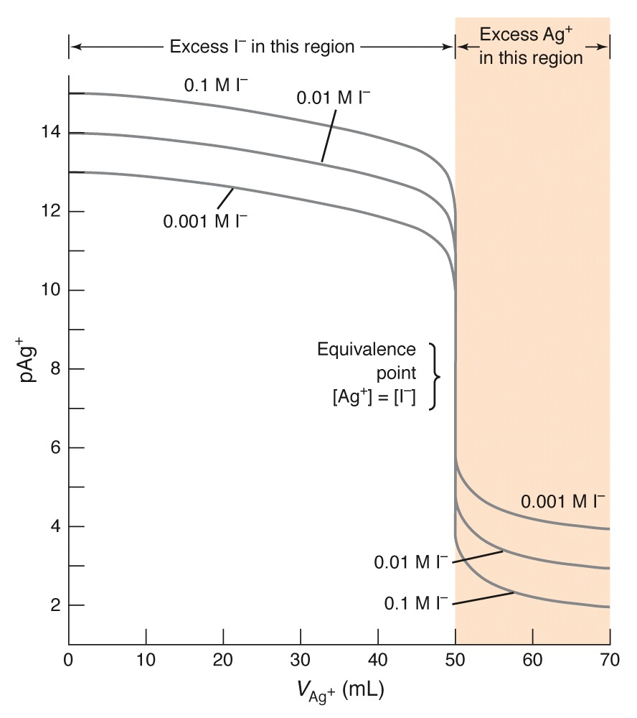
Figure 7.6 Precipitation titration Curves

Slide 36
End-Point Detection
argentometric titrations
1. Mohr - titration of Cl⁻ with AgNO₃
  - K₂CrO₄ gives brick red color to precipitate, Ag₂CrO₄

Slide 37
End-Point Detection
argentometric titrations
2. Volhard - titration of Ag⁺ with Cl⁻
    - KSCN in the presence of Fe⁺³ gives blood red color to precipitate, FeSCN⁺²

Slide 38
End-Point Detection
argentometric titrations
3. Fajans - titration of Cl⁻ with AgNO₃
    - absorption indicator, dye absorbs on to the surface of the particles of AgCl, attracted by excess Cl⁻ absorbed on the surface of the precipitate

Slide 39
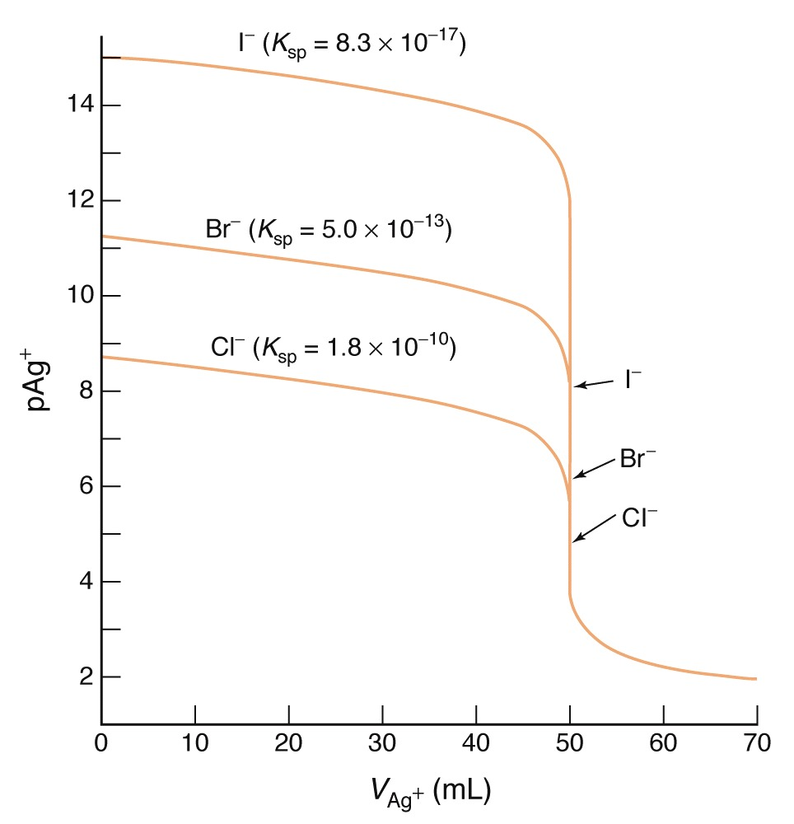

Slide 40
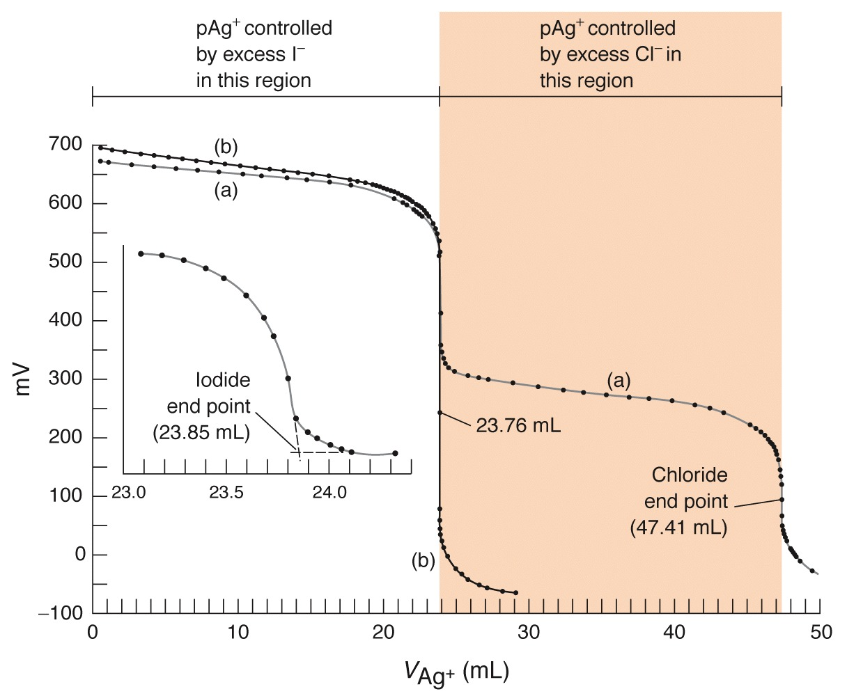

Slide 41
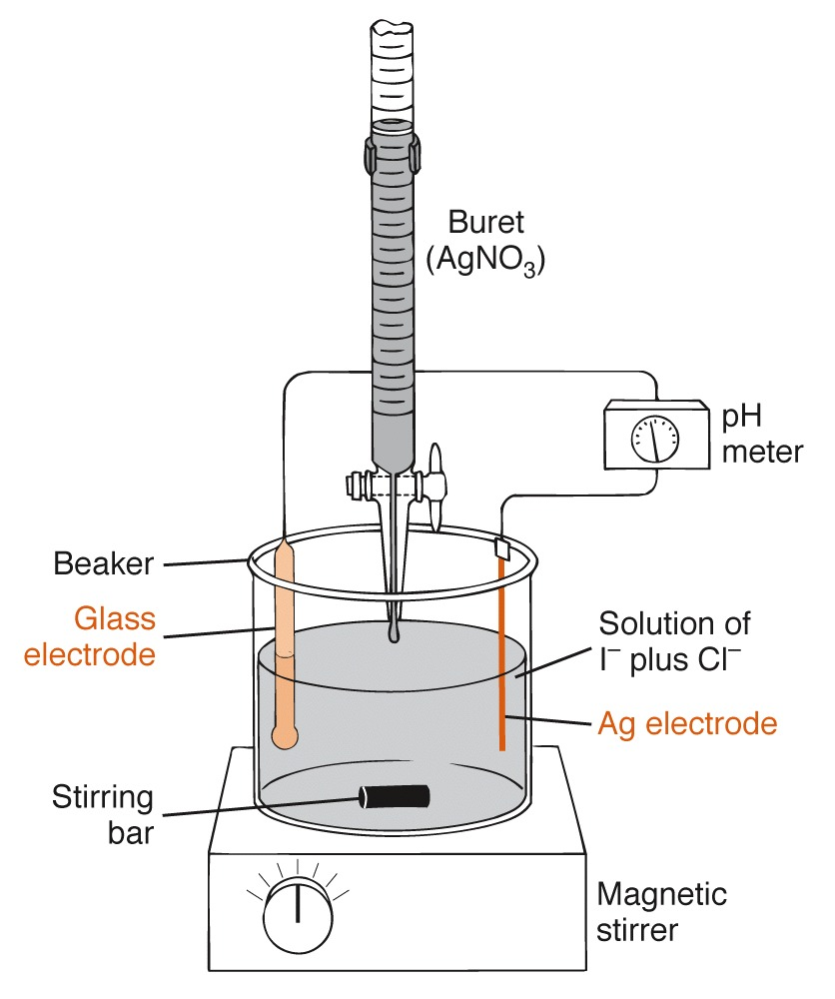

Slide 42
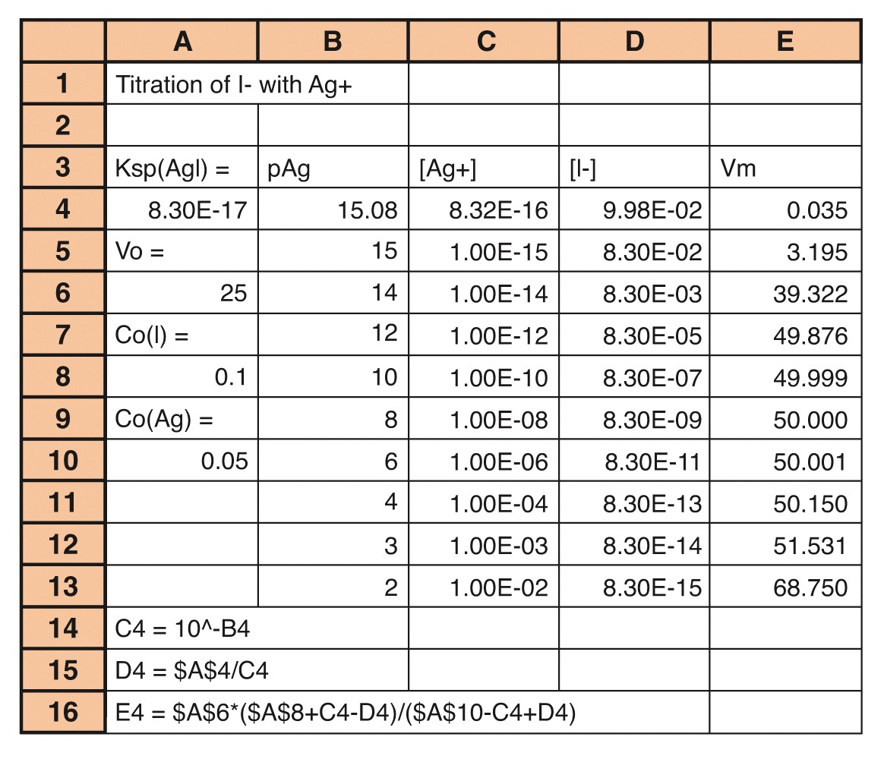

Slide 43
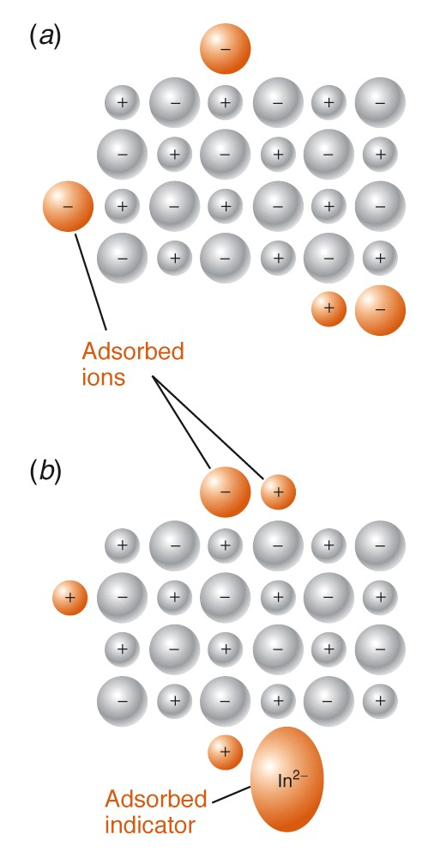

Slide 44


