Slide 1
Nekaj primerov gramatikalizacije
Angleški lets
Velelnik, 2.os., let "pustiti, dovoliti":
(1) a. Let us go. "Spusti nas."
b. Let yourself down on the rope. "Spusti se po vrvi."
c. Let John go. "Spusti Janeza/Pusti Janezu, da gre."
osebek: you; predmet: us, yourself, John
(2) We were let go. (trpnik/pasiv)
"Dovolili so nam/Dovoljeno nam je bilo, da gremo."

Slide 2
Velelnik, 1.os.(množ.); adhortativni let‘s (=let+us)
(3) Let's go to the cinema.= I suggest that I and you…
"Pojdimo v kino."
us = osebek glagola go, *predmet glagola let:
Pomen: ✓ mi pojdimo v kino, *dovoljeno nam je, da gremo v kino.
Pogovorne različice: lets = vsi primeri, ki niso 1.os.množ.:
1.os.edn.:
(4) Lets give you a hand. "Naj ti pomagam."
neprva oseba (srednji zahod ZDA):
(5) Lets you and him fight.
(6) Lets you go first, then if we have any money left, I'll go.
spodbujanje otrok:
(7) Lets wash your hands.
(8) Lets eat our liver now, Betty.

Slide 3
Razvoj lets in gramatikalizacija:
a) Sprememba pomena: let "dovoliti"; let us "spodbujanje nekoga,
da nekaj naredi"; poudarjen govorčev odnos; 16.stol.;
b) Osebek: iz 1.os.množ. se razširi na druge osebe;
c) razvoj us: beseda > pona/naslonka > fonem
(let) us > (let)'s > (let)s;
d) Monomorfemski lets podlega fonološkim pravilom:
[lts] > [ls];
zelo pogovorni jezik → naslonka: sgo, sfight;
e) Lets eno od možnosti v jeziku, tj. let+us,
specializira za novo funkcijo (adhortativ)
(9) Let him speak now or forever hold his peace.

Slide 4
2. Zanikanje in Jespersenov krog
Morfo-fonološki proces gramatikalizacije; ponavljajoča se šibitev in
krepitev označevalca zanikanja. (Dahl 1979, Jepsersen 1924)
The negative adverb is often weakly stressed, because some other word in
the sentence has to receive a strong stress of contrast. But when the negative
has become a mere proclitic syllable or even a single sound, it is felt to be too
weak, and has to be strengthened by some additional word, and this in its turn
may come to be felt as the negative proper, which then may be subject to the
same development as the original word. We have thus a constant interplay of
weakening and strengthening, which with the further tendency to place the
negative in the beginning of the sentence where it is likely to be dropped […]
leads to curious results.
Jespersen (1924: 335)

Slide 5
Potek:
1) označevalec zanikanja je pred glagolom; tipično naslonka;
2) okrepitev z elementom za glagolom; tipično prislov; dva označevalca zanikanja;
3) opustitev označevalca pred glagolom; gramatikalizacija prislova za glagolom;
4) premik označevalca za glagolom pred glagol;
5) šibljenje označevalca v naslonko.
Angleščina ‘I don’t say.’, (Jespersen 1924):
(10) a) ic ne secge.
b) I ne seye not.
c) I say not.
d) I do not say.
e) I don’t say.

Slide 6
Francoščina 'I do not say/Jaz ne rečem':
(11) a) jeo ne dis. (stara francoščina)
b) je ne dis pas. (moderna knjižna francoščina)
c) je dis pas. (moderna pogovorna francoščina)
Od kje izvira pas? Hock (1991):
(12) a) il ne vait/va 'he doesn't go' zgodnja francoščina
b) il ne sai 'he doesn't know'
(13) a) il ne vait/va pas 'he doesn't go a step = at all"
b) il ne sai rien 'he doesn't know a thing = anything at all"
!pas, rien = predmet
(14) a) il ne va pas 'he doesn't go' moderna francoščina
b) il ne sait pas 'he doesn't know'
!pas = označevalec zanikanja
(15) a) il va pas 'he doesn't go'
b) il sait pas 'he doesn't know'

Slide 7
Slovenščina, Ilc (2011):
Knjižna slovenščina: 1. faza Jespersenovega kroga, naslonka ne₁
ne₁+glagol; zlitje z biti, imeti, hoteti; premik skupaj s pomožnikom:
(16) a. Jože ne dela.
b. Jože noče delati. (ne+hoče=noče)
c. Ne boš kupil te knjige? *Boš kupil ne te knjige?
Panonska narečna skupina: 2.-4. faza Jespersenovega kroga, naslonka ne₁
in prislovni označevalec zanikanja ne₂ (ne, nei, nene)
Značilnosti ne₂ (primeri iz Ilc (2011)):
ni nujno tik pred glagolom:
(17) Še plačati je mugo, pa ga je nikdar ne več vzeo na delo.
‘Even though he had to pay for it, he was never hired for work anymore.’
(18) Tega nene dobro vem.
‘I don’t know this very well.’

Slide 8
ne zlije se z glagolom biti:
(19) Počitka smo ne meli kak mojo zei tota deca.
‘We didn’t have so much rest as children have today.’
(20) To je ne tak.
‘This isn’t so.’
v vprašanjih se ne premakne skupaj s pomožnikom:
(21) Si ga nei čula?
‘Have you not heard him?’
redko se pojavi skupaj z ne₁:
(22) Nei ne nücamo.
‘We don’t need it.’
(23) Nei ne veimo.
‘We don’t know.’

Slide 9
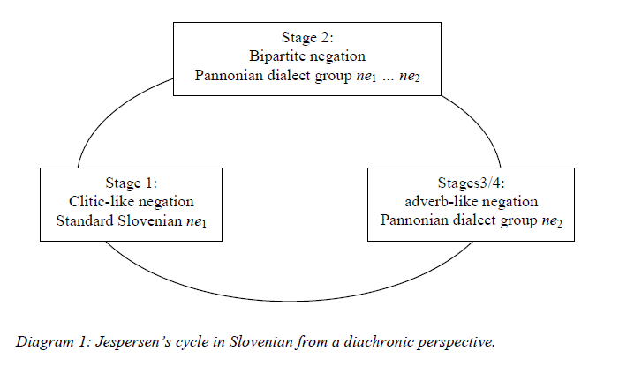
Ilc (2011)

Slide 10
Viri:
DAHL, Östen (1979) “Typology of sentence negation.” Linguistics 17:79-106.
HOCK, H. Henrich (1991) Principles of Historical Linguistics. Berlin: Mouton de Gruyter.
HOPPER, Paul J. in Elisabeth C. TRAUGOTT (1993) Grammaticalization.
Cambridge University Press.
ILC, Gašper (2011) “Jespersen‘s Cycle in Slovenian.” Linguistica 51:349-363.
JESPERSEN, Otto (1924) The Philosophy of Grammar. London: George Allen&Unwin Ltd.

