Slide 1
Biosinteza proteinov
Voet 3: poglavje 32
Stryer 5: poglavje 29
Krebs 3: poglavji 25 in 24

Slide 2
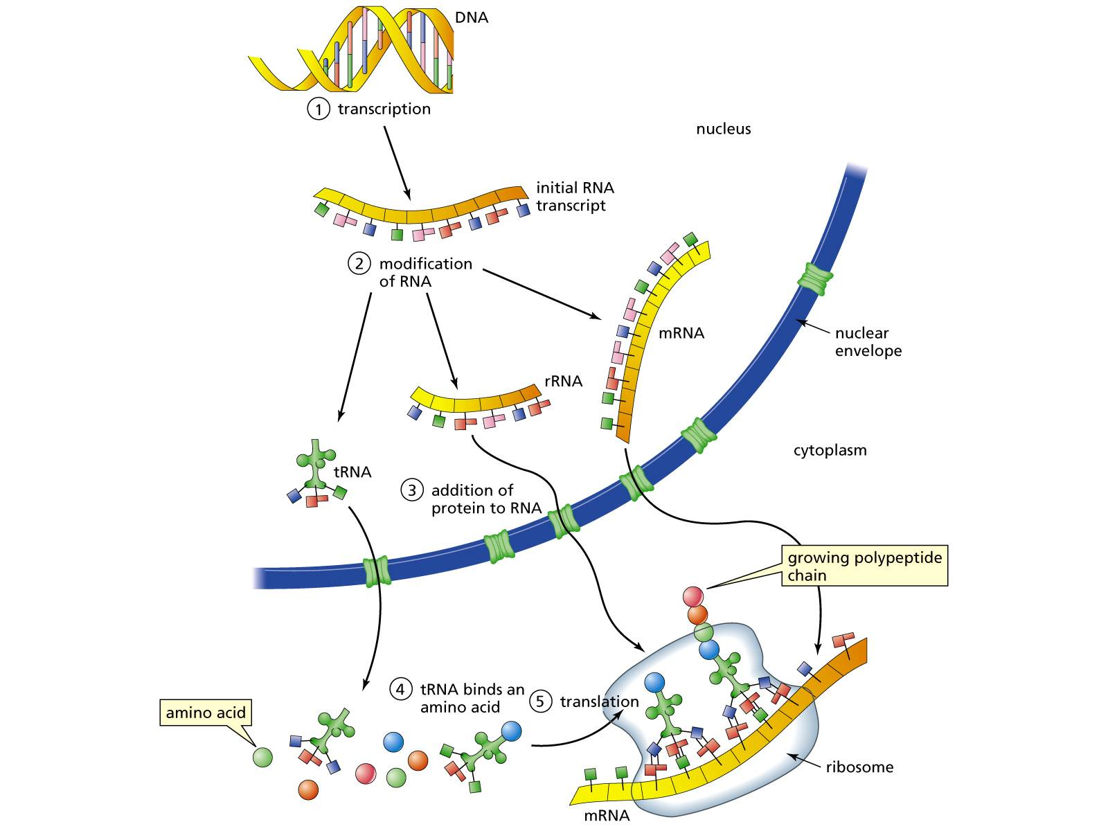

Slide 3
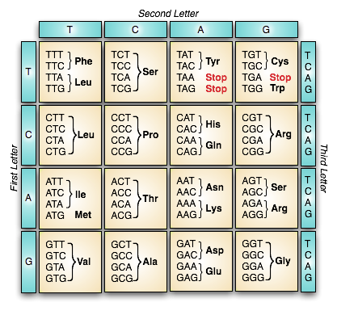
http://plato.stanford.edu/entries/information-biological/
Notes:
61 tripletov kodira za AA, 3 stop; 20 AA; za Met, Trp samo 1, za Leu, Arg, Ser po 6. Smisel: 2 nukleotida premalo za 20 AA, če 3, ostanejo kapacitete; ob mutacijah pri večkratni zasedenosti tako manjša verjetnost, da stop. Sinonimni kodoni se razlikujejo predvsem v zadnji bazi (degeneracija kodona). Za stop-kodone ne obstajajo tRNA (vežejo sprostitvene faktorje).

Slide 4
standardni začetni kodon: AUG
nestandardni: GUG, UUG, …
E. coli:
AUG – 83 % mRNA (Met)
GUG – 14 % mRNA (Val)
UUG – 3 % mRNA (Leu)
AUU
CUG
Tudi pri alternativnih start kodonih je najpogosteje 1. aminokislina Met !

Slide 5
Odstopanja od “standardnega” genetskega koda pri mitohondrijih.

Slide 6
Adapterska hipoteza: genetski kod berejo molekule, ki prepoznajo posamezne kodone, hkrati pa nosijo ustrezne aminokisline.
Notes:
http://genome.wellcome.ac.uk/doc_WTD022319.html

Slide 7
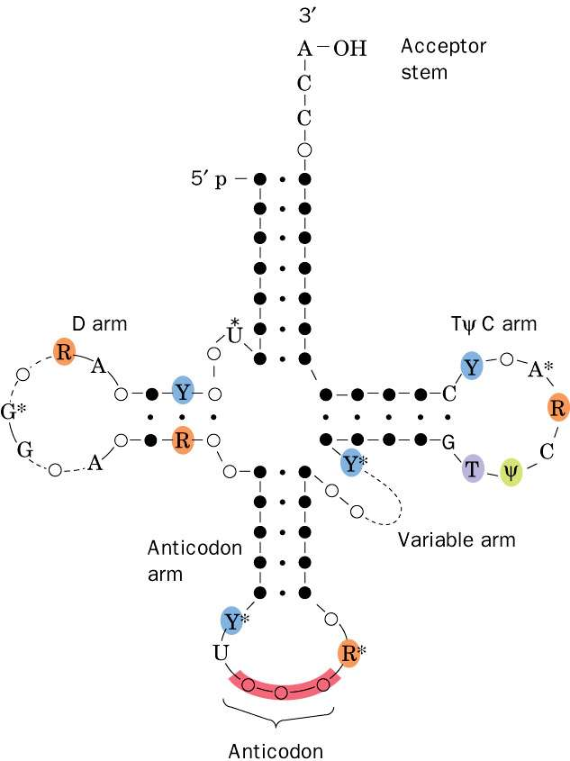
Nukleotidno zaporedje in oznake krakov na primeru kvasovkine tRNA^{Ala}, prikazane v strukturi deteljice.
Notes:
Vse tRNA imajo med 73 in 93 nt (~25 kDa) in vsebujejo nenavadne baze (kot posledica postranskripcijskih encimsko-kataliziranih modifikacij).

Slide 8
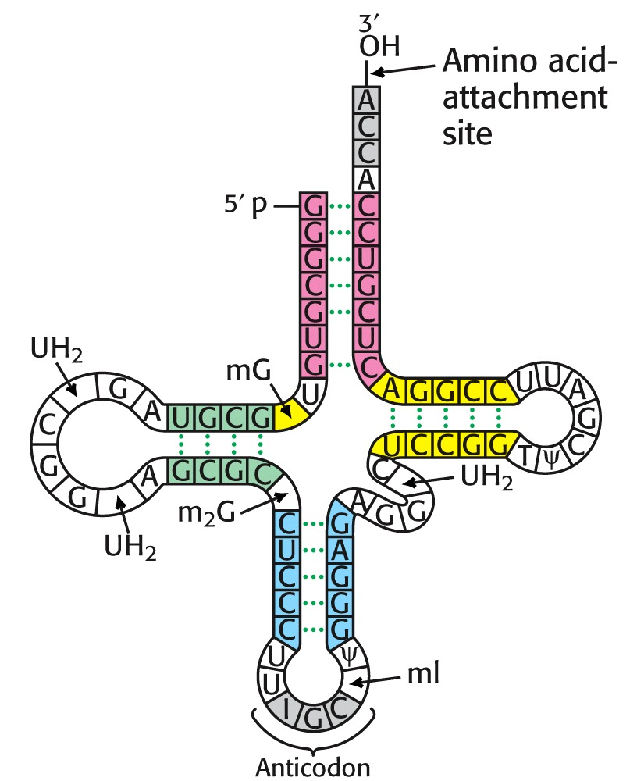
UH₂=metilinozindihidrouridin
mG=metilgvanozin
m₂G=dimetilgvanozin
T=ribotimidin
I=inozin
mI=metilinozin
ψ=psevdouridin
Notes:
kvasna Ala-tRNA

Slide 9
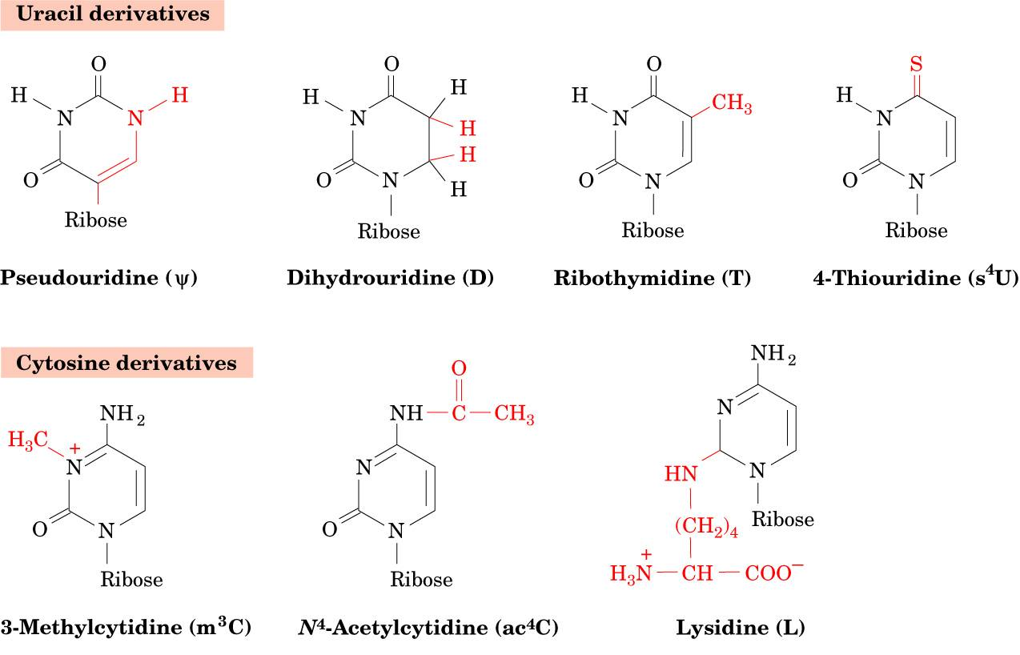
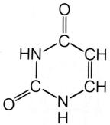

Slide 10
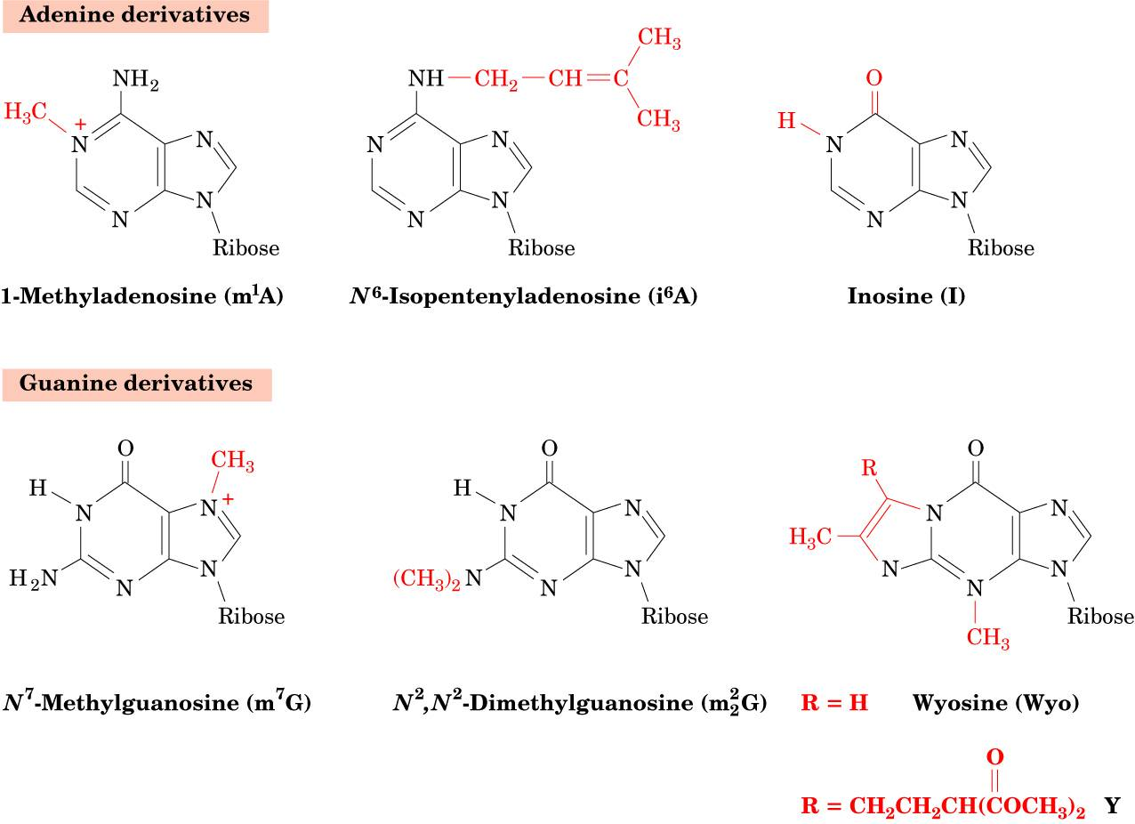
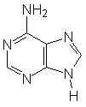
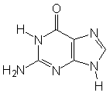

Slide 11
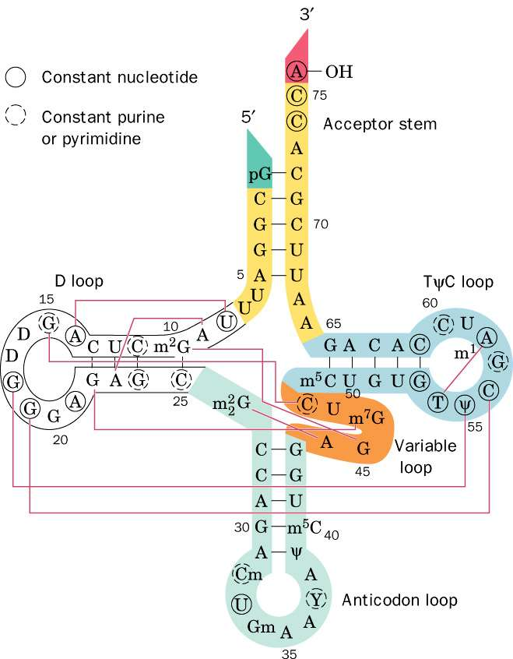
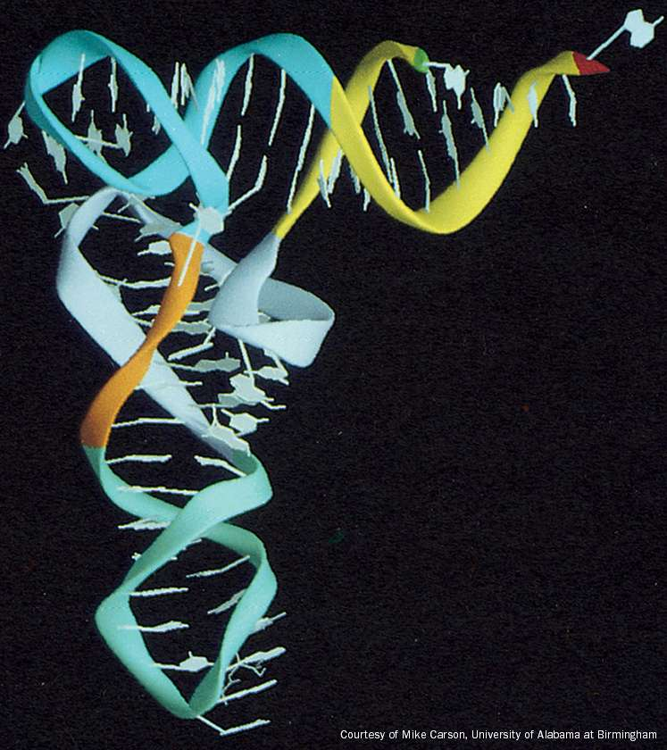

Slide 12
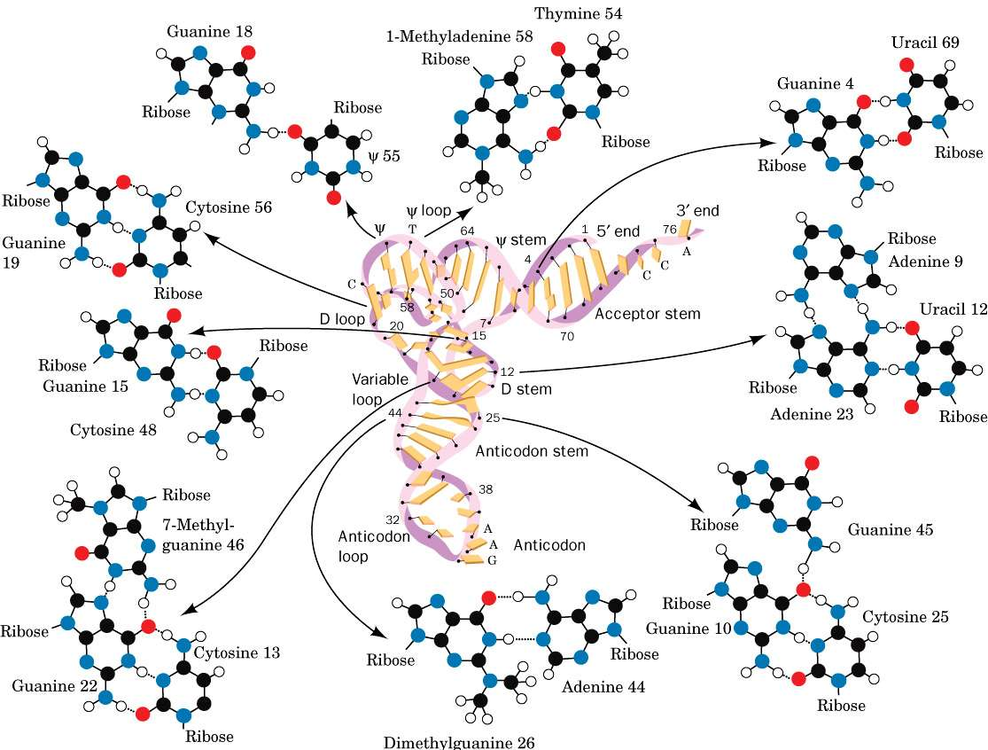

Slide 13
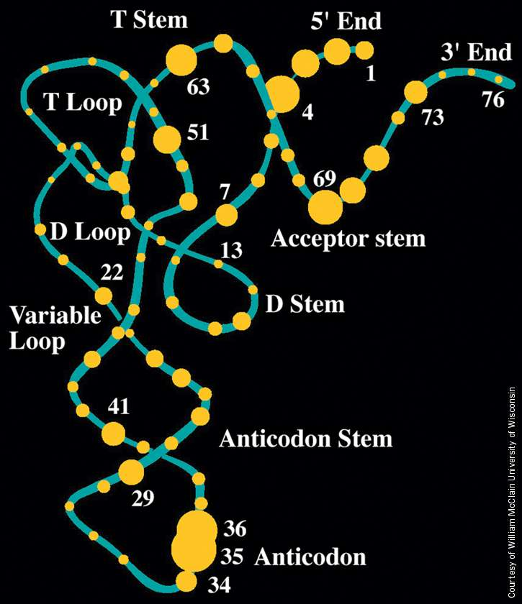

Slide 14
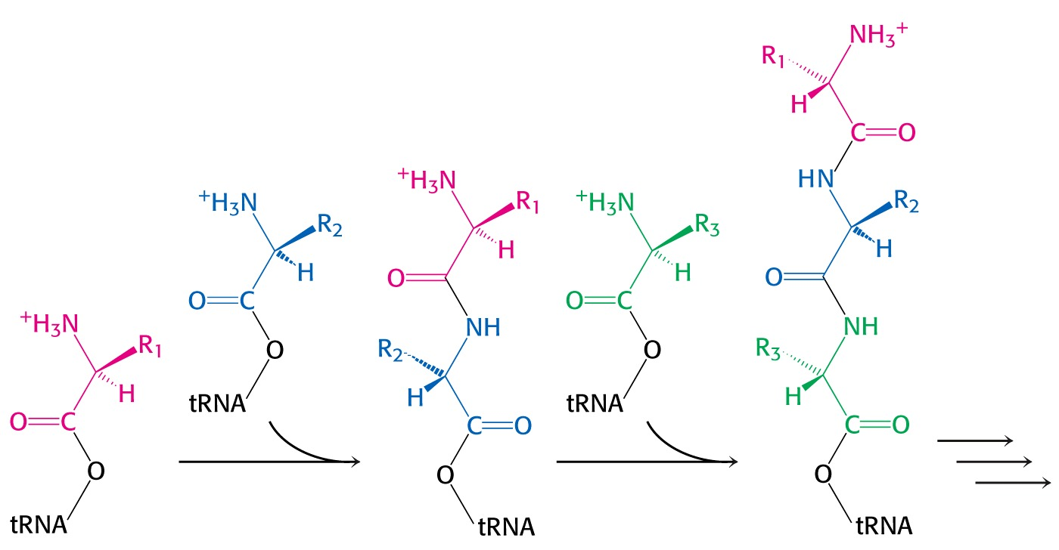
Notes:
zaporedje reakcij: polimerizacija s posredovanjem tRNA

Slide 15
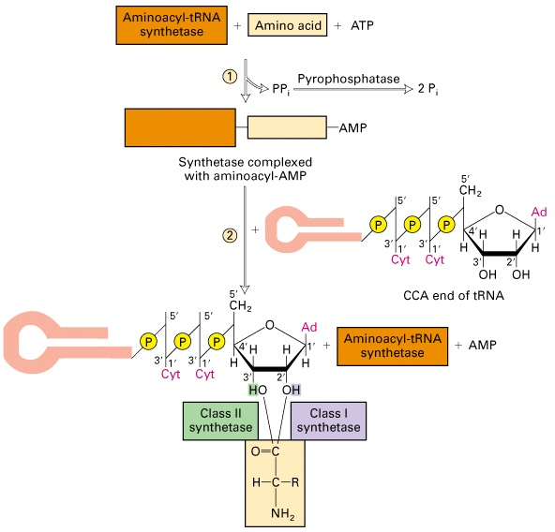

Slide 16
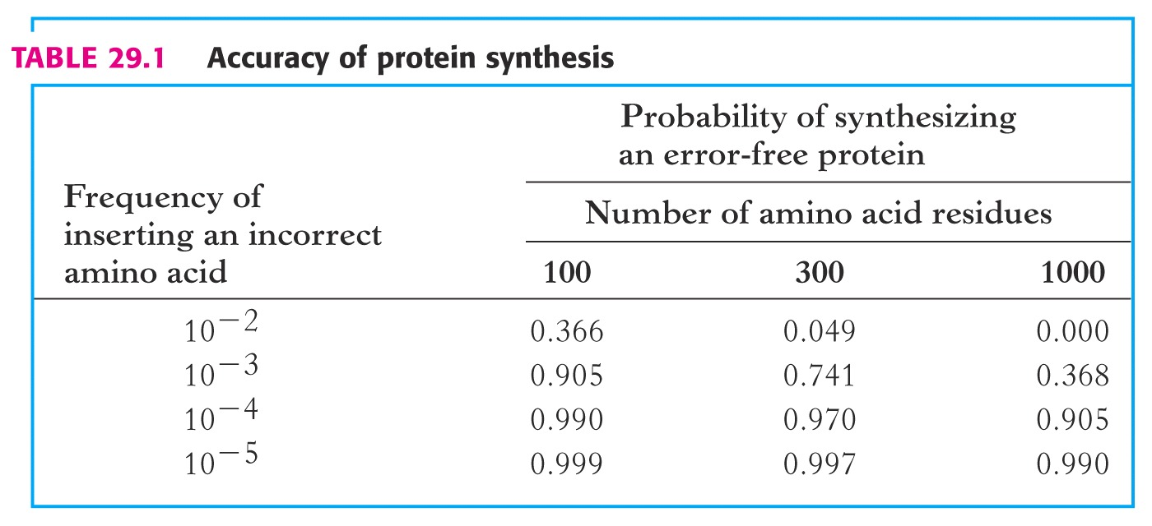
p = (1-ε)^{n}
Notes:
Pri E. coli teče translacija s hitrostjo 40 AA/s, pri tem pa mora biti natančnost čim večja (1 napaka / 10.000 vgrajenih AA).

Slide 17
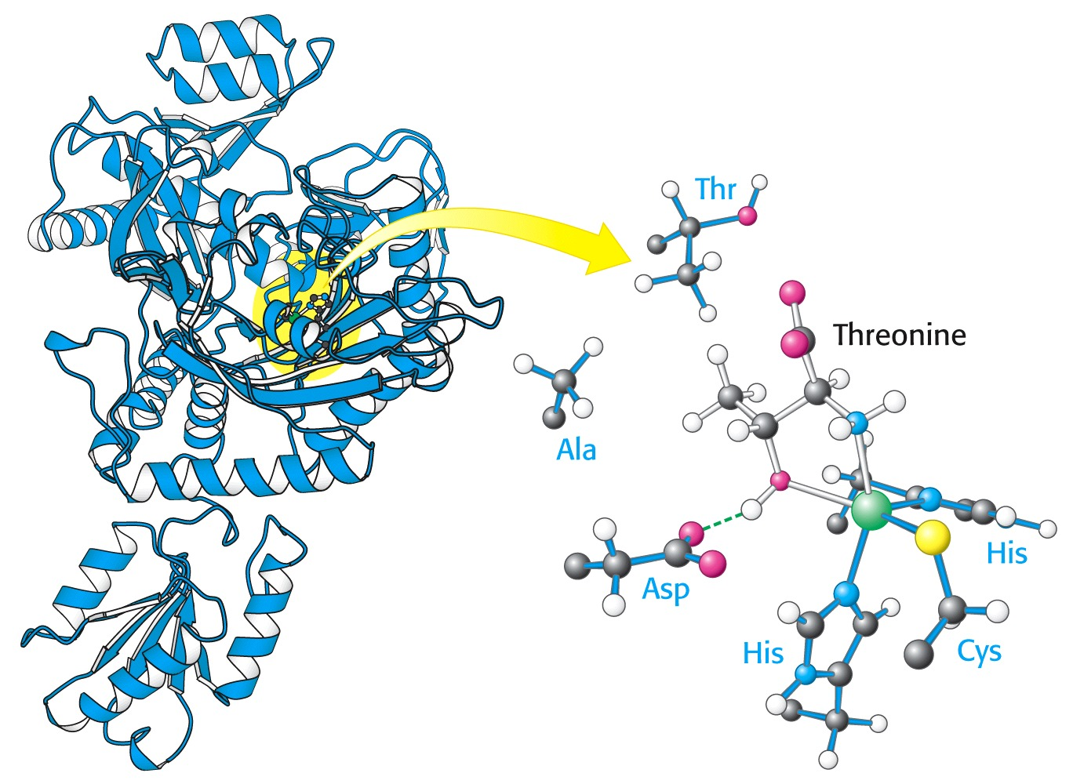
Notes:
Thr-aminoacil-tRNA sintetaza (razred II)
aktivno mesto: adenilacija aminokisline ob porabi ATP, nato vezava na akceptorsko mesto tRNA

Slide 18
Nature Reviews Microbiology 8, 849-856 (Dec. 2010)
Notes:
a | Formation of a cognate amino acid–tRNA pair. A cognate amino acid (blue) is activated at the aminoacyl-tRNA synthetase (aaRS) active site with ATP to form an aminoacyl adenylate, releasing pyrophosphate (PPi). Subsequently, a cognate tRNA binds to the aaRS, and the amino acid is attached to the 3′ end of the tRNA and AMP is released, forming an aminoacyl-tRNA. The aminoacyl-tRNA is released and binds to elongation factor Tu (EFTu). b | Quality control steps during the formation of a non-cognate aminoacyl-tRNA. After activation of a non-cognate amino acid (red) the aminoacyl adenylate may be hydrolysed and released. A non-cognate aminoacyl-tRNA may be translocated into the editing site of the aaRS for hydrolysis. If the mischarged aminoacyl-tRNA is released from the aaRS without being edited it is subjected to editing by trans-editing factors or through resampling by the aaRS. Non-cognate aminoacyl-tRNAs are discriminated by EFTu, which either binds them too tightly or too weakly for efficient delivery and release in the ribosome.

Slide 19
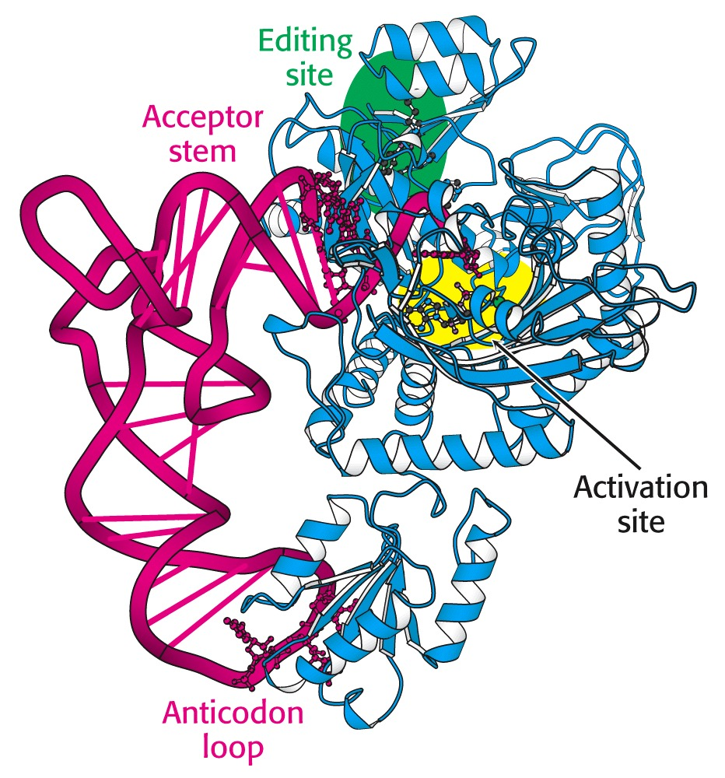
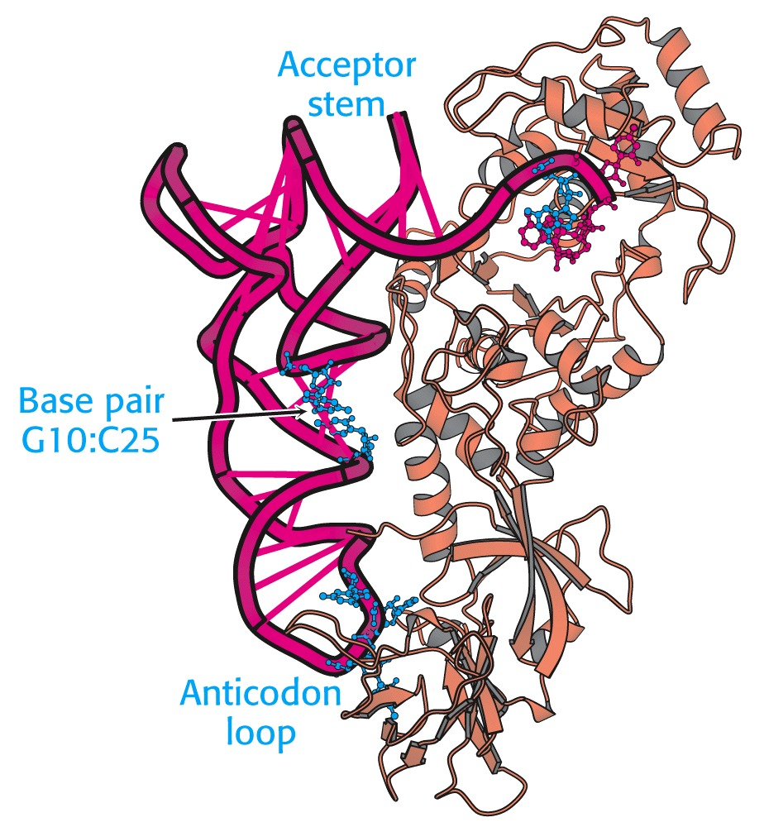

Slide 20
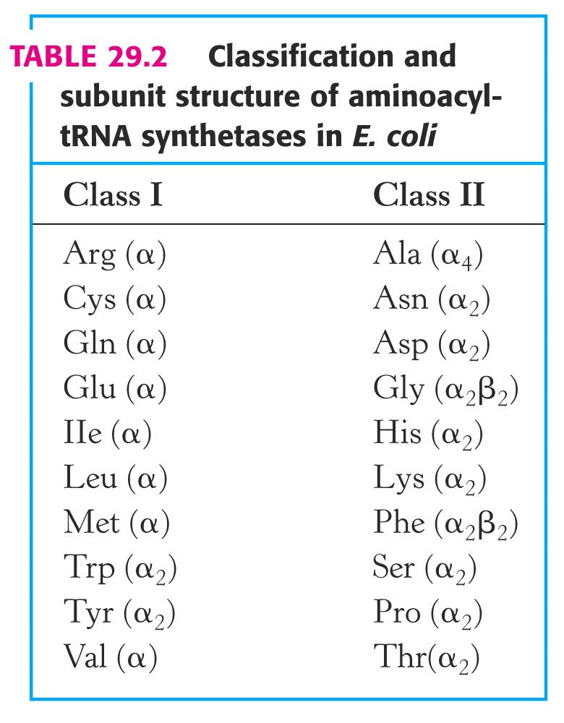
Notes:
klasifikacija in zgradba podenot aminoacil-tRNA sintetaz pri E. coli
v resnici obstajata 2 različni sintetazi za Lys

Slide 21
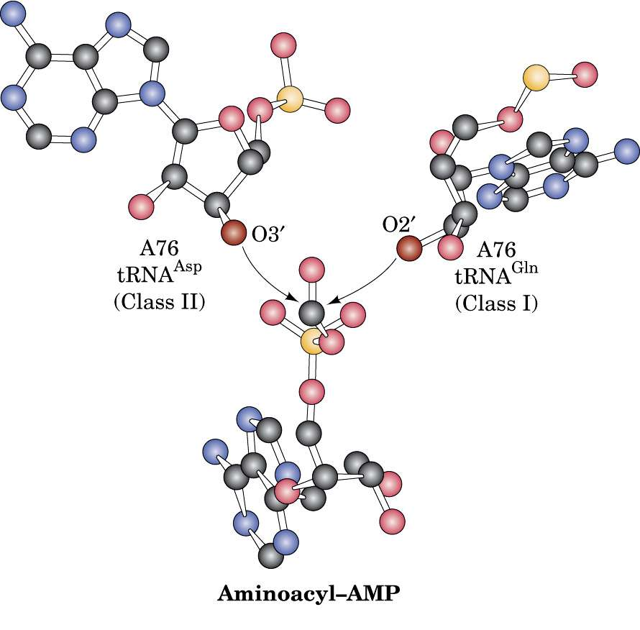
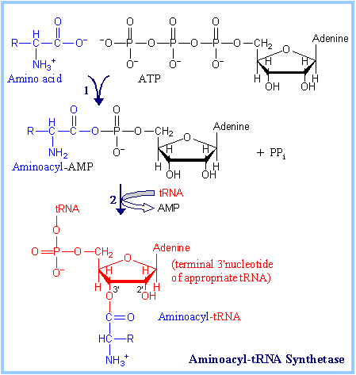
Notes:
http://www.dentistry.leeds.ac.uk/biochem/MBWeb/mb2/part1/trna.htm

Slide 22
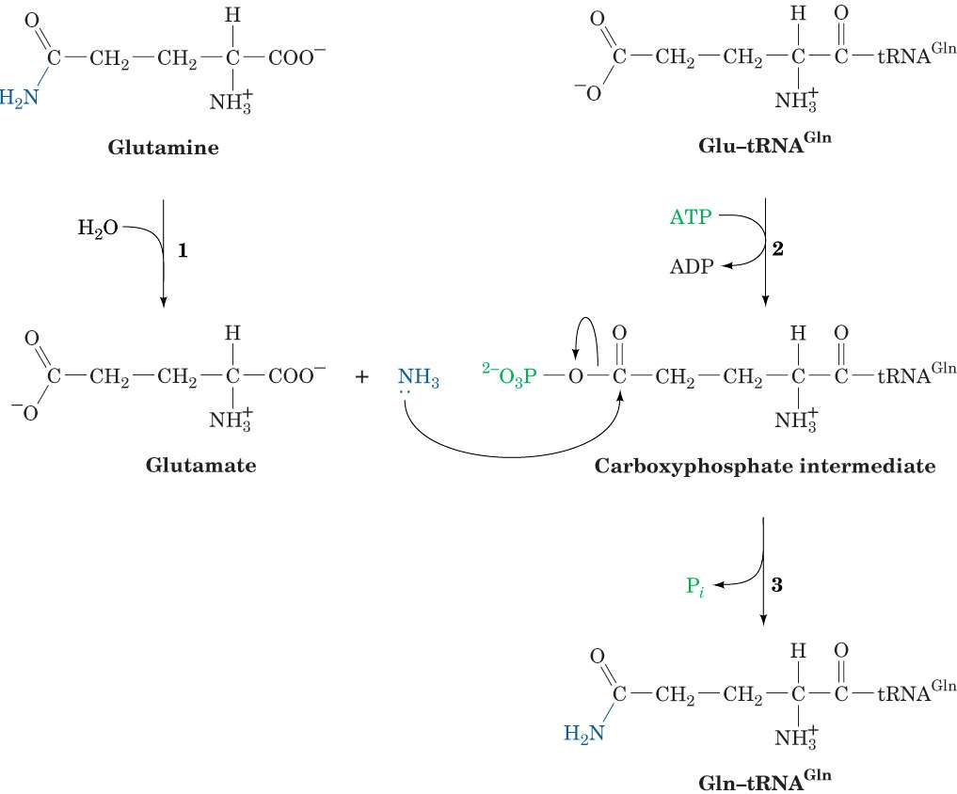
Nekatere bakterije, arheje, mitohondriji in kloroplasti nimajo GlnRS; pri njih se Glu-tRNA encimsko transamidira v Gln-tRNA.

Slide 23
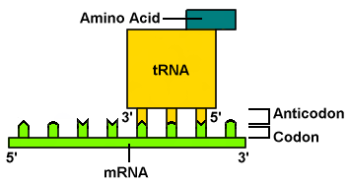
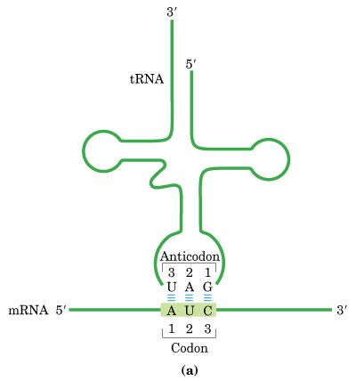
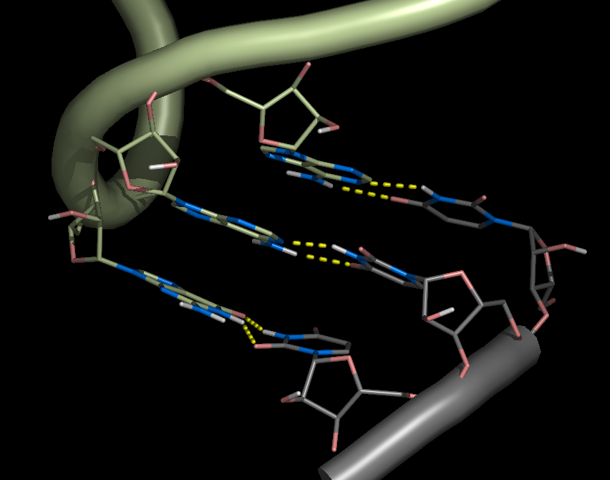
Notes:
http://web.chem.ucsb.edu/~molvisual/rna_biochem.html

Slide 24
Notes:
translacija - shematski prikaz

Slide 25
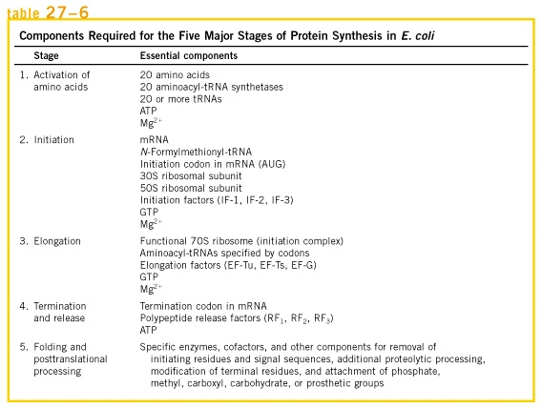

Slide 26
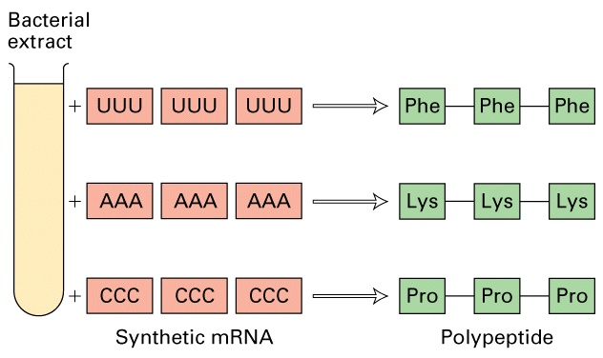
poli-Lys se ne obarja s TCA!!! (Ochoa, Watson)

Slide 27
stabilni brezcelični sistem E. coli
mešanica 19 neradioaktivnih + 1 radioaktivno označene aminokisline (→ 20 paralelk z vsakič drugo označeno AK)
dodatek (m)RNA
inkubiranje
obarjanje proteinov & spiranje precipitata
merjenje radioaktivnosti v oborini
pri poli-U so izmerili radioaktivnost le v paralelki z označenim Phe

Slide 28
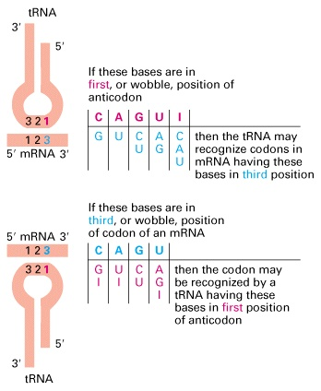
degeneriranost genetskega koda
ohlapne baze
5' anticodon base | 3' codon base
A | U
C | G
G | C or U
U | A or G
I | A or C or U
Notes:
Pravilo ohlapnosti ima izjeme. Teoretično bi sicer zadoščalo 31 tRNA, a jih je več. Pri E. coli je 84 ORF za tRNA, od tega so samo 3 za po eno AA (His, Trp, Se-Cys), nekatere AA pa imajo tudi po 7 (Arg, Val) ali 8 (Leu).

Slide 29
Adenozin-deaminaza (ADA): katabolizem purinov
SCID (huda kombinirana imunska pomanjkljivost: posledica dedne okvare ADA
http://themedicalbiochemistrypage.org/scid.html

Slide 30
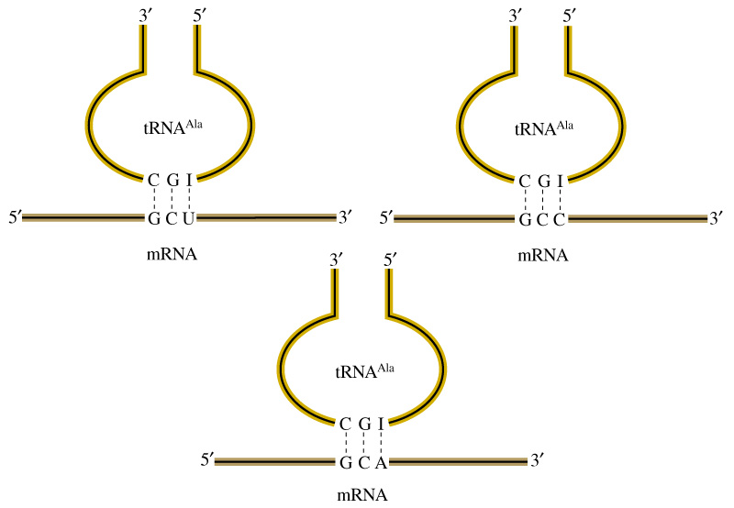

Slide 31
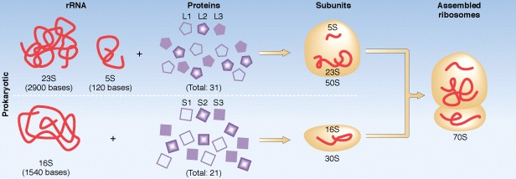
Ribosome | Small subunit | Large subunit
70S, 2520 kDa | 30S, 930 kDa | 50S, 1590kDa
RNA: 1664 kDa | 16S, 1542 nt, 560 kDa | 1104 kDa 23S, 2904 nt 5S, 120 nt
Proteins: 857 kDa | 370 kDa, 21 kinds | 487 kDa, 31 kinds

Slide 32
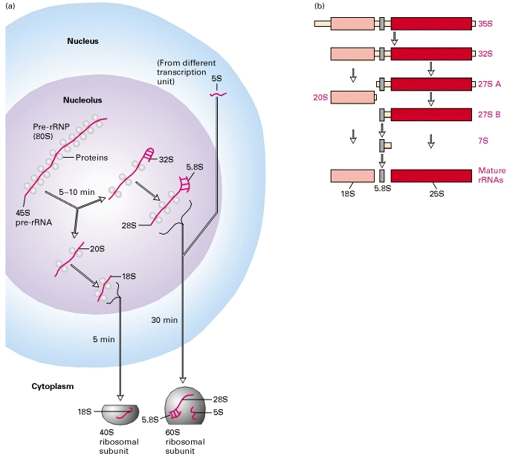
Lodish 4
Zorenje evkariontske rRNA
Notes:
(a) Major intermediates and times required for various steps in pre-rRNA processing in higher eukaryotes. Ribosomal and nucleolar proteins associate with 45S pre-rRNA soon after its synthesis, forming an 80S pre-rRNP. Synthesis of 5S rRNA occurs outside of the nucleolus. The extensive secondary structure of rRNAs (see Figure 4-33) is not represented here. Note that RNA constitutes about two-thirds of the mass of the ribosomal subunits, and protein about one-third. (b) Pathway for processing of 6.6-kb (35S) pre-rRNA primary transcript in S. cerevisiae. The transcribed spacer regions (tan), which are discarded during processing, separate the regions corresponding to the mature 18S, 5.8S, and 25S rRNAs. All of the intermediates diagrammed have been identified; their sizes are indicated in red type. [Part (b) adapted from S. Chu et al., 1994, Proc. Nat’l. Acad. Sci. USA 91:659.]

Slide 33
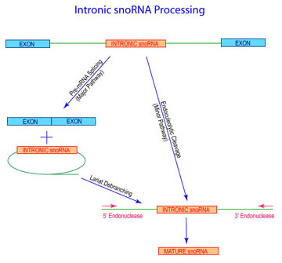
snoRNP:
mali nukleolarni ribonukleoproteinski delec
Notes:
Prior to cleavage by exo- and endonucleases, the pre-rRNA undergoes a complex pattern of nucleoside modifications. These include methylations and pseudouridylations, guided by snoRNAs.

Slide 34
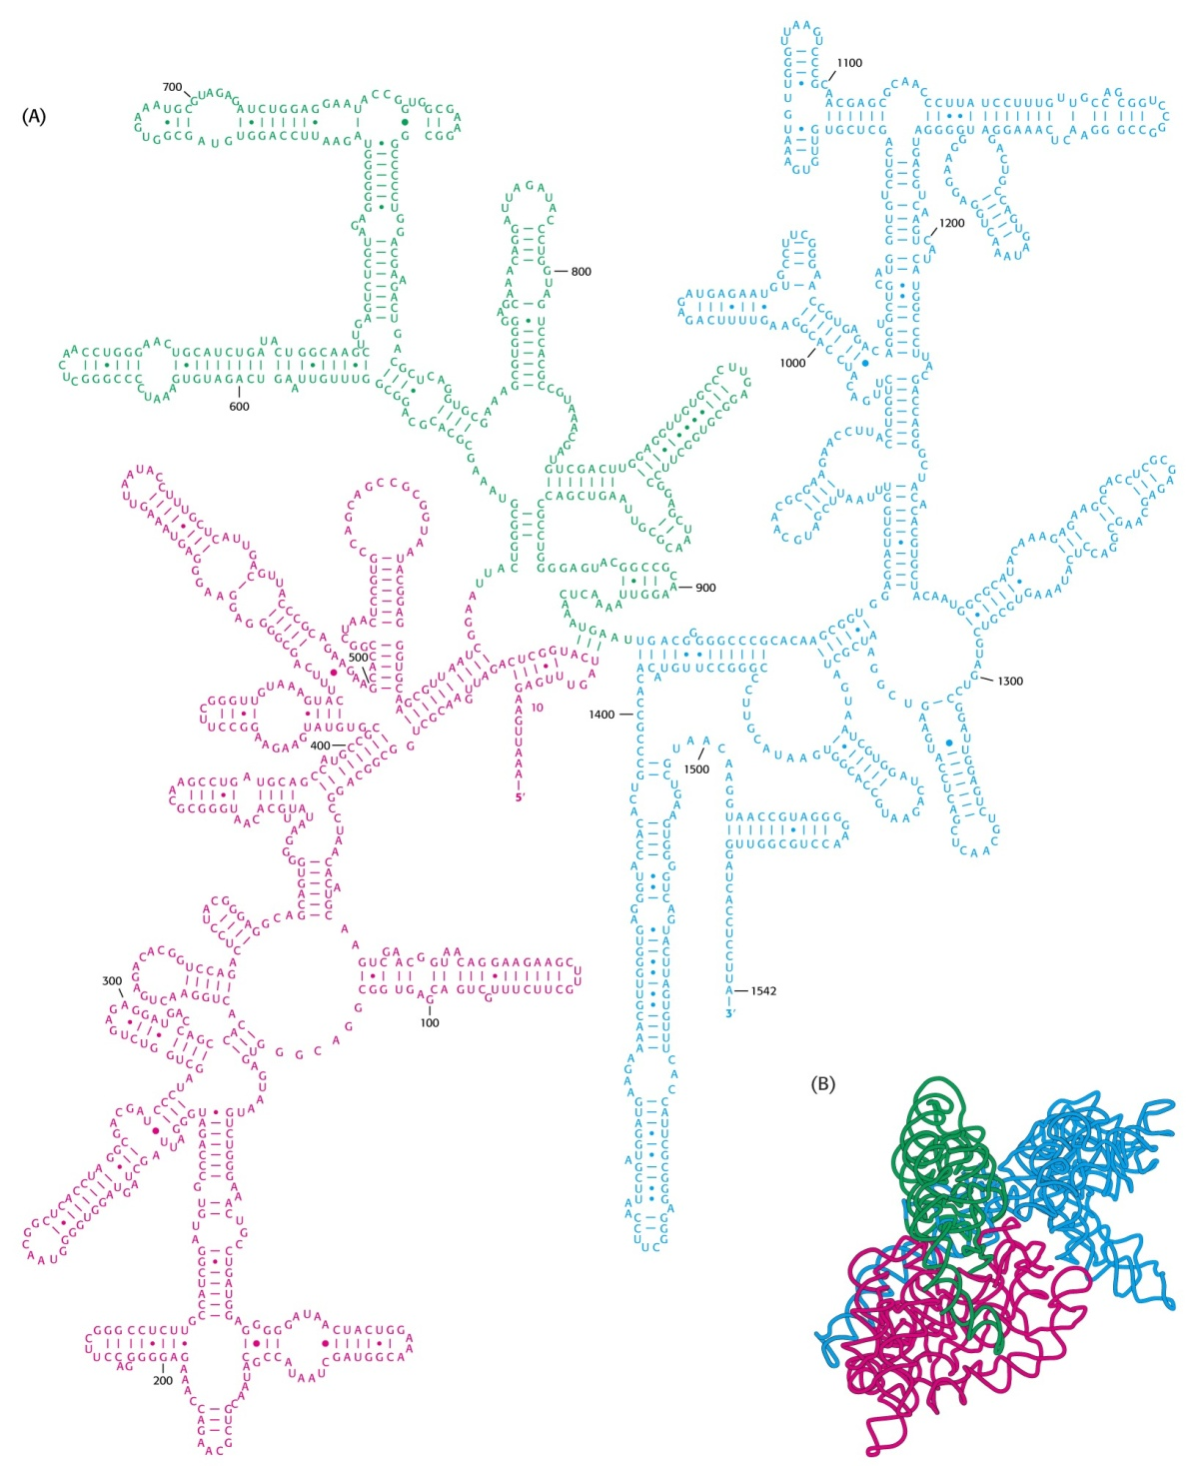
rRNA 16 S
1542 nt
Notes:
zgradba podenote 16S (1542 b), 3 domene; uporabljajo pri določanju evolucijskih poti zaradi velike ohranjenosti

Slide 35
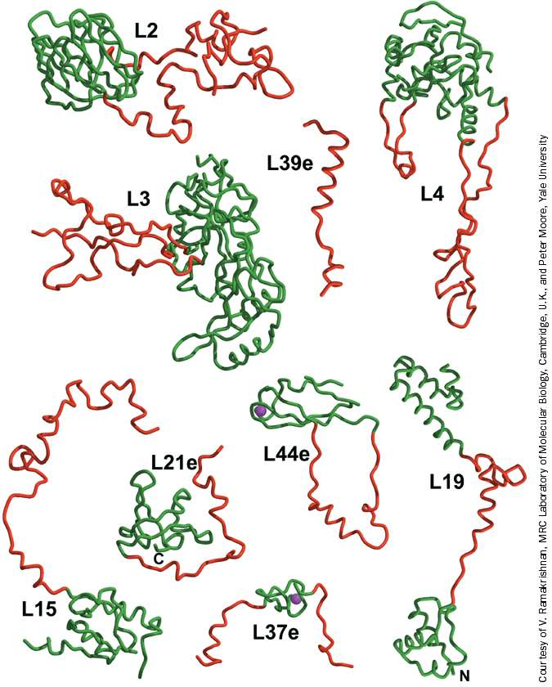
Nekateri proteini, ki sestavljajo ribosomsko podenoto 50 S.

Slide 36
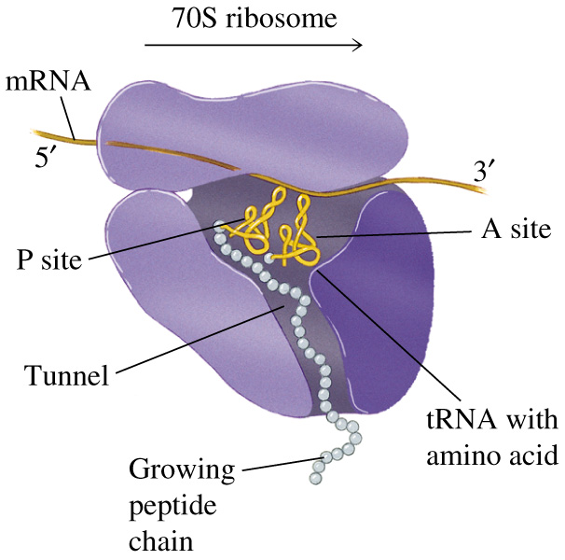

Slide 37
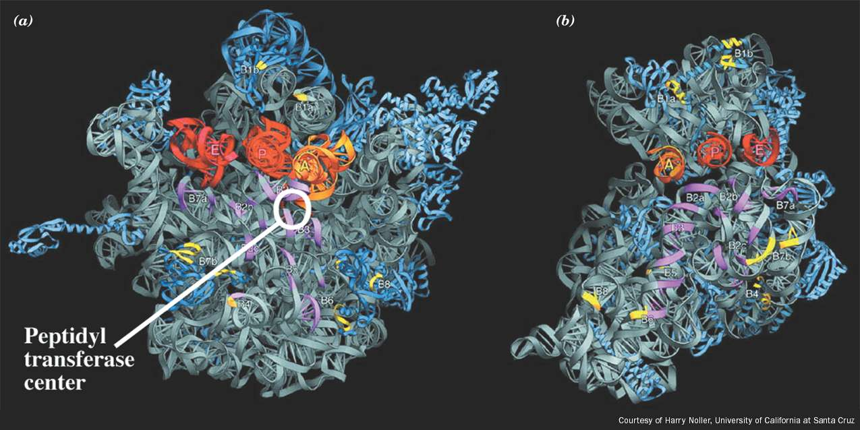

Slide 38
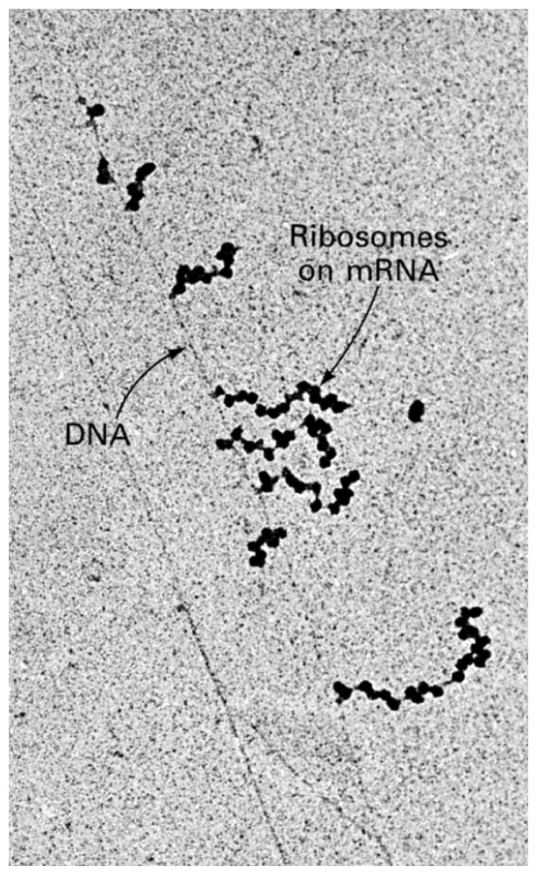
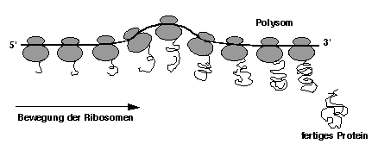
Notes:
polisomi pri E. coli; transkripcija in translacija pri prokariontih sta (skoraj) hkratna in povezana procesa

Slide 39
Trije možni bralni okviri na mRNA. Vsak bralni okvir pomeni drugačen polipeptid, ki lahko nastane na osnovi istega zaporedja nukleotidov.

