Slide 1
Razgradnja proteinov
Voet 3: poglavje 32.6

Slide 2
Razgradnja proteinov
(proteoliza)
razgradnja v prebavilih
razgradnja v celici
in vitro
Proteolitični encimi (proteinaze)
Sistematika na osnovi mehanizma (oz. AK v aktivnem centru):
serinske, cisteinske (tiolne), aspartatne, glutamatne, treoninske, metalo~, mešanega tipa, z neznanim mehanizmom
Klasifikacija MEROPS: razdelitev na klane in družine glede na mehanizem in evolucijsko sorodnost

Slide 3
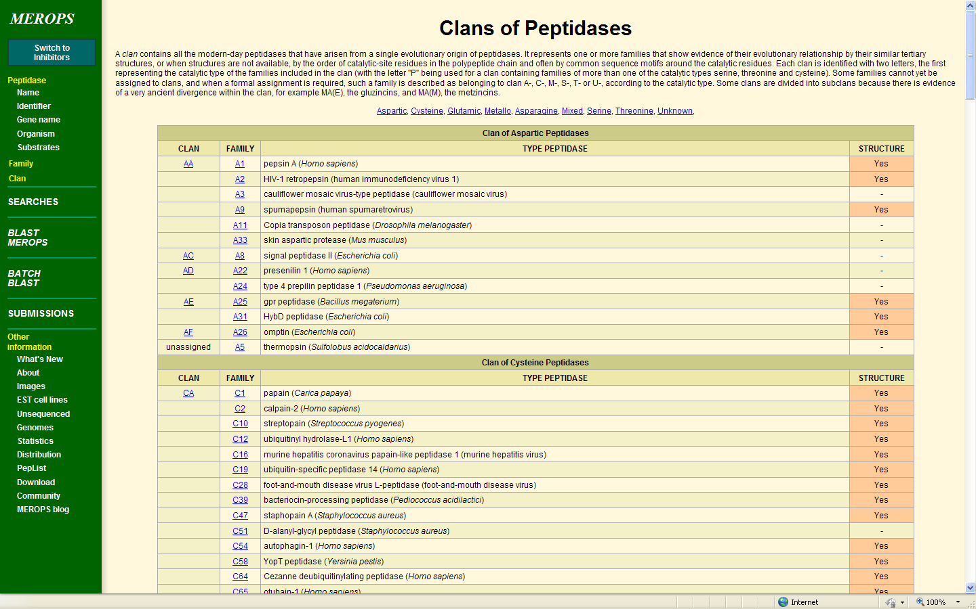

Slide 4
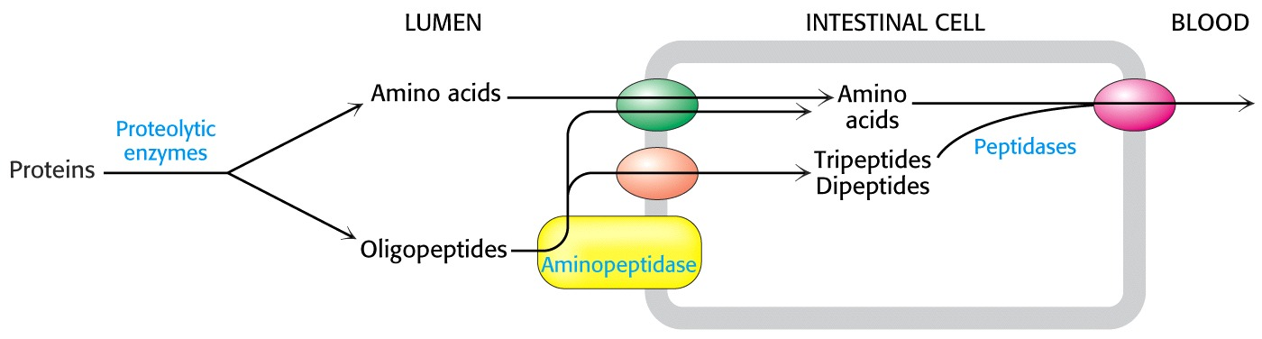
Notes:
razgradnja in absorpcija proteinov iz prebavnega trakta

Slide 5
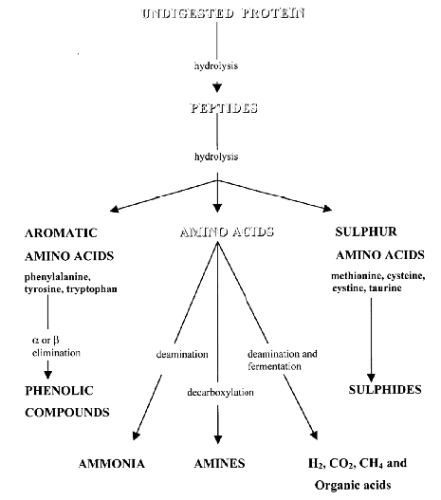
Curr. Issues Intest. Microbiol. 2000
Presnova proteinov v debelem črevesju
Notes:
razgradnja proteinov v debelem črevesju zaradi delovanja črevesnih bakterij
On average, 12g of proteinaceous material or 0.5 - 4g total nitrogen, enters the large intestine each day mainly in the form of protein (48 - 51%) and peptides (20 - 30%). Dietary sources make up at least 50% of this protein material. The remaining proteinaceous material arriving at the colon is made up of endogenous material, namely pancreatic enzymes, mucus and exfoliated epithelial cells.

Slide 6
Razgradnja proteinov v celici
- odstranjevanje za celico nefunkcionalnih ali nevarnih proteinov
- uravnavanje celičnega metabolizma
(odstranjevanje nepotrebnih encimov in regulatorjev)
Koncentracija proteina v celici/ organizmu je odvisna od
hitrosti sinteze in hitrosti razgradnje!

Slide 7
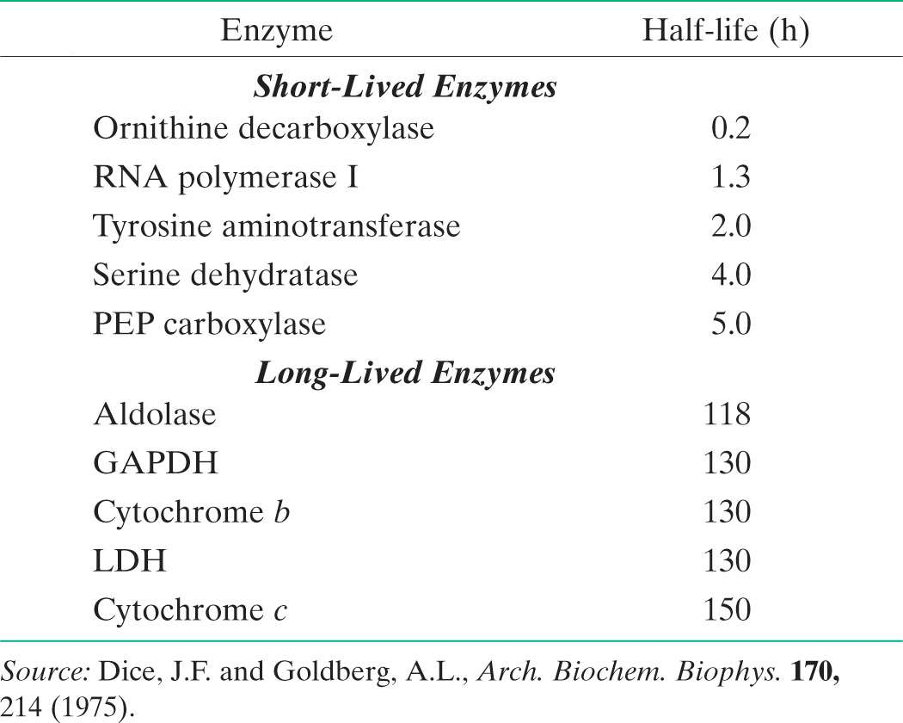
Razpolovni časi nekaterih jetrnih encimov pri podganah.
Notes:
kratkoživi encimi so tisti, ki predstavljajo pomembne kontrolne točke v metabolizmu, stabilni pa so tisti, ki so ne glede na fiziološke pogoje vedno enako aktivni
Celica ne razlikuje med pravkar sintetiziranimi proteini in starimi proteini, pač pa jih razgradi naključno, a s hitrostjo, ki je značilna za določen protein.
Hitrost razgradnje se spremeni v odvisnosti od hormonskega stanja in prehranjenosti.

Slide 8
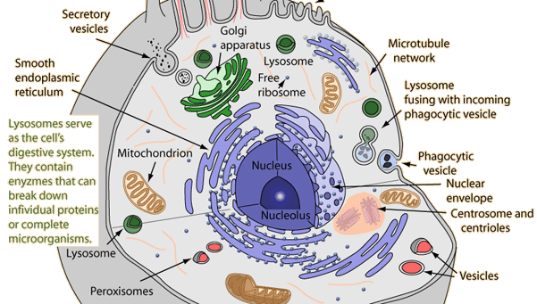
Znotrajcelična razgradnja:
- v lizosomih (nespecifična razgradnja)
- v citosolu (razgradnja z Uq označenih proteinov v proteasomu; od ATP odvisni mehanizmi)
Lizosomska razgradnja: predvsem zunajcelični proteini, ki vstopajo z endocitozo, sodelujejo pa tudi pri avtofagocitozi (fuzija z fagosomi; = avtofagija).
Citosolna razgradnja: predvsem za znotrajcelične proteine, ki so nepravilno zviti ali označeni za razgradnjo kot posledica fosforilacijskih signalnih kaskad.
http://hyperphysics.phy-astr.gsu.edu/hbase/biology/imgbio/lysosome.gif

Slide 9
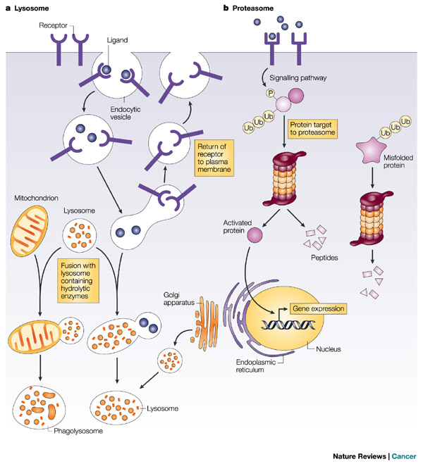
Znotrajcelična razgradnja: v lizosomih (nespecifična razgradnja) ali
v citosolu (razgradnja označenih proteinov)
Notes:
The two main routes of intracellular protein degradation are the lysosomes and the proteasomes. a | Lysosomes are cytoplasmic, membrane-bound vesicles that enclose proteases and hydrolytic enzymes. They degrade extracellular and transmembrane proteins that are taken up by endocytosis — the process by which the cellular plasma membrane invaginates and breaks off internally to transport materials into the cell — and participate in autophagocytosis by fusing with phagosomes. b | Proteasomes are primarily involved in degrading intracellular proteins. These might be targeted by phosphorylation following activation of signalling pathways, or recognized because they are misfolded. The proteins are targeted for degradation by their ubiquitin tag.

Slide 10
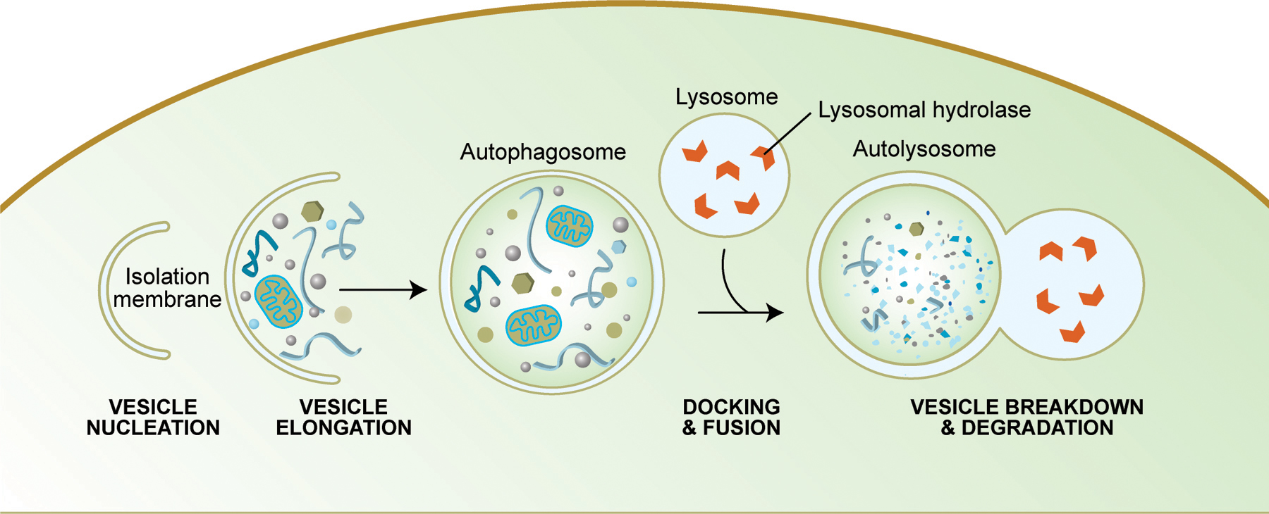
http://www.wormbook.org/chapters/www_autophagy/autophagy.html
Shematski prikaz avtofagije
Notes:
Autophagy begins with the formation of double-membrane-bounded autophagosomes. The origin(s) of the autophagosome membranes are unclear.
Autophagosomes fuse with lysosomes to form autophagolysosomes, a process that is governed by a number of factors, including dynein activity. The contents of autophagolysosomes are finally degraded by acidic lysosomal hydrolases.
The green dots represent the protein LC3 (also known as ATG8). This is the only known marker that specifically localizes to autophagosome and autophagolysosome membranes and not to other membranes. LC3 localizes to these structures after it has been processed and conjugated to phosphatidylethanolamine.

Slide 11
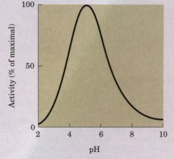
Lizosomi vsebujejo številne hidrolaze (~50 različnih), med njimi proteinaze s skupnim imenom katepsini.
Zaradi nizkega pH v lizosomih imajo katepsini pH-optimum v kislem.
Katepsini so večinoma cisteinske proteinaze, obstajajo
pa tudi aspartatne (in serinske). Sintetizirajo se v neaktivni obliki
– s propeptidom, ki prekriva aktivno mesto.
V procesu aktivacije se propeptid odcepi.
pcatL pcatB
Coulombe et al., EMBO J. 1996

Slide 12
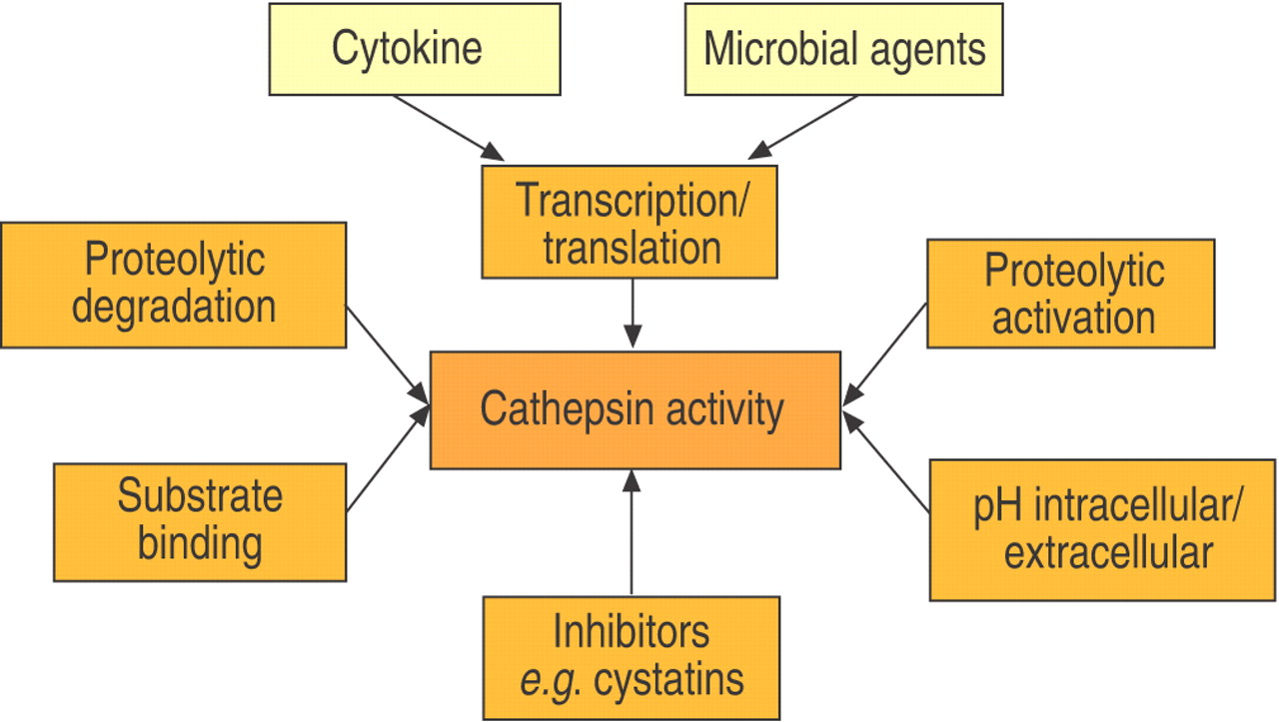
Regulacija encimske aktivnosti katepsinov (Bühling et al., 2004)

Slide 13
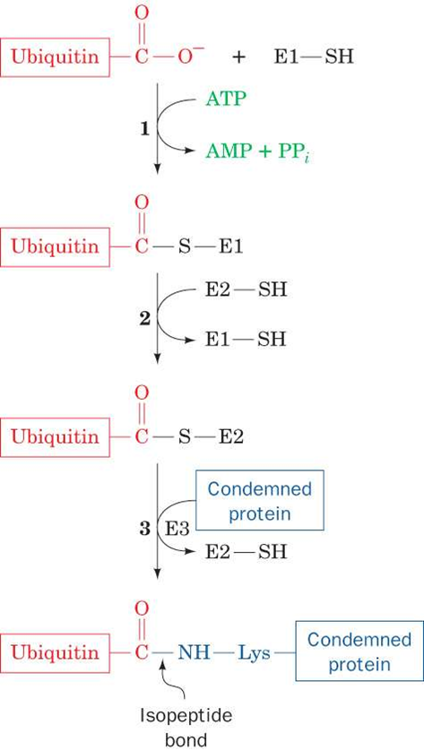
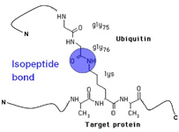
Ubikvitinacija

Slide 14
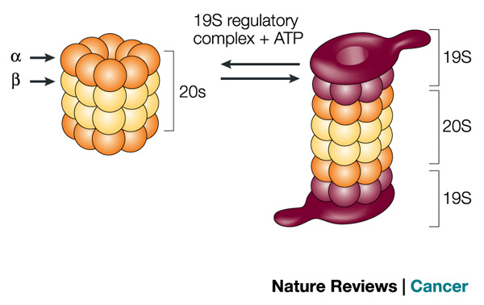
Shematski prikaz zgradbe proteasoma
26 S ≈ 2100 kDa, 20 S ≈ 670 kDa, 19 S ≈ 700 kDa
Notes:
A three-dimensional representation of the proteasome multi-enzyme complex. This is composed of the 20S complex, which comprises alpha- and beta-subunits, and two 19S regulatory complexes. Together with ATP, these form the 26S proteasome.

Slide 15
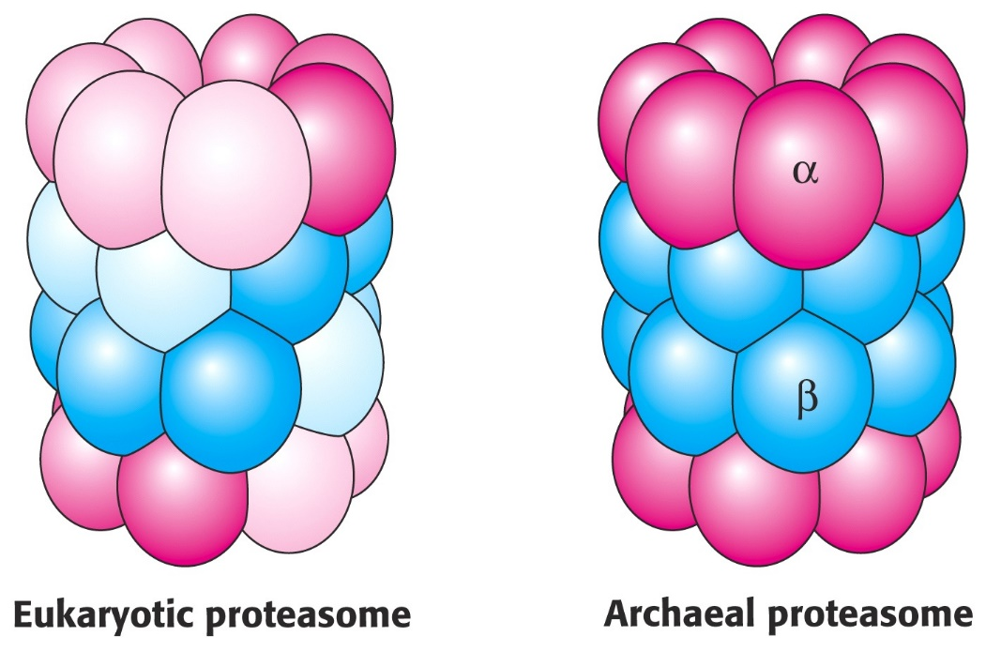
Razgradnja proteinov v proteasomu 20 S poteka samo, če je tarčni protein nezvit in ob porabljanju ATP.
Vloga kape (19 S) je prepoznavanje ubikvitiniranih proteinov in njihovo razvitje.
V obroč nameščenih 6 podenot ima ATPazno aktivnost. ATP je potreben tako za prepoznavanje substratov, kot za razvijanje proteinov in odpiranje kanala za vstop substrata v notranje votline.
Proteasomi 20 S so prisotni ne samo v citoplazmi, pač pa tudi v jedru. Mehanizem cepitve proteinov je poseben, s Thr v aktivnem centru.

Slide 16
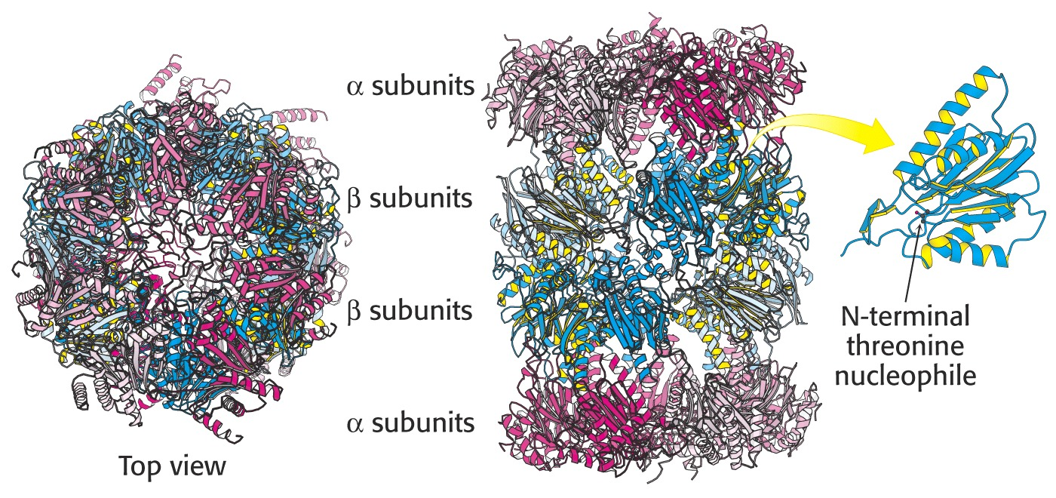
Zgradba osrednjega dela proteasoma
Notes:
proteasom (20 S)

Slide 17
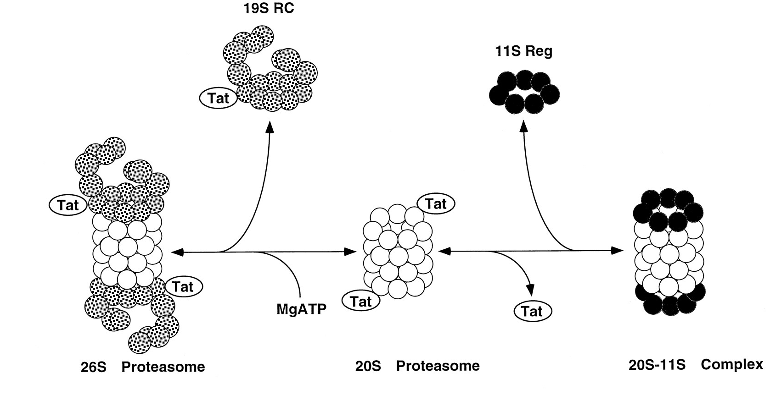
Dodajanje regulatorja 11 S na proteasom 20 S pri višjih evkariontih
Notes:
Regulator pri višjih evkariontih odpira kanal za vstop substratnih proteinov. Proteasom ima torej ali regulator ali kapo. Z regulatorjem (nima ATPazne aktivnosti) se odpira vstop samo krajšim peptidom, ne pa proteinom.
Summary of the interconversion of proteasomal complexes, their reported in vivo functions, and the effects of Tat shown in this paper. The 11 S regulator (11S Reg) is presented as a heptameric ring. Its exact symmetry, however, is unknown. The presentation of the 19 S regulatory complex (19S RC) is based on earlier structural data (27). JBC March 28, 1997 vol. 272 no. 13 8145-8148

Slide 18
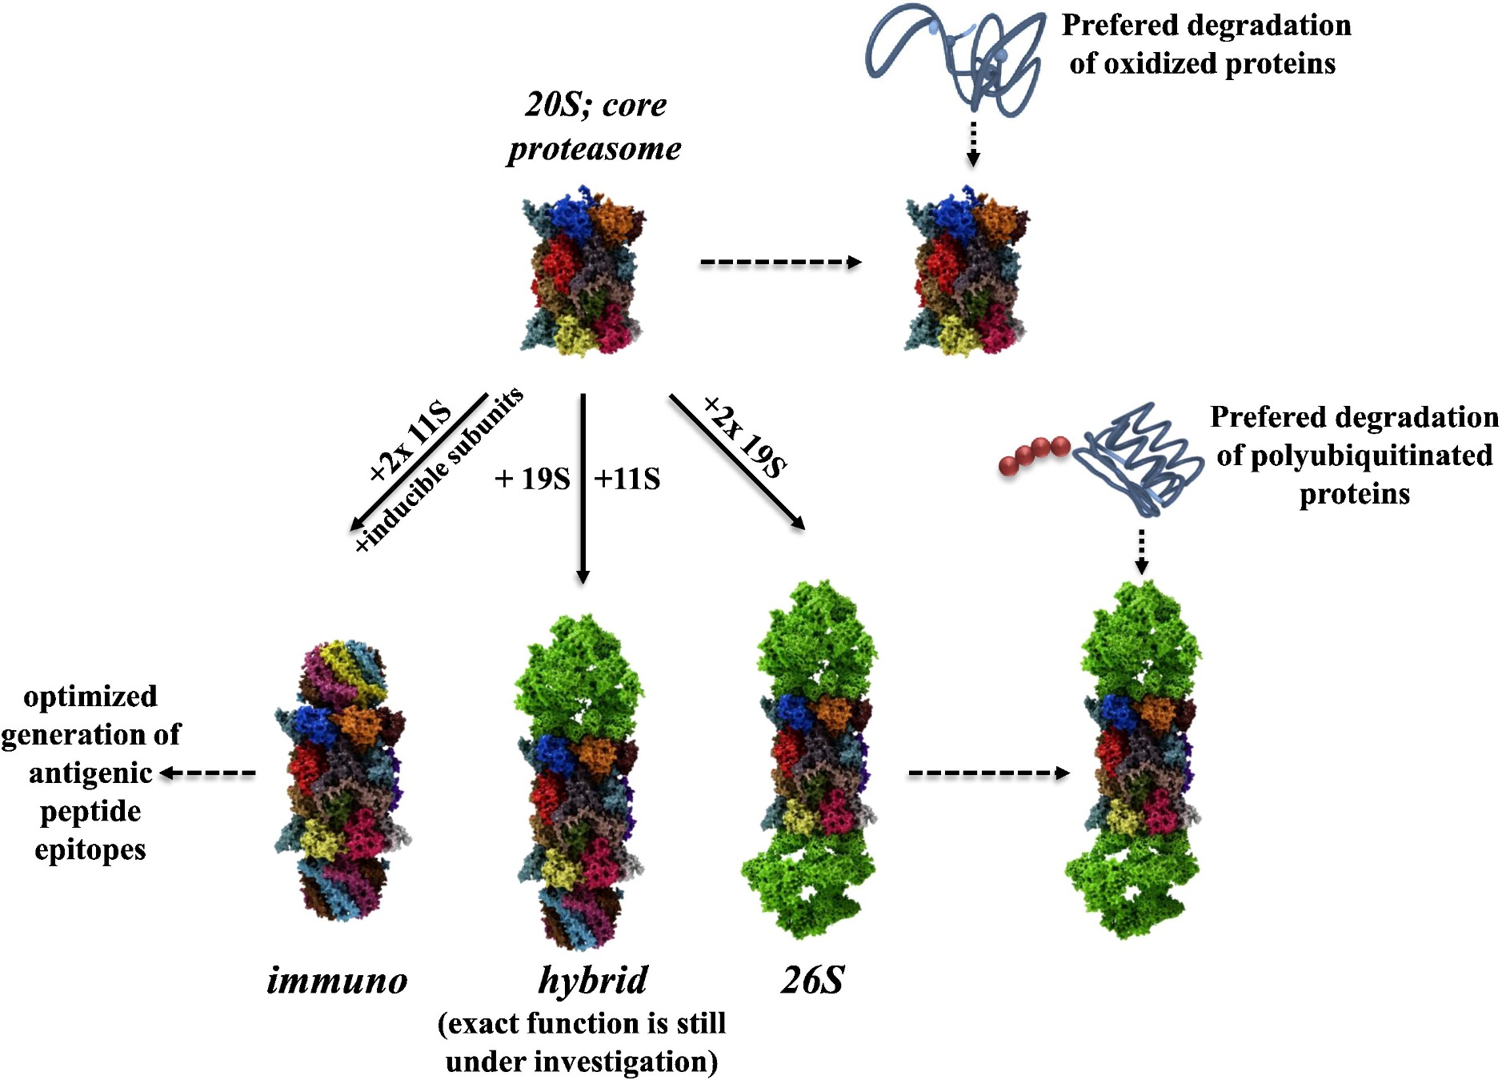
Hoehn et al., J. Proteomics, 2013

Slide 19
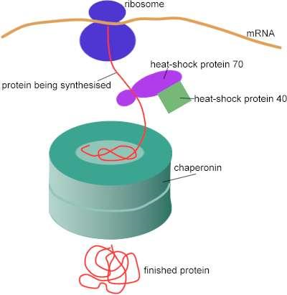
Molekulski šaperoni
preprečujejo nastajanje agregatov nezvitih proteinov v celici
delujejo predvsem na večdomenske proteine in proteine z več podenotami
vežejo se na izpostavljena hidrofobna področja, ki so izpostavljena topilu
pogosto imajo ATPazno aktivnost
med šaperone spada več nesorodnih razredov proteinov

Slide 20
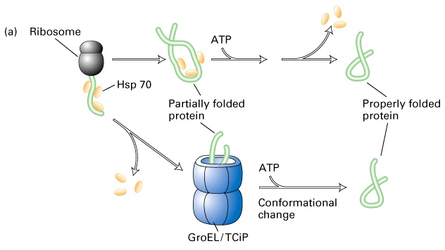
Razredi molekulskih šaperonov
Hsp70 (70 kDa, monomerni, se povezujejo s košaperoni Hsp40)
šaperonini (več podenot, oblika kletke → obdajo protein, ki se zvije v notranjosti kletke)
Hsp90 (pomagajo predvsem pri zvijanju proteinov, ki sodelujejo pri prenosu signalov)
nukleoplazmini (jedrni, za pravilno sestavljanje nukleosomov)
Notes:
(primerjaj z razdelitvijo na http://people.cryst.bbk.ac.uk/~ubcg16z/hsplec.html)

Slide 21
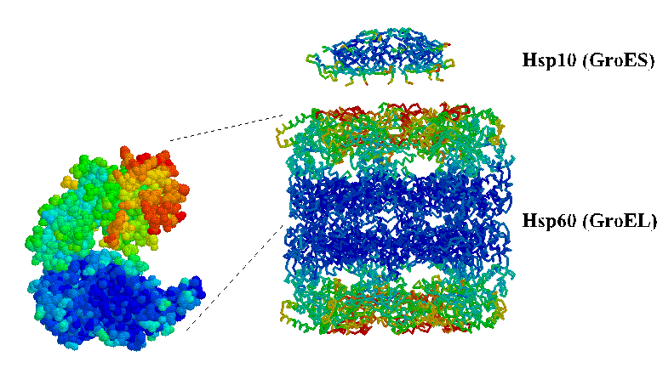
Šaperonini
dve družini:
- Hsp60 (GroEL pri E. coli, Cpn60 v kloroplastih): 14 x 60 kDa
- Hsp10 (GroES, Cpn10): heptamer (7 x 10 kDa) kot prstan
Vsaka od 14 podenot Hsp60 v dveh obročih ima dve domeni (ena je nad drugo).

Slide 22
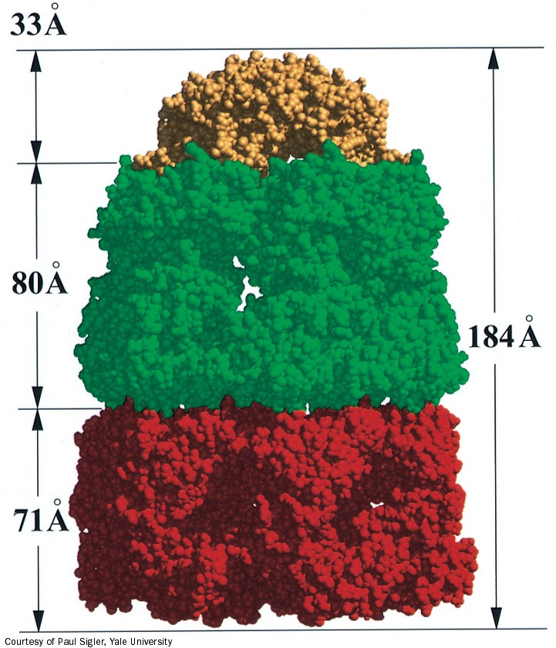
Sestavljanje kompleksa GroEL₂-GroES – (ADP)₇.

Slide 23
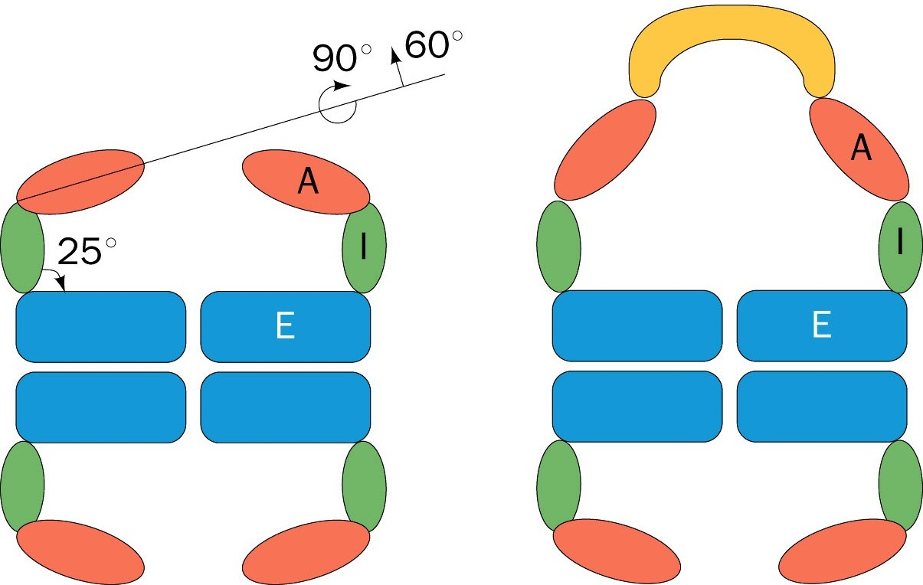
Konformacijske spremembe ob vezavi GroES: volumen votline se več kot podvoji.
E=ekvatorska domena, I=indermediarna, A=apikalna. Votlina lahko sprejme ~70 kDa velik protein.

Slide 24
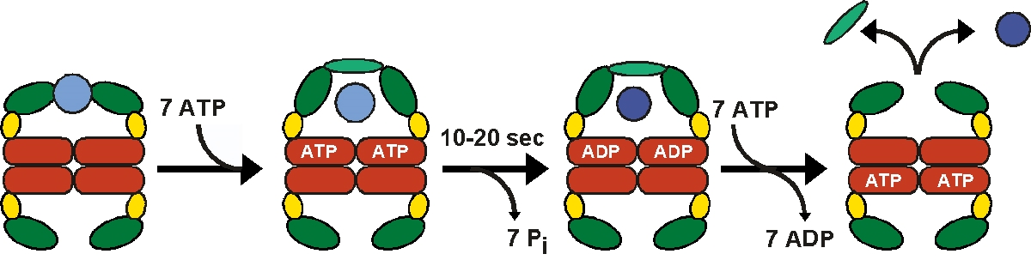
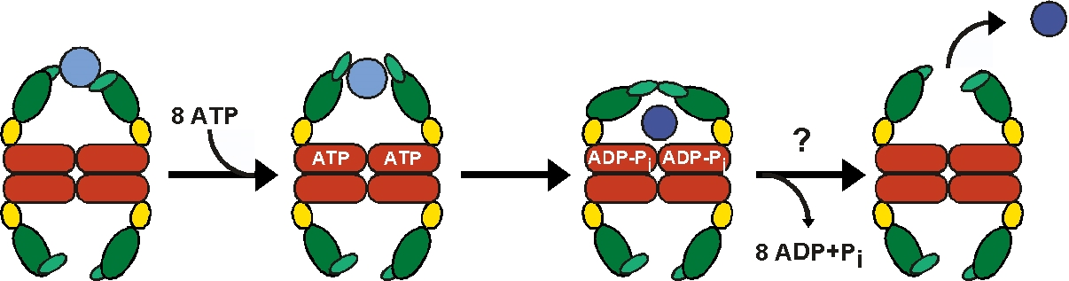
Šaperonini
skupina I (bakterije, organeli): košaperon deluje kot pokrov, ki zapira kletko
skupina II (arheje, evkarionti): zapiranje izvede poseben segment apikalnih domen
J. Martin, MPI Tuebingen
Notes:
a)
The reaction cycle of the bacterial GroEL/GroES chaperonin system. The molecules are shown in cross-sections. Each GroEL subunit consists of a central domain (red) an apical substrate-binding domain (dark green) and a connecting intermediate region (yellow). The binding of unfolded substrate protein (light blue) to one GroEL ring is followed by binding of ATP and the cochaperonin GroES (light green). The substrate is released into the now-closed ring cavity where it can fold. Following ATP
hydrolysis, the binding of ATP to the opposite ring triggers the dissociation of GroES and the dissociation of folded substrate protein from the complex.
b)
Model for the reaction cycle of the archaeal (Methanococcus maripaludis) Mm-cpn chaperonin system (16 subunits). The molecules are shown in cross-sections. Each Mm-cpn subunit consists of a central domain (red) an apical substrate-binding domain (dark green) and a connecting intermediate region (yellow). The binding of unfolded substrate protein (light blue) to one Mm-cpn ring is followed by binding of ATP. This event induces conformational changes in helical domain protrusions (light green), leading to closure of the cylindrical cavity. The substrate folds inside the chaperonin complex and dissociates from it after ATP hydrolysis has occurred. Lid segments are not required for substrate and ATP binding but are needed to mediate folding

Slide 25
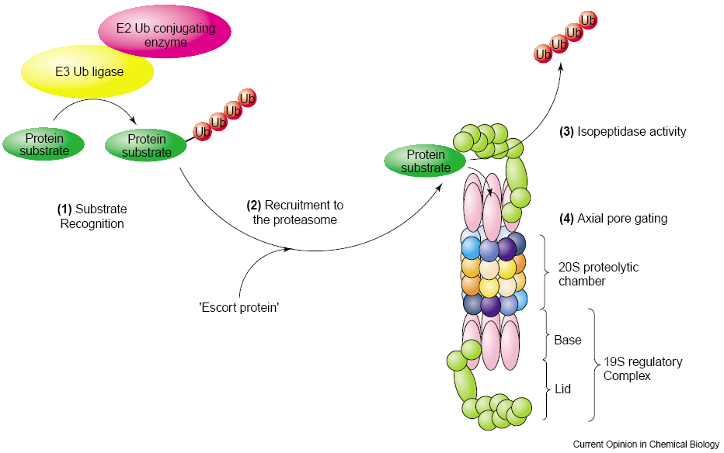
Označeni substrati se vežejo na pokrov (19 podenot), kjer se veriga Uq odcepi, nato pa pride do razvitja substratne molekule in odprtja pore, pri čemer sodeluje obroč 6 iz podenot, vezanih na podenote alfa.
Notes:
Recent advances in our understanding of the mechanisms underlying proteasome-mediated protein degradation. Several studies have yielded
new information on each of the four steps leading to proteolysis: (1) substrate recognition by an E3 ubiquitin ligase, and subsequent ubiquitination;
(2) escort of protein substrates to the 26S proteasome via binding to adaptor proteins containing UBA and UBL domains; (3) Cleavage of the
isopeptide bond linking the polyubiquitin chain to the protein substrate; (4) translocation of the protein substrate into the proteolytic chamber.
Ub, ubiquitin.

Slide 26
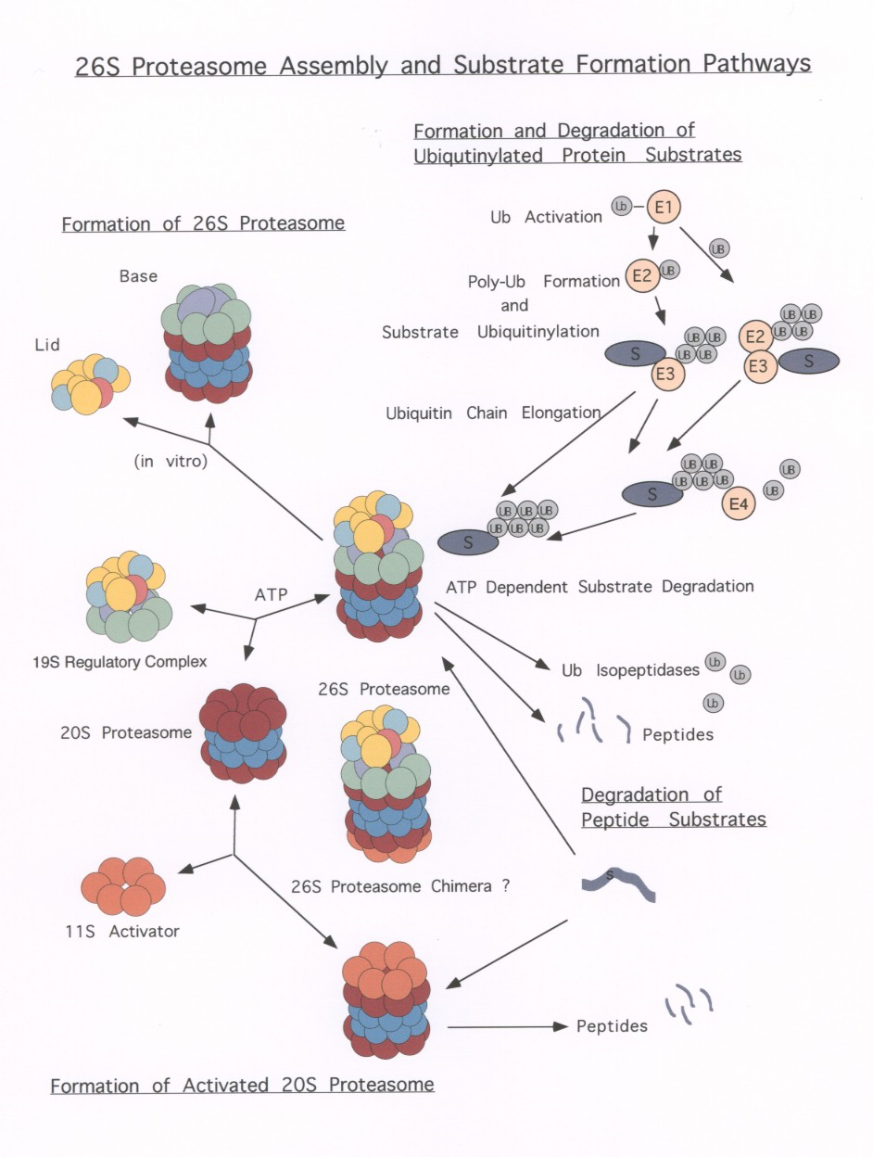

Slide 27
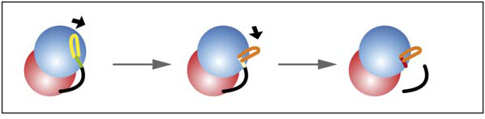
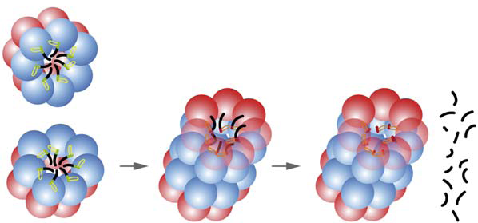
Structure 14, 1179–1188, 2006
Sestavljanje proteasoma 20 S iz dveh pol-proteasomov in aktivacija
pro- v aktivne podenote beta z odcepom propeptida.
Notes:
A Model of Assembly-Dependent Activation of Proteasomes
Prior to the association of the two half proteasomes (lower left), the S2-S3 loops are in an extended position as shown in the upper left of the top part of the figure. Upon association of the two half proteasomes (lower middle), the S2-S3 loops are repositioned. This repositioning of the loop, in turn, establishes the appropriate orientation of the active-site residues that supports the cleavage of the propeptides and activation of the proteasomes (lower right). The sequence of events is shown in close-up view in the top figures. Red spheres represent a subunits, and blue spheres depict b subunits with the S2-S3 loops shown in yellow prior to association of half proteasomes.
The reorientation of the loop and the N-terminal active site region during assembly process are depicted by changes in their colors. The propeptides are shown in black line connected to the active site residue at the N-terminal end.

Slide 28
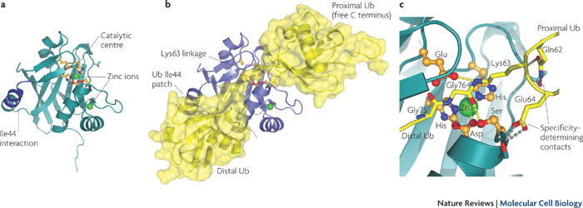
Pred vstopom tarčnega proteina v lumen se Uq odstranijo ob delovanju
deubikvitinaze (DUB), ki je ena od podenot kape in je metaloproteinaza.
Obstajajo tudi proste DUB, ki lahko podaljšajo življenjsko dobo proteina.
Večinoma so cisteinske proteinaze.
Notes:
Structure of the catalytic domain of AMSH-LP (associated molecule with the SH3 domain of STAM (AMSH)- like protease; also known as STAMBPL1), a JAMM/MPN+ (JAB1/MPN/MOV34 metalloenzyme) deubiquitinase (DUB; also known as deubiquitylating or deubiquitinating enzyme). a | AMSH-LP (shown in green) in isolation (Protein Data Bank identifier 2znr). b | AMSH-LP in complex with Lys63-linked diubiquitin (PDB identifier 2znv)29, with the protein shown in blue and ubiquitin (Ub) shown in yellow. c | A close-up view of the active site. The complex structure was obtained from a catalytic mutant (Glu292Ala) and hence the active apo-structure is shown with Lys63-linked diubiquitin derived from this complex29. The specificity-determining interactions of the Gln62 and Glu64 of the proximal ubiquitin with AMSH-LP are shown as grey dotted lines. Active site residues are shown in orange and zinc ions are shown as light green spheres and interactions in the active centre are indicated by yellow dotted lines.
Nature Reviews Molecular Cell Biology 10, 550-563 (August 2009)

Slide 29
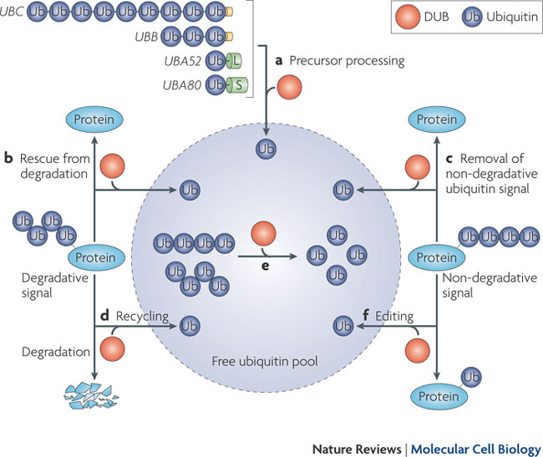
Notes:
a | Ubiquitin is encoded by four genes (UBC, UBB, UBA52 and UBA80) and is transcribed and translated as a linear fusion consisting of multiple copies of ubiquitin or ubiquitin fused to the amino terminus of two ribosomal proteins, 40S ribosomal protein L40 (L) and 60S ribosomal protein S27a (S). Note that the polyubiquitin genes encode an extension one or several amino acids long at their carboxyl terminus (shown in yellow). Generation of free ubiquitin from these precursors is a key function of deubiquitinases (DUBs; also known as deubiquitylating or deubiquitinating enzymes). b | Deubiquitylation can rescue proteins from degradation. c | Alternatively, deubiquitylation can remove a non-degradative ubiquitin signal. d | DUBs have a crucial role in maintaining ubiquitin homeostasis and preventing degradation of ubiquitin together with substrates of the 26S proteasome and lysosomal pathways (recycling of ubiquitin). e | Disassembly of ubiquitin chains generated by en bloc removal from substrates ensures that recycled ubiquitin re-enters the free ubiquitin pool. f | Some DUBs might function to edit ubiquitin chains and thereby help to exchange one type of ubiquitin signal for another.
Nature Reviews Molecular Cell Biology 10, 550-563 (August 2009)

Slide 30
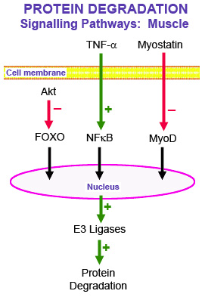
http://neuromuscular.wustl.edu
Proces ubikvitinacije lahko nadzorujejo signalne poti preko transkripcijskih faktorjev,
ki uravnavajo izražanje encimov, potrebnih za dodajanje ubikvitinskih enot na tarče.

Slide 31
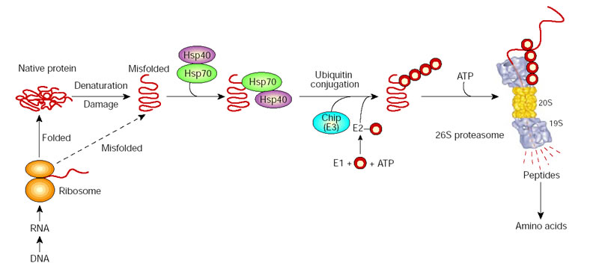
Nature 426, 895-899 (2003)
Šaperoni lahko sodelujejo pri prepoznavanju nepravilno zvitih proteinov, kar privede do njihove ubikvitinacije.
Notes:
Molecular chaperones may function in protein folding and in the degradation of misfolded species. By associating with exposed hydrophobic domains, chaperones Hsp70/40 promote the folding of newly synthesized proteins and favours their refolding. Alternatively, they can facilitate the recognition of abnormal proteins, leading to their ubiquitylation by CHIP, the E3, and their degradation by the 26S proteasome. The red circles represent ubiquitin.

Slide 32
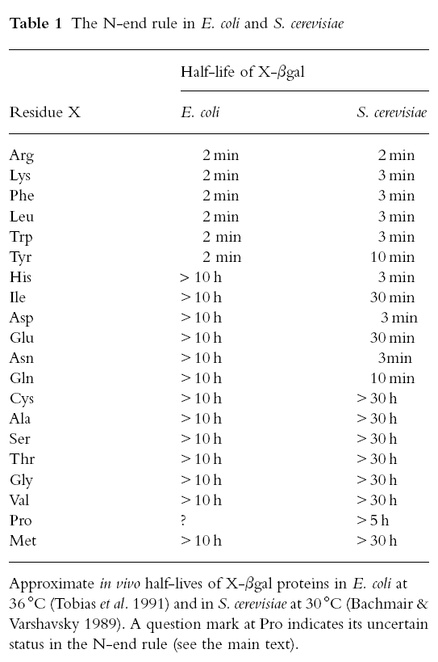

Slide 33
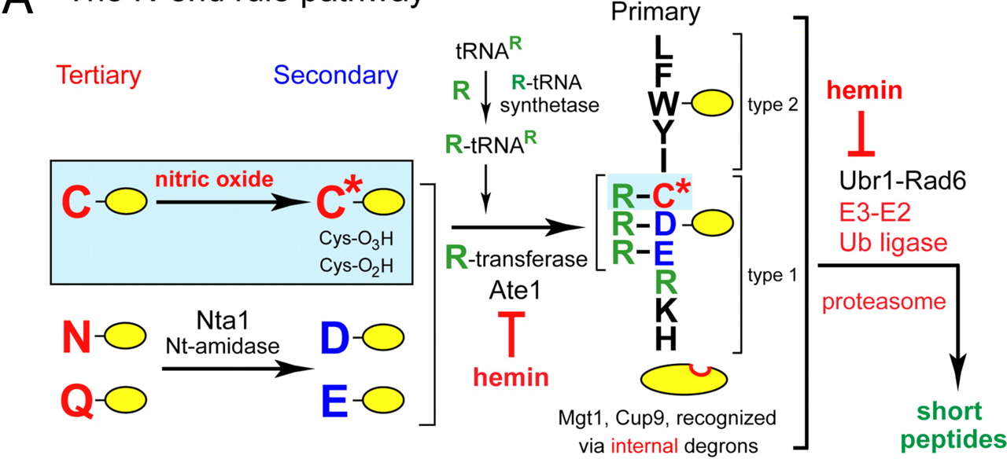
Pravilo N-konca
Razen osnovnih destabilizirajočih N-končnih aminokislinskih ostankov oz. zaporedja
(N-degron) obstajajo še dodatni signali, ki vplivajo na obstojnost proteina po pretvorbah:
Asn, Gln – terciarna destabilizirajoča ostanka – se encimsko deaminirata v sekundarna destabilizirajoča Asp in Glu. Nanju se veže (primarno destabilizirajoči) Arg ob delovanju Arg-tRNA-transferaze.
S. cerevisiae PNAS (2009)
Notes:
The S. cerevisiae N-end rule pathway. N-terminal residues are indicated by single-letter abbreviations for amino acids. Yellow ovals denote the rest of a protein substrate. Primary, secondary, and tertiary denote mechanistically distinct subsets of destabilizing N-terminal residues. Hemin (Fe3+-heme) inhibits the arginylation activity of the ATE1-encoded Arg-tRNA-protein transferase (R-transferase), and also inhibits a subset of Ubr1 functions (24). Reactions in the shaded rectangle are a part of the pathway that is active in multicellular eukaryotes, which produce NO (18), and is also relevant to eukaryotes such as S. cerevisiae, which lack NO synthases but can produce NO by other routes and can also be influenced by NO from extracellular sources. C* denotes oxidized Cys, either Cys-sulfinate or Cys-sulfonate.

Slide 34
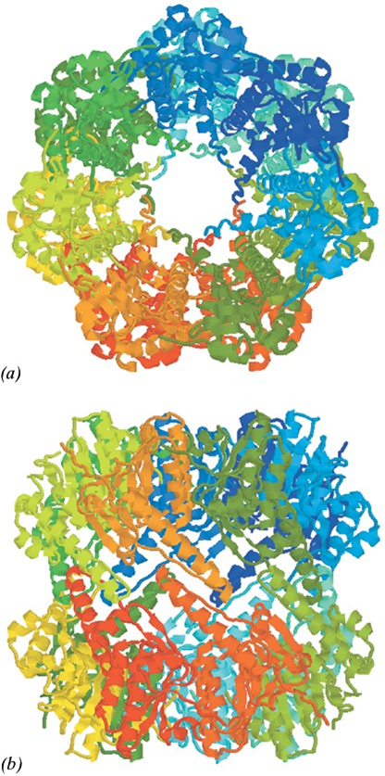
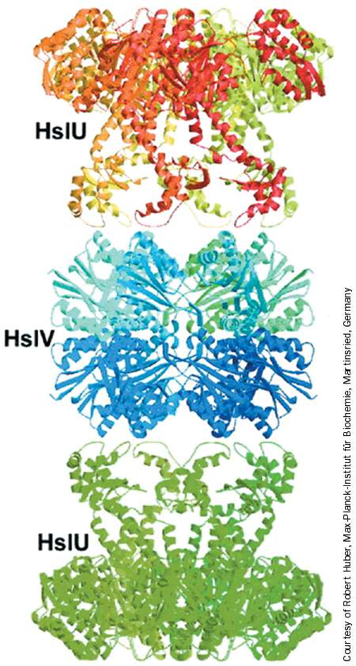
Razgradnja proteinov pri prokariontih
Bakterije nimajo proteasomov 20 S (izjema: Actinomyces), vseeno pa imajo od ATP odvisno razgradnjo proteinov s sodčkastimi encimi.
Pri E. coli 80 % razgradnje proteinov posredujeta proteazi Lon in Clp, ki ju sestavlja več podenot, pri čemer je aktivno mesto obrnjeno v notranjost strukture. Pri proteolizi sodeluje tudi kompleks HslUV (heat shock locus UV).
Heptamerni kompleks ClpP, ki v Clp-kompleksu sodeluje z ATPazami (ClpA, ClpX).
Kompleks HslUV (820 kDa), kjer ima ‚kapa‘ HslU ATPazno aktivnost, HslV pa proteazno.
Notes:
Kljub na videz podobni zgradbi je tip zvitja pri ClpP povsem drugačen kot pri proteasomu. ClpP je serinska proteaza. Podoben protein je tudi v mitohondrijih.
HslU je heksamer, HslV pa dodekamer, skupaj torej 24 podenot, strukturno pa je kompleks precej podoben proteasomu.

Slide 35
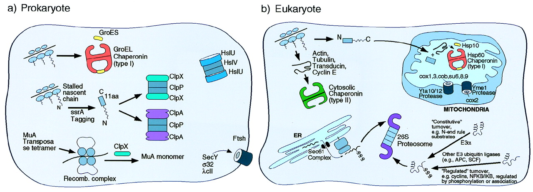
PNAS (1999) 96, 11033-11040
Vloga ‚šaperonskih obročev‘ pri zvitju in razgradnji proteinov
Notes:
Schematic illustration of the role of chaperone rings in ATP-dependent protein folding and unfolding/degradation in prokaryotic and eukaryotic cells. Protein folding chaperonins are illustrated in the upper portion of each “cell,” and proteolytic chaperones and the associated proteolytic cylinders are shown in the lower portion. In the case of the prokaryotic Clp components, the homohexameric ATPases, ClpA or ClpX, form coaxial associations with the termini of the double ring cylindrical serine protease, ClpP, delivering recognized substrates to it for degradation (see text). In the absence of association with ClpP, however, ClpA or ClpX can mediate disassembly of oligomeric substrate proteins, exemplified by ClpX-mediated disassembly of the MuA transposase tetramer. Note the two chaperonin classes in the eukaryotic cell (cytosolic and mitochondrial). In the case of the eukaryotic proteasome, the general pathways of ubiquitination to direct proteins for degradation by the proteasome are shown. Not shown is the presence of the proteasome in the nuclear compartment, where similar pathways of turnover appear to be operative.

Slide 36
Dodelava proteinov v ER
zvitje
nastanek disulfidnih mostičkov
glikozilacija (pripenjanje in dodelava)
proteolitično procesiranje
sestavljanje multimernih proteinov
V GA lahko pridejo samo pravilno zviti in sestavljeni proteini; ostali se zadržijo v ER, najpogosteje pa se vrnejo v citosol, kjer se razgradijo.

Slide 37
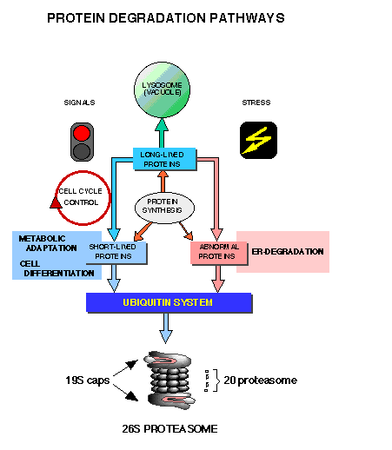
http://www.uni-stuttgart.de/ibc/wolf/proteasome.html

Slide 38
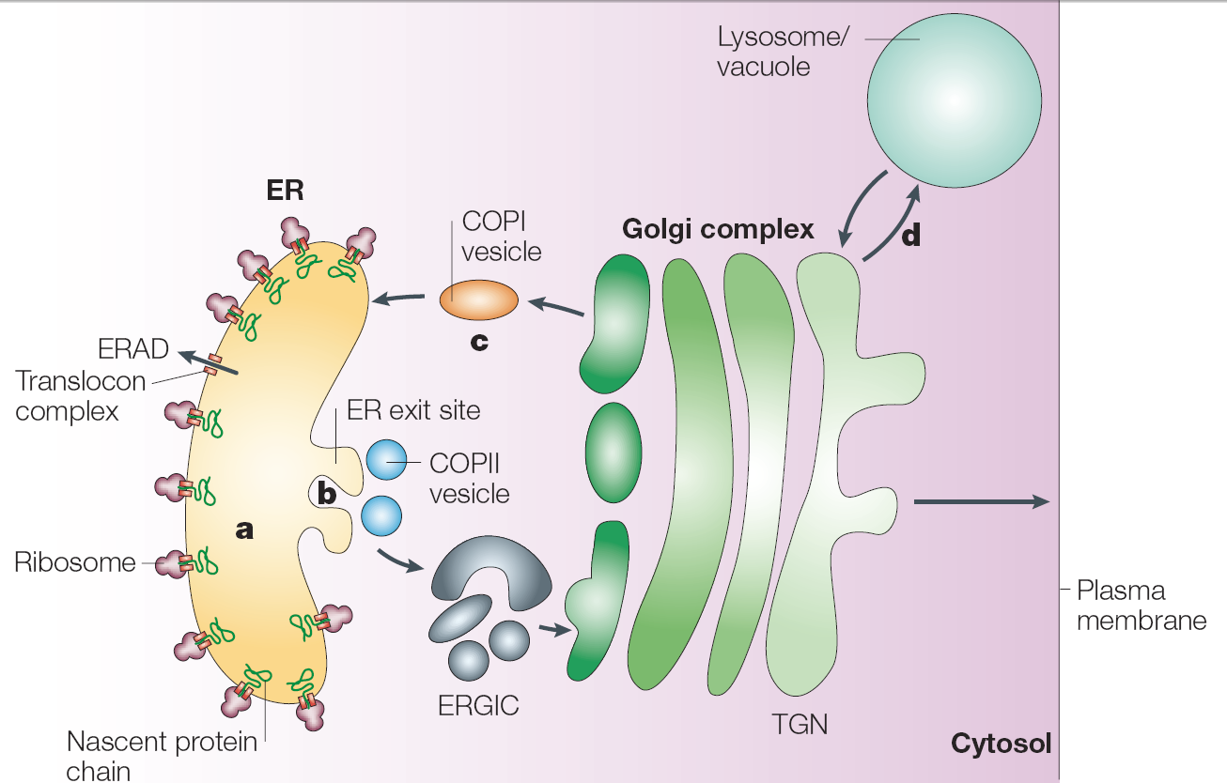
Preverjanje kakovosti proteinov v ER: kontrola nativnosti
ERAD = ER-associated degradation
ERGIC = ER- Golgi intermediate compartment
TGN = trans-Golgi network
Nature Rev. Mol. Cell Biol. 2003
Notes:
The endoplasmic reticulum (ER) is the site of synthesis and maturation of proteins entering the secretory pathway (see figure, part a). It contains molecular chaperones and folding factors that assist protein folding and retain non-native conformers. Terminally misfolded proteins and unassembled oligomers are retro-translocated to the cytosol and are degraded by the proteasome — a process referred to as ER-associated degradation (ERAD). Once they are correctly folded, native conformers enter ER exit sites (see figure, part b). Vesicles that are coated with the coatomer protein (COP)II coat bud off and traffic through the ER–Golgi intermediate compartment (ERGIC) to the cis-face of the Golgi complex. In certain cases, the retrieval of misfolded proteins from the Golgi complex by COPI vesicles has been observed (see figure, part c). The Golgi complex does not contain molecular chaperones and does not seem to support protein folding. Once they have passed through the cis-Golgi, proteins proceed through the trans-Golgi network (TGN) to the plasma membrane or beyond. In special cases, which have been observed mainly in Saccharomyces cerevisiae, non-native proteins can be diverted from the TGN to the lysosome/vacuole for degradation (see figure, part d).

Slide 39
Z ER povezana razgradnja proteinov (ERAD)
Senzorji pravilnosti zvitja so šaperoni in nekateri drugi proteini.
Zaznavajo izpostavljene hidrofobne regije, proste Cys in nedokončane glikanske verige.
Terminalno napačno zviti proteini zapustijo ER z retrogradnim transportom.
V citosolu se označijo z Uq in razgradijo. Ubikvitinacijo omogočajo Uq-ligaze in pomožni proteini v membrani ER.
Pri kvasovkah so kontrolne točke zvitja verjetno tri. Membranski proteini se preverjajo drugače kot ostali. Pri membranskih se najprej preveri zvitje citosolne domene (ERAD-C), nato luminalne domene (ERAD-L: na enak način tudi nemembranski proteini); obstaja tudi ERAD-M (preverjanje transmembranskih domen). Vsaka od treh poti zahteva drugo Uq-ligazo E3.

Slide 40
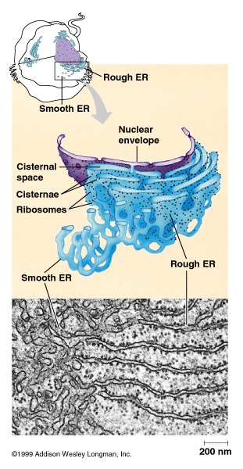
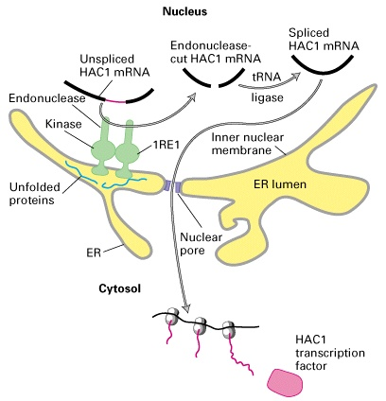
Ključna vloga IRE1 pri odgovoru ER na nezvite proteine: vezava nezvitega proteina na IRE1 povzroči sintezo transkripcijskega faktorja HAC1, ta pa aktivira transkripcijo genov za ostale proteine, udeležene v odgovoru ER.
Notes:
The unfolded-protein response. IRE1 is a transmembrane protein in the inner nuclear membrane, a membrane that is continuous with the ER membrane. This multifunctional protein (green) has a binding site for unfolded proteins (blue) on its luminal surface; its nuclear-facing domain contains a protein kinase of unknown function and a specific RNA endonuclease. Binding of unfolded proteins in the ER lumen dimerizes the receptor and somehow activates the endonuclease, which cleaves the unspliced mRNA precursor encoding the transcription factor HAC1. The two exons of HAC1 mRNA then are linked together by tRNA ligase, which usually splices tRNA precursors, forming a functional HAC1 mRNA. Following its synthesis in the cytosol, HAC1 protein moves back into the nucleus and activates transcription of genes encoding several chaperones and other proteins that assist in folding unfolded proteins in the ER lumen. [See C. Sidrauski and P. Walter, 1997, Cell 90:1031.]

Slide 41
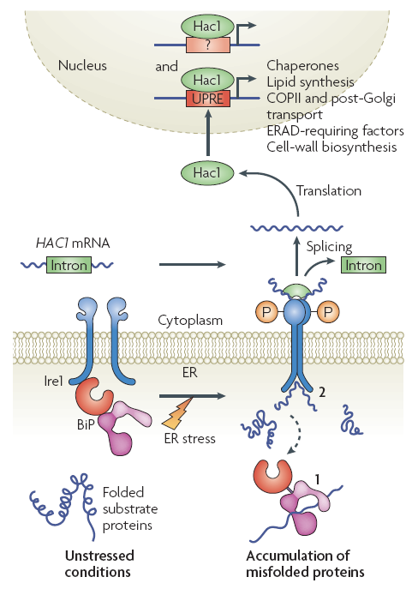
Nature Rev. Mol. Cell Biol. 2008
Notes:
Misfolded protein accumulation in the endoplasmic reticulum (ER) can lead to the induction of the unfolded protein response (UPR), which reduces ER-protein load by several mechanisms (see the main text). In yeast, the sole UPR transducer is inositol-requiring protein-1 (Ire1), an ER-localized transmembrane Ser/Thr kinase and site-specific endoribonuclease. Under unstressed conditions, immunoglobulin binding protein (BiP) binds to Ire1 in the ER lumen and maintains the enzyme in an inactive state (see figure). When the ER is stressed, BiP can be titrated away to bind to misfolded substrates, in turn activating Ire1 (see figure, step 1). Ire1 also dimerizes and might directly bind to misfolded proteins owing to the formation of a peptide-binding pocket in the ER-luminal domain, thus resulting in activation (see figure, step 2). Ire1 activation involves the transphosphorylation of its cytoplasmic domain, which triggers endoribonuclease activity and splices an intron in the mRNA that encodes Hac1 (homologous to ATG6/CREB), a dedicated UPR transcriptional activator. The processed mRNA is re-ligated by a tRNA ligase, Trl1, and translated. Hac1 then translocates into the nucleus, binds to UPR elements (UPREs) and possibly other sequences in the promoter region of target genes, and upregulates their expression. In higher eukaryotes, the UPR consists of three transducers, IRE1, PERK and activating transcription factor-6 (ATF6) (not shown). IRE1 functions in a manner that is identical to its yeast homologue. ER-stress-activated PERK is a transmembrane kinase that phosphorylates the α-subunit of the eukaryotic translation initiation factor-2 (eIF2α), and thus inhibits protein translation. ATF6 traffics to the Golgi under conditions of ER stress. Here, it is
proteolytically processed by the S1P and S2P intramembrane proteases to release the ATF6-fragment transcription factor. This fragment translocates into the nucleus and upregulates target genes. In each case, BIP is also required for transducer activation. Interestingly, the IRE1 branch of the UPR seems to be anti-apoptotic, whereas persistent PERK signalling might trigger apoptosis158. COPII, coatomer protein complex-II; ERAD, ER-associated degradation.

