Slide 1
Rekombinacija in popravljanje DNA
Voet 3: poglavja 30.5 – 30.7
Stryer 5: poglavji 27.5 in 27.6
Krebs 3: poglavji 15 in 16

Slide 2
Rekombinacija
homologna (=splošna): zamenjava homolognih segmentov med dvema molekulama DNA – poteka med mejozo pri evkariontih in pri nekaterih tipih popravljanja napak na DNA
mestnospecifična: pri prokariontih (haploidni), kjer druga veriga DNA vstopi v celico (transformacija, transdukcija, konjugacija)
somatska: v celicah imunskega sistema, kjer je potrebna velika pestrost zapisov (npr. za različna protitelesa)
Notes:
somatska tudi pri menjavi ‚spola‘ pri kvasovkah in pri aktivaciji izražanja površinskih antigenov pri tripanosomah

Slide 3
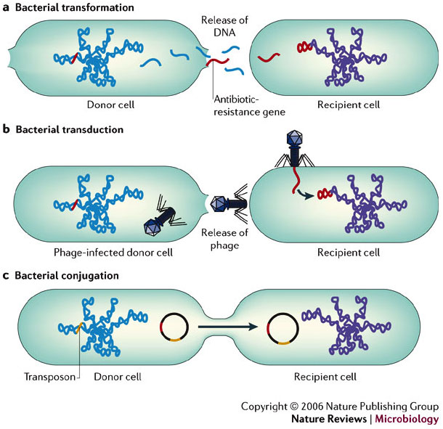
Prenosi DNA med prokarionti
Transformacija: sprejem tuje DNA iz okolice
Transdukcija: bakteriofagi prinašajo DNA iz druge bakt. celice
Konjugacija: DNA prihaja iz druge celice iste ali druge vrste medtem, ko sta celici fizično povezani

Slide 4
Rekombinacija /2
intermediat imenujemo Hollidayevo križišče
potrebna je aktivnost nukleaze in ligaze
alternativna modela: Messelson-Raddingov in model popravljanja dvojnih prekinitev

Slide 5
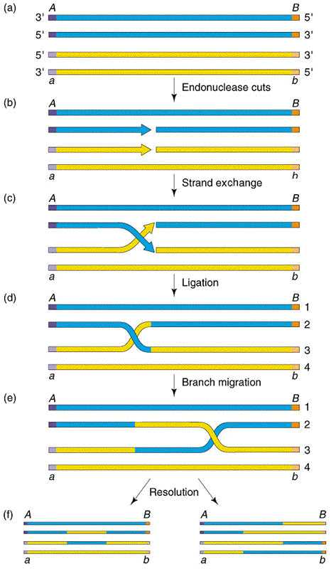
Notes:
(a) pair of chromatids
(b) a single strand cut is made in each chromatid
(c) strand exchange takes place between the chromatids
(d) ligation occurs yielding two completely intact DNA molecules
(e) Branch migration occurs, giving regions of heteroduplex DNA
(f) resolution of the Holliday junction gives two DNA molecules with heteroduplex DNA. Depending upon how the Holliday junction is resolved, we either observe no exchange of flanking markers (left) or an exchange of flanking markers (right)
http://nitro.biosci.arizona.edu/courses/EEB320-2005/Lecture13/lecture13.html

Slide 6
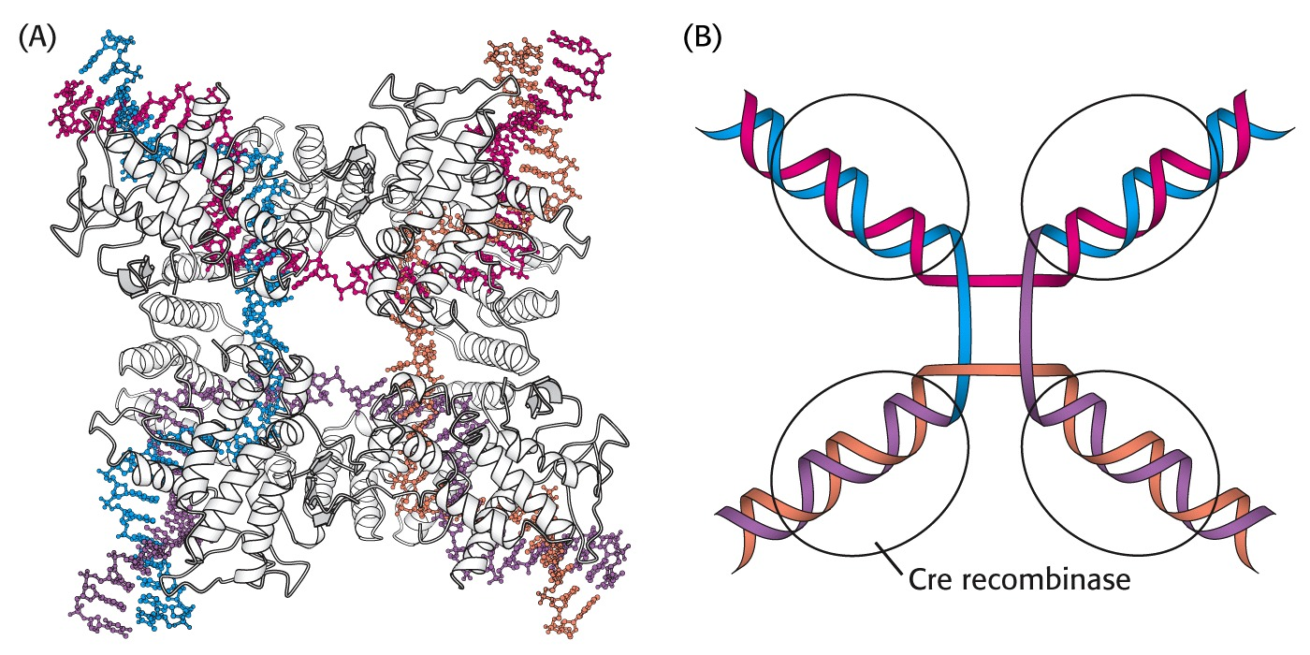
Cre iz faga P1 deluje na tarčna mesta loxP (34 bp)

Slide 7
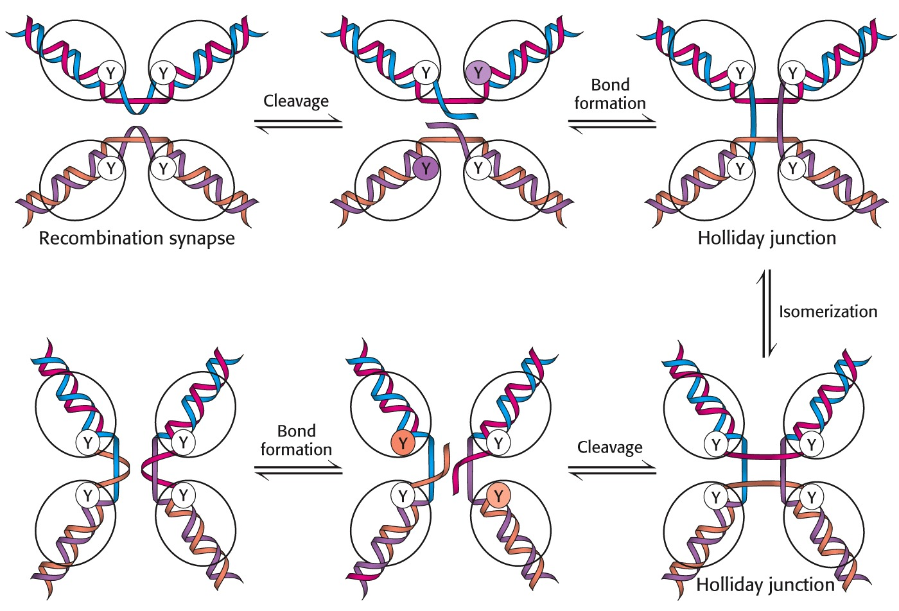

Slide 8
Rekombinaze:
encimi, ki katalizirajo izmenjavo verig DNA
- RecA (E. coli)
- RAD51 (S. cerevisiae)
- Cre (fag P1)
- FLP / FRT
…
Pri E. coli mutante recA⁻ izmenjujejo DNA 10⁴-krat redkeje kot recA⁺.
RecA se veže na DNA (ds ali ss) neodvisno od zaporedja – predpogoj je zareza
z vsaj 1 nt ssDNA – in naredi filamente, dolge tudi >1000 monomernih enot. Vežejo se na homologna mesta in ob hidrolizi ATP katalizirajo izmenjavo verig.
~6 monomerov se veže na 1 zavoj dsDNA, ki se razvleče in vsebuje ~19 bp.

Slide 9
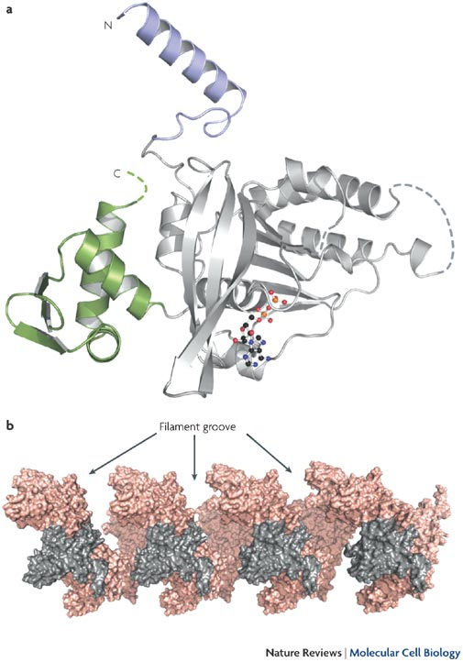
Struktura rekombinaze RecA in sestavljanje filamentov
Notes:
Escherichia coli RecA is a 352-residue polypeptide chain (molecular mass of 37,842 D). The structure of RecA was elucidated by Story and Steitz in 1992 and multiple structures of RecA and its homologues have since been determined. Unfortunately, none of these structures include bound DNA, and much remains to be elucidated about the DNA-binding sites on this protein. The structure of a single filament subunit (part a) has a large core domain (shown in grey), and two smaller domains at the N and C termini (shown in purple and green, respectively). The core domain is the prototype of a motif known as the RecA fold, which is found to be common to a range of other proteins including motor proteins such as the F1 ATPase, multiple helicases, DNA-transport proteins and certain other transporters. Bound ADP is shown in a stick-and-ball structure. In the active RecA filament, ATP is bound at the subunit–subunit interface. A depiction of the RecA filament, based on the Story and Steitz structure, is shown in part b. There are six RecA subunits per helical turn of the filament, which corresponds to the extended (18 base pairs per turn) conformation of the DNA that is bound within the filament. The helical groove that provides access to the filament interior is indicated. Four individual subunits are shown in grey.

Slide 10
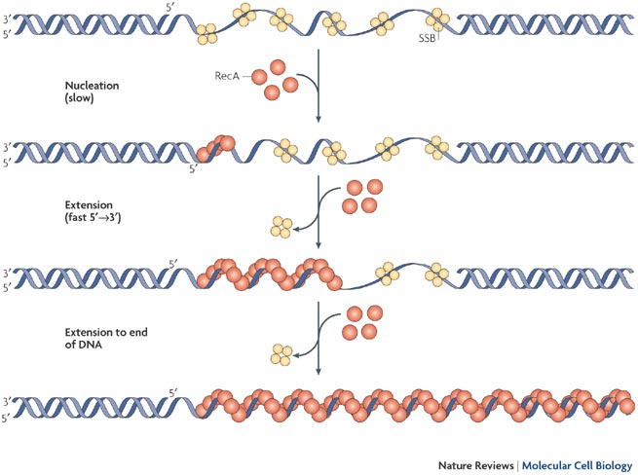
Nukleoproteinski filament z RecA
Notes:
RecA binds to DNA and forms a nucleoprotein filament in several steps. First, nucleation occurs slowly, with the single-stranded DNA-binding protein (SSB) functioning as a barrier to nucleation. Next, the filament extends rapidly, adding new subunits in the 5‘ → 3' direction and extends to the end of the DNA. When ATP is hydrolysed, disassembly also occurs, but more slowly than assembly (not shown). Disassembly also proceeds in the 5‘ → 3' direction at the end that is opposite to that where assembly occurs.

Slide 11
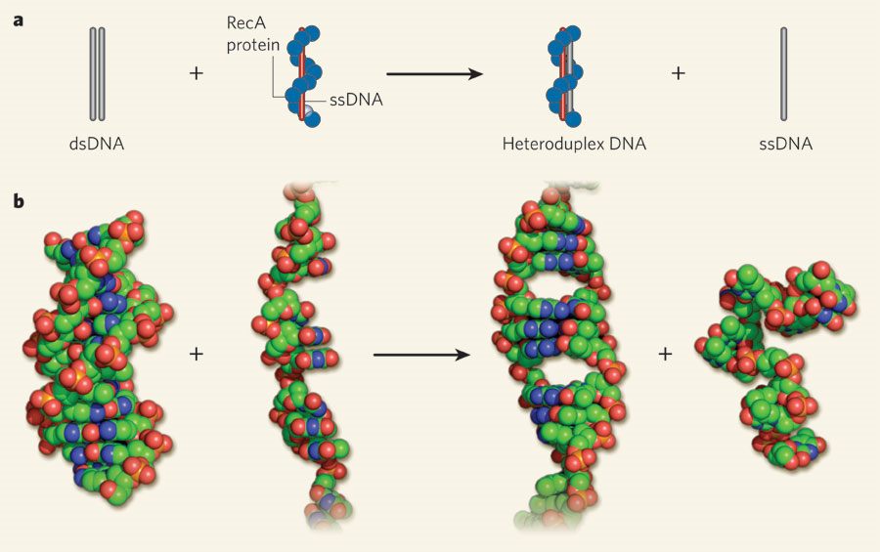
Izmenjava verig s posredovanjem RecA
Nature 453, 463-466(22 May 2008)
Notes:
a, The prototypical DNA-strand-exchange reaction. Double-stranded DNA (dsDNA) pairs with the RecA presynaptic filament, which consists of RecA protein and single-stranded DNA (ssDNA), to produce heteroduplex DNA bound by RecA and the exchanged ssDNA.
b, Structures of the participating DNA molecules: B-form dsDNA; ssDNA within the presynaptic filament (as determined by Chen and colleagues, protein not shown); dsDNA within the filament (protein not shown); and randomly coiled ssDNA.

Slide 12
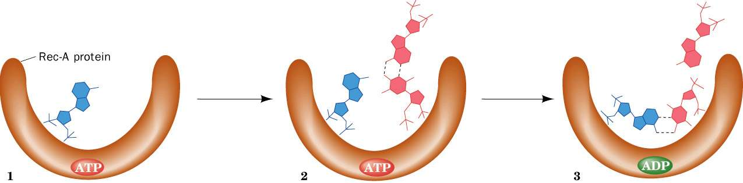
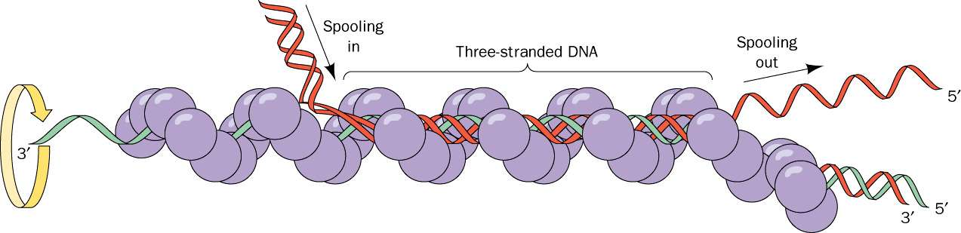
Voet 3

Slide 13
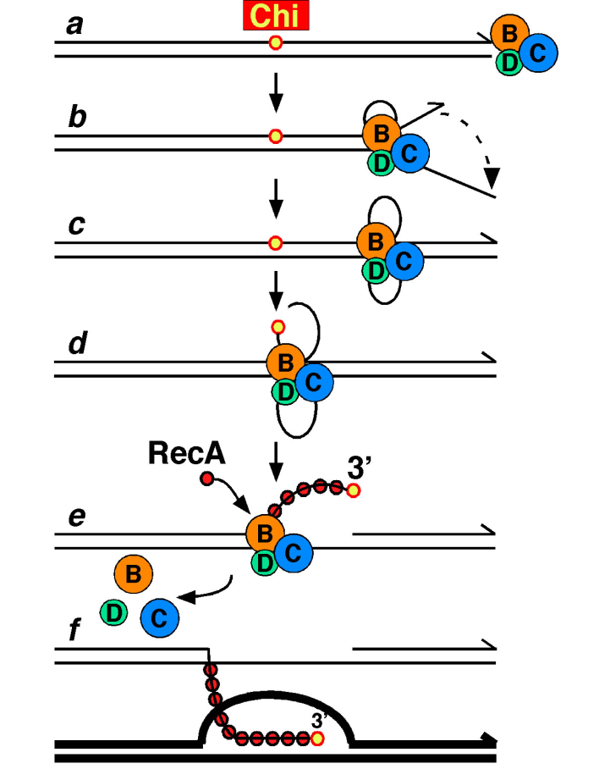
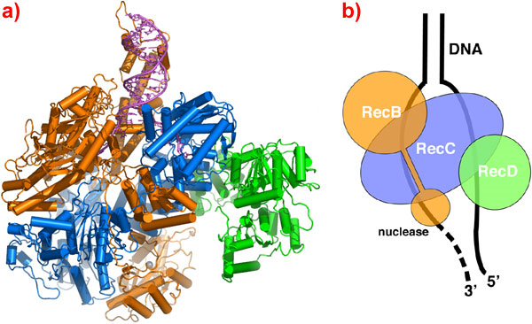
Iniciacija rekombinacije: RecBCD
330 kDa, helikaza + nukleaza
http://labs.fhcrc.org/gsmith/index.html
http://www.esrf.eu/news/spotlight/spotlight13dnarepair/index_html/
Notes:
(a) Ribbon representation of the RecBCD complex. RecB is shown in orange, RecC in blue and RecD in green. The DNA is shown in magenta. The nuclease active site has a calcium ion bound in it, shown as a grey sphere. (b) Schematic diagram of the complex showing the path taken by the DNA through the complex.

Slide 14
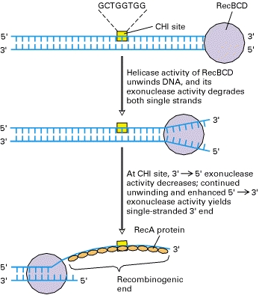
Mehanizem delovanja RecBCD
mesta hi: pri fagu lambda pogosta mesta začetka rekombinacije, pri E. coli na ~5 kb
Lodish 4
Notes:
Initiation of recombination by E. coli RecBCD enzyme
This multifunction enzyme, which binds to free blunt ends of DNA, acts as a helicase, 3′ → 5′ exonuclease, and 5′ → 3′ exonuclease. When the enzyme encounters a CHI site, its 3′ → 5′ activity is inhibited and its 5′ → 3′ activity enhanced, yielding a single-stranded 3′-hydroxyl end. This recombinogenic 3′ end becomes coated with multiple RecA proteins, which then catalyze strand invasion and formation of a Holliday structure.
This enzyme complex, composed of proteins encoded by the recB, C, and D genes, specifically recognizes double-strand breaks. Such breaks occur naturally during bacterial conjugation, a process in which chromosomal DNA is transferred from one bacterium to another through direct cell contact, and during bacteriophage-mediated transduction. Double-strand breaks also can be generated by exposure to x-rays and certain chemicals.

Slide 15
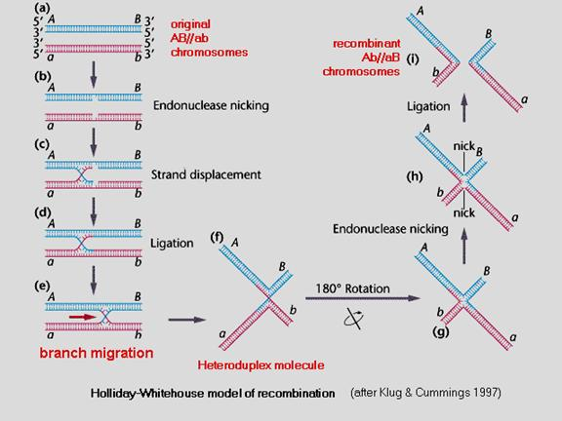

Slide 16
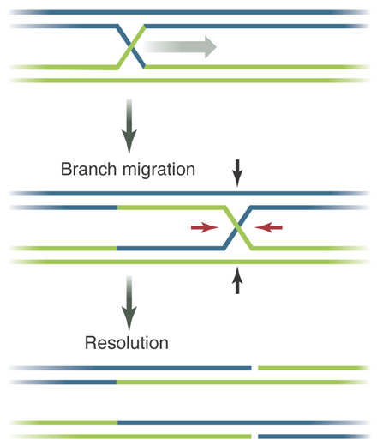
RuvAB
‚resolvaza‘
RuvC
Science 2004

Slide 17
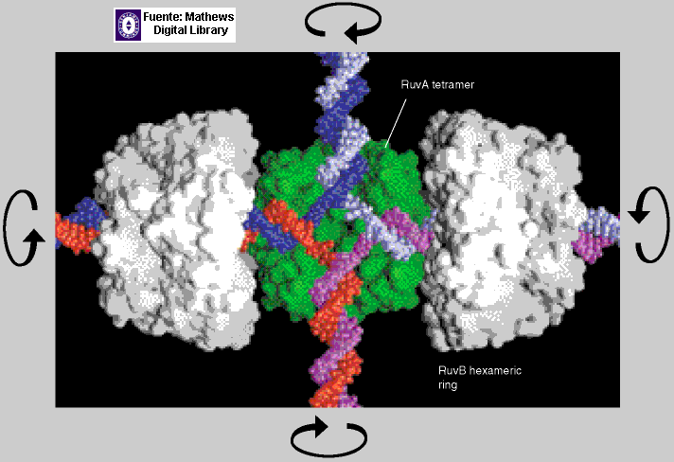
RuvA: veže RuvB na DNA
RuvB: helikaza, premika mesto prekrižanja po DNA
(RuvC: nukleaza, razcepi križišče)

Slide 18
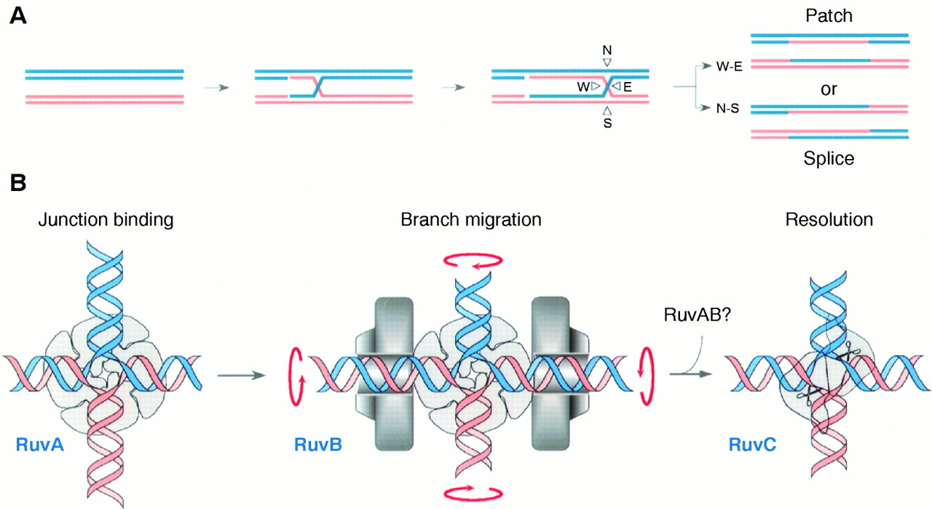
RuvABC: ‚resolvosom‘
Science, 274 (1996)

Slide 19
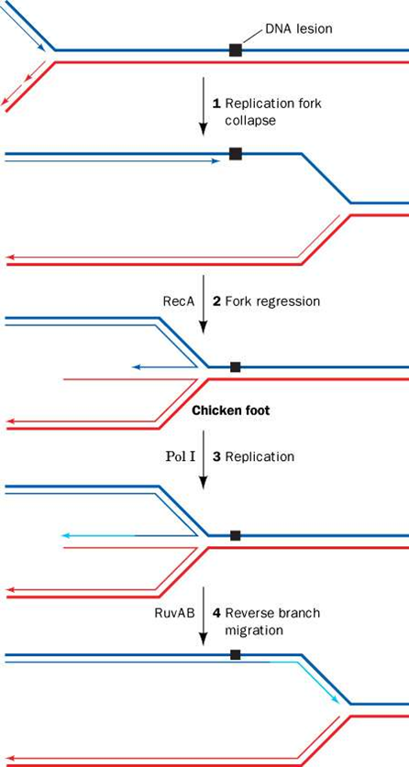
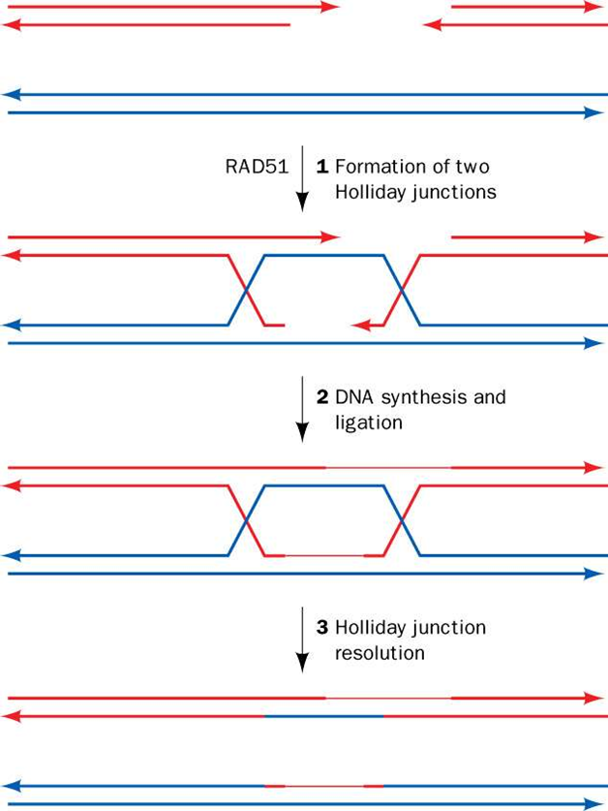
Rekombinacijsko popravljanje zastoja na replikacijskih vilicah
Popravljanje prekinitve dveh verig s povezovanjem homolognih koncev
Notes:
Okvara replikacijskih vilic: ~1x na generacijo pri bakterijah, 10x na celični cikel pri evkariontih – str. 1192.
Prekinitev obeh verig (DSB) se lahko reši z združevanjem nehomolognih koncev (NHEJ) – pride do mutacije – , ali pa s povezovanjem homolognih koncev (dve Hollidayevi križišči) – str. 1993.

Slide 20
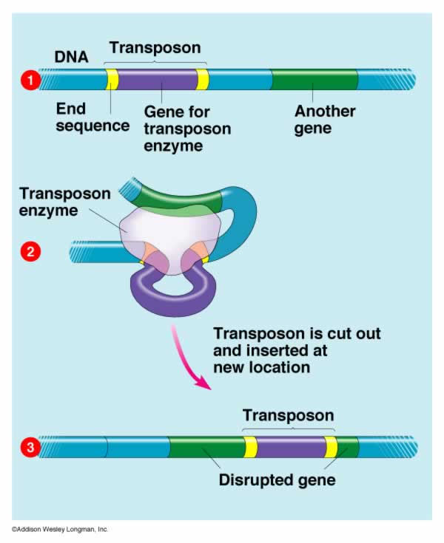

Slide 21
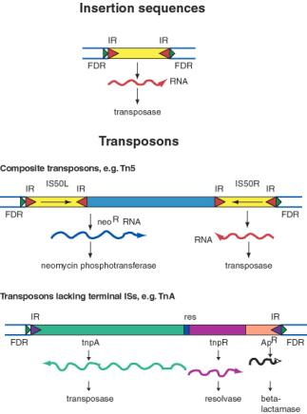
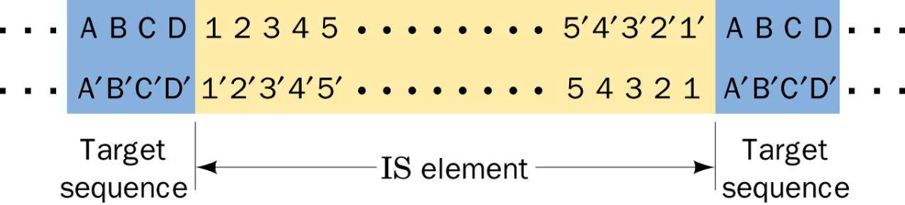
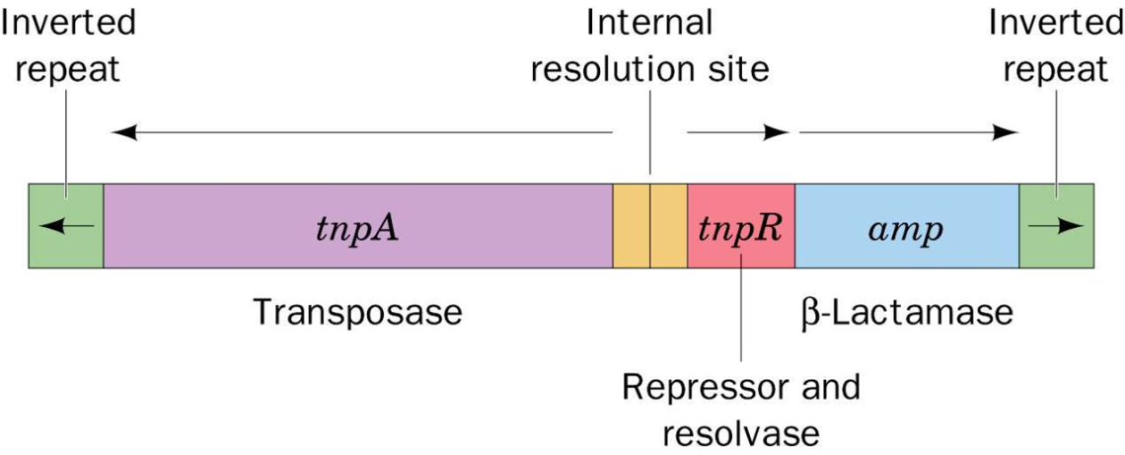
Insercijska zaporedja in transpozicijski elementi
Tn3
Notes:
General structure of insertion sequences and transposons. Flanking direct repeats (FDRs) are shown as green triangles, inverted repeats (IRs) are red or purple triangles, insertion sequences (ISs) are yellow boxes with red triangles at the end, and other genes are boxes of different colors. The boxes and triangles include both strands of duplex DNA. DNA outside the FDRs is shown as one thick blue line for each strand. Tn5 has an IS50 element on each side, in an inverted orientation. Transcripts are shown as curly lines with an arrowhead pointing in the direction of transcription. The neoR gene for Tn5 is composed partly of the leftward IS (ISL) and partly of other sequences (included in the blue box). The transposase for Tn5 is encoded in the rightward IS (ISR).
Structure of IS elements. These and other transposons have inverted terminal repeats (numerals) and are flanked by direct repeats of host DNA target sequences (letters).

Slide 22
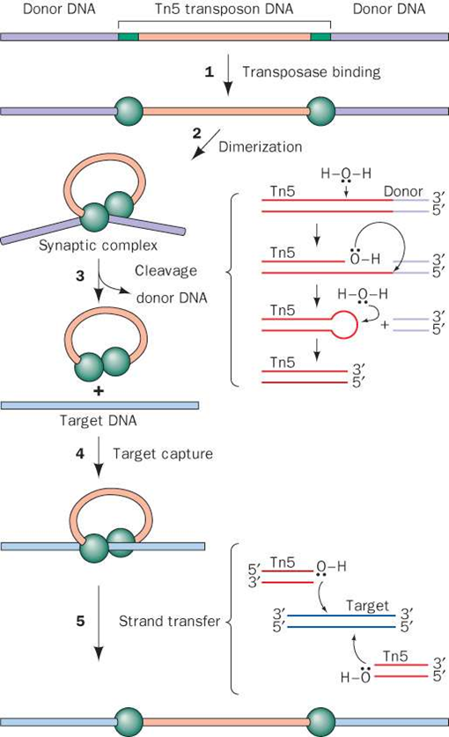
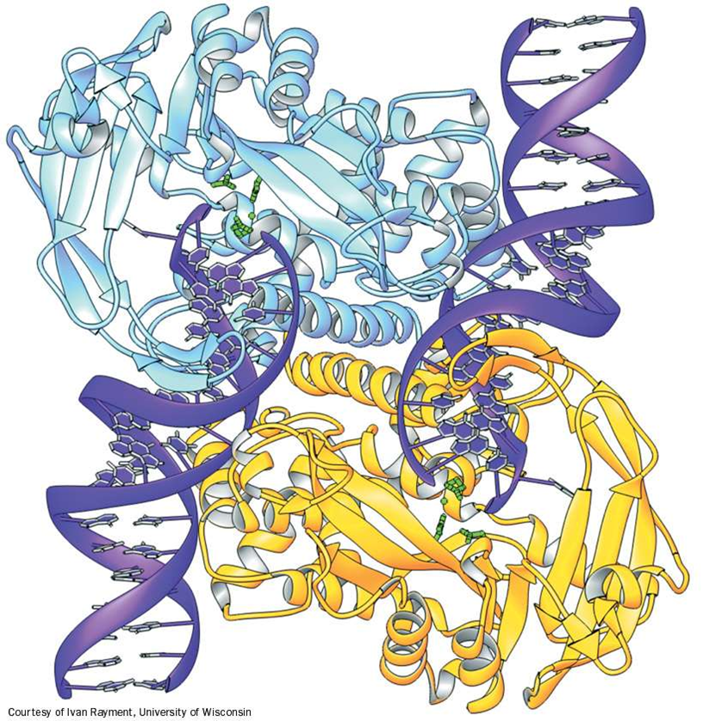
Mehanizem ‚izreži in prilepi‘, ki ga katalizira transpozaza Tn5.
Notes:
OE = zaporedje ‚outside end‘
Dimerizacija transpozaze pomeni aktivacijo encima z izbočenim transpozonskim zaporedjem: sinaptični kompleks (2). Po nukleofilnem napadu vode se izcepi transpozon kot lasnična zanka. Prenese se na tarčno mesto, kjer 3‘-OH transpozona napadeta zaporedje DNA in pride do vključitve.

Slide 23
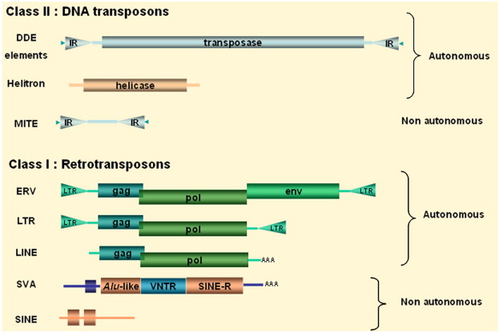
Gene 454(1–2), 2010, 1–7

Slide 24
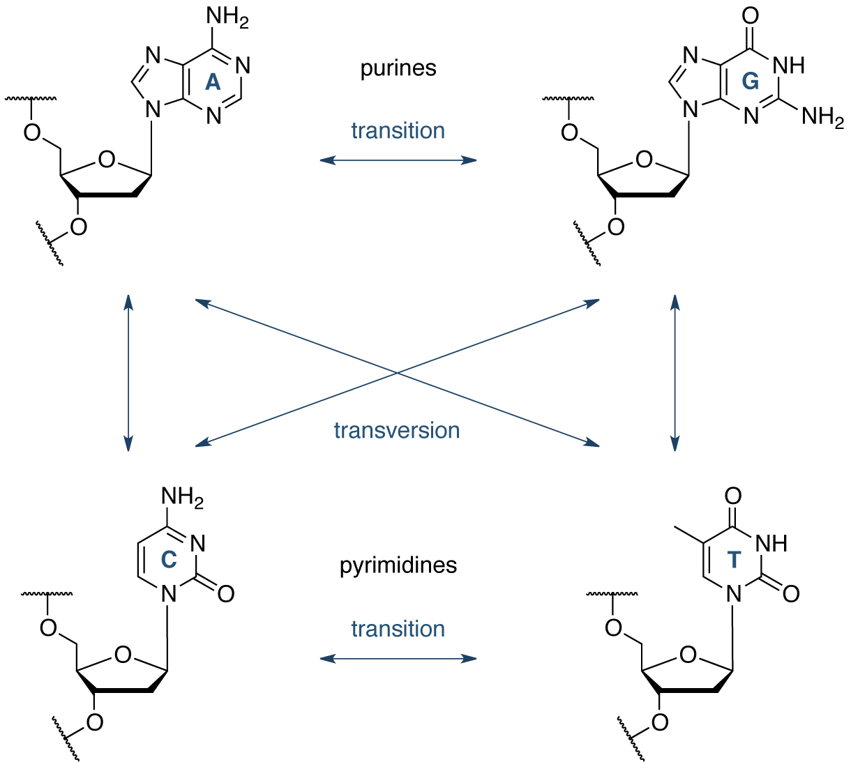
http://www.atdbio.com/content/15/Mutagenesis-and-DNA-repair
Notes:
Figure 1. Transversion mutations and transition mutations. A transition is the conversion of a purine nucleotide to another purine nucleotide (A ↔ G), or a pyrimidine nucleotide to another pyrimidine nucleotide (C ↔ T). A transversion is the conversion of a purine to a pyrimidine, or a pyrimidine to a purine.

Slide 25
Vrste mutacij
substitucije baz: tranzicije/transverzije
delecije 1 ali več baz
insercije 1 ali več baz
tranzicije: pirimidin z drugim pirimidinom, purin z drugim purinom
transverzije: pirimidin s purinom ali obratno

Slide 26
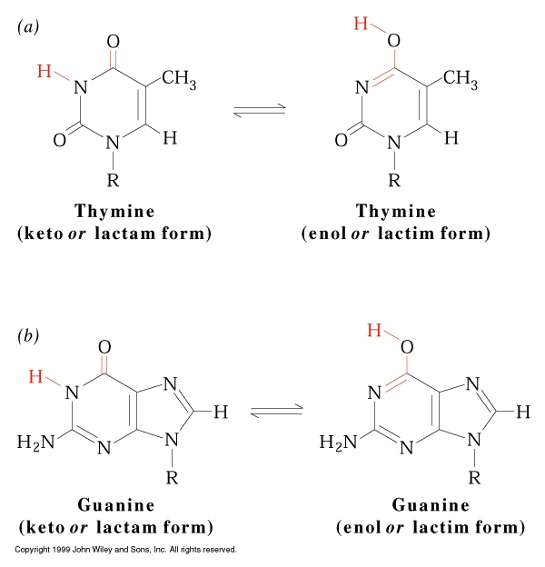
Tavtomerizacija stranskih skupin na bazah
keto (-C=O) → enol (=C-OH)
http://www.mun.ca/biochem/courses/3107/Topics/DNA_properties.html

Slide 27
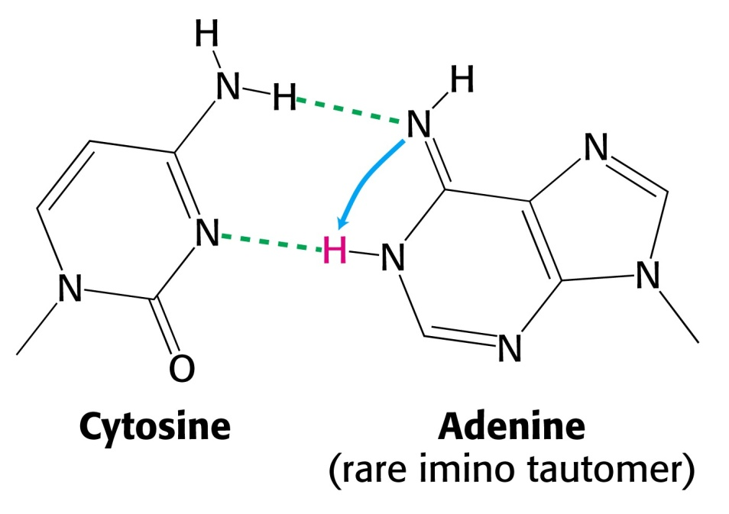
Tranzicije zaradi tavtomerizacije str. skupin na bazah:
amino (-NH₂) → imino (=NH) ⇒ A …T → A … C
Notes:
mutacije!

Slide 28
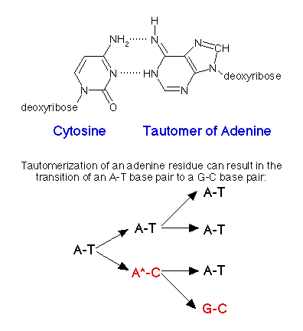

Slide 29
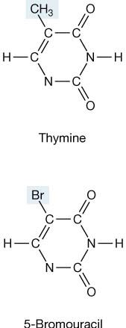
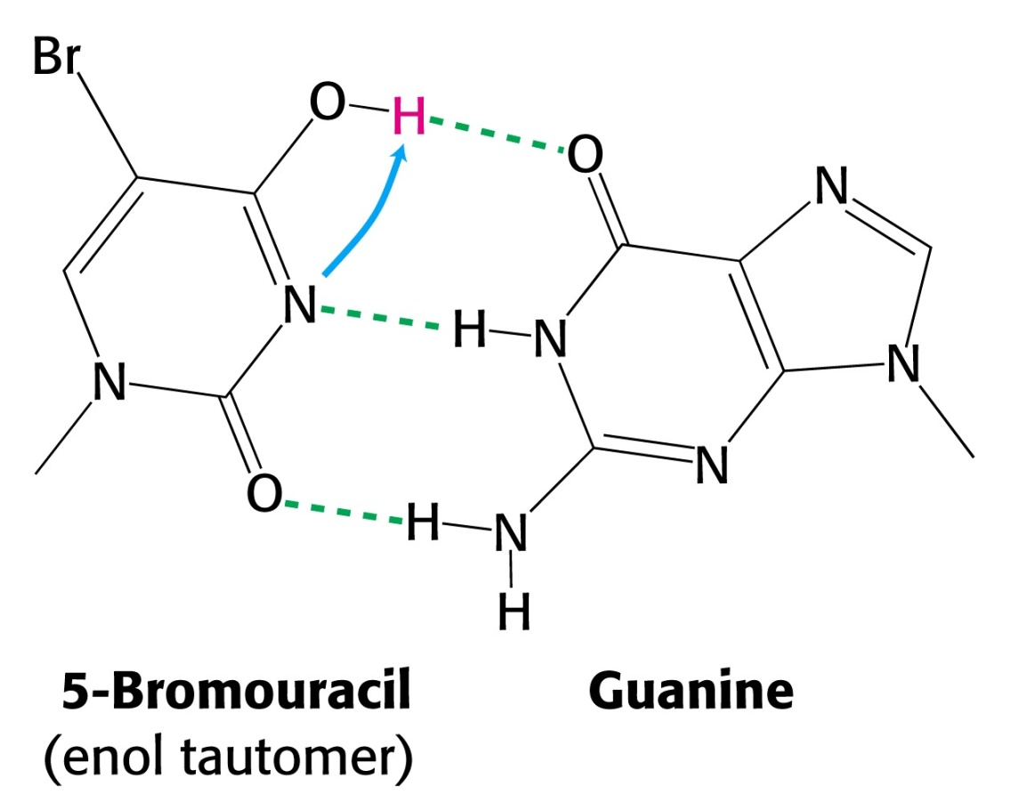
Tranzicije zaradi tavtomerizacije baznih analogov:

Slide 30
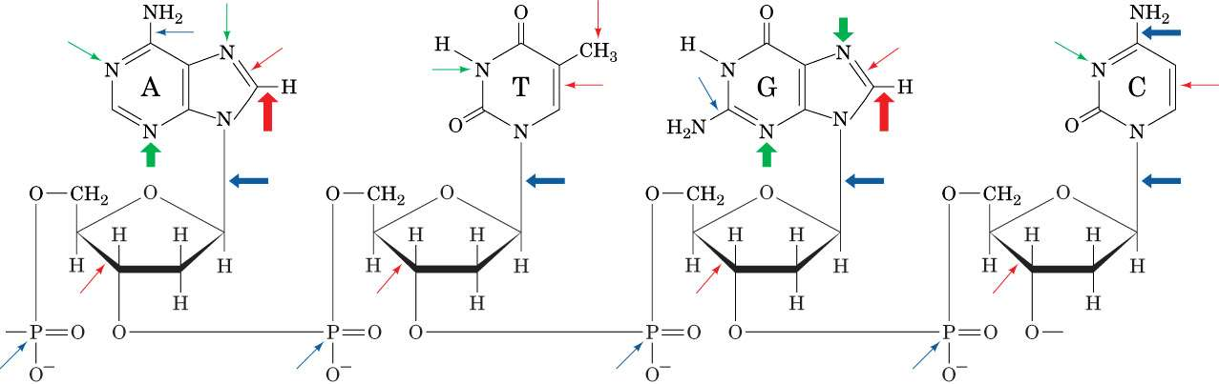
Poškodbe in mesta, občutljiva za kemične spremembe DNA in vivo. rdeče: oksidacija, modro: hidroliza, zeleno: metilacija

Slide 31
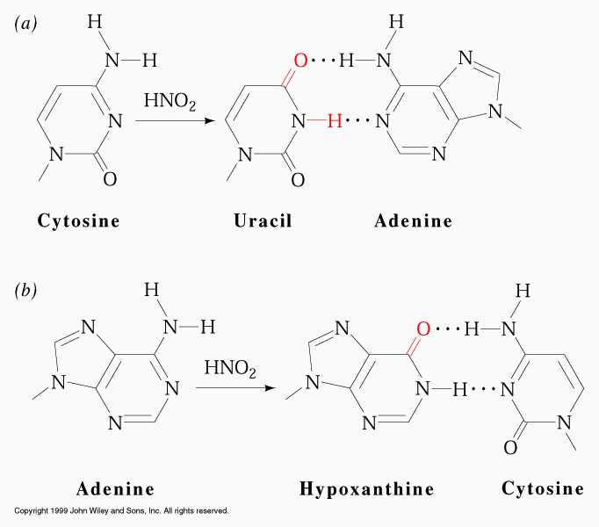
Kemični mutageni
oksidativna deaminacija C → U, A → hipoksantin, G → ksantin

Slide 32
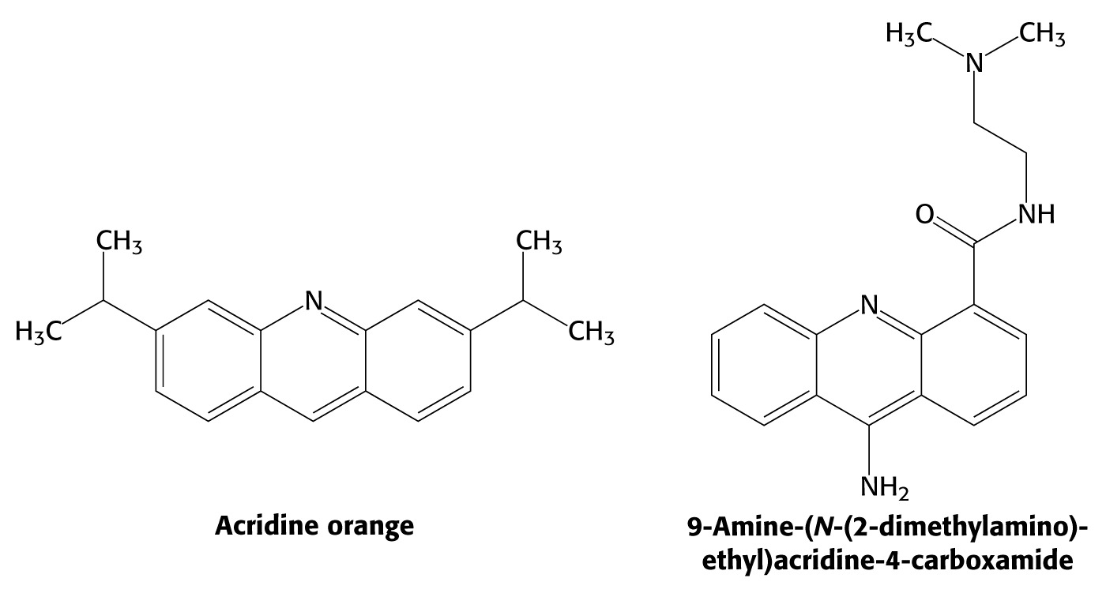
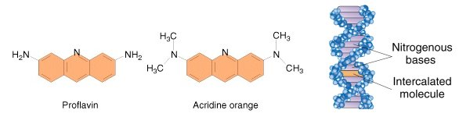
Insercije zaradi interkalacije:
ploske organske molekule se vrivajo med bazne pare
Notes:
akridini

Slide 33
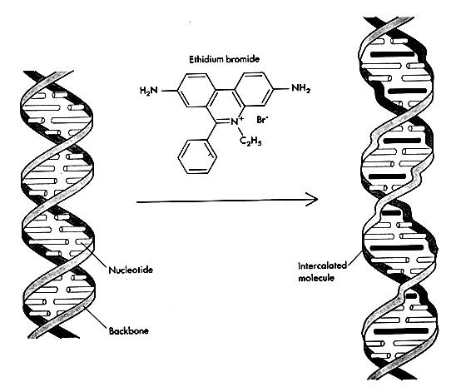

Slide 34
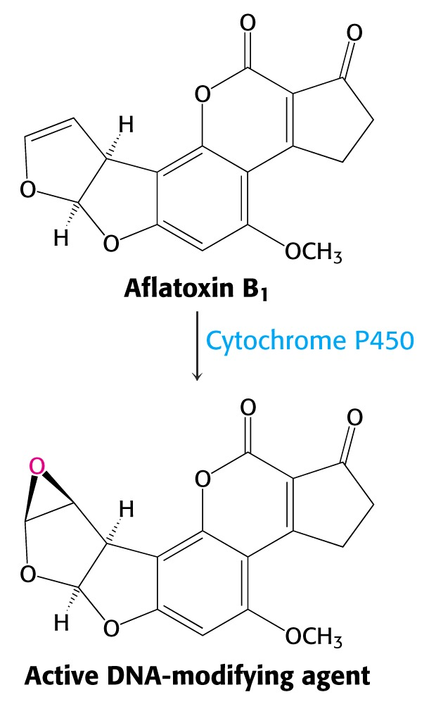
Notes:
nekatere snovi prehajajo iz nenevarne v mutageno obliko šele po delovanju encimov, ki sicer sodelujejo v detoksifikacijskih procesih: aflatoksin v epoksidno snov, ki deluje na N7 gvanozina.

Slide 35
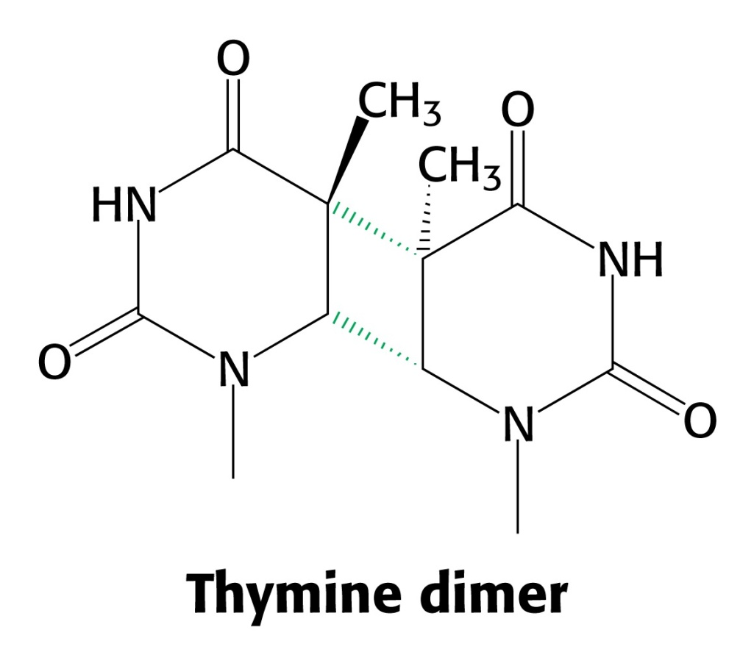
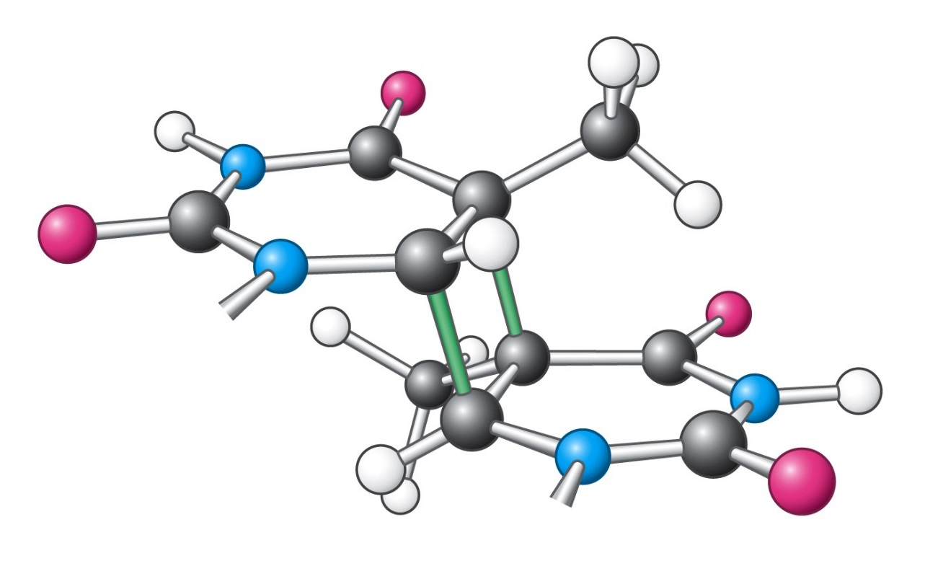
Notes:
ob izpostavitvi UV prihaja do poškodb DNA; najpogostejše so tvorbe pirimidinskih dimerov. Tudi ionizirajoče sevanje in kemikalije lahko poškodujejo DNA (modifikacija baz, delecije, prelomi verig, ...). Dimer je sterično neustrezen dimenzijam vijačnice, zato se ob njem podovjevanje in prepisovanje ustavita.

Slide 36
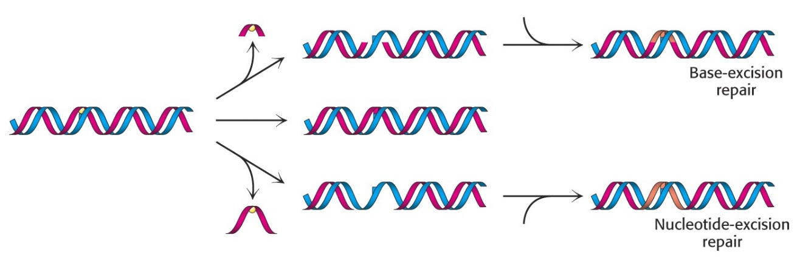
Mehanizmi popravljanja okvar na DNA:
NAPAKE NA 1 VERIGI
- direktno popravljanje (npr. T-dimerov, metiliranih G)
- popravljanje z izcepom baze (BER) – če je baza kemično modificirana
- popravljanje z izcepom nukleotida (NER) – če napaka pomeni distorzijo dvojne vijačnice
- popravljanje neujemanja (MMR) – nesparjeni bazni pari po replikaciji
NAPAKE NA 2 VERIGAH
- nehomologno povezovanje koncev (NHEJ)
- homologna rekombinacija

Slide 37
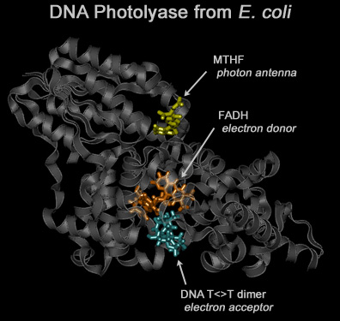
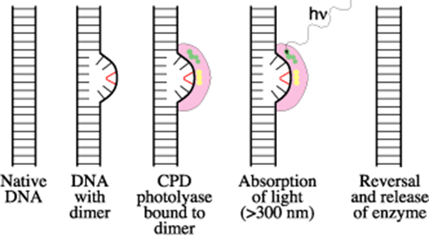
MTHF= N,N-meteniltetrahidrofolat

Slide 38
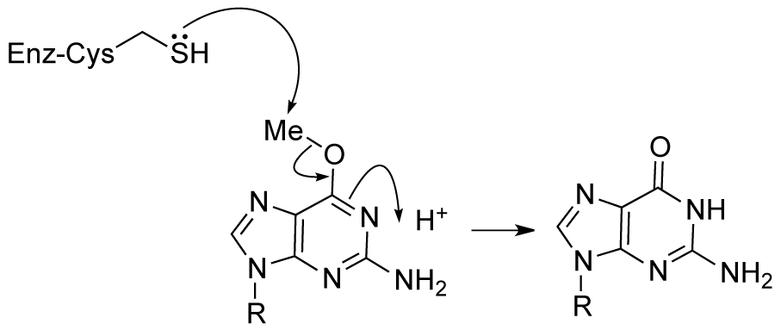
Popravljanje kemično modificiranih baz – direktno popravljanje
Odstranjevanje metilne skupine z metilgvanina s samomorilskim encimom O(6)-metilgvanin metiltransferazo (MGMT). Encim se v reakciji metilira in ob tem inaktivira.
http://www.atdbio.com/content/15/Mutagenesis-and-DNA-repair

Slide 39
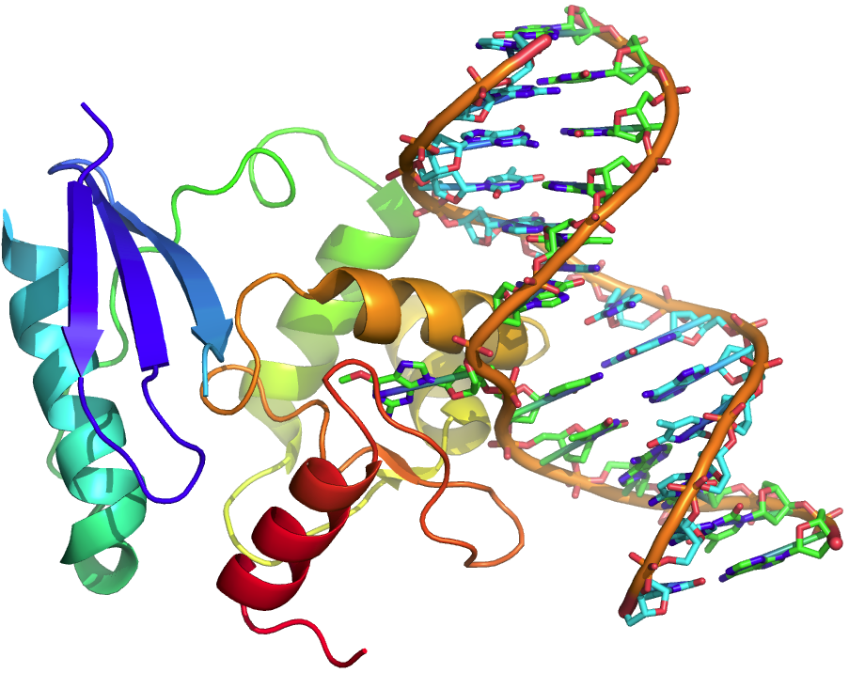
Nature 315 (6020), 604-606, 1985
Izvihane baze na mestu mutacije: ‚base flipping‘

Slide 40
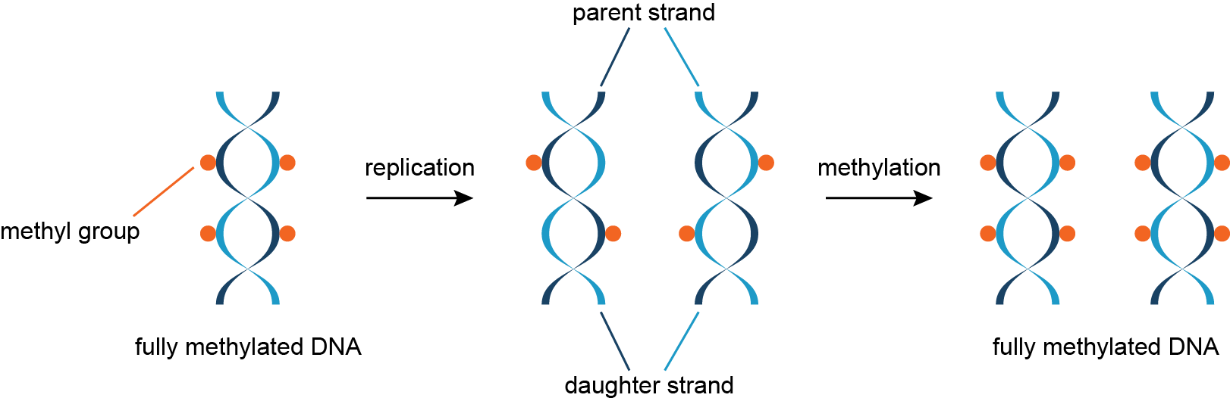
Prepoznavanje hčerinske in starševske verige
Starševska veriga je metilirana, hčerinska pa sprva še ne (E. coli).
Pregledovalni proteini morda delujejo predvsem na mestih zarez med delnimi produkti podvojevanja genoma (predvsem pri zastajajoči verigi in pri evkariontih).
Popolno metilacijo kasneje, po morebitnem popravljanju napak, katalizirajo vzdrževalne metiltransferaze.
http://www.atdbio.com/content/15/Mutagenesis-and-DNA-repair

Slide 41
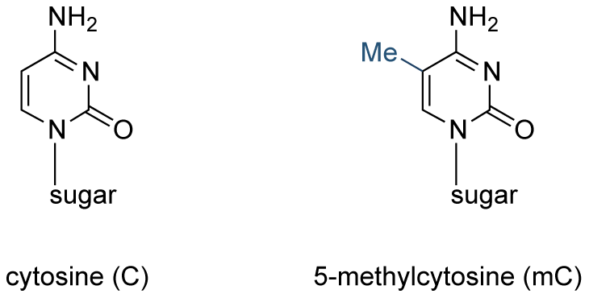
Protein UHRF1 prepozna hemimetilirana mesta na DNA in nanja usmerja DNA-metiltransferazo I.
Interakcija z DNA poteka preko domene SRA, ki so ji določili strukturo v prosti obliki in v kompleksu z DNA.
Nature 455, 818-821(9 October 2008)
Notes:
a, Ribbon representation of the SRA–DNA complex in the same orientations as in Fig. 1a: grey, SRA; orange, N-tail and finger loop; light blue, loop L3; light green, DNA; magenta, flipped-out base 5mC7.
b, Schematic representation of the protein–DNA interactions observed in the crystal structure. Hydrogen bonds between SRA and DNA are shown by red lines: dotted, main-chain contacts; solid, side-chain contacts. Van der Waals contacts between SRA and DNA are shown by blue lines. W, water molecules mediating indirect interactions.

Slide 42
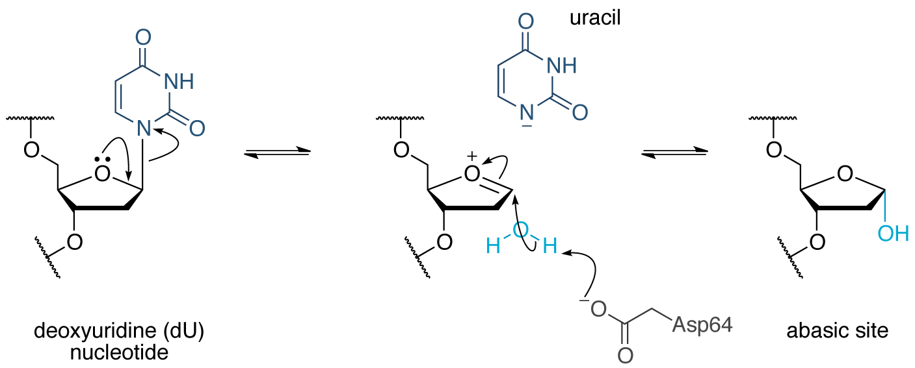
Popravljanje z izcepom baze (BER)
1. Okvarjeno bazo odstrani DNA-glikozilaza (za različne baze različne). S tem nastane abazično (AP) mesto na verigi.
http://www.atdbio.com/content/15/Mutagenesis-and-DNA-repair
Notes:
UDG N-glycosidic bond hydrolysis. Mechanism of hydrolysis of the N-glycosidic bond of a uridine nucleotide, catalyzed by uracil DNA glycosylase (UDG), which initiates base excision repair of uridine nucleotides in DNA. The oxacarbenium ion intemediate is stabilized by electrostatic interactions with the enzyme (not shown).

Slide 43
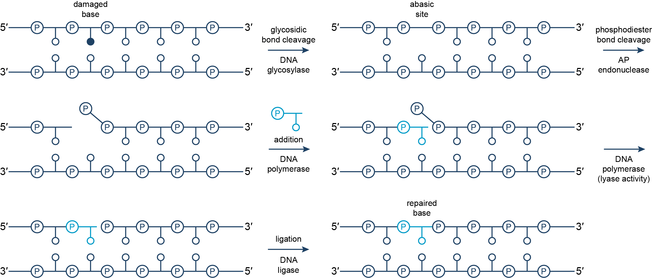
Popravljanje z izcepom baze
2. Manjkajoči del se zapolni po delovanju AP-endonukleaze, DNA-polimeraze in DNA-ligaze.
http://www.atdbio.com/content/15/Mutagenesis-and-DNA-repair
Notes:
DNA base excision repair. The damaged base is recognized and excised by a DNA glycosylase, leaving an abasic (AP) site. An AP endonuclease cleaves the phosphodiester bond at the 5′-end of the damaged base. DNA polymerases add a nucleotide monophosphate to replace the damaged base, which is then removed by the lyase activity of the polymerase. Finally, a DNA ligase closes the gap to complete DNA repair. The mechanism of base excision repair varies between organisms, and several pathways can exist for a single organism.

Slide 44
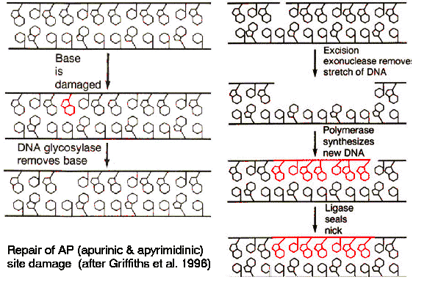
Popravljanje z odcepom baze:
alternativni mehanizem z zamenjavo več nt

Slide 45
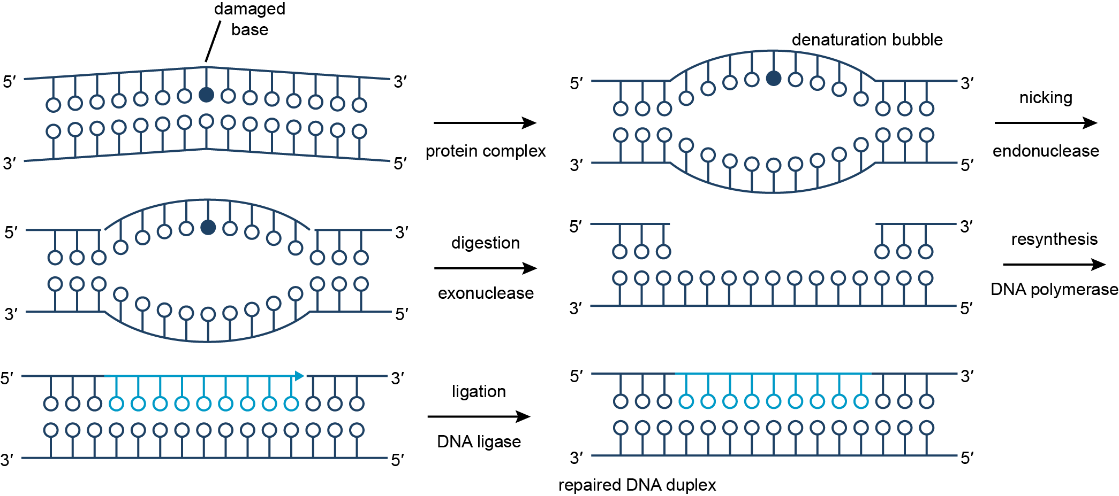
Popravljanje z izcepom nukleotida (NER)
Napake v obliki dvojne vijačnice prepoznajo proteini, nato nastane ‚denaturacijski mehurček‘, dolg ~30 bp. Pride do uvedbe dveh zarez, izcepa vmesnega segmenta in do popravljanja z DNA-polimerazo in ligazo.
http://www.atdbio.com/content/15/Mutagenesis-and-DNA-repair
Notes:
DNA nucleotide excision repair. The damaged distorted double helix containing a damaged base is recognized by a protein complex, and a denaturation bubble is formed. An endonuclease nicks the damaged strand and a short oligonucleotide is excised. Polymerases fill the gap, and finally ligases close the gap to complete the repair process.

Slide 46

Popravljanje neujemanja (MMR)
Proteini prepoznajo nepravilni bp. Na nemetilirani verigi (hčerinski) endonukleaza zareže na obeh straneh mutacije, eksonukleaza odstrani vmesni del. DNA-polimeraza in ligaza zapolnita vrzel.
http://www.atdbio.com/content/15/Mutagenesis-and-DNA-repair
Notes:
DNA mismatch repair. An endonuclease nicks the unmethylated daughter strand at two positions either site of the mismatch. An exonuclease digests the excised fragment, the resulting gap is filled in by a DNA polymerase (using the parent strand as a template) and a ligase, completing the repair process.

Slide 47


Popravljanje neujemanja pri E. coli
Notes:
popravljanje neujemanja DNA pri E. coli: sodelovanje 3 proteinov Mut: MutS prepozna G-T, MutH cepi skelet v bližini; UvrD (helikaza) skupaj z eksonukleazo loči & razgradi okvarjeno verigo. Kompleks MutSL se pomika po DNA ob hidrolizi ATP (MutS). MutH se veže, ko dimer MutSL doseže hemimetilirano mesto; hčerinska veriga se namreč na GATC metilira šele naknadno.

Slide 48

Prepoznavanje mesta mutacije
Dimer MutS (MutS2) prepozna napačno sparjeno bazo na hčerinski verigi in se veže nanjo.
MutH se veže na hemimetilirana mesta, aktivira pa se po stiku z dimerom MutL (MutL2), ki se veže na MutS2-DNA.
Na DNA naredi zanko in skenira, kje je najbližje metilacijsko mesto d(GATC), kar je lahko tudi ~1 kb stran.
Kompleksu sledi eksonukleaza in razgradi DNA.
Izreže se regija, ki je daljša kot samo do mesta mutacije.
DNA-polimeraza sintetizira novo komplementarno verigo. Končno vrzel zapolni DNA-ligaza. Metilaza Dam metilira hčerinsko verigo.
http://www.sci.sdsu.edu/%7Esmaloy/MicrobialGenetics/topics/mutations/mismatch-repair.html

Slide 49

Uravnavanje SOS-odgovora pri E. coli
Notes:
Protein LexA blokira gene za več (43) proteinov, ki sodelujejo pri popravljanju DNA. Veže se na operator dolžine 20 bp (SOS box). RecA v pogojih, ki bi lahko privedli do mutacij, inducira avtokatalitsko cepitev LexA, zato se začne sinteza mRNA za popravljalne proteine.

Slide 50

Delovanje LexA
BMC Bioinformatics 2008 9:23

Slide 51

Princip SOS - popravljanja
DNA-polIII se ustavi na mestu mutacije (dimer TC). Na mestih za mutacijo so vezani SSB in RecA v obliki filamenta. Ker popusti blokada LexA, se sintetizira UmuD. Ta se procesira do aktivne oblike UmuD‘, ki pritegne UmuC. Ta kompleks (UmuD‘2C) je DNA-pol V brez eksonukleazne aktivnosti in nadaljuje sintezo preko mutiranega mesta.
Za organizem je mutacija bolj sprejemljiva kot prekinitev sinteze.
Notes:
Deluje lahko tudi DNA-pol IV (DinB). Obe polimerazi sta nagnjeni k uvajanju mutacij (error-prone); njuna natančnost je 1000x nižja kot pri polI ali polIII.

Slide 52


http://www.gladstone.ucsf.edu/gladstone/files/publicaffairs/mono15fig3.gif
http://www.web-books.com/MoBio/Free/Ch7F3.htm

Slide 53

Notes:
http://ntp.niehs.nih.gov/?objectid=16D6D969-A9F4-0B6F-2B81F2FB53BBFD3E

