Slide 1
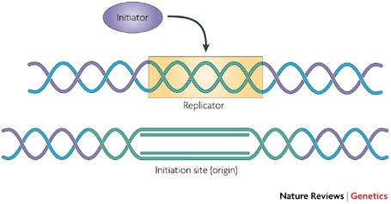
Replikonski model
Nature Reviews Genetics 8, 588-600 (2007)
replikator … genetski element, na katerem pride do iniciacije podvojevanja DNA
replikon …. tisti del kromatina, ki se podvoji pod kontrolo določenega replikatorja
iniciator …. proteini (kompleks), ki se vežejo na replikator in sprožijo podvojevanje
iniciacijsko mesto (ori) …. mesto na kromatinu, kjer se pojavijo replikacijske vilice (lahko sovpadajo
z replikatorjem, niso pa vsi replikatorji aktivni v vsakem celičnem ciklu)
Notes:
The replicon model proposes that cis-acting elements, termed replicators, genetically determine the location of replication initiation events. Replicators interact with trans-acting regulatory factors, called initiators. This interaction starts DNA replication in response to signals from the cell-cycle machinery.

Slide 2
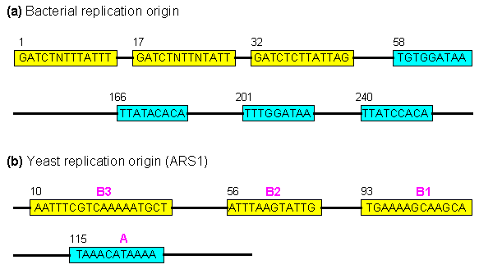
http://www.web-books.com/MoBio/Free/Ch7A.htm
Notes:
Sequences of bacterial and yeast replication origins. (a) The bacterial replication origin contains three homologous 13-mers and four homologous 9-mers. (b) The yeast replication origin is called autonomously replicating sequence (ARS). The "A" region is absolutely necessary, while B1, B2, and B3 can increase the replication efficiency.

Slide 3
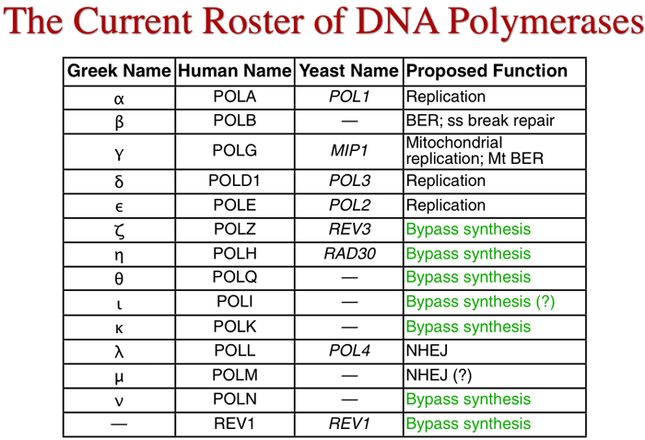
Notes:
bypass: na mestih poškodovane DNA

Slide 4
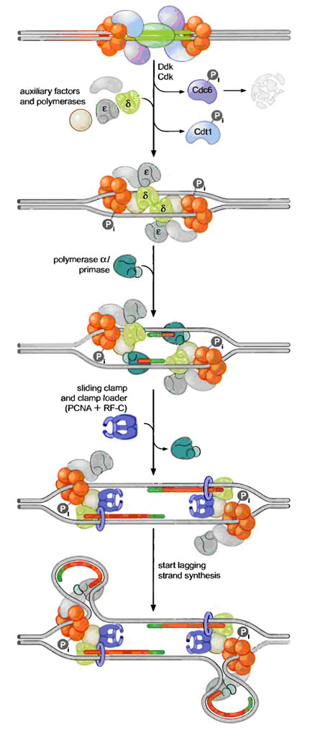
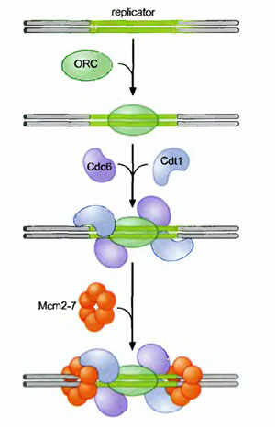
prediniciacija iniciacija →
ORC: origin recognition complex
Cdc, Cdt: helicase loading proteins
Mcm2-7: helicase
Notes:
http://biosiva.50webs.org/rep3.htm
During pre-initiation stage, replicator selection occurs. Replicator selection is the process of identifying the sequences that will direct the initiation of replication and occur in G1 phase. and occurs in Gl (prior to S phase). This process leads to the assembly of a multiprotein complex at each replicator in the genome. Origin activation only occurs after cells enter S phase and triggers the Replicator - associated protein complex to initiate DNA unwinding and DNA polymerase recruitment. Replicator selection is mediated by the formation of pre-replicative complexes (pre-RCs). The first step in the formation of the pre-RC is the recognition of the replicator by the eukaryotic initiator, ORC (Origin recognition Complex). Once ORC is bound, it recruits two helicase loading proteins (Cdc6 and Cdtl). Together, ORC and the loading proteins recruit a protein that is thought to be the eukaryotic replication fork helicase (the Mem 2-7 complex). Formation of the pre-RC does not lead to the immediate unwinding of origin DNA or the recruitment of DNA polymerases. Instead the pre-RCs that are formed during Gl are only activated to initiate replication after cells pass from the Gl to the S phase of the cell cycle.
Pre-RCs are activated to initiate replication by two protein kinases namely Cdk (Cyclin Dependant Kinase) and Ddk (Ddt4 Dependant Kinase). Kinases are proteins that covalently attach phosphate groups to target proteins. Each of these kinases is inactive in Gl and is activated only when cells enter S phase. Once activated, these kinases target the pre-RC and other replication proteins. Phosphorylation of these pro-proteins results in the assembly of additional replication proteins at the origin and the initiation of replication.
These new proteins include the three eukaryotic DNA polymerases and a number of other proteins required for their recruitment. Interestingly, the polymerases assemble at the origin in a particular order. DNA Pol d and e associate first, followed by DNA Pol a/primase. This order ensures that all three DNA polymerases are present at the origin prior to the synthesis of the first RNA primer (by DNA Pol a/primase). Once present at the origin, DNA Pol a/primase synthesizes an RNA primer and briefly extends it. Thus initiation of replication started.

Slide 5
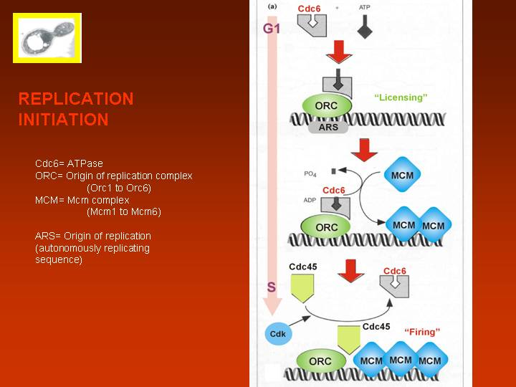
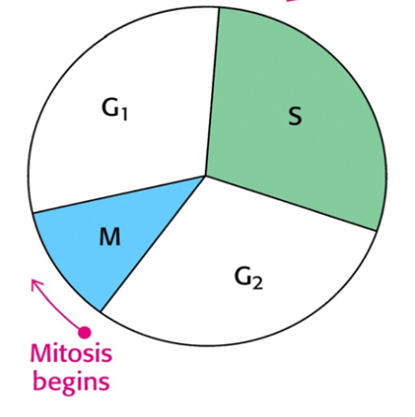
http://biochemie.web.med.uni-muenchen.de/Yeast_Biology/10_Cellcycle.htm
Notes:
Iniciacija podvojevanja DNA pri kvasovkah.
MCM = ‚mini chromosome maintenance‘ protein

Slide 6
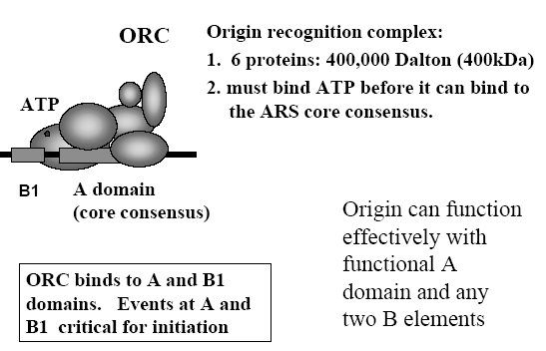

Slide 7
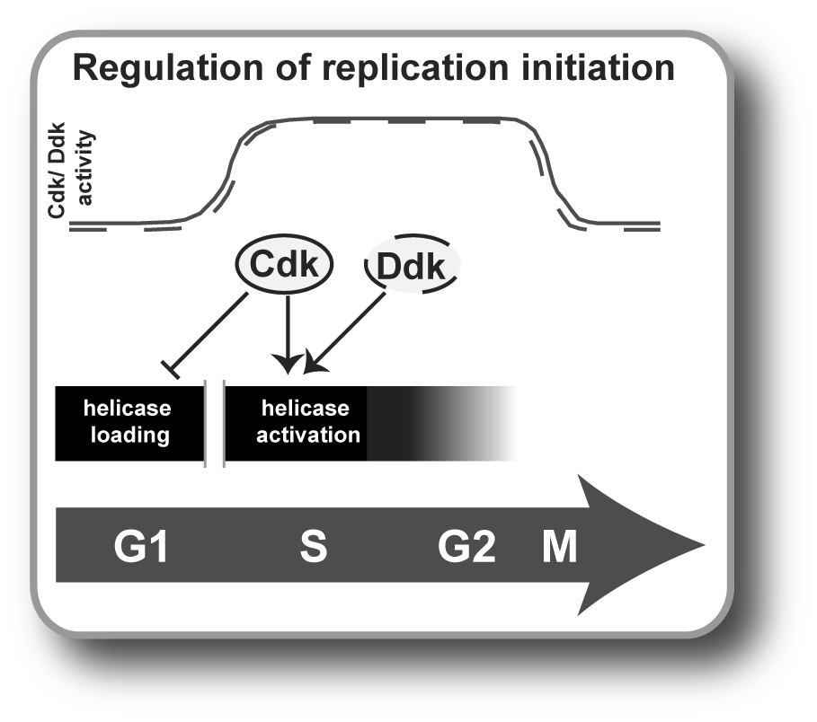
http://www.biochem.mpg.de/en/rg/pfander/Research/index.html
Notes:
ddk = kinaza, ki fosforilira MCM

Slide 8
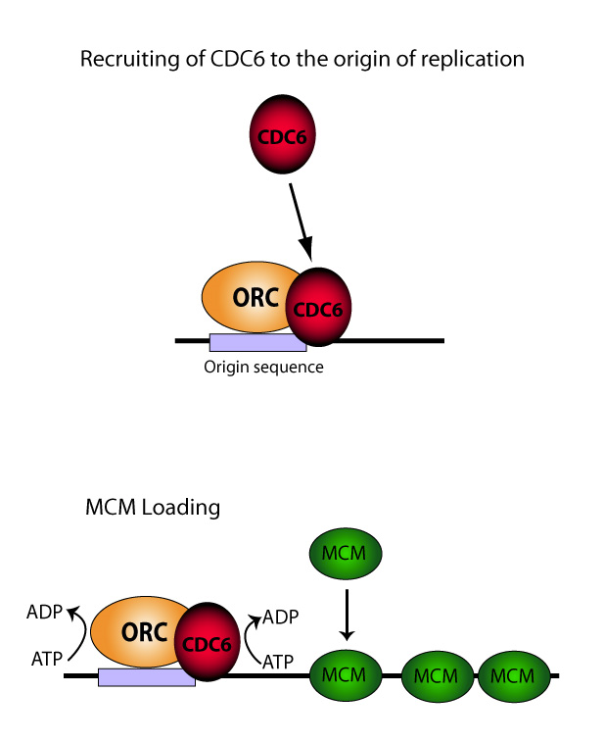
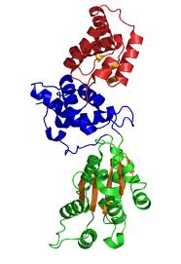

Slide 9

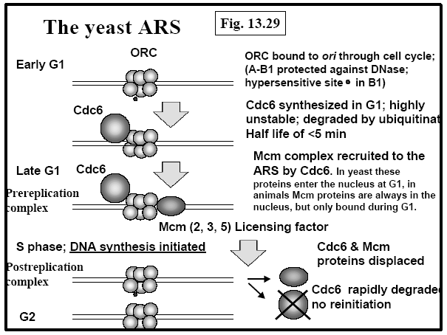
http://nersp.nerdc.ufl.edu/~arabian/mcb3020s/lecture3.pdf
Notes:
MCM se organizira v heksamer in deluje kot helikaza

Slide 10
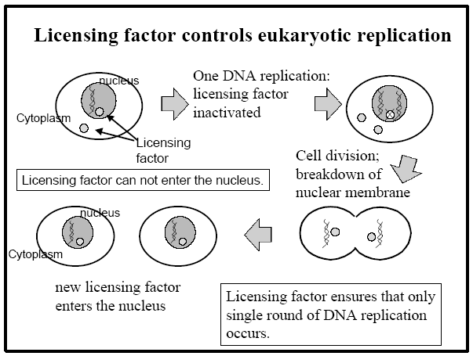

Slide 11
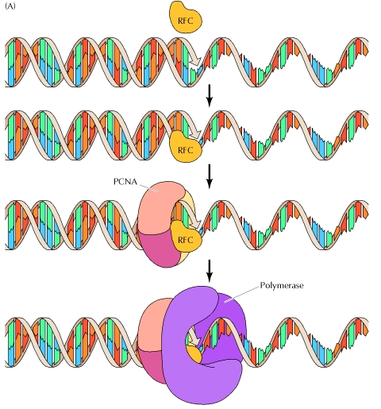
RFC: podajalec drsne vponke
(clamp-loading protein)
PCNA: drsna vponka
(sliding-clamp protein)
Cooper 2
Notes:
(A) The clamp-loading protein (RFC in mammalian cells) binds DNA at the junction between primer and template. The sliding-clamp protein (PCNA in mammalian cells) binds adjacent to the RFC, and DNA polymerase then binds to PCNA. (B) Model of PCNA bound to DNA. (B, from T. S. Krishna, X. P. Kong, S. Gary, P. M. Burgers and J. Kuriyan, 1994. Cell 79: 1233.)

Slide 12
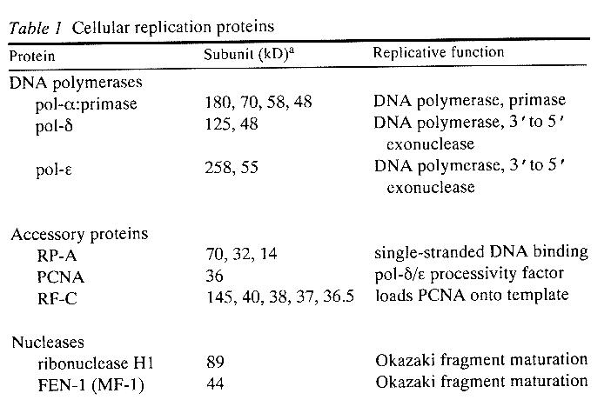

Slide 13
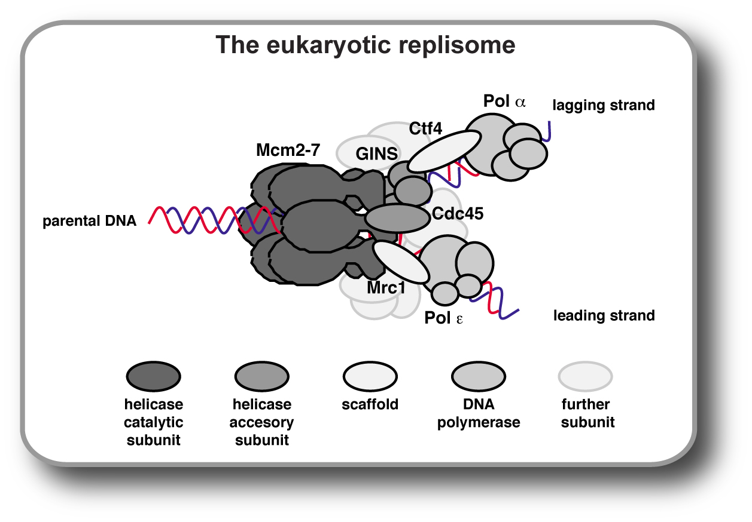
http://www.biochem.mpg.de/en/rg/pfander/Research/index.html

Slide 14
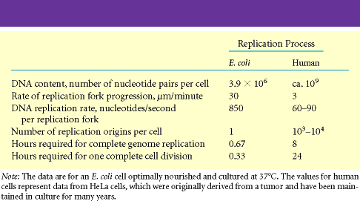
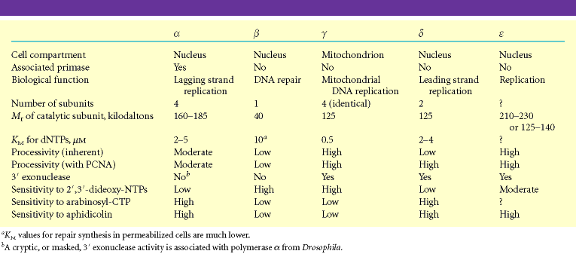

Slide 15
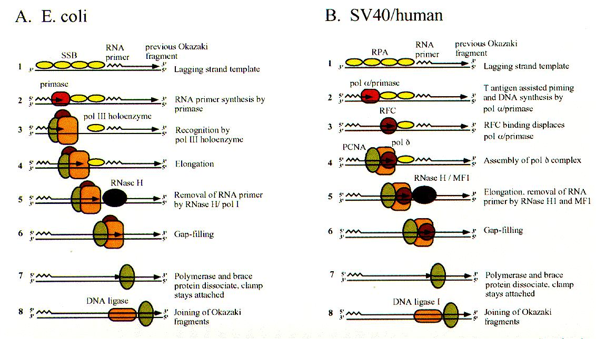
http://cmgm.stanford.edu/biochem201

Slide 16
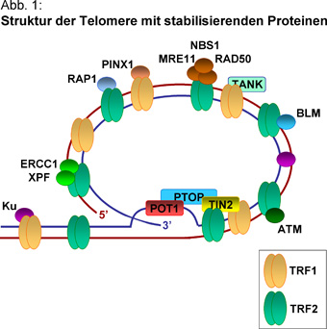
http://ftp.uke.uni-hamburg.de/kliniken/medizinische-klinik-1/index_43074.php

Slide 17
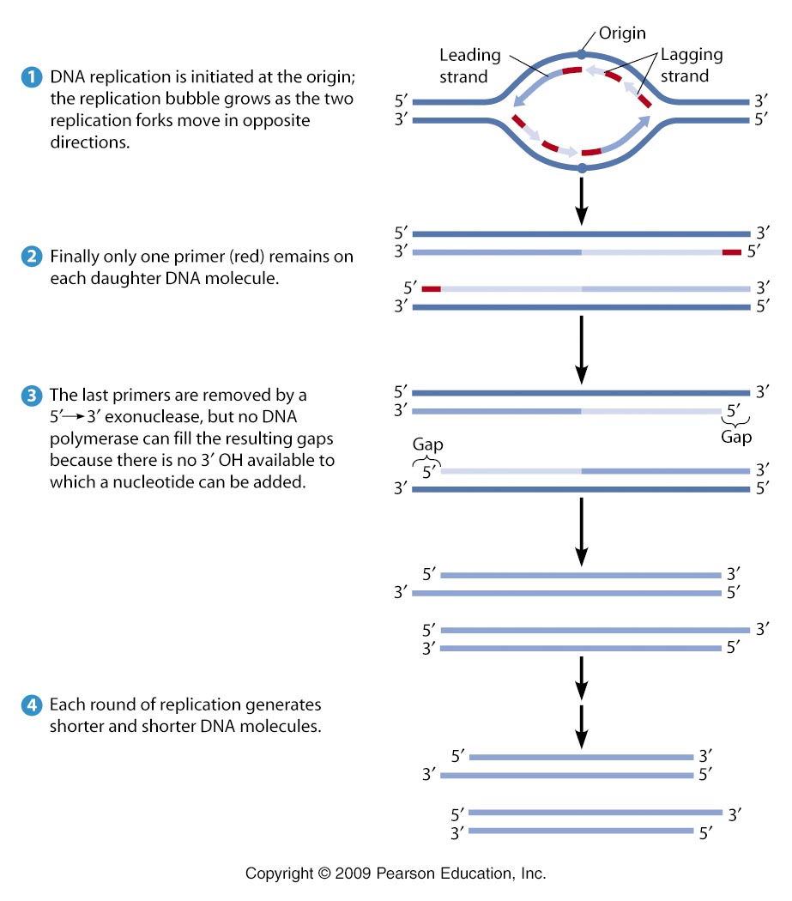

Slide 18
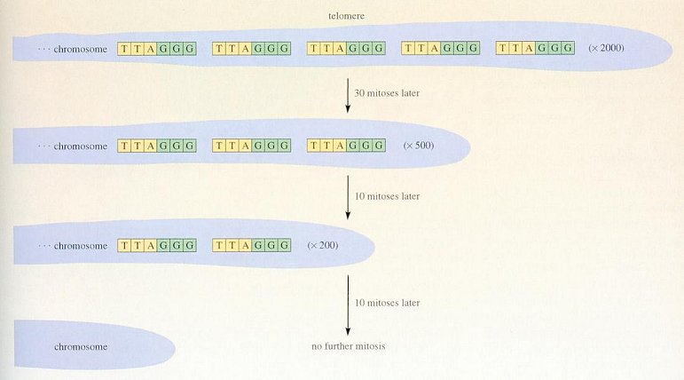
Hayflickov fenomen

Slide 19
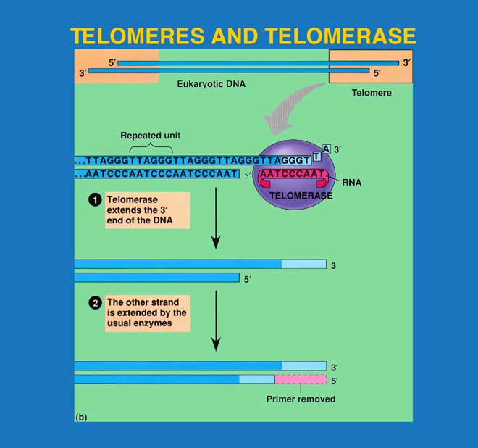

Slide 20
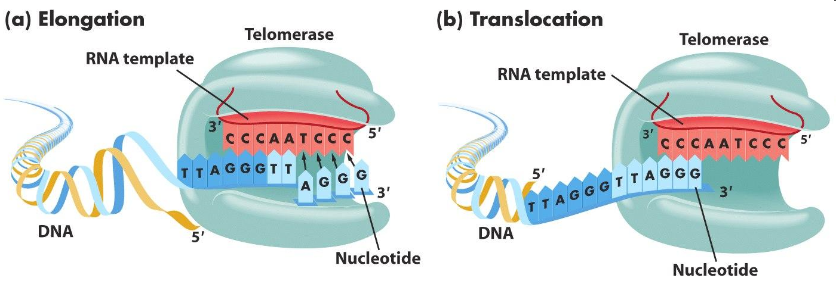
http://barleyworld.org/css430_09/lecture%207-09/figure-07-25.JPG

Slide 21
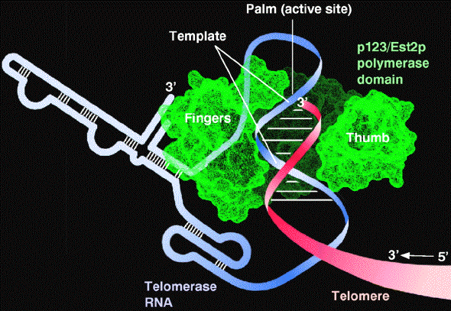
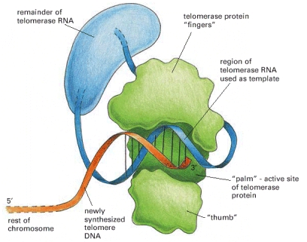
Alberts 4
http://cechlab.colorado.edu/telomodel.html
Notes:
The telomerase is a protein–RNA complex that carries an RNA template for synthesizing a repeating, G-rich telomere DNA sequence. Only the part of the telomerase protein homologous to reverse transcriptase is shown here (green). A reverse transcriptase is a special form of polymerase enzyme that uses an RNA template to make a DNA strand; telomerase is unique in carrying its own RNA template with it at all times. (Modified from J. Lingner and T.R. Cech, Curr. Opin. Genet. Dev. 8:226–232, 1998.)

