Slide 1
Evkarionti in regulacija izražanja genov
večji genom, več kromosomov
razpršenost zapisov za encime iste poti
različni tipi celic
celični razdelki
transkripcija in translacija nista povezani

Slide 2
Shematski prikaz promotorja gena za inzulin:
Tipični promotor za RNA-polimerazo II sestavljajo osrednja, bližnja in oddaljena regija
http://genocon.org/assignment-2012/assignment-a/basic-science-a-eukaryotic-promoter/

Slide 3
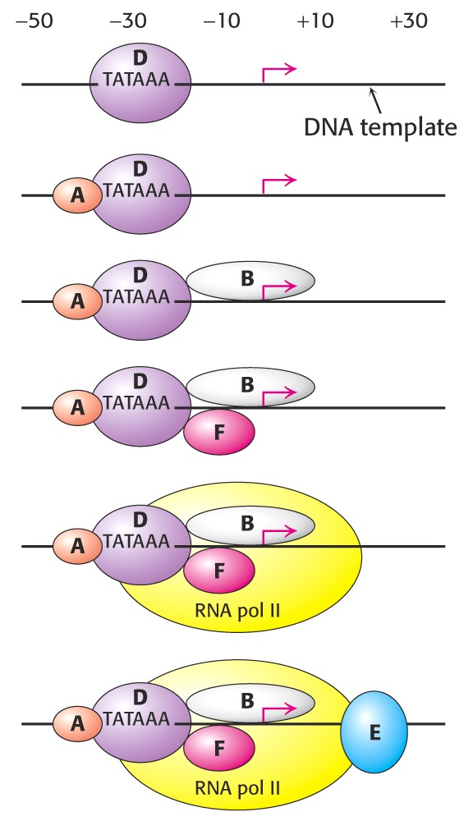
Osrednji promotor predstavljajo vezavna mesta za splošne transkripcijske faktorje

Slide 4
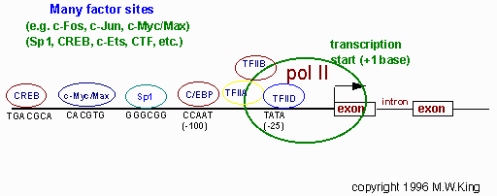
Bližnji promotor predstavljajo vezavna mesta za regulatorne transkripcijske faktorje

Slide 5
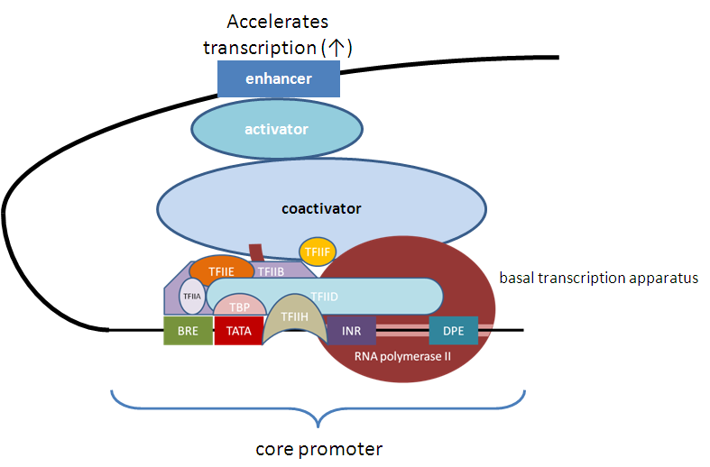
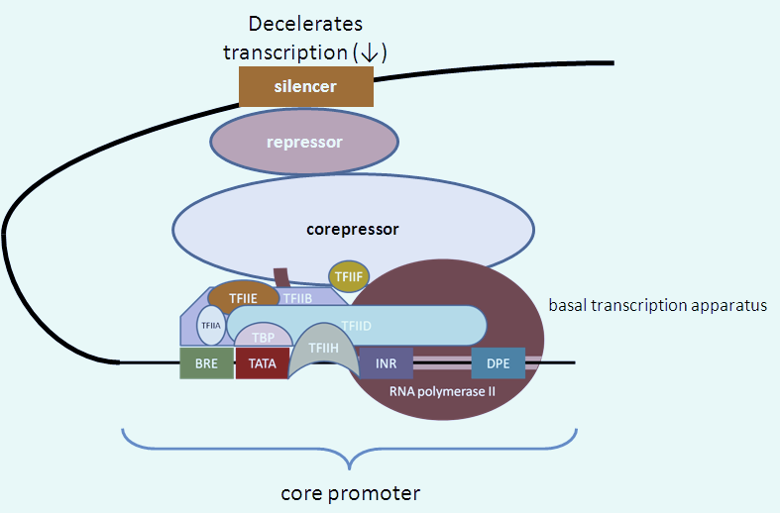
Na oddaljene regije – ojačevalna in utiševalna zaporedja – se vežejo aktivatorji ali represorji.
Interakcija z osnovnim transkripcijskim aparatom poteka preko koaktivatorjev oz. korepresorjev.
http://genocon.org/assignment-2012/assignment-a/basic-science-a-eukaryotic-promoter/
Notes:
Človeške celice imajo po ~50.000 funkcionalnih ojačevalnih zaporedij. Zaradi različnosti celičnih tipov je skupno število ojačevalnih zaporedij med 10E5 in 10E6.

Slide 6
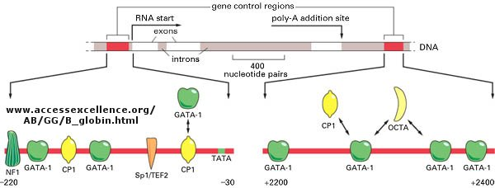
Uravnavanje izražanja gena za globin
GATA-1: eritroidni transkr. faktor se veže na škatlo GATA
Sp1: specifičnostni protein 1 se veže na škatlo GC
NF1: jedrni faktor 1 se veže na CCAAT
CP1: centromer-vezavni protein 1 se veže na CCAAT
Notes:
GATA-1 is a member of the GATA transcription factor family and is involved in cell growth and cancer. This protein plays a role in erythroid development by regulating the switch of fetal hemoglobin to adult hemoglobin. Mutations in this gene have been associated with X-linked dyserythropoietic anemia and thrombocytopenia.

Slide 7
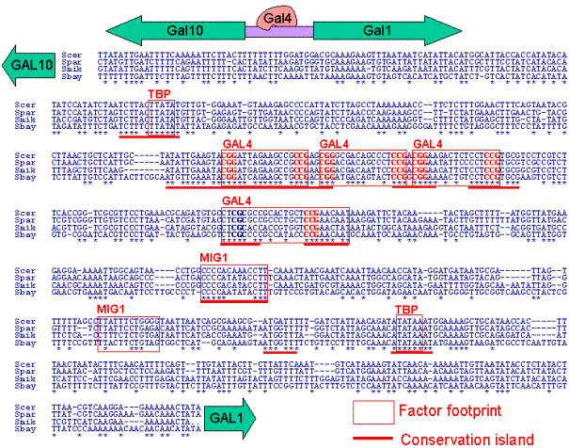
http://web.mit.edu/manoli/www/thesis/Chapter3.html
Nukleotidna zaporedja intergenske regije gal10 – gal1 z vezavnimi mesti za regulator Gal4.
Zgornja aktivatorska zaporedja pri kvasovkah označujemo z UAS.

Slide 8
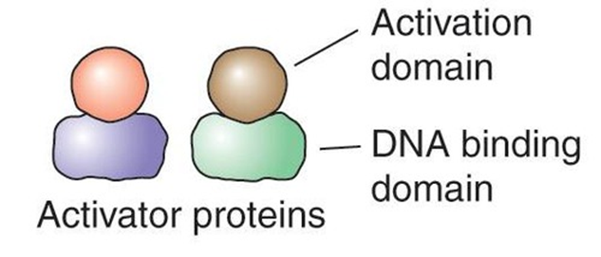
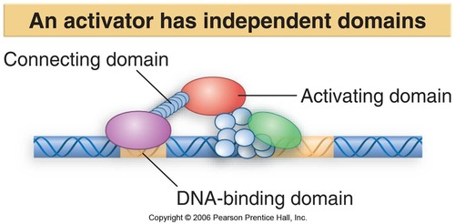
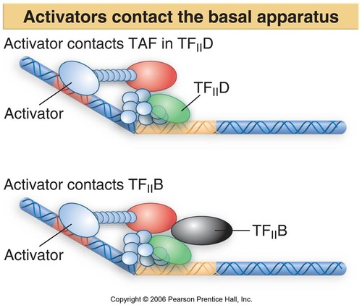

Slide 9
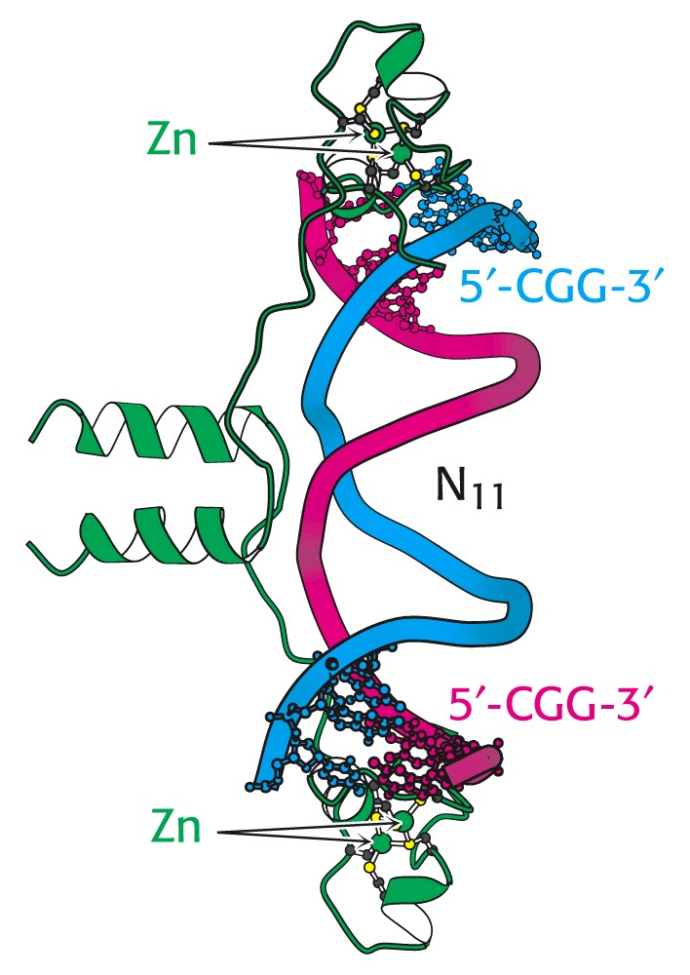
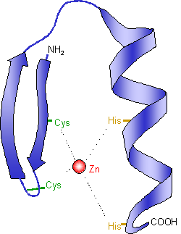
GAL4 („transkripcijski faktor“ pri kvasovkah): veže se na CGG N₁₁ CCG
Notes:
transkripcijski aktivatorji imajo domeno za vezavo na DNA in domeno, ki sodeluje pri tvorbi transkr. kompleksa na TATA

Slide 10
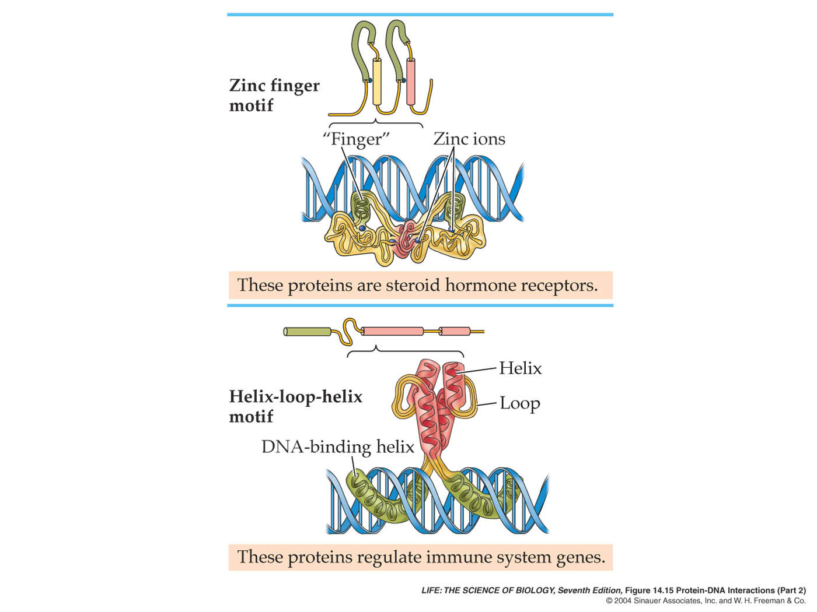

Slide 11
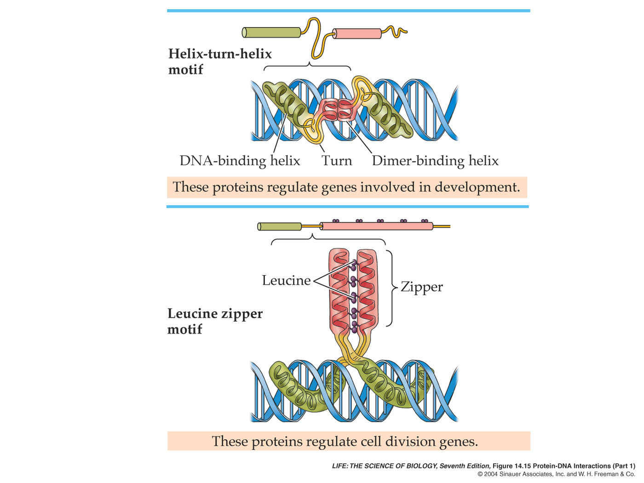

Slide 12
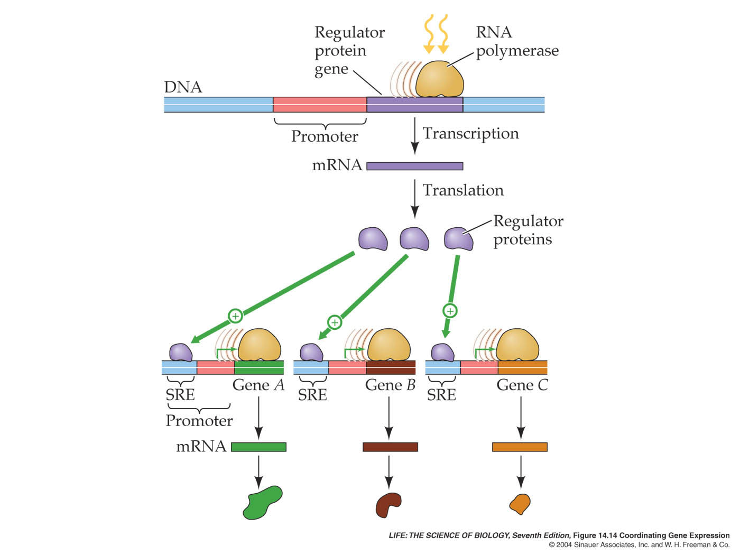
Notes:
How do eukaryotic cells coordinate the regulation of several genes whose transcription must be turned on at the same time?

Slide 13
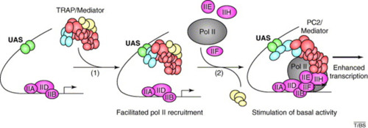

Slide 14
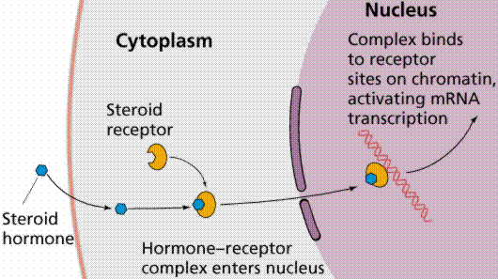
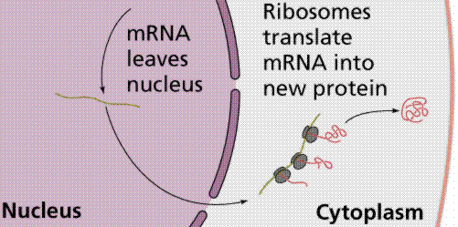
Life 4

Slide 15
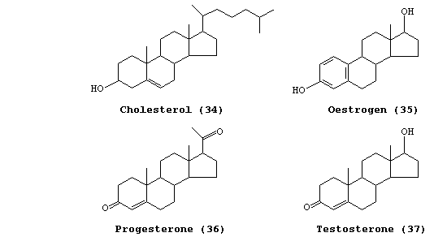
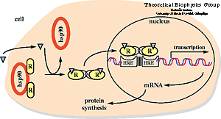
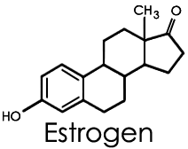
steroidni hormoni

Slide 16
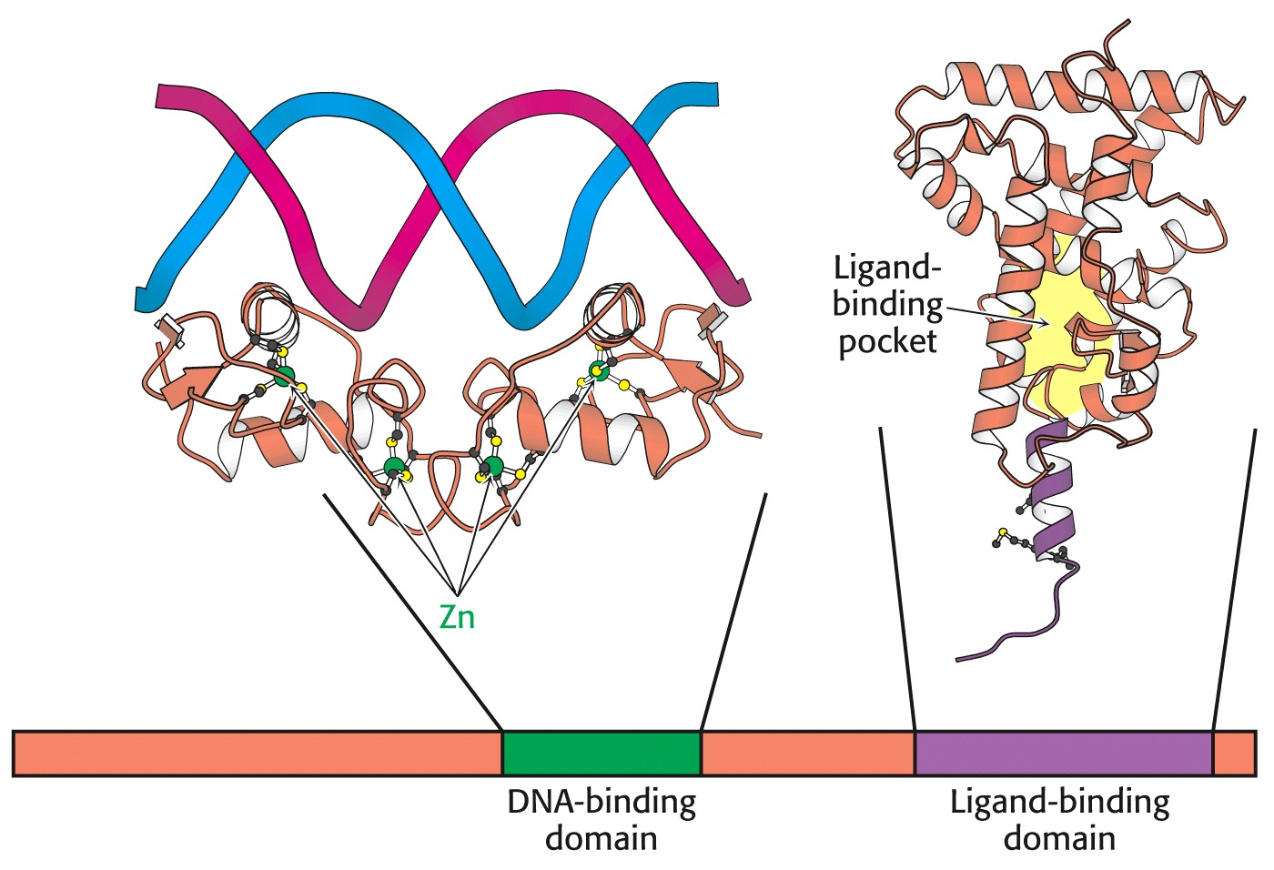
Notes:
jedrni receptor za steroidne hormone (proteinski nivo): 66 AA se veže na DNA, 240 AA veže hormon

Slide 17
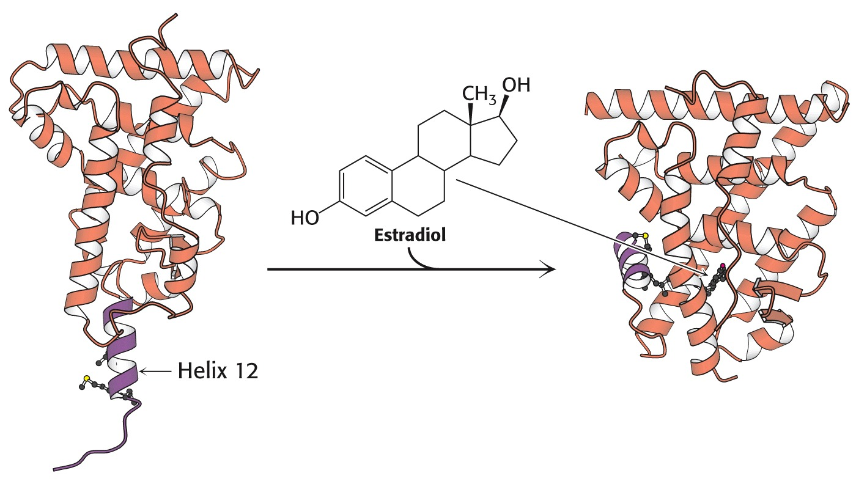
Notes:
jedrni receptor za estradiol: konformacijska sprememba po vezavi hormona

Slide 18
Notes:
angažiranje koaktivatorja na primeru estrogenskega receptorja

Slide 19
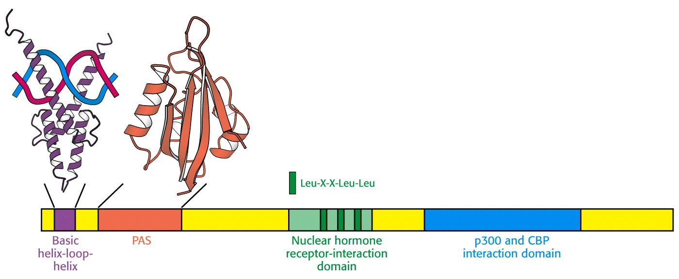
p300 = E1A binding protein p300 CBP = CREB-binding protein
Zgradba koaktivatorjev iz družine p160
Notes:
koaktivatorji: zgradba po domenah CREB = cAMP response element binding; PAS-domena: značilno zvitje, funkcija senzorja (Period circadian protein/Aryl-hydrocarbon receptor nuclear translocator protein/Single-minded protein)

Slide 20
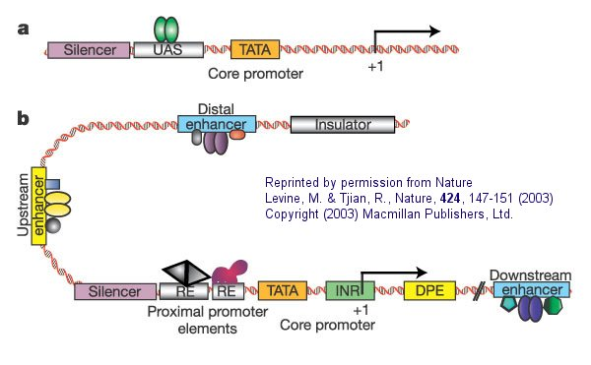
Primera preproste (a) in kompleksne transkripcijske enote (b)
Notes:
Comparison of a simple eukaryotic promoter and extensively diversified metazoan regulatory modules. a, Simple eukaryotic transcriptional unit. A simple core promoter (TATA), upstream activator sequence (UAS) and silencer element spaced within 100–200 bp of the TATA box that is typically found in unicellular eukaryotes. b, Complex metazoan transcriptional control modules. A complex arrangement of multiple clustered enhancer modules interspersed with silencer and insulator elements which can be located 10–50 kb either upstream or downstream of a composite core promoter containing TATA box (TATA), Initiator sequences (INR), and downstream promoter elements (DPE).

Slide 21
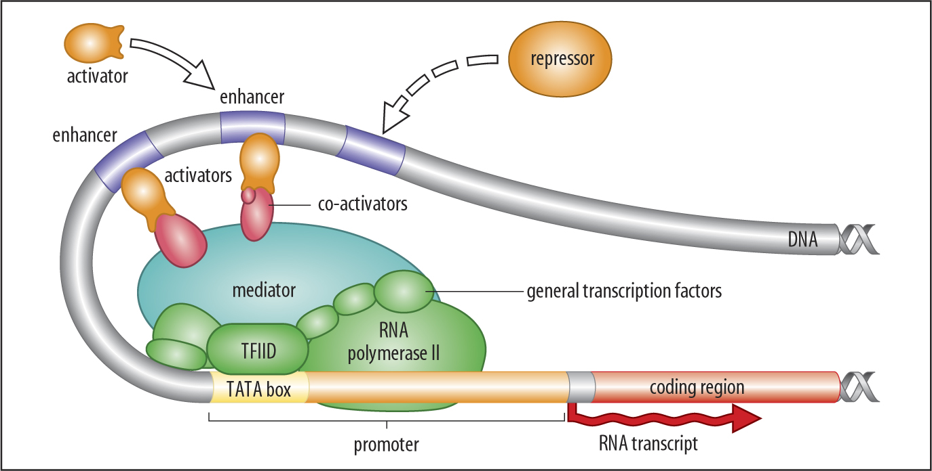

Slide 22
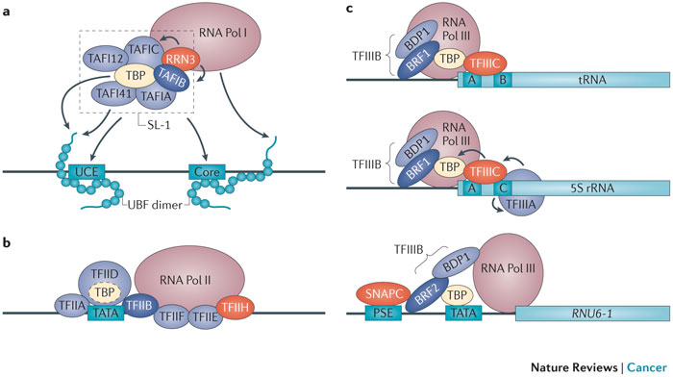
NRC 13, 299-314 (2013)
Notes:
a | Assembly of the RNA polymerase (Pol) I pre-initiation complex (PIC) at ribosomal RNA gene (rDNA) promoters begins with the binding of upstream binding factor (UBF) to the upstream control elements (UCEs) and core element of the rDNA promoter, leading to the recruitment of the SL-1 initiation factor, which contains TATA-box-binding protein (TBP) and at least five TATA-box-associated factors (TAFs). The resultant stable UBF–SL-1 complex recruits an initiation-competent form of RNA Pol I, which contains RRN3 that mediates interactions between RNA Pol I and SL-1 (Ref. 189). b | For RNA Pol II transcription, TBP initiates PIC assembly by binding to the TATA box at the promoter. TFIIA and TFIIB interact with TBP and reinforce its binding to DNA. In turn, TFIIB recruits RNA Pol II and TFIIF, thus positioning RNA Pol II over the transcription start site (TSS). TFIIH mediates 'melting' of the TSS to form the open complex that is stabilized by TFIIE190. The dashed outline of TBP indicates that it is part of the TFIID complex. c | RNA Pol III PICs differ in composition depending on the class of genes transcribed. Most RNA Pol III-transcribed genes (for example, those that encode tRNAs) have internal promoters that comprise two sequence blocks (A and B) that are located in the transcribed region. The A and B blocks are recognized by TFIIIC that recruits TFIIIB, which is composed of the subunits B-related factor 1 (BRF1), BDP1 and TBP. Finally, TFIIIB recruits RNA Pol III. For 5S rDNA promoters the B block is replaced by a sequence, termed block C, to which TFIIIA binds and recruits and orientates TFIIIB, following which transcription initiation proceeds as for tRNA genes. For a small number of RNA Pol III-transcribed genes (for example, U6 snRNA (RNU6-1)) the promoters are located upstream of the gene and contain TATA boxes bound by TBP, and proximal sequence elements (PSEs) bound by a complex called small nuclear RNA-activating protein complex (SNAPC). These upstream promoters are bound by a different form of TFIIIB from tRNA genes, which is composed of BRF2, BDP1 and TBP9.

Slide 23
Modifikacije osrednjih histonov

Slide 24
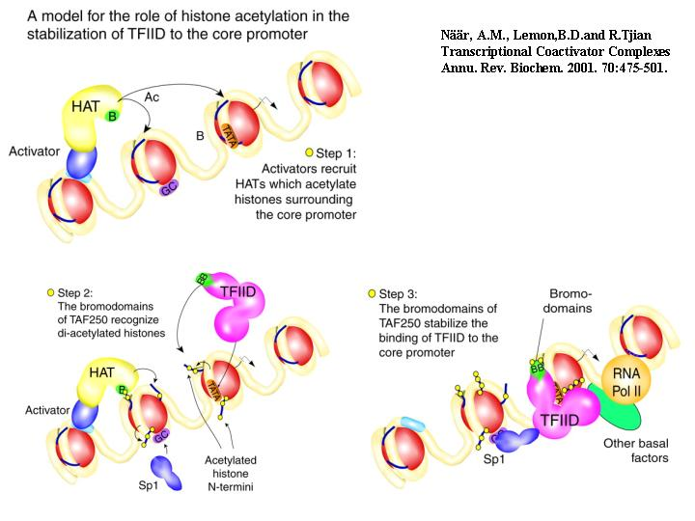

Slide 25
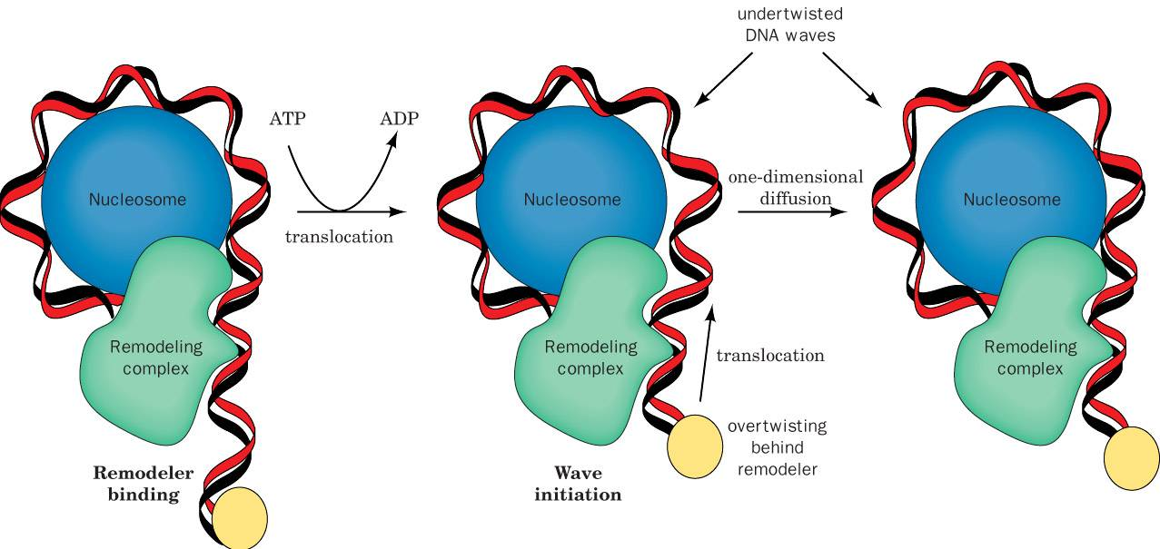
Model preoblikovanja nukleosoma z delovanjem kromatin-preoblikovalnega kompleksa.

Slide 26
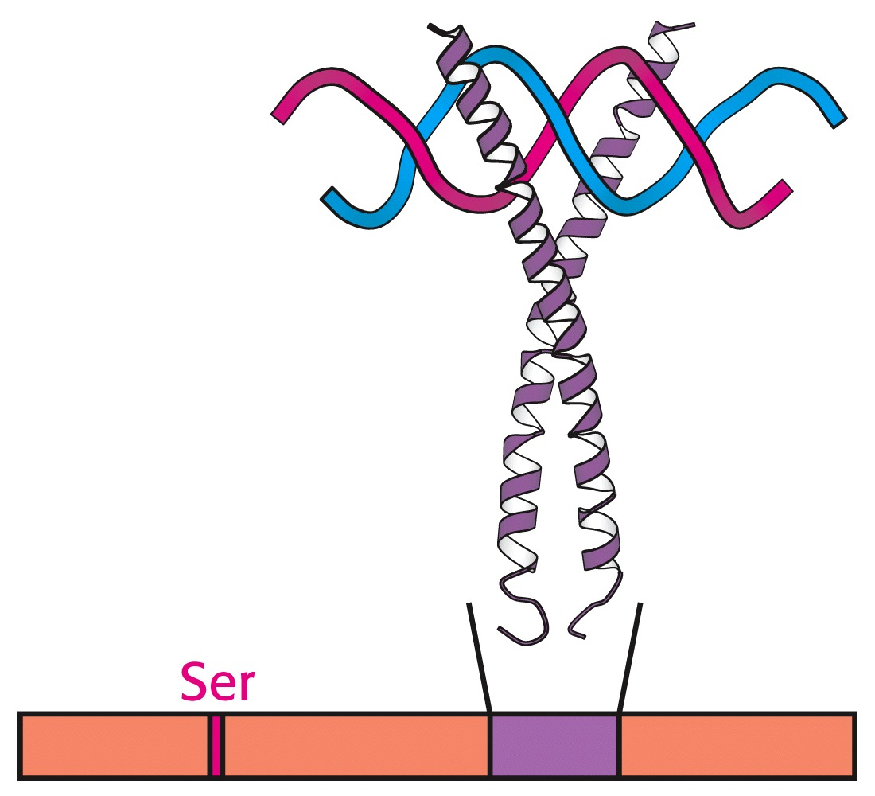
Odzivni element za cAMP: vezava CREB
Notes:
CREB (cAMP response element-binding) is a cellular transcription factor. It binds to certain DNA sequences called cAMP response elements (CRE), thereby increasing or decreasing the transcription of the downstream genes. A typical (albeit somewhat simplified) sequence of events is as follows: A signal arrives at the cell surface, activates the corresponding receptor, which leads to the production of a second messenger such as cAMP or Ca2+, which in turn activates a protein kinase. This protein kinase translocates to the cell nucleus, where it activates a CREB protein. The activated CREB protein then binds to a CRE region, and is then bound to by a CBP (CREB-binding protein), which coactivates it, allowing it to switch certain genes on or off. The DNA binding of CREB is mediated via its basic leucine zipper domain (bZIP domain) as depicted in the phtograph.

Slide 27
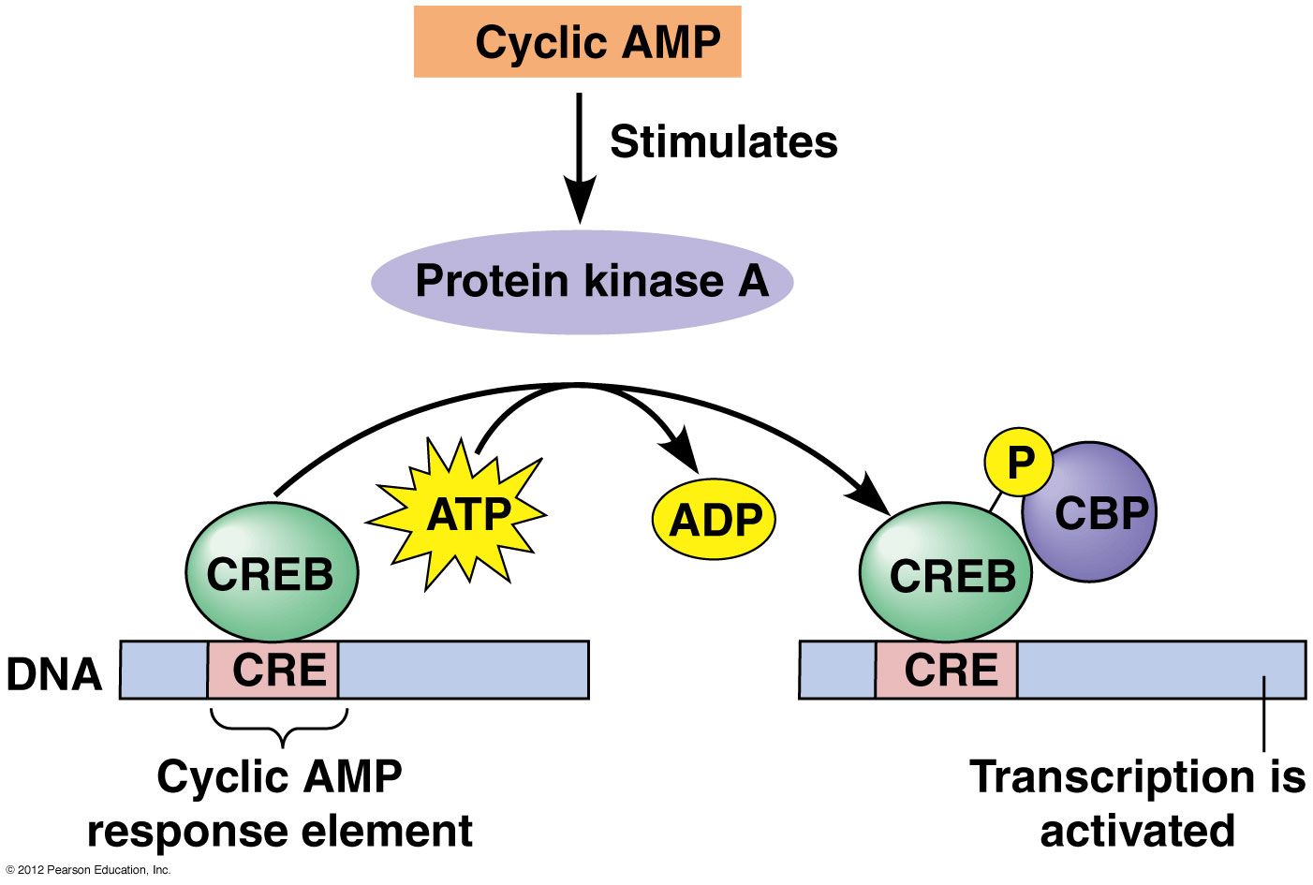

Slide 28
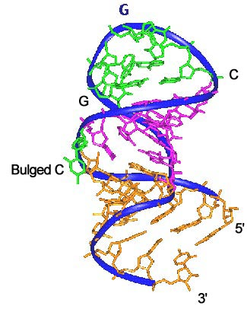
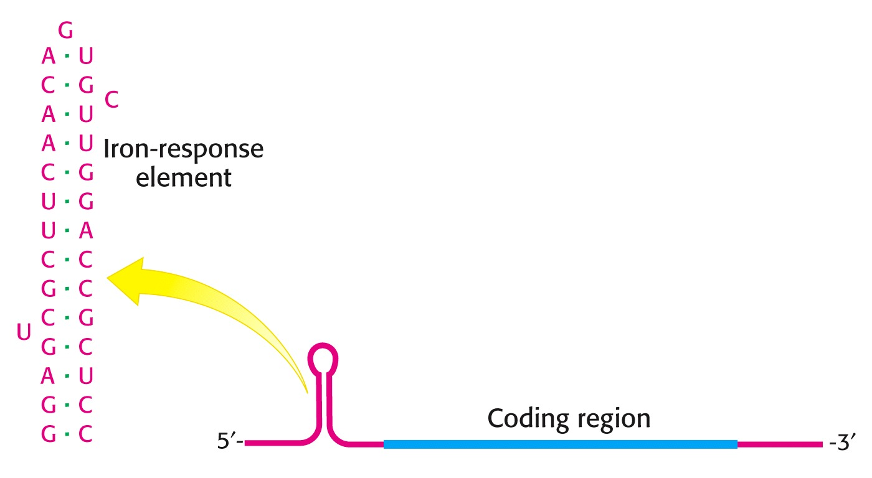
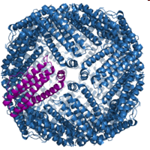
odzivni element za železo → posttranskripcijska regulacija izražanja feritina

Slide 29
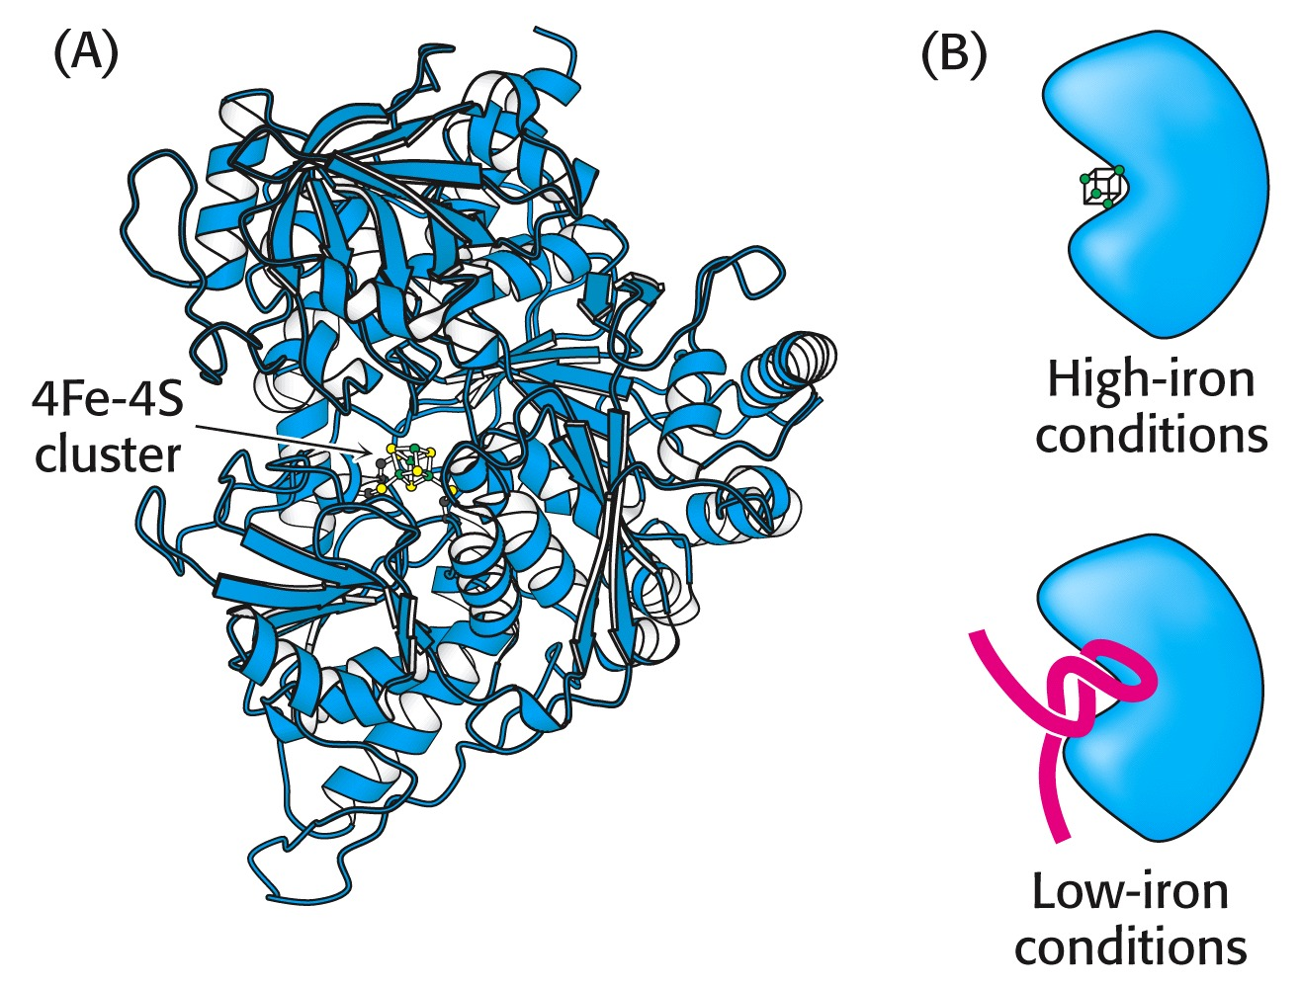
IRE-BP z mestom za vezavo 4Fe-4S

Slide 30
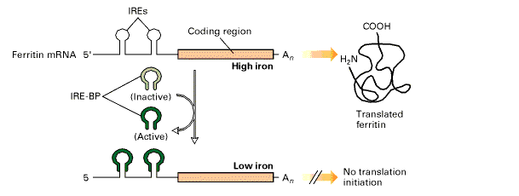
veliko Fe: Fe se v veže na IRE-BP - nekativen, zato ne pride do atenuacije
malo Fe: IRE-BP – aktiven – se veže na DNA (IRE) in prepreči translacijo

Slide 31
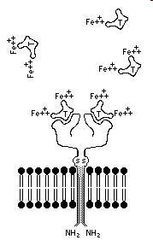
odzivni elementi za železo → regulacija izražanja transferinskega receptorja

Slide 32
malo Fe → IRE-BP se veže in stabilizira mRNA za transferinski receptor

Slide 33
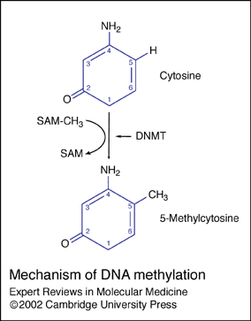
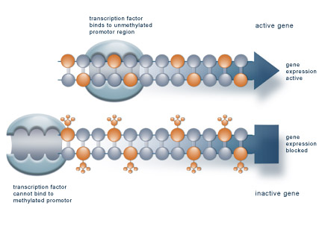
DNTM = DNA-metiltransferaza
SAM = S-adenozilmetionin

