Slide 1
Uravnavanje izražanja genov: Prokarionti
Voet 3: poglavje 31.3
Stryer 5: poglavje 31
Krebs: poglavje 26

Slide 2
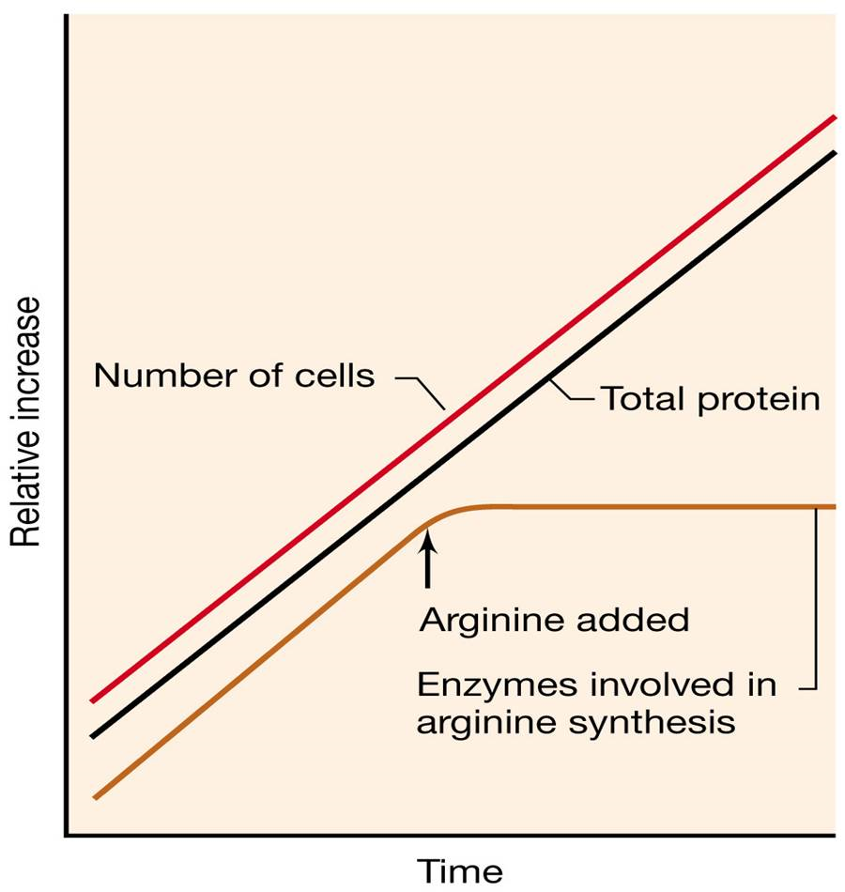
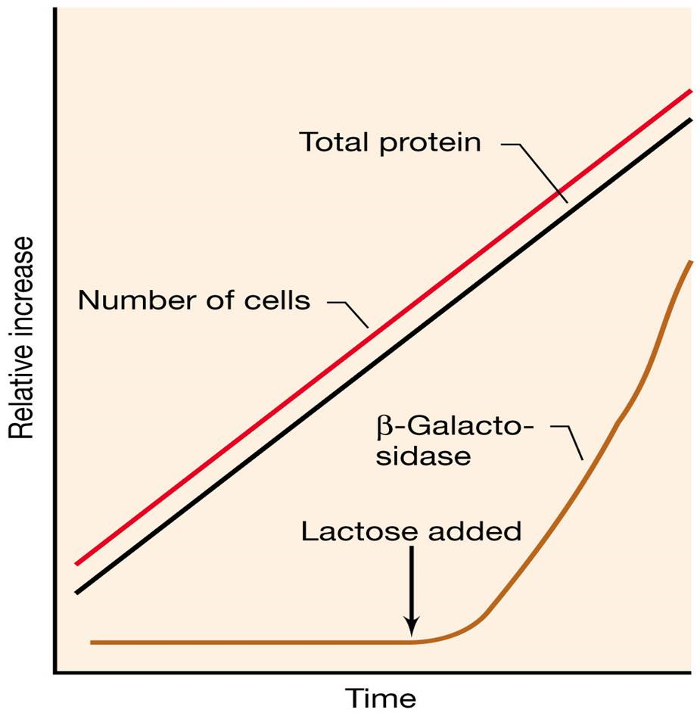
represija
indukcija

Slide 3
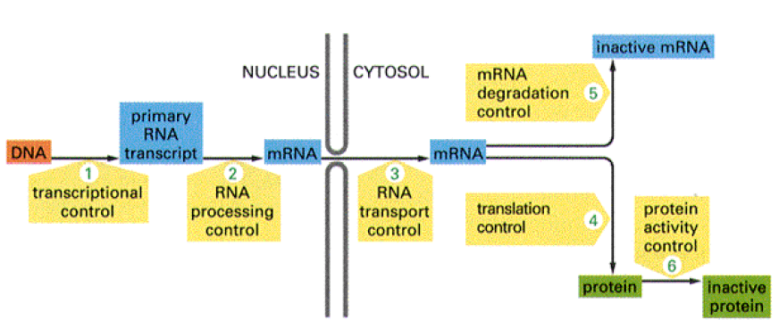

Slide 4
Možni načini uravnavanja koncentracije proteina v celici (splošno):
hitrost transkripcije
hitrost posttranskripcijskega procesiranja
hitrost razgradnje mRNA
hitrost sinteze proteina
hitrost posttranslacijskega procesiranja
hitrost razgradnje proteinov

Slide 5
Osnovna tipa izražanja genov:
konstitutivno (stalna transkripcija – “hišni geni”)
inducibilno /represibilno (aktivacija/inaktivacija genov)

Slide 6
operon: niz genov z usklajeno regulacijo
represorji / aktivatorji: regulatorji transkripcije
kontrola izražanja poteka najpogosteje na ravni transkripcije

Slide 7
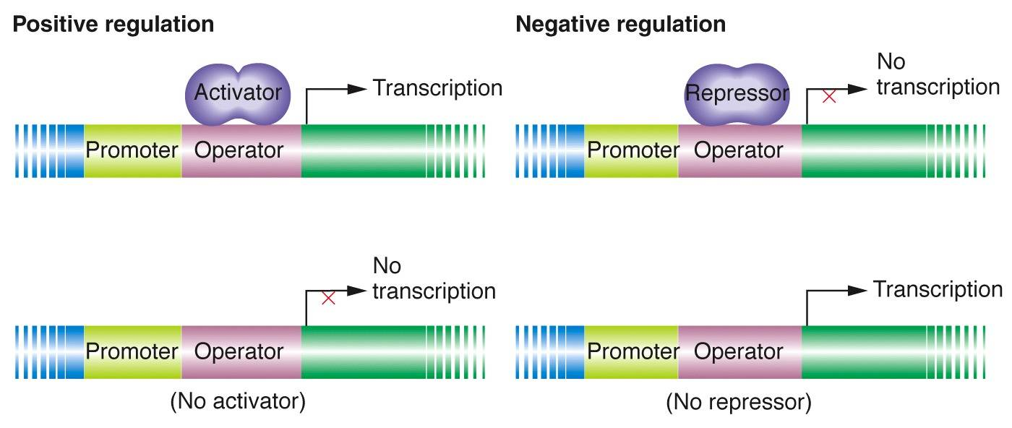

Slide 8
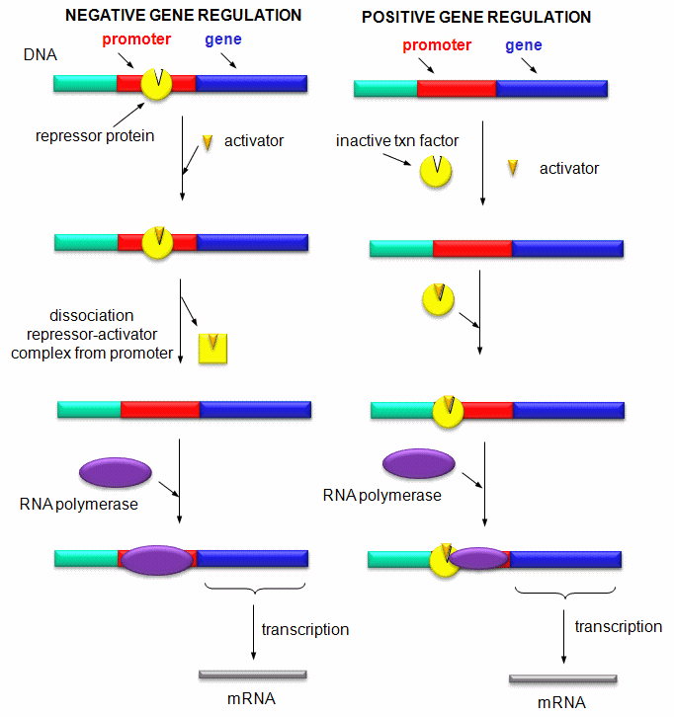

Slide 9
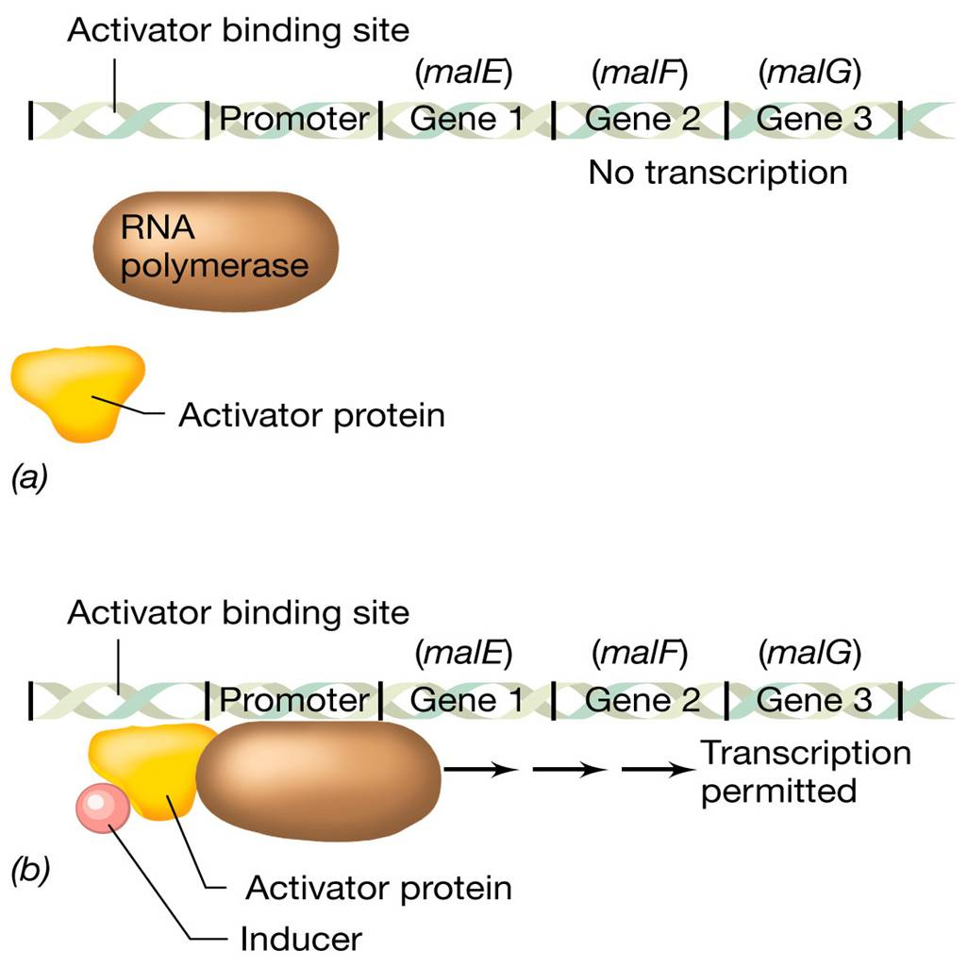
Maltozni operon: pozitivna regulacija, kjer aktivator deluje po vezavi induktorja (mal)
Notes:
Positively controlled promoters have nucleotide sequences that are not close matches to the consensus sequence even with the correct sigma factor, the RNA polymerase has difficulty recognizing these promoters. The activator protein, when bound to DNA, helps the RNA polymerase, either recognize the promoter or begin transcription
by bending DNA, allows the RNA polymerase to make correct contacts with the DNA also interact directly with the RNA polymerase
(a) In the absence of an inducer, neither the activator protein nor the RNA polymerase can bind to the DNA.
n
(b) An inducer molecule binds to the activator protein, which in turn binds to the activator binding site. This allows RNA polymerase to bind to the promoter and begin transcription. In the case of the malEFG operon, the activator protein would be the maltose activator protein and the inducer would be the sugar maltose

Slide 10
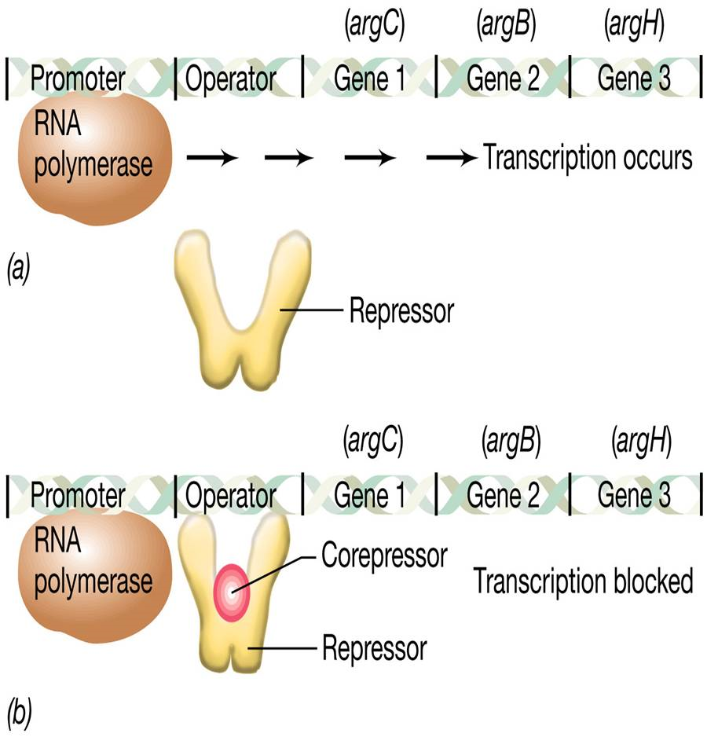
Argininski operon: represor deluje šele po vezavi korepresorja (Arg)

Slide 11
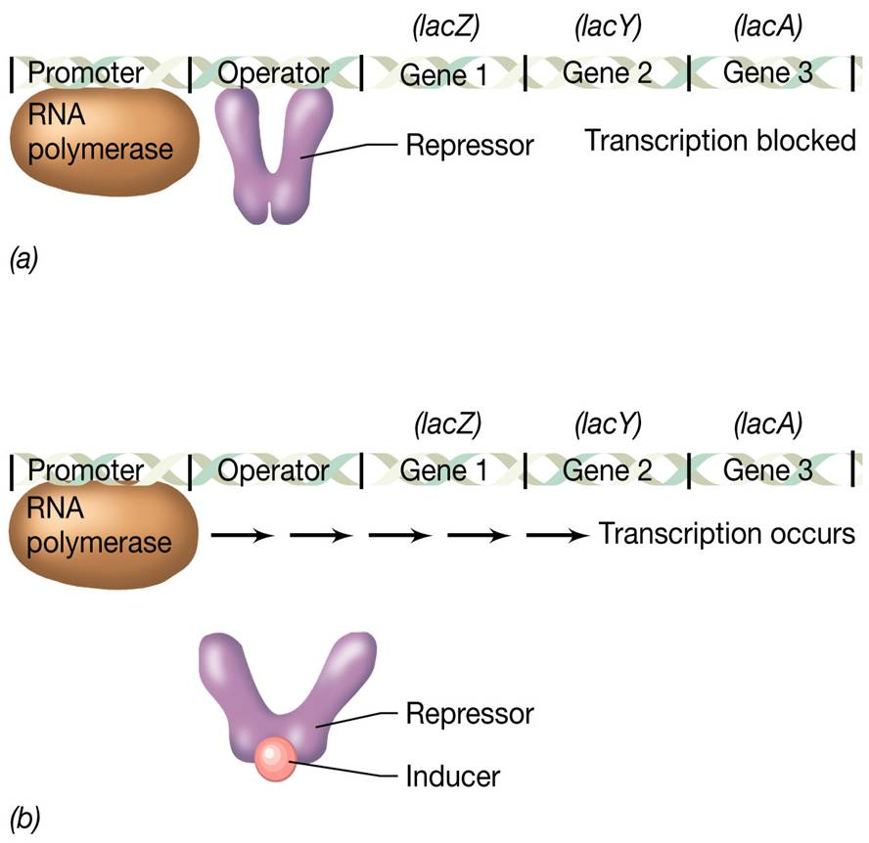
Laktozni operon: represor deluje, dokler se nanj ne veže induktor (lac)

Slide 12
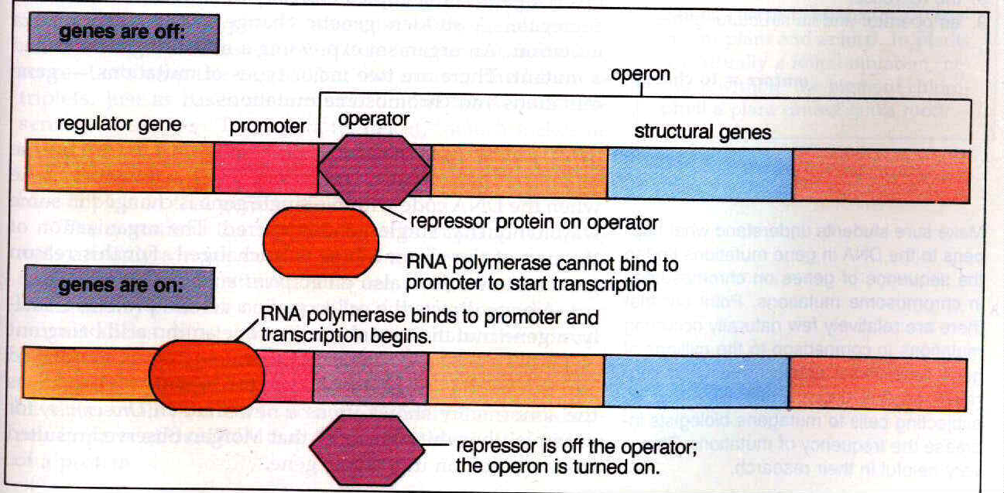

Slide 13
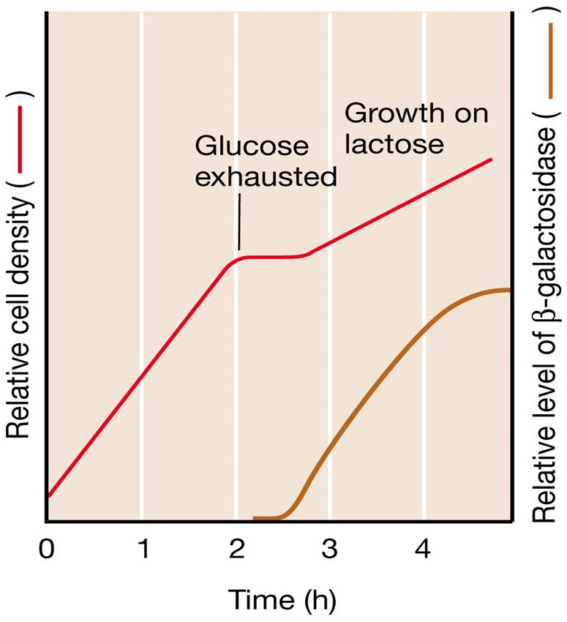
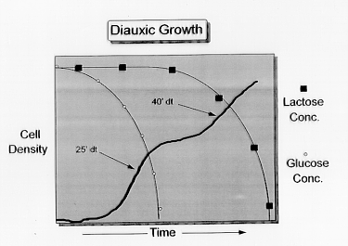

Slide 14
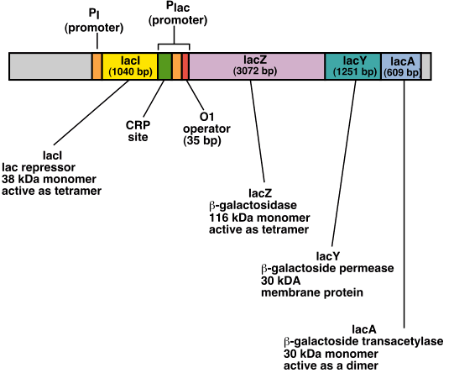

Slide 15
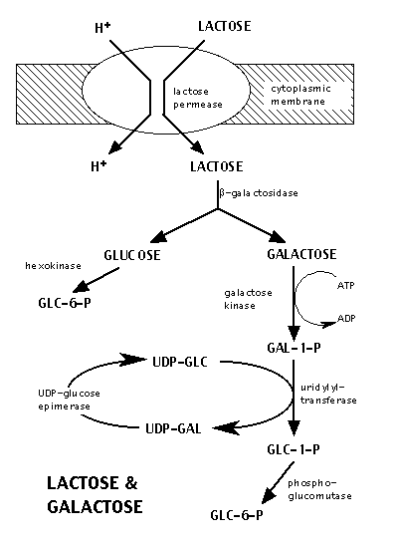
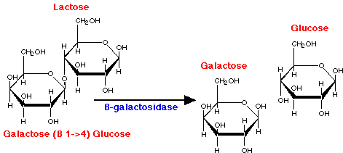

Slide 16
5-bromo-4-kloro-3-indolil-beta-D-galaktopiranozid

Slide 17
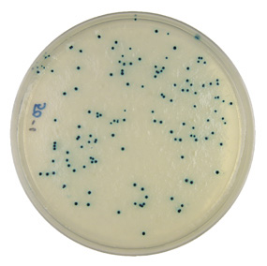
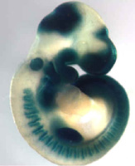
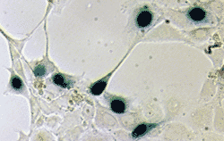
β-galaktozidaza kot reporterski encim: detekcija preko razgradnje X-gal.

Slide 18
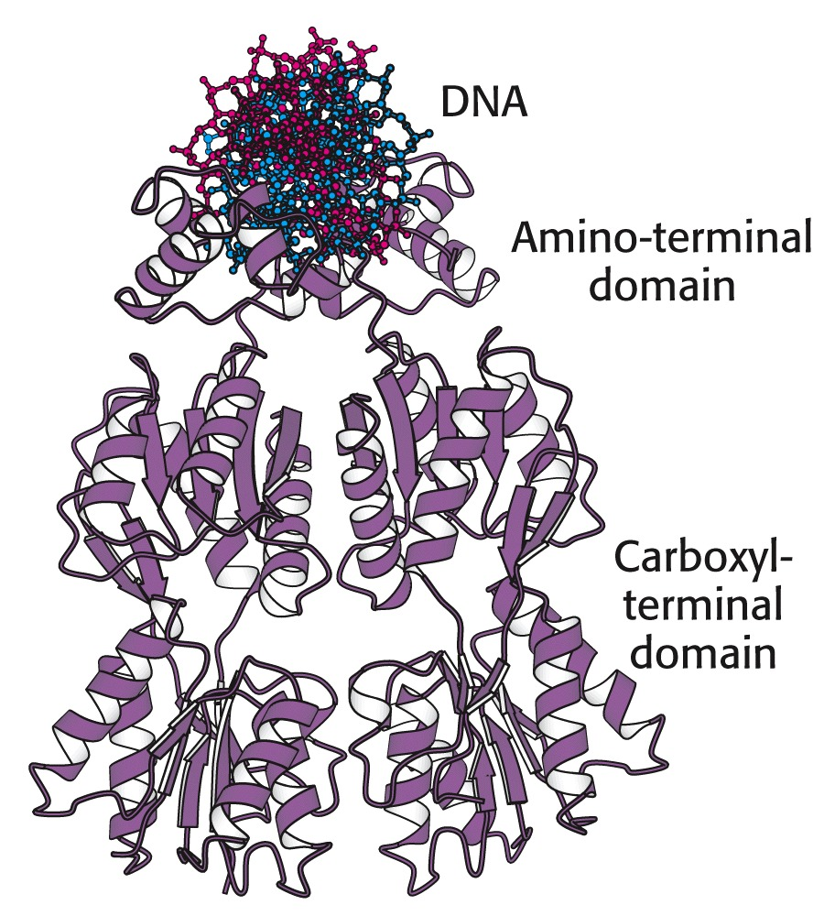
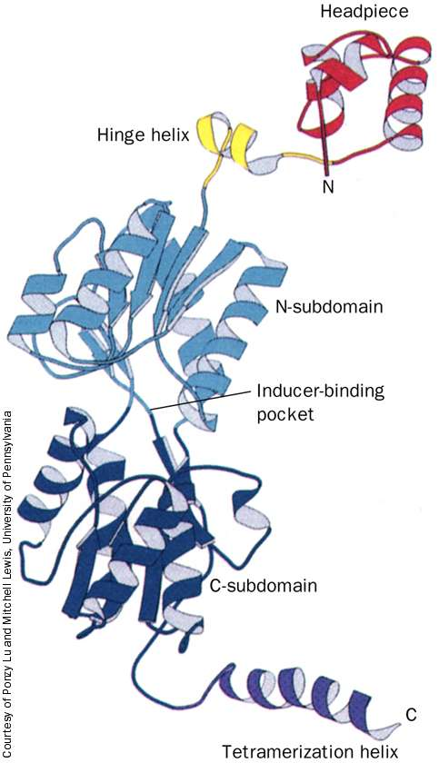
Notes:
zgradba lac-represorja (prikazano kot delni dimer; v celici nastopa kot homotetramer)

Slide 19
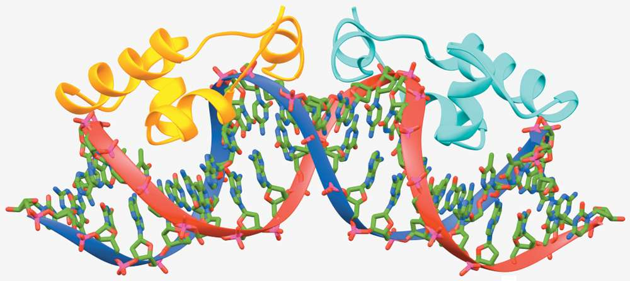
Vezavna regija lacI na operator lac pri E. coli. Struktura na osnovi NMR.

Slide 20
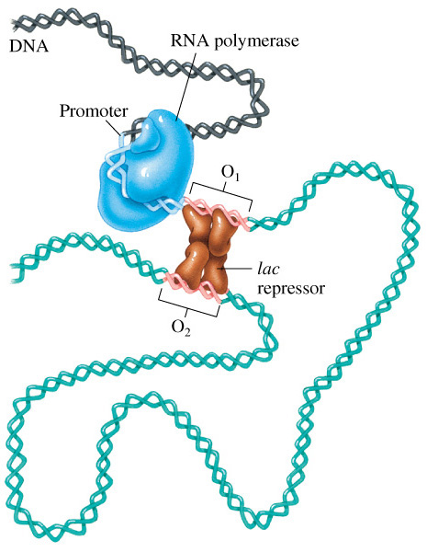
Notes:
The tetrameric lac repressor interacts simultaneously with two sites near the promoter of the lac operon. As a result, a loop of DNA forms. RNA polymerase can still bind to the promoter in the presence of the lac repressor - DNA complex.
The DNA loop structure was observed in electron micrographs of the lac repressor with DNA containing lac repressor binding sites. RNA polymerase is poised on the promoter, and will transcribe the gene if the lac repressor releases (as in the presence of lactose).

Slide 21
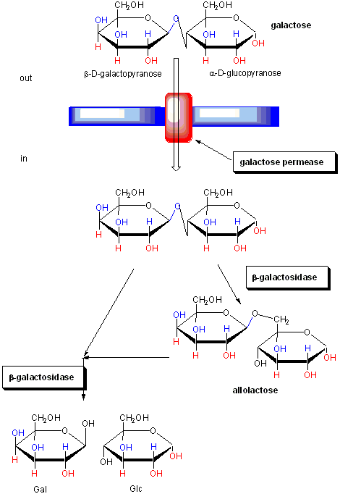
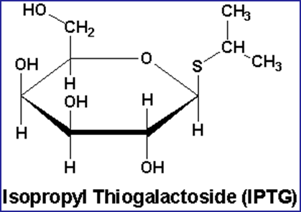

Slide 22
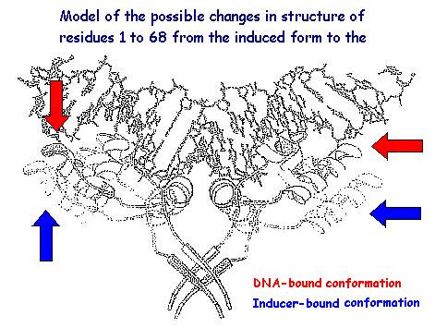
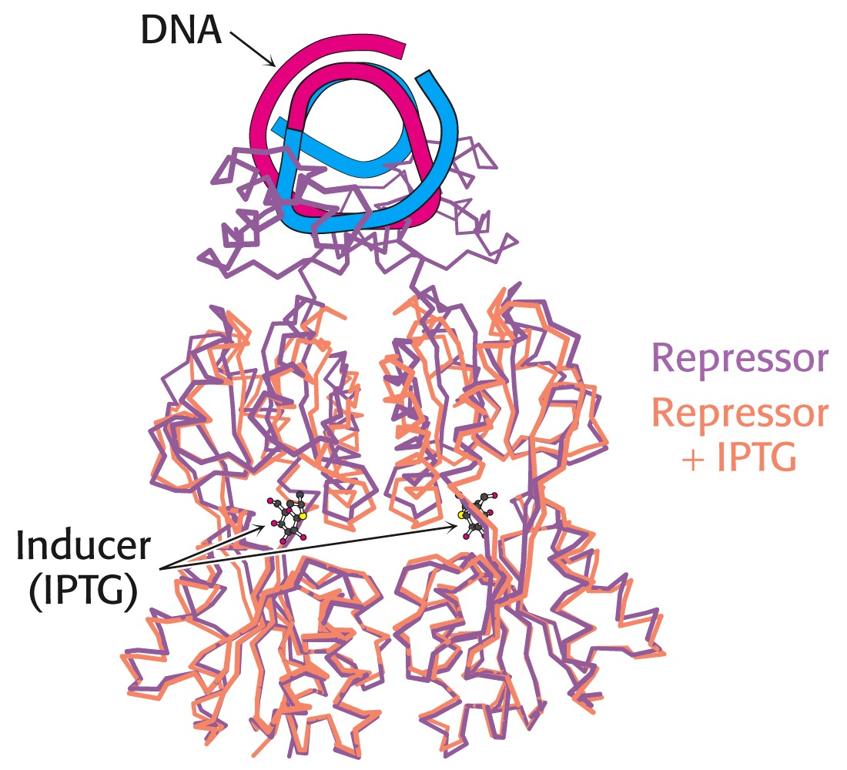
Notes:
vpliv prisotnosti induktorja na zgradbo represorja

Slide 23
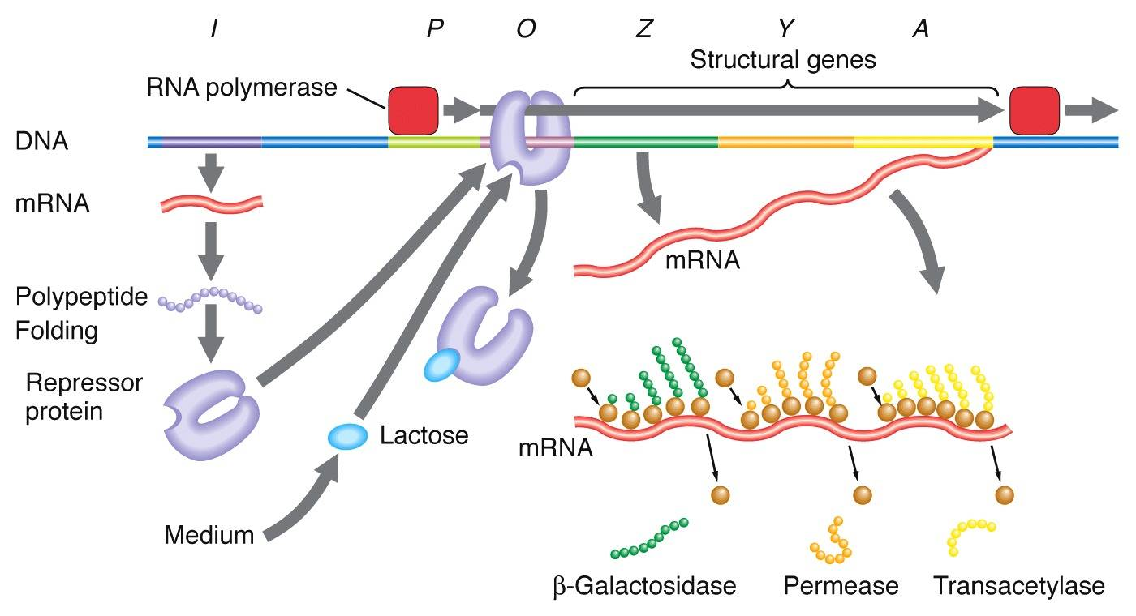

Slide 24
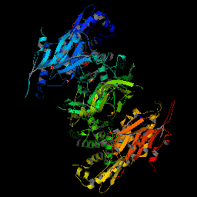

Slide 25
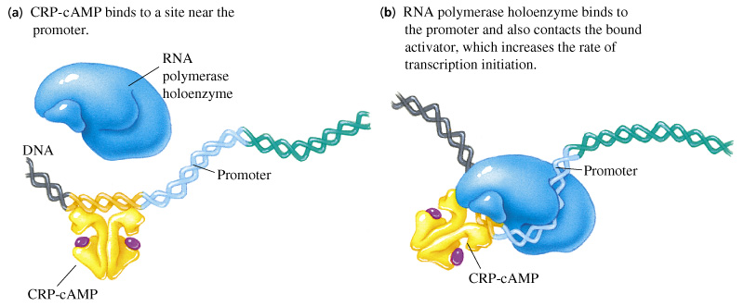
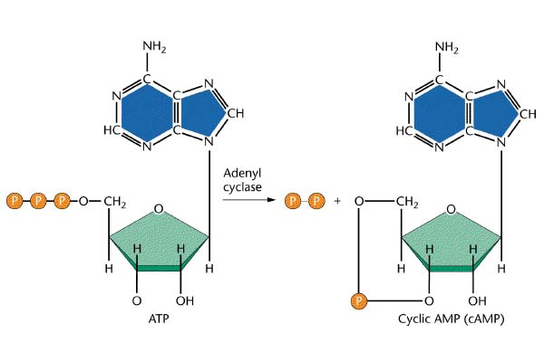
glucose
Notes:
Catabolite regulatory (or receptor) protein (CRP) is able to bind its operator sequence only when bound to cAMP. Transcription initiation by RNA holoenzyme is increased when the enzyme interacts with this bound activator.
[cAMP] is a measure, in E. coli, of the extracellular glucose concentration. Low glucose levels stimulate production of cAMP and, therefore, activation of genes, such as the lac operon, that provide the cell with other nutritional options. cAMP production is shown in Figure 21.20. Details of CRP-cAMP binding to DNA are shown in Figures 21.21 and 21.22.

Slide 26
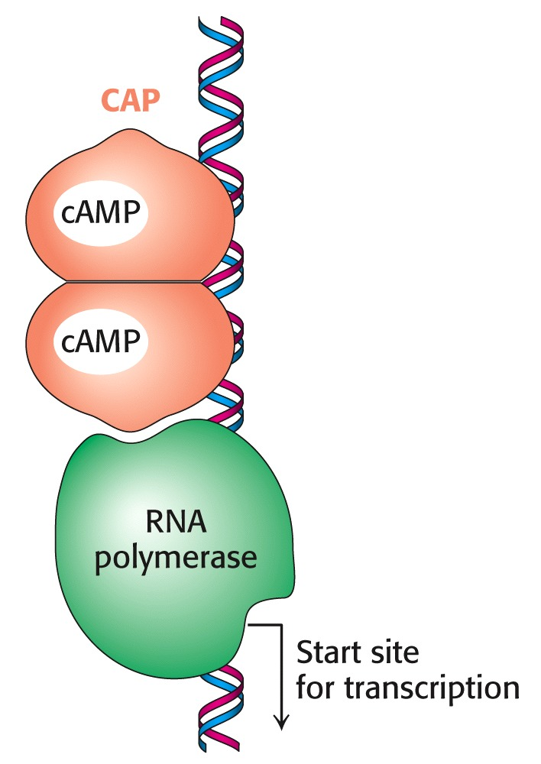
aktivacija operona lac preko katabolitne represije
50x pogostejša iniciacija transkripcije
Notes:
vezavno mesto za dimer CAP (katabolitni aktivatorski protein) je okrog mesta –61 glede na začetno mesto transkripcije

Slide 27
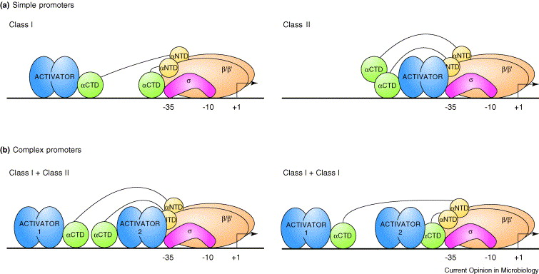
Promotorji razreda I in II se razlikujejo po oddaljenosti od promotorja in po načinu
interakcije s C-končno domeno podenote alfa RNA-polimeraze in/oz. s podenoto sigma.
Razred I: npr. lac (CAP @ -61); razred II: npr. galP1 (@-41).
Notes:
Activation by recruitment with one or two transcription factors. (a) Simple promoters activated by contacts with one activator, which recruit RNAP. The figure shows the position of the transcription activator and RNAP subunits at typical Class I and Class II promoters, relative to the transcription start site (+1) and the promoter −10 and −35 elements. The RNAP αCTDs are connected to αNTD by flexible linkers, represented by lines, which allow αCTD to bind at different locations depending on the promoter. At simple promoters, only one αCTD is needed for contact with the transcription activator. (b) Complex promoters activated by independent contacts with two activators that recruit RNAP. The organization of model ‘Class I + Class II’ and ‘Class I + Class I’ promoters carrying tandem binding sites for two transcription activators is shown. Each activator contacts one of the RNAP αCTDs that are depicted as in (a).
Volume 7, Issue 2, April 2004, Pages 102–108

Slide 28
Nukleotidno zaporedje promotorsko-operatorske regije lac-operona E. coli.

Slide 29
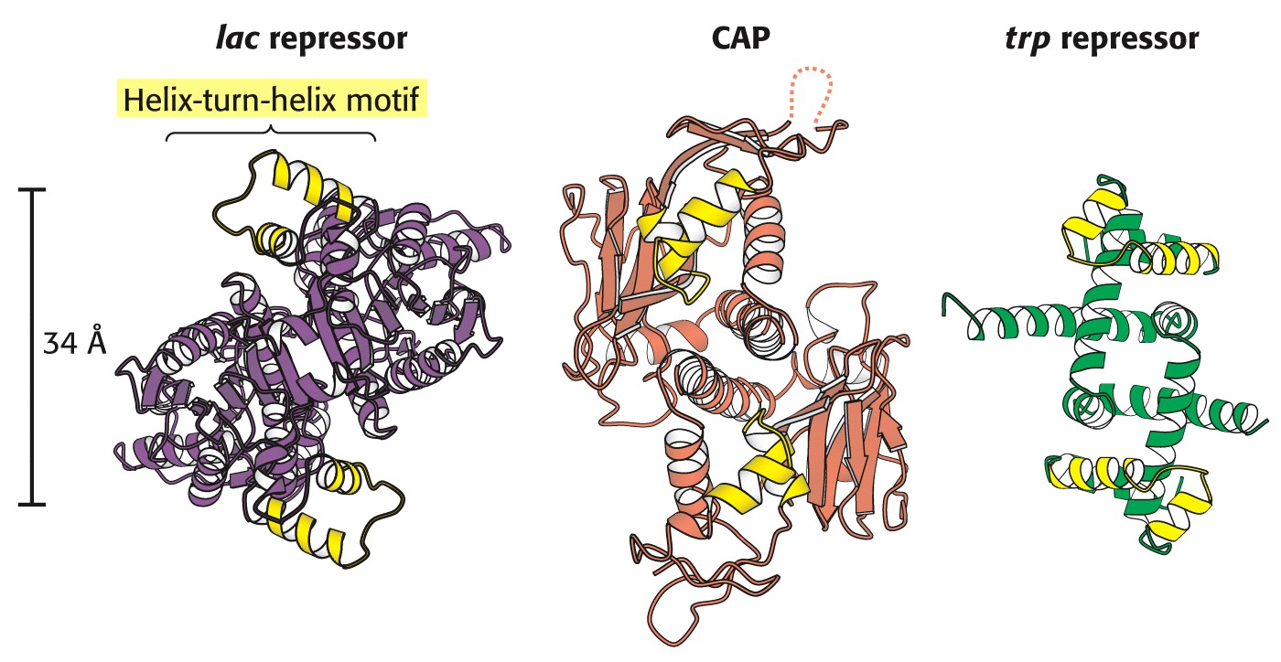
Notes:
motiv vijačnica-zavoj-vijačnica je značilen za vezavna mesta za DNA – pojavlja se 2x v oddaljenosti ~34 A

Slide 30
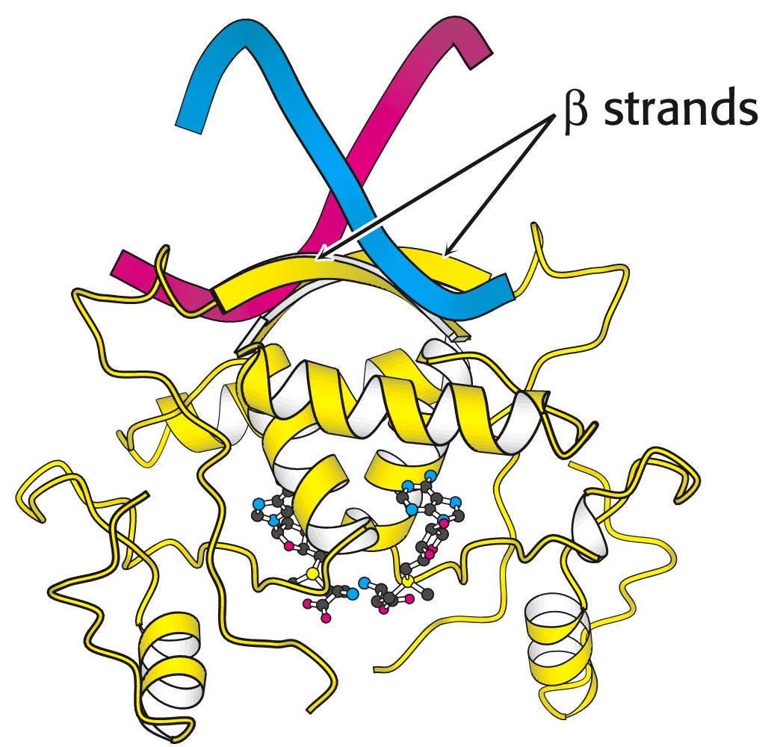
met - represor
Notes:
vezavno mesto za DNA lahko predstavlja tudi beta-strukturni element (kot tu pri represorju metionina)

Slide 31
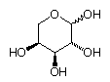
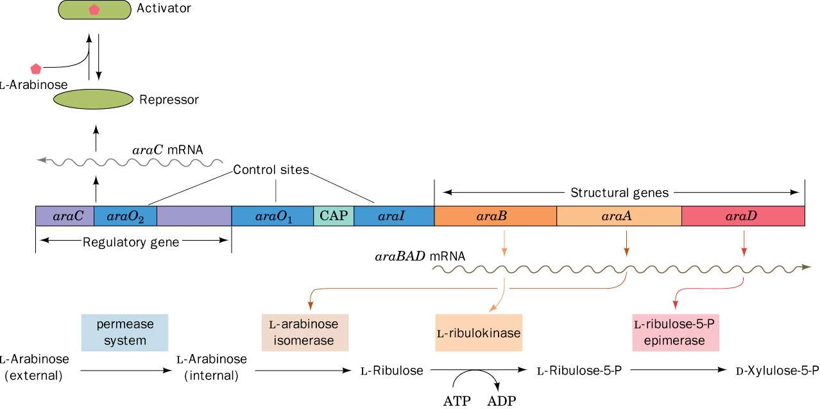
Genetska karta operonov araC in araBAD E. coli.

Slide 32
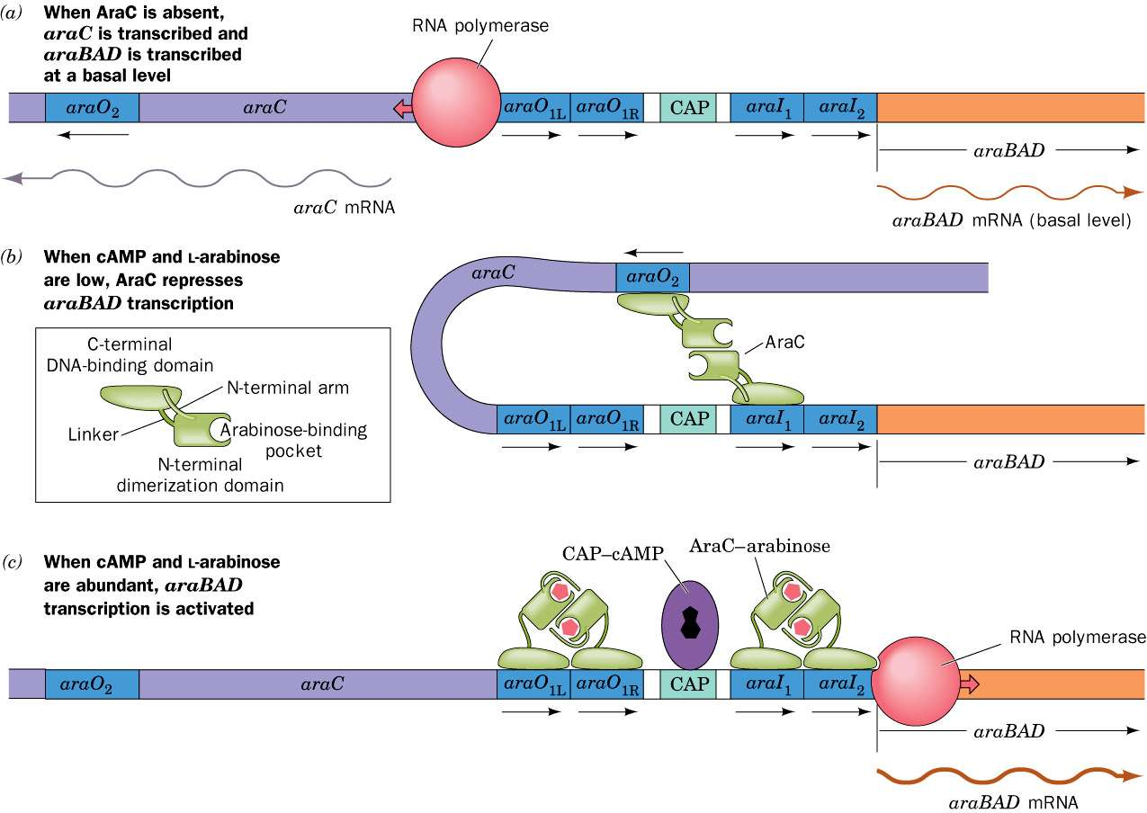
Uravnavanje araBAD. a) v odsotnosti araC; b) v prisotnosti araC, a brez L-arabinoze in brez cAMP; c) v prisotnosti araC, cAMP in L-arabinoze.

Slide 33
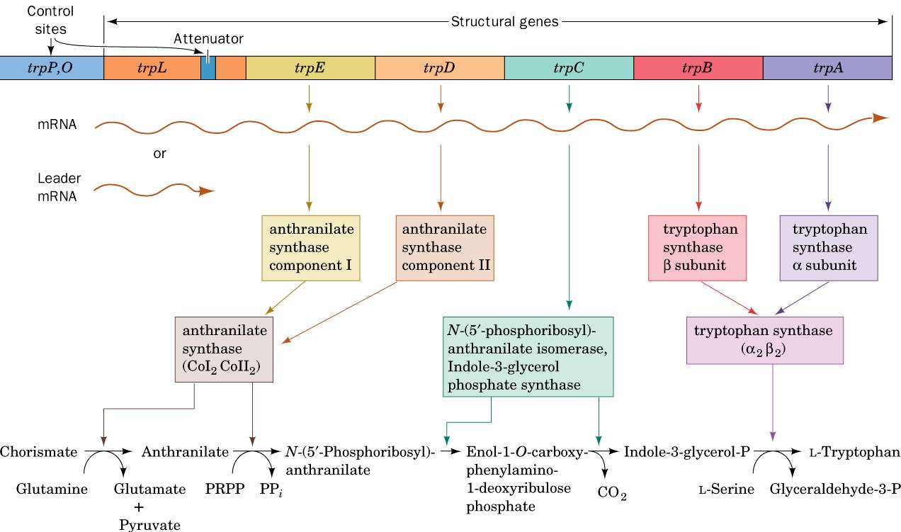

Slide 34
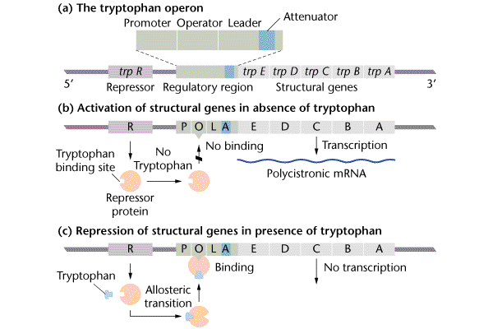

Slide 35
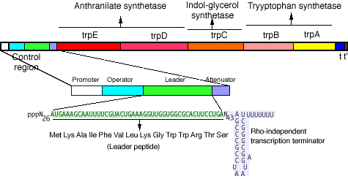
atenuatorji → posttranskripcijski regulatorji
Notes:
atenuatorji regulirajo operone za sintezo aminokislin – primer posttranskripcijske regulacije
vodilni peptid Trp-operona (14 AA): zapisu sledi atenuatorska regija RNA, ki lahko zavzame različne sekund. strukture

Slide 36
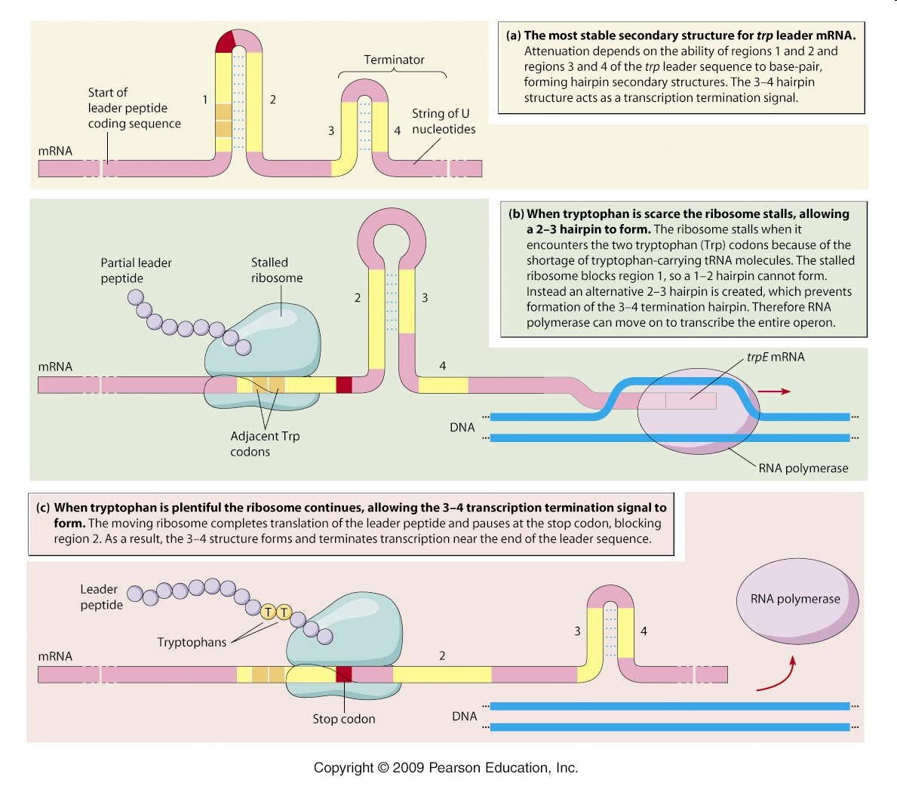

Slide 37
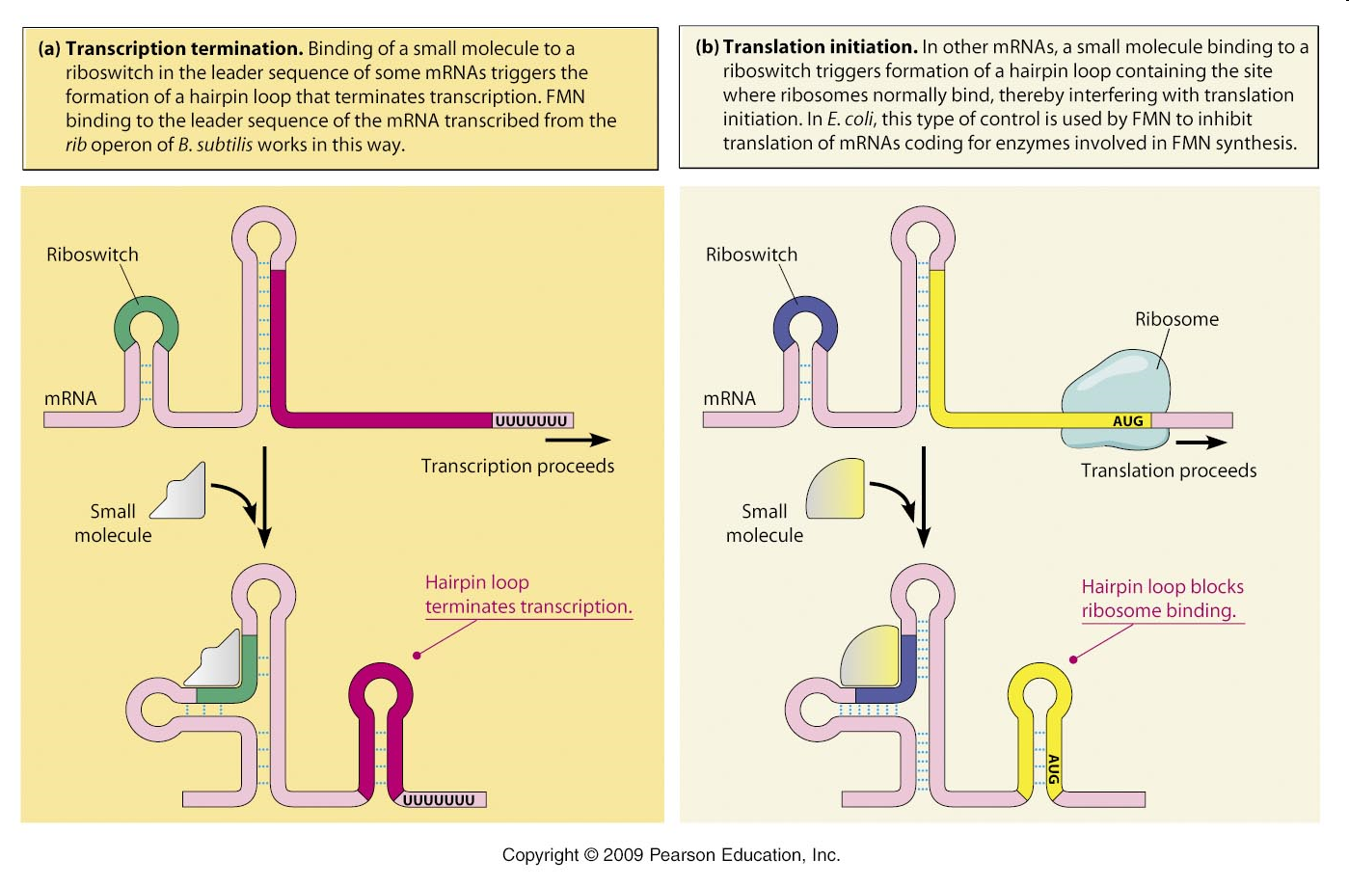
Notes:
FMN = flavin mononukleotid, Rib = riboflavinski operon

Slide 38
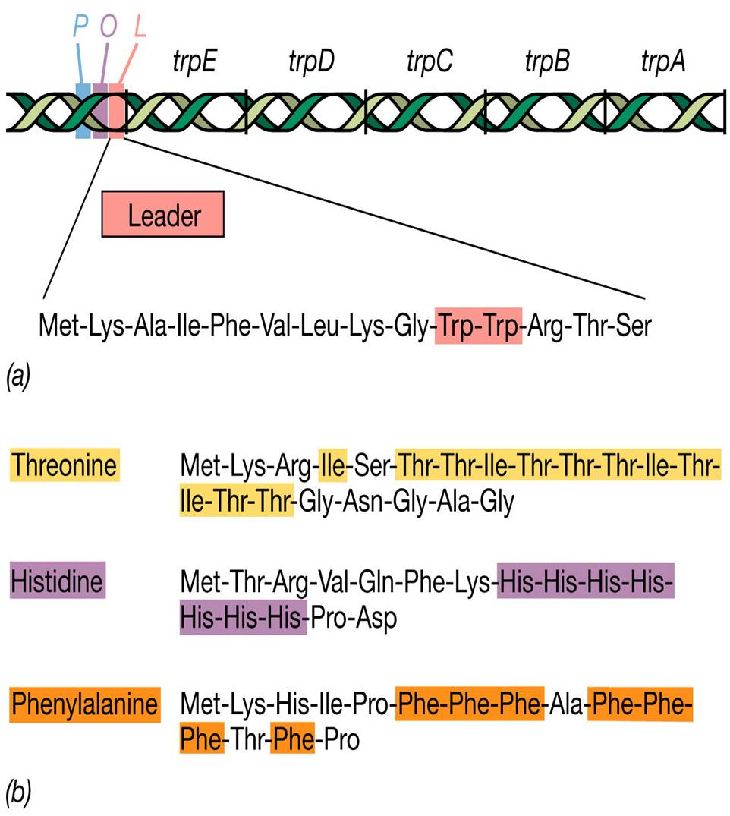
Notes:
vodilni peptidi Trp-, Thr-, His- in Phe-operonov

Slide 39
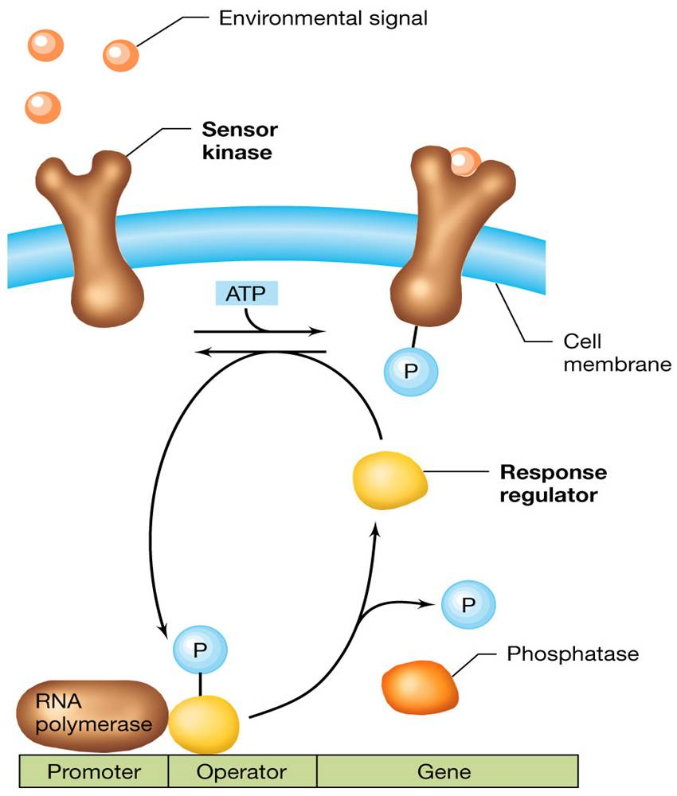
Dvokomponentni sistem uravnavanja z receptorsko kinazo in odzivnim regulatorjem.
V opisanem primeru je fosforilirani regulator represor.
Notes:
http://202.204.115.56/jpkch/jpkch/2008/wswx/chapter%208.htm

Slide 40
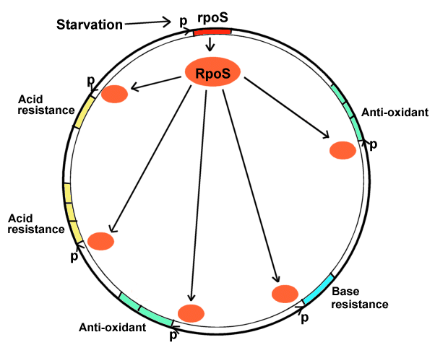
Regulon je skupina operonov, ki jih uravnava isti regulator.
To je možno, ker imajo enak promotor /operator.
RpoS je posebni faktor sigma, ki omogoča transkripcijo stresnih genov.
Notes:
http://202.204.115.56/jpkch/jpkch/2008/wswx/chapter%208.htm

