Slide 1
Podvojevanje DNA
Voet 3: poglavji 29 in 30
Stryer 5: poglavje 27
Krebs 3: poglavji 12 in 13

Slide 2
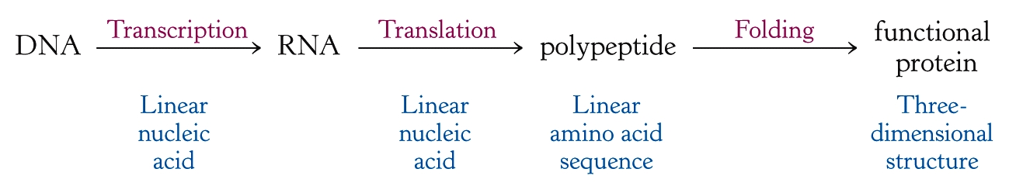
prepisovanje
prevajanje
zvijanje
Notes:
prepisovanje, prevajanje, zvijanje
(podvojevanje)

Slide 3
DNA
DNA je polimer deoksiribonukleotidnih enot
nukleotid = dušikova baza + sladkor + fosf. sk.
nukleozid = dušikova baza + sladkor
nukleozid-5’-fosfat = 5’-nukleotid
baze prenašajo genetske informacije
sladkorne in fosfatne skupine imajo strukturno funkcijo

Slide 4
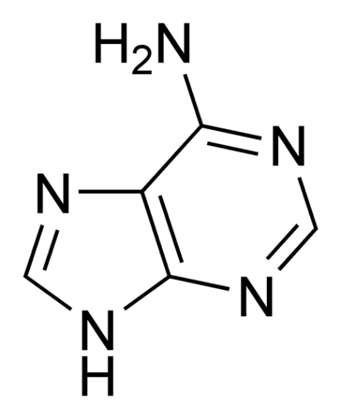
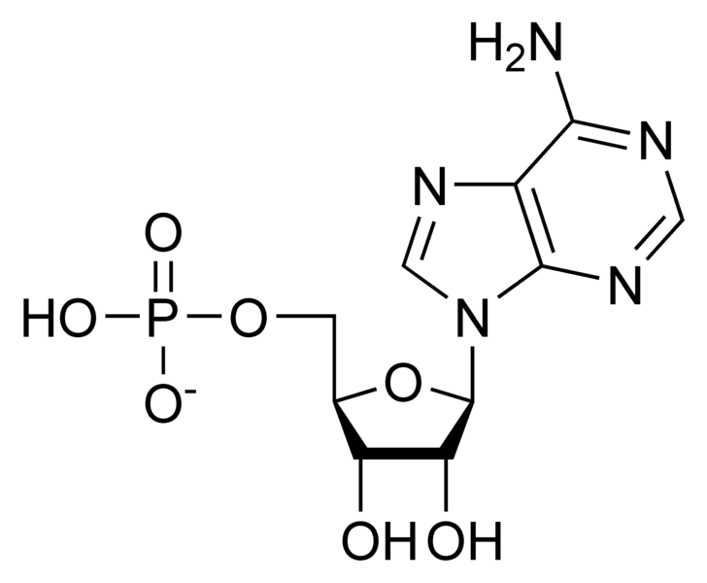
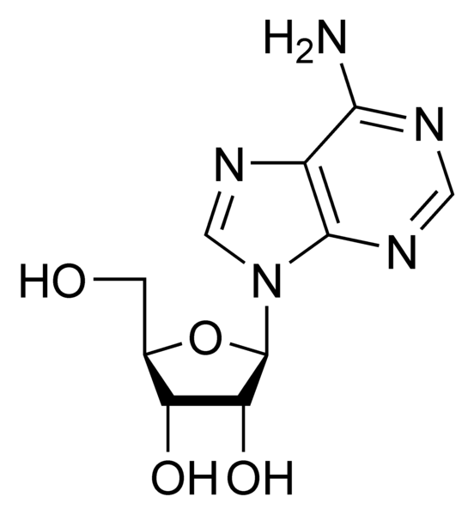
baza: adenin
nukleotid: adenozinmonofosfat
nukleozid: adenozin

Slide 5
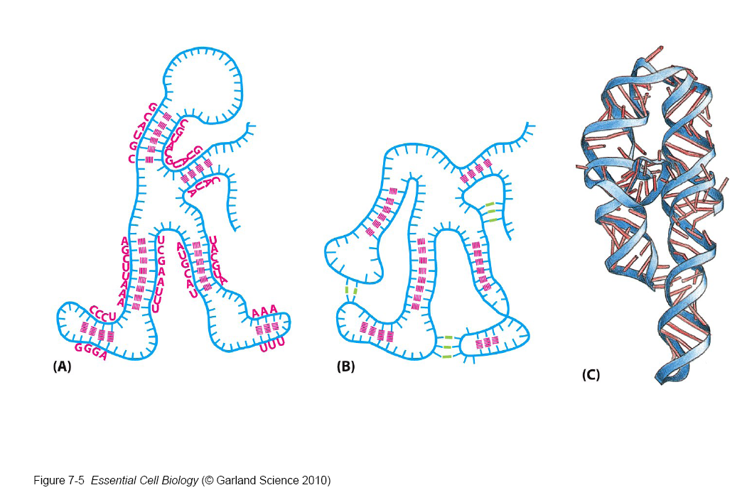

Slide 6
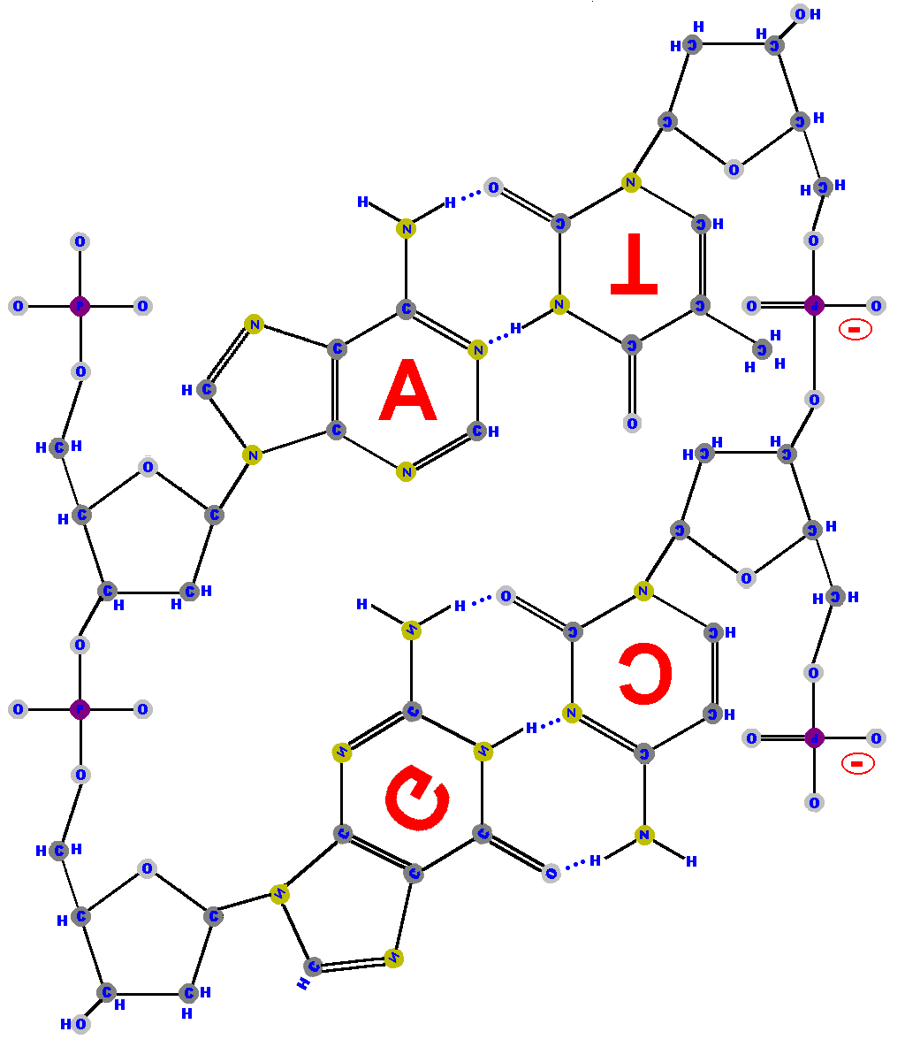
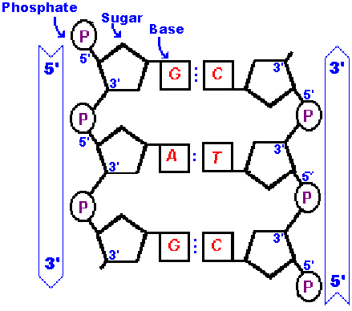
http://www.synapses.co.uk/genetics/dnastruc.html

Slide 7
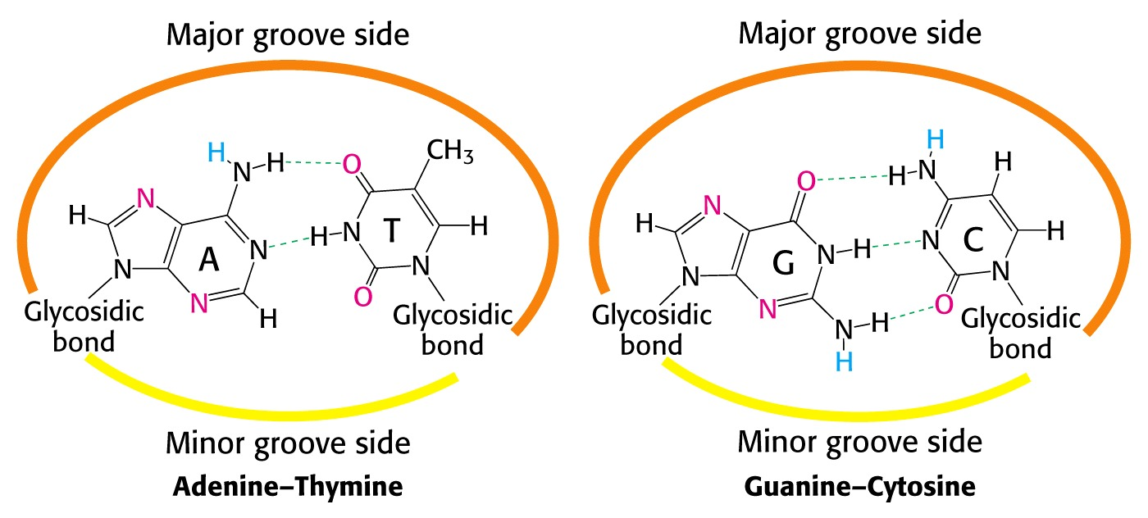
Notes:
Žlebova imata v notranjosti potencialne donorje (modri) in akceptorje (rdeči) vodikove vezi – omogočajo interakcije z drugimi molekulami.

Slide 8
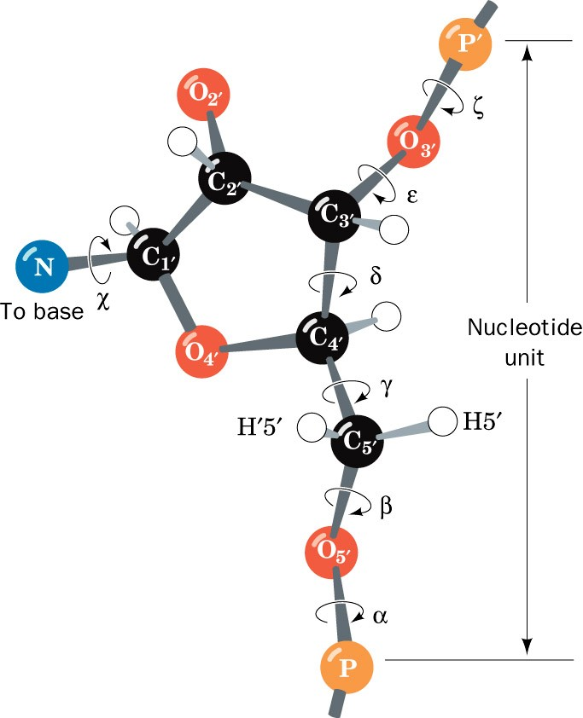
Konformacijo nukleotidne enote določa sedem torzijskih kotov.

Slide 9
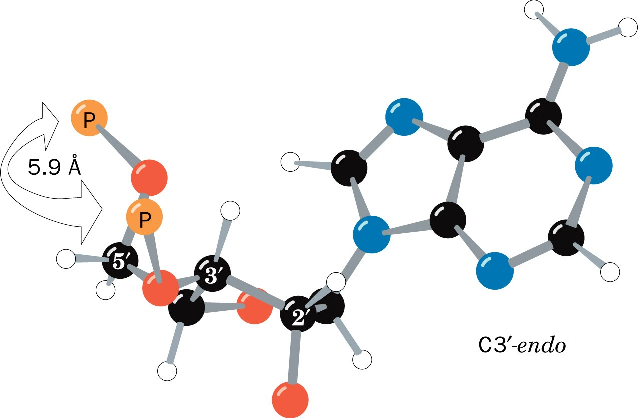
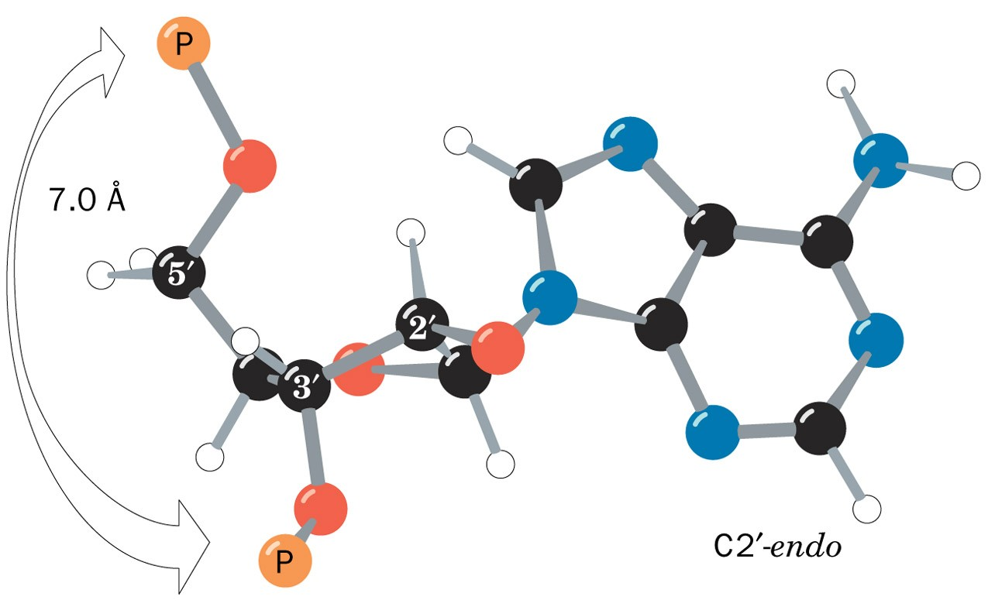

Slide 10
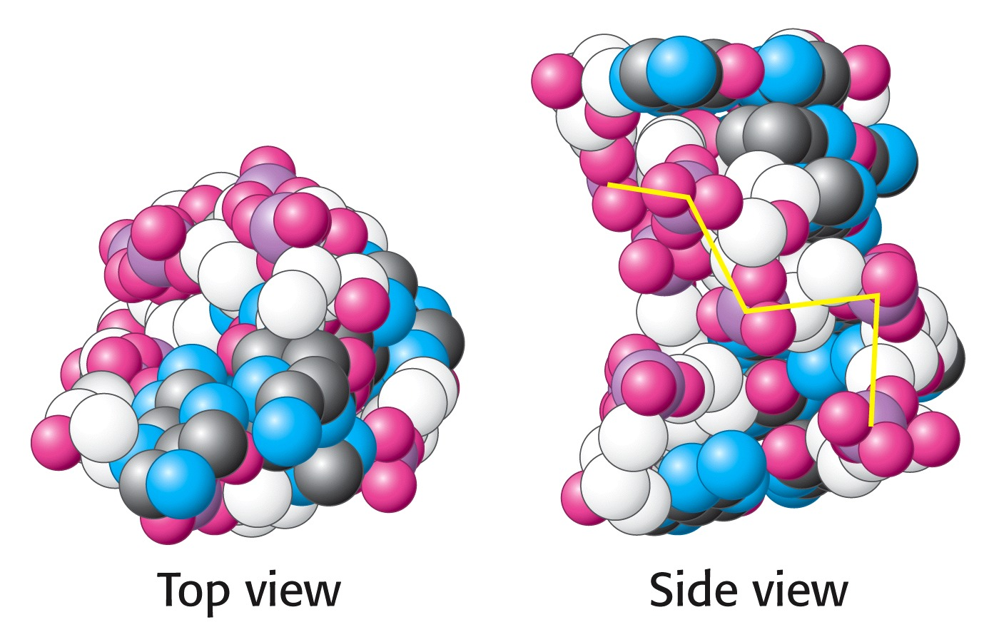
Z-DNA
oligonukleotid CGCGCG
Notes:
Z-DNA je na osnovi strukture 6-mera CGCGCG: levosučna vijačnica, fosfati nameščeni cikcakasto, ima samo 1izrazit žleb. Tako strukturo imajo le oligonukl. s ponavljajočim zaporedjem purin-pirimidin v pogojih visoke ionske moči.

Slide 11
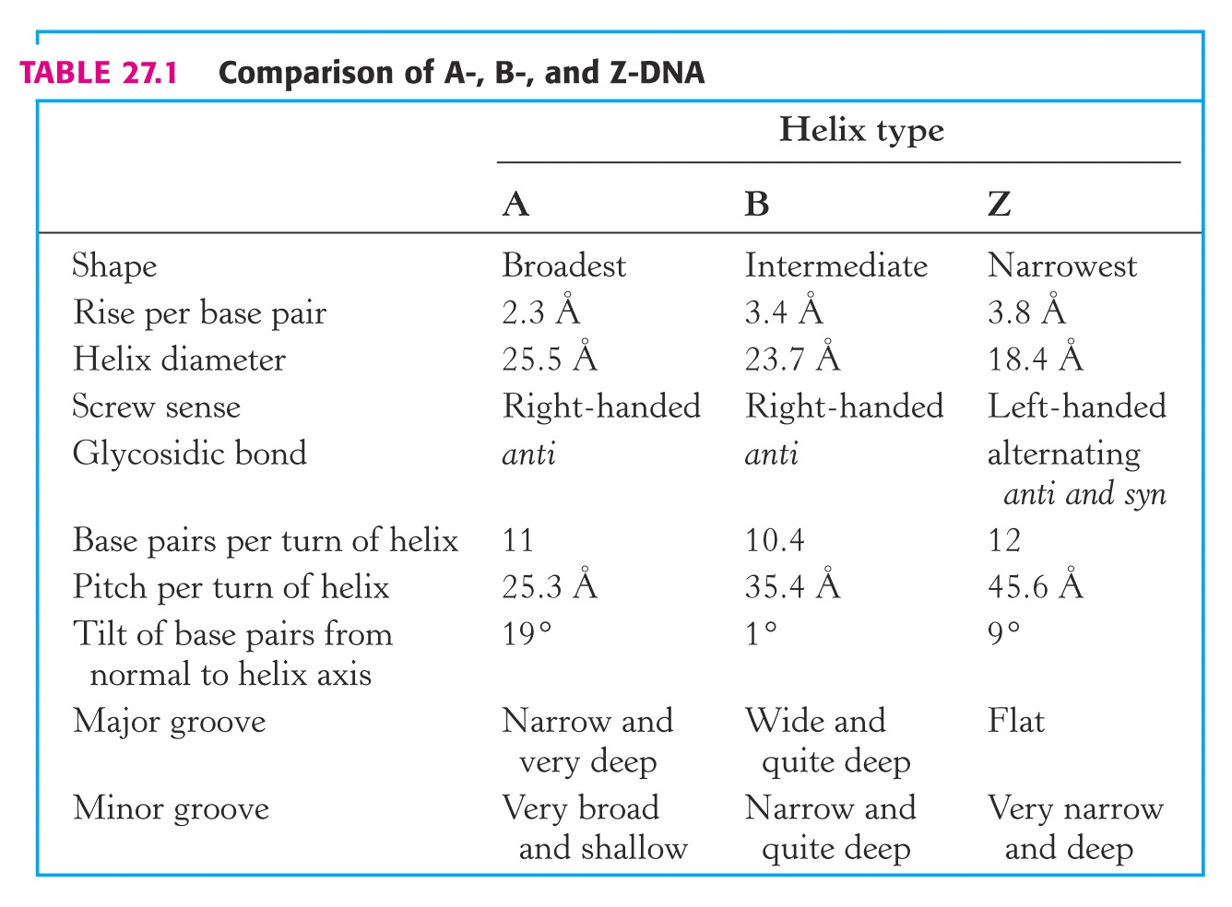

Slide 12
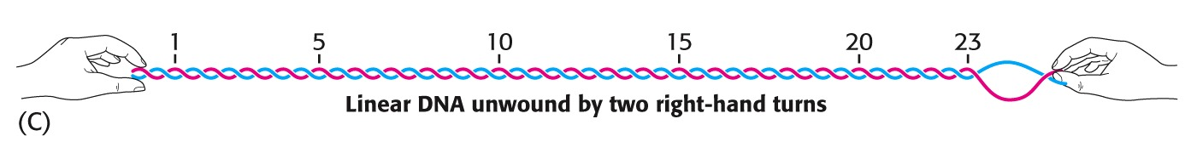
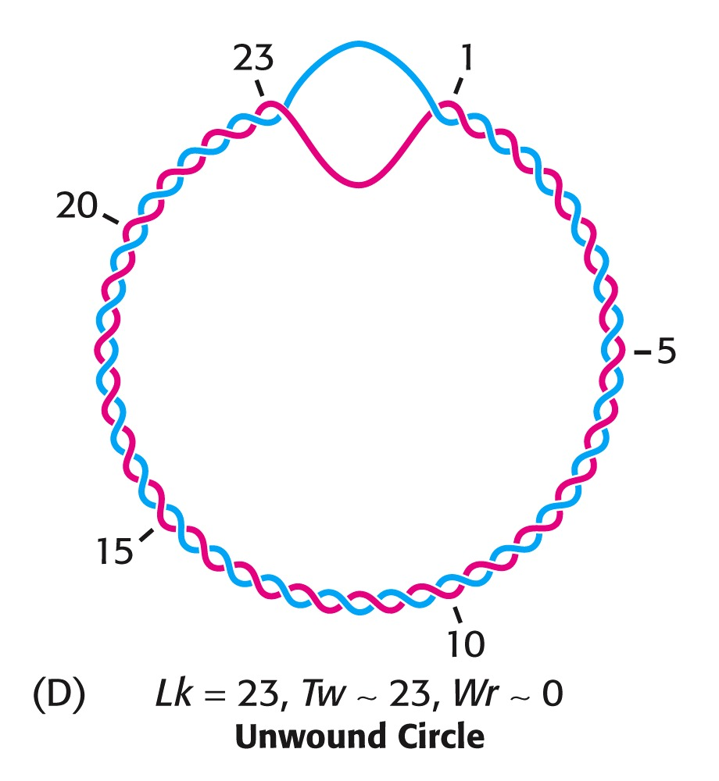
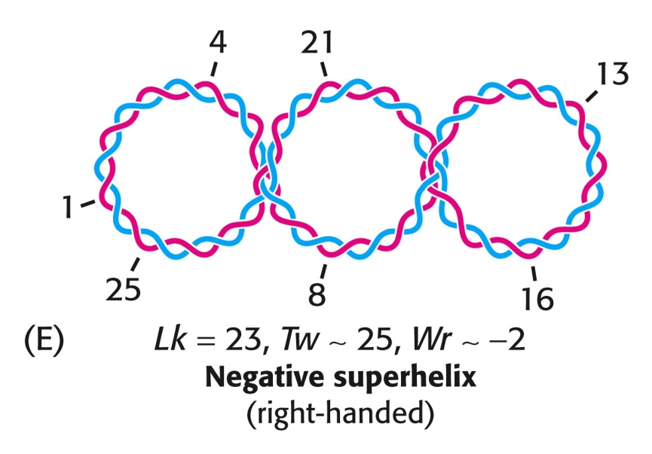
Lk: vezavno število (linking number) –
število skupnih zavojev
Tw: twisting number – število zavojev ene verige okrog druge
Wr: writhing number – število zavojev osi dvojne vijačnice… merilo ravni dodatnega zvitja
Lk = Tw + Wr
Notes:
Dodatno zvita DNA

Slide 13
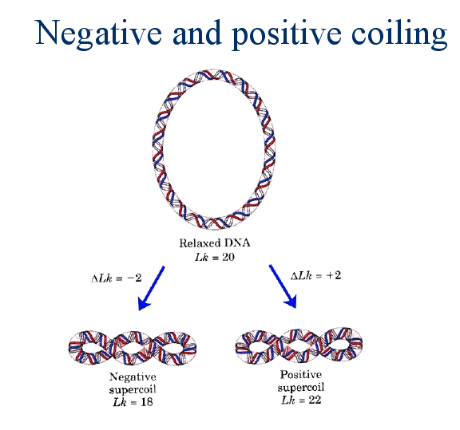
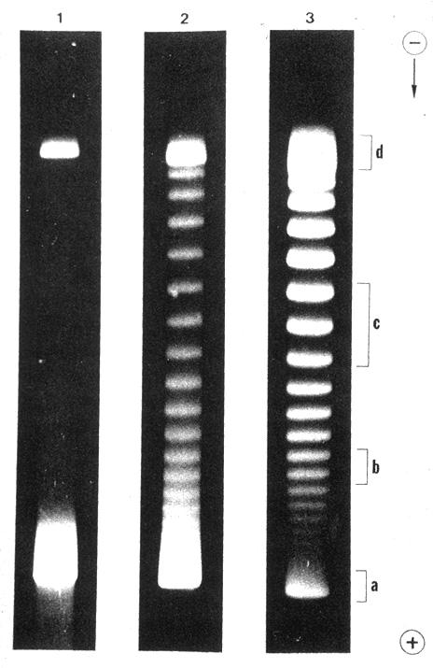
0 5 30 min.
Notes:
SV40 + topoI

Slide 14
Topoizomeraze
topoizomeraze tipa I
prerežejo 1 verigo DNA
sproščajo dodatne zavoje
termodinamsko ugodno
topoizomeraze tipa II
prerežejo 2 verigi DNA
uvedejo dodatne zavoje
porabljajo ATP

Slide 15
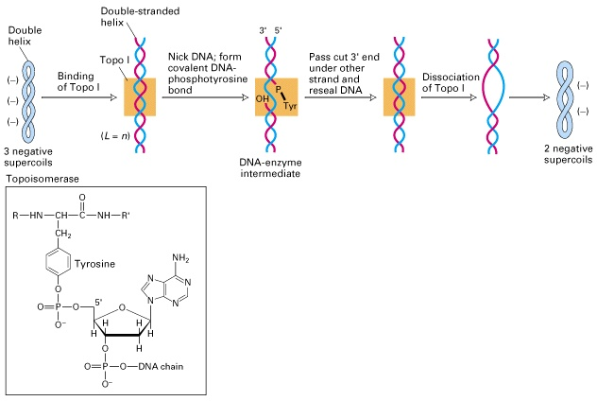

Slide 16
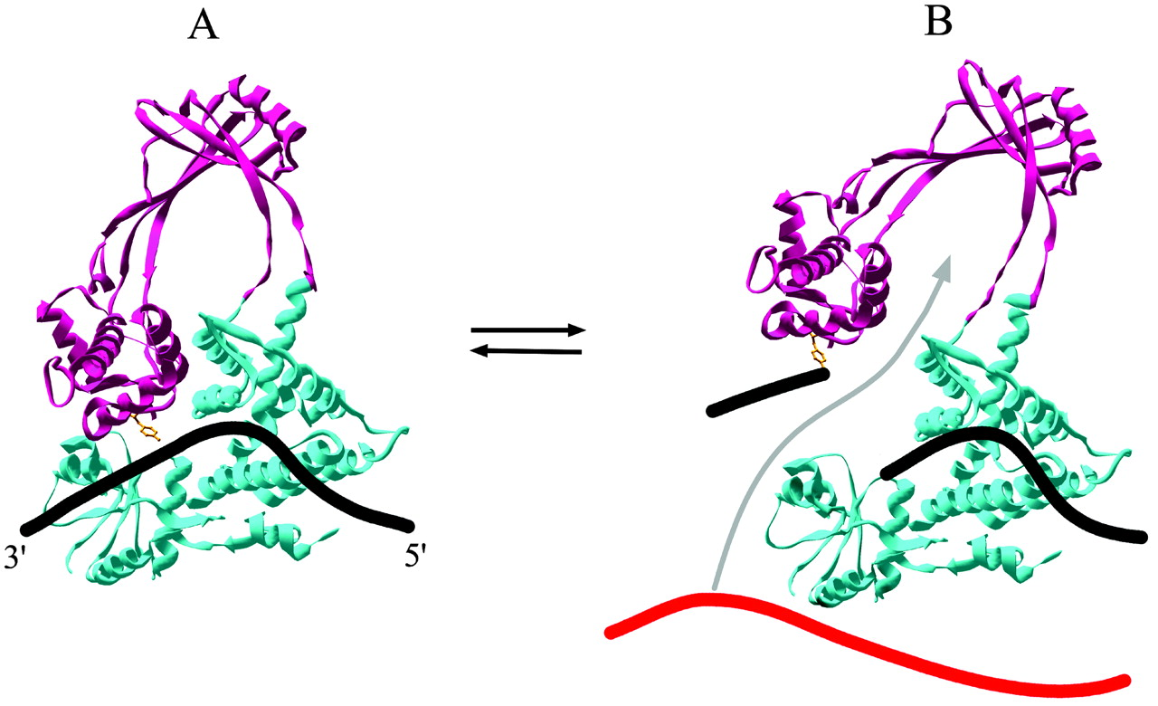
PNAS (2002) vol. 99 no. 19, 11998
Notes:
Enzyme-bridged DNA strand-passage model for type IA topoisomerases. The ribbon diagrams are based on the crystal structure of E. coli DNA topoisomerase I (PDB ID code ) and show A) the closed form of the enzyme before cleavage of the DNA (single strand of DNA modeled as a thick black line; and the open form after cleavage with both ends of the broken DNA strand associated with the enzyme (B). The active site tyrosine that becomes covalently attached to the 5′ end of the broken strand is shown in ball and stick and colored orange. The top region of the protein [domains II and III (8)] that is hypothesized to move upwards after cleavage is colored magenta; the bottom region (domains I and IV) is colored cyan. In B, strand passage moves a single strand of DNA from either the same or a different DNA molecule (shown in red) through the enzyme-bridged opening in the cleaved strand (movement depicted by gray arrow).

Slide 17
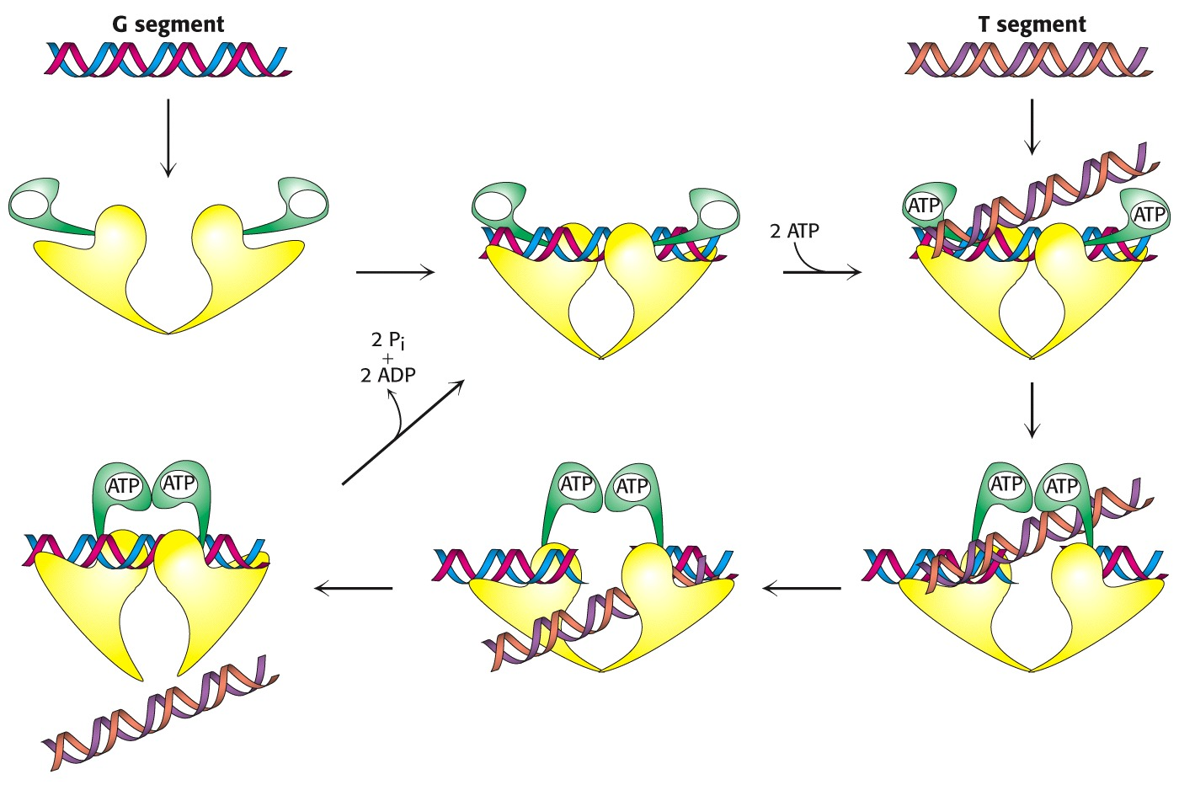
Notes:
mehanizem delovanja topoizomeraze II

Slide 18
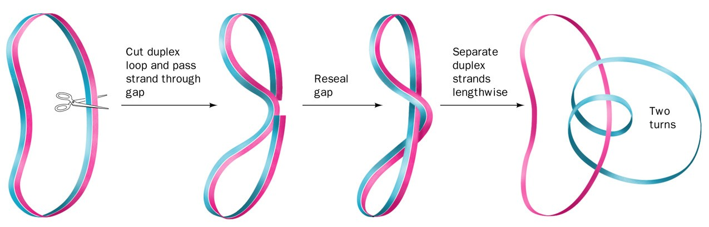
DNA-giraza (=bakterijska topoizomeraza tipa II) deluje tako, da prereže obe verigi dsDNA, nato pa pelje dsDNA skozi vrzel, ki jo na koncu ponovno zapre.

Slide 19
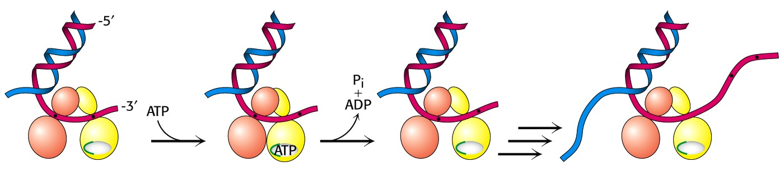
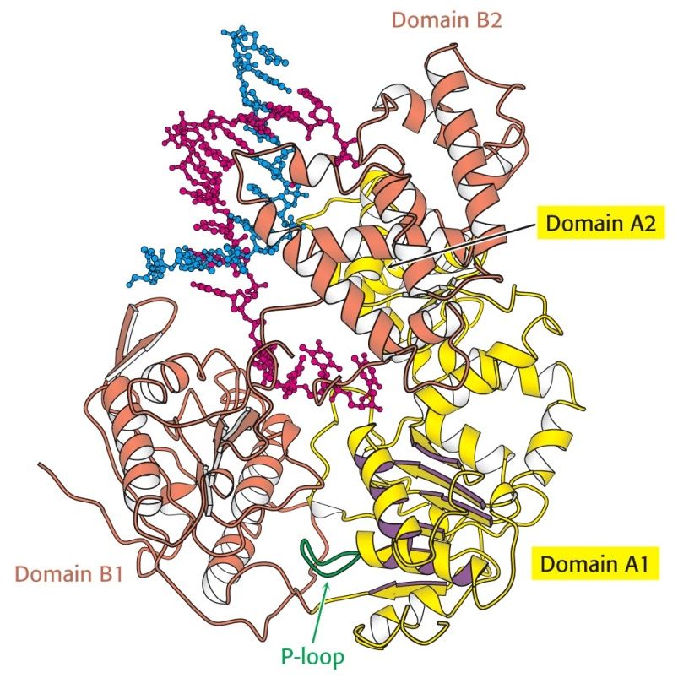
Notes:
mehanizem delovanja helikaz

Slide 20
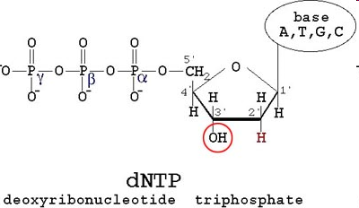
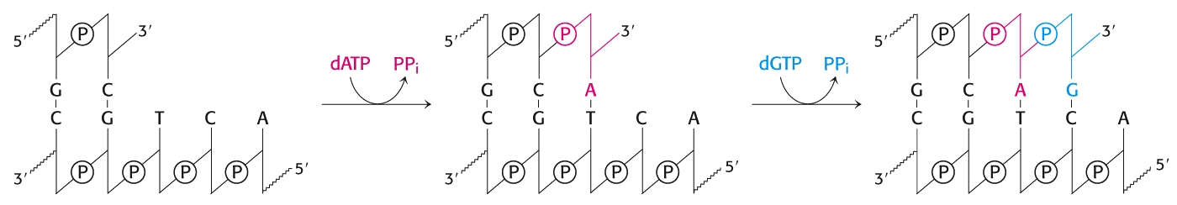
Notes:
princip sinteze 2. verige DNA oz. podaljševanja DNA v smeri 5’->3’ z delovanjem DNA-polimeraze (katalizira tvorbo fosfodiestrske vezi na osnovi matrice in ob prisotnosti začetnega oligonukleotida)

Slide 21
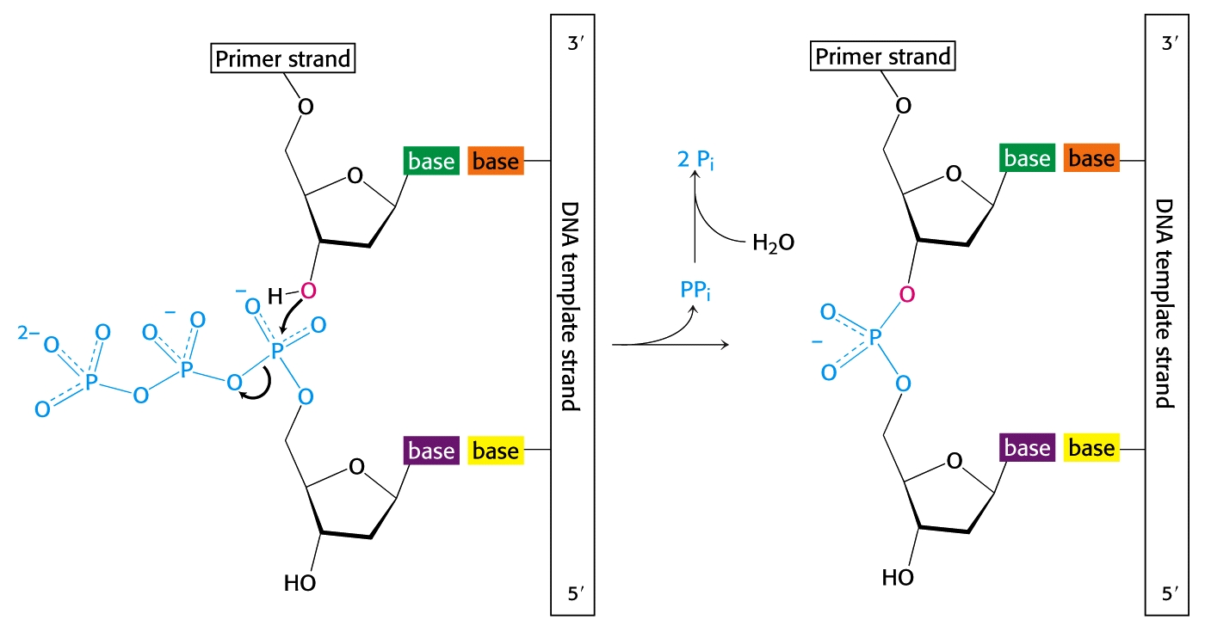
DNA-polimeraza
Notes:
DNA-polimeraza: nukleofilni napad OH skupine na 3’-koncu na notranji fosfor dNTP (deoksiribonukleozid-trifosfata); sledi odcep pirofosfata, ki se hidrolizira (pirofosfataza).
+ Eksonukleazna aktivnost omogoča popravljanje napačno vgrajene baze.

Slide 22
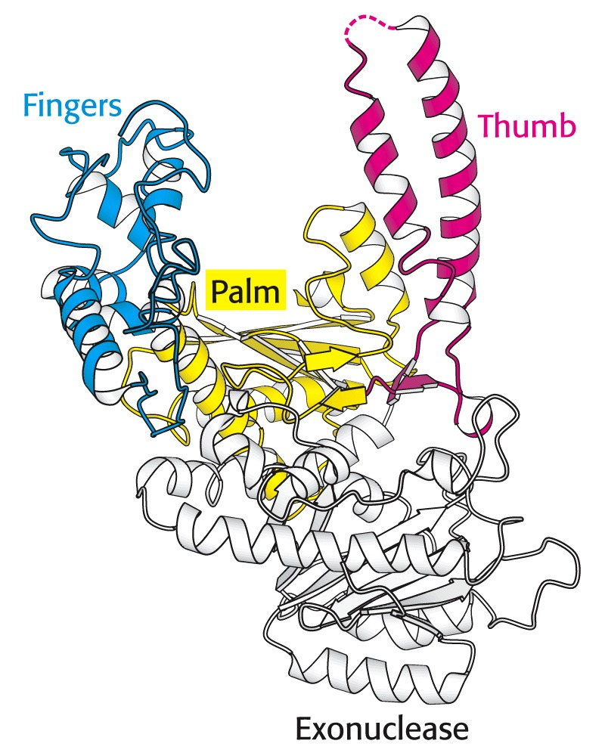
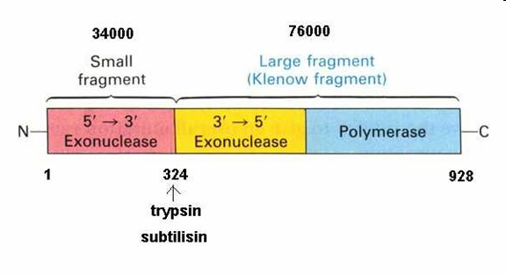
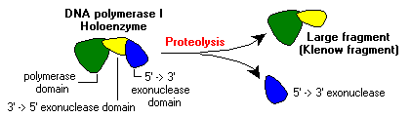
DNA-polimeraza I
(fragment Klenow: 604/928)
Notes:
zgradba fragmenta Klenow DNA-polimeraze I iz E. coli (Kornberg, 1955); sodeluje pri podvajanju in popravljanju, ni pa glavna polimeraza. Bila je prvi znani encim, ki je bil usmerjen na matrico (template-directed). Razen polimerazne (5’->3’) ima tudi eksonukleazno aktivnost v smeri 3’->5’, a odceplja samo nesparjene nukleotide. Katalitski mesti sta ločeni. Eksonukleaza deluje pri popravljanu napak.Vsi popravljalni sistemi skupaj imajo zanesljivost 10⁻¹⁰/generacijo. Encim ima tudi 5’->3’ eksonukleazno aktivnost, ki je pomembna pri podvajanju.
Polimerazna in 3’->5’ –eksonukleazna aktivnost sta na veliki podenoti (67 kDa, Klenow-encim po delovanju proteaz).

Slide 23
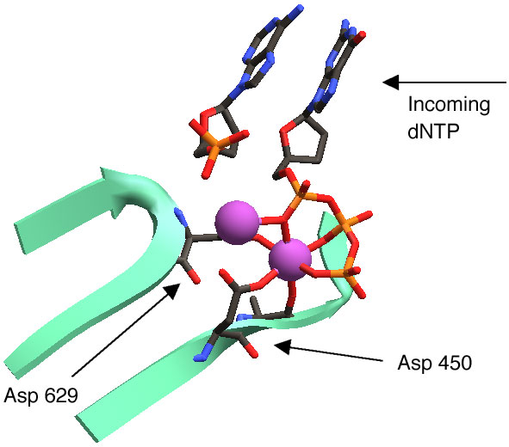
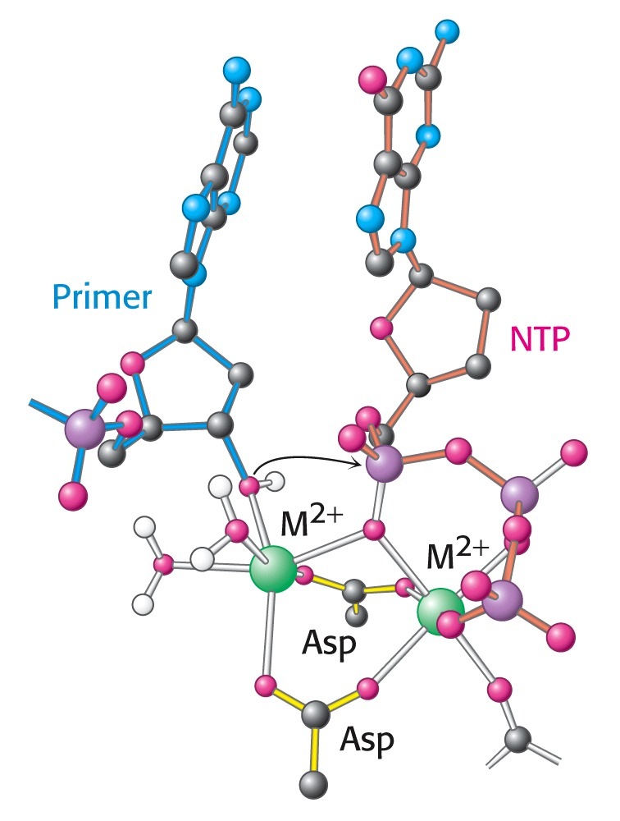
Notes:
mehanizem delovanja DNA-polimeraz: vloga kovinskih ionov

Slide 24
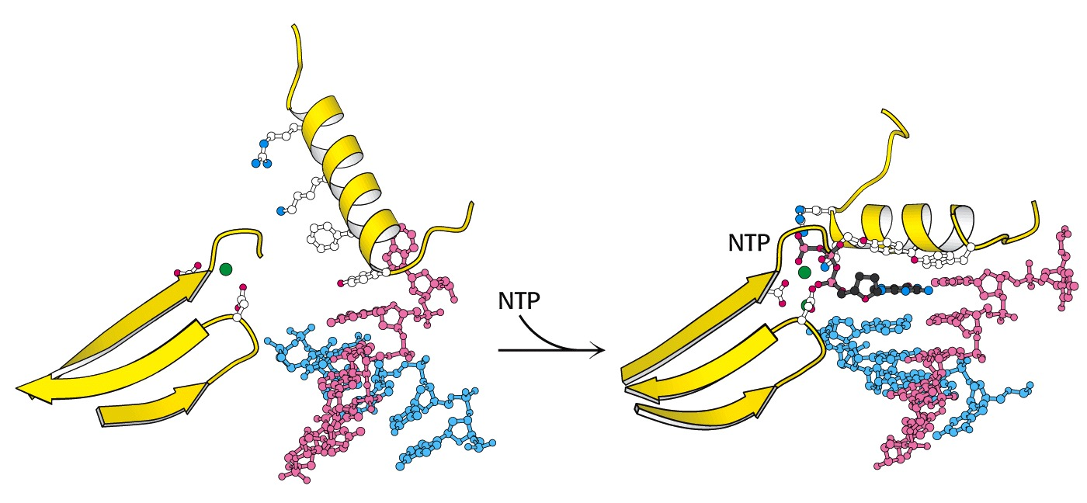
Notes:
‘prsti’ po vezavi dNTP zarotirajo, tako da nastane žep, v katerega se prilega le pravilno oblikovan bazni par

Slide 25
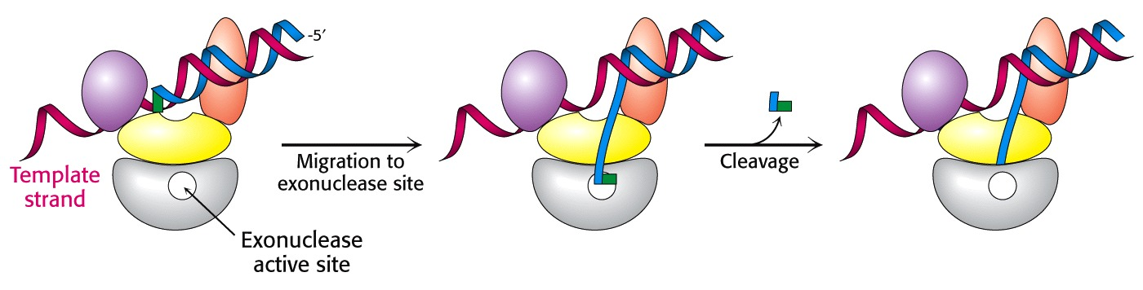
Notes:
aktivnost kontrolnega branja

Slide 26
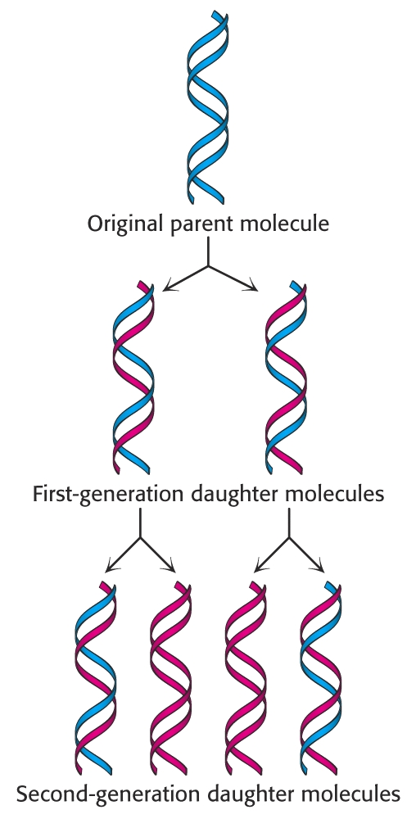
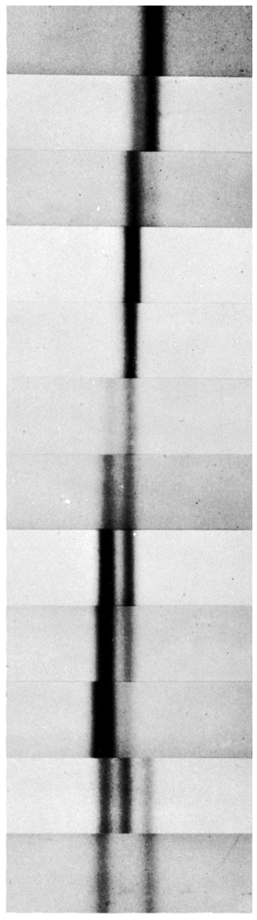
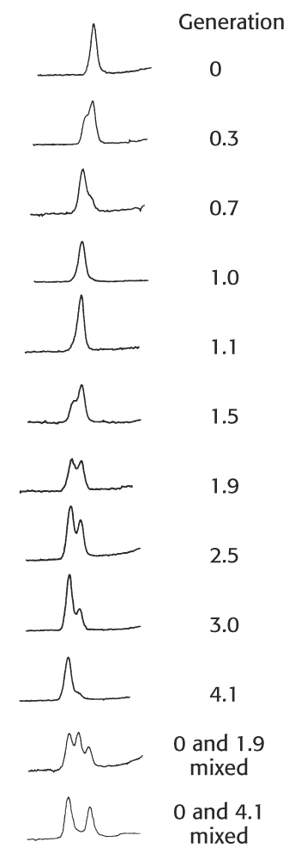
Notes:
Po 1 generaciji (delitvi) je 50% DNA že lahke (razlika v gostoti je 1%) v obliki hibrida; starševske težke DNA ni več. Po 2 generacijah je enako hibrida in lahke DNA.

Slide 27
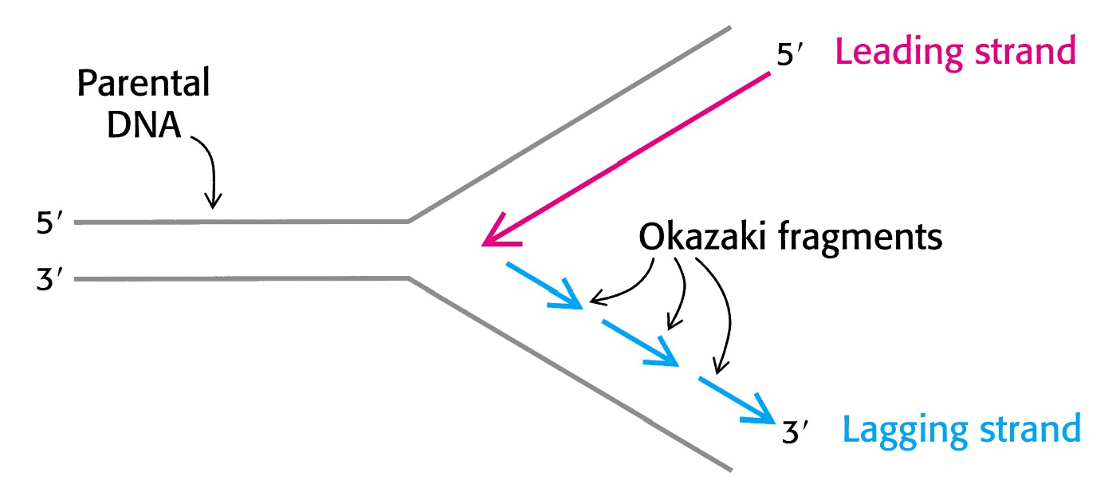
Notes:
Okazakijevi fragmenti so regije ~1000 nukleotidov, ki se prehodno pojavijo na mestu replikacijskih vilic na eni od verig. Povežejo se po delovanju DNA-ligaze. Sinteza teče v resnici v smeri 5’->3’ na obeh verigah.

Slide 28
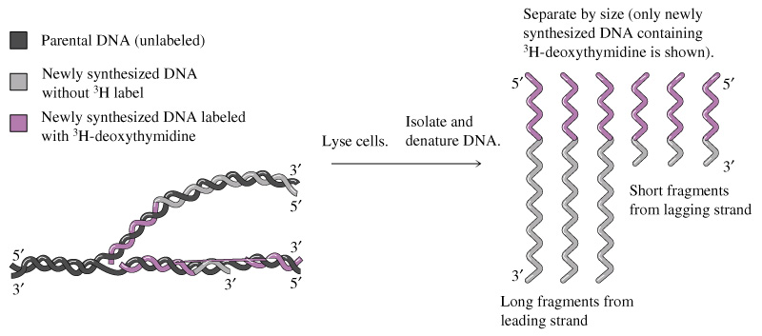

Slide 29
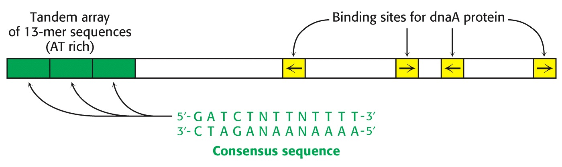
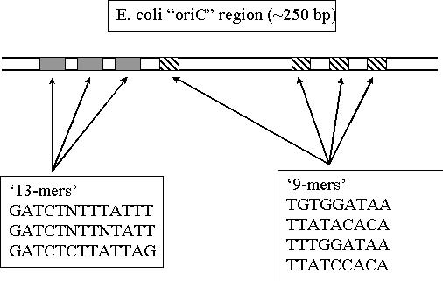
Notes:
Pri E. coli se podvajanje začne na mestu oriC (245 bp): z AT bogata regija omogoča taljenje DNA. Sledi vezavno mesto za protein dnaA, ki skupaj z dnaB in C upogne in razpre vijačnico (dnaB je helikaza). Razprt heliks stabilizira SSB (protein, ki veže enoverižno DNA), 4mer po 19 kDa. Dodatno zvitje ponovno uvaja giraza.

Slide 30
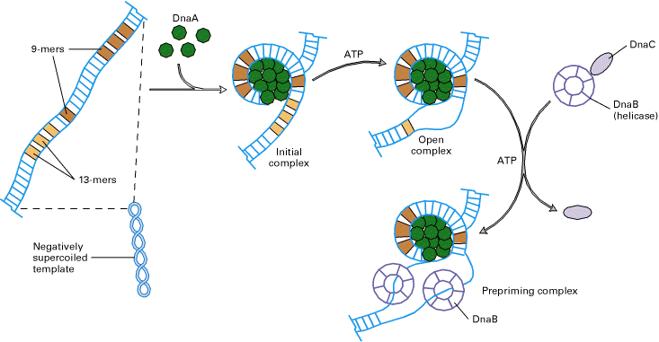
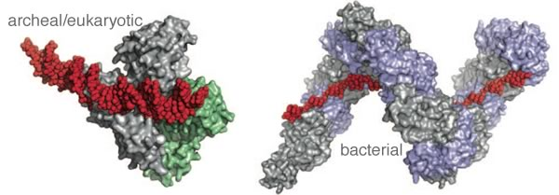
DnaA
Notes:
Pri E. coli se podvajanje začne na mestu oriC (245 bp): z AT bogata regija omogoča taljenje DNA. Sledi vezavno mesto za protein DnaA, ki skupaj z DnaB in C upogne in razpre vijačnico (DnaB je helikaza). Razprt heliks stabilizira SSB (protein, ki veže enoverižno DNA), 4mer po 19 kDa. Dodatno zvitje ponovno uvaja giraza.

Slide 31
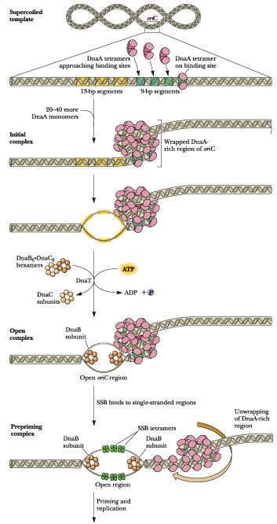
Notes:
http://web.virginia.edu/Heidi/chapter30/chp30.htm
Figure 30.16 × The probable course of events during initiation of E. coli replication at oriC. Tetramers of DnaA protein bind at each of the four 9-bp repeats in oriC; then additional DnaA protein binds to give a nucleosomelike structure with DNA on the outside. The three 13-bp A:T-rich regions are then “melted” to yield an open complex, and the DnaB protein delivered from the DnaB:DnaC protein complex enters. The helicase activity of DnaB unwinds the duplex, displacing DnaA protein. SSB protein binds to single-stranded DNA as it is generated, preventing its re-annealing.

Slide 32
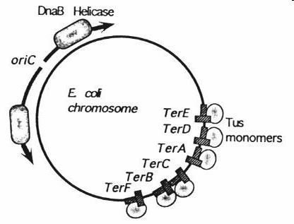
http://mol-biol4masters.org/Prokaryotic_DNA_Replication3-E_coli_DNA_Replication.htm
Notes:
Exactly opposite to the site of origin, a termination site is located, where replication ends. In this region there are six 23 bp long identical, non-palindromic sequences are found, where three each of them are oriented in opposite direction. They are Ter-E, D and A on one side and Ter-C, B and F are on the other side. The said sequences are recognized by a protein called Tus (37.08 kd) (Terminator Utilizing proteins), which binds to the said sequences and prevent the movement of replication fork into newly formed DNA for another round of replication cycle, otherwise the replication progresses in to newly made strands and the DNA is subjected to another round of replication. TER sequences act as a sort of trap, where replication fork can enter but cannot exit. However, the TER sequences are not obligatory; for even in the absence of them, or even if they are deleted, replication completes without any hitch.

Slide 33
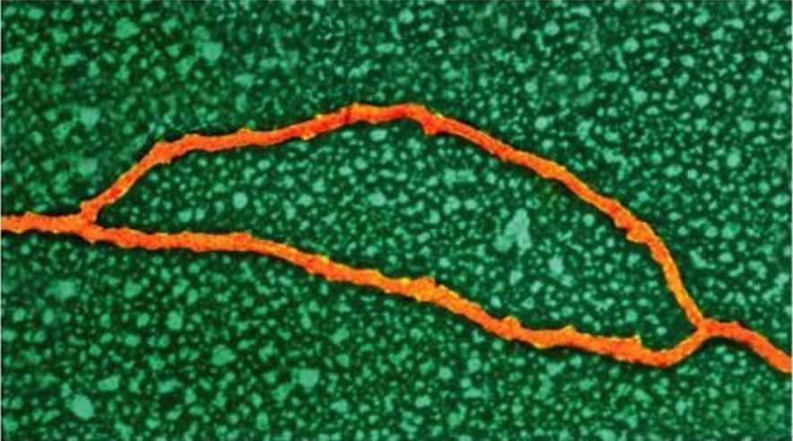
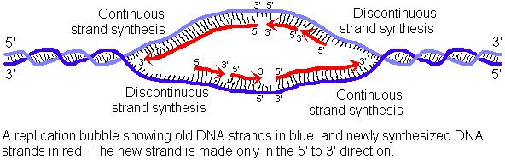
http://bio3400.nicerweb.com/Locked/media/ch11/HeLa.html
Replikacijski
mehurček
http://homepages.ius.edu/GKIRCHNE/DNA.htm
Notes:
Transmission electron micrograph of human DNA from a HeLa cell, illustrating replication forks and the associated replication bubble.

Slide 34
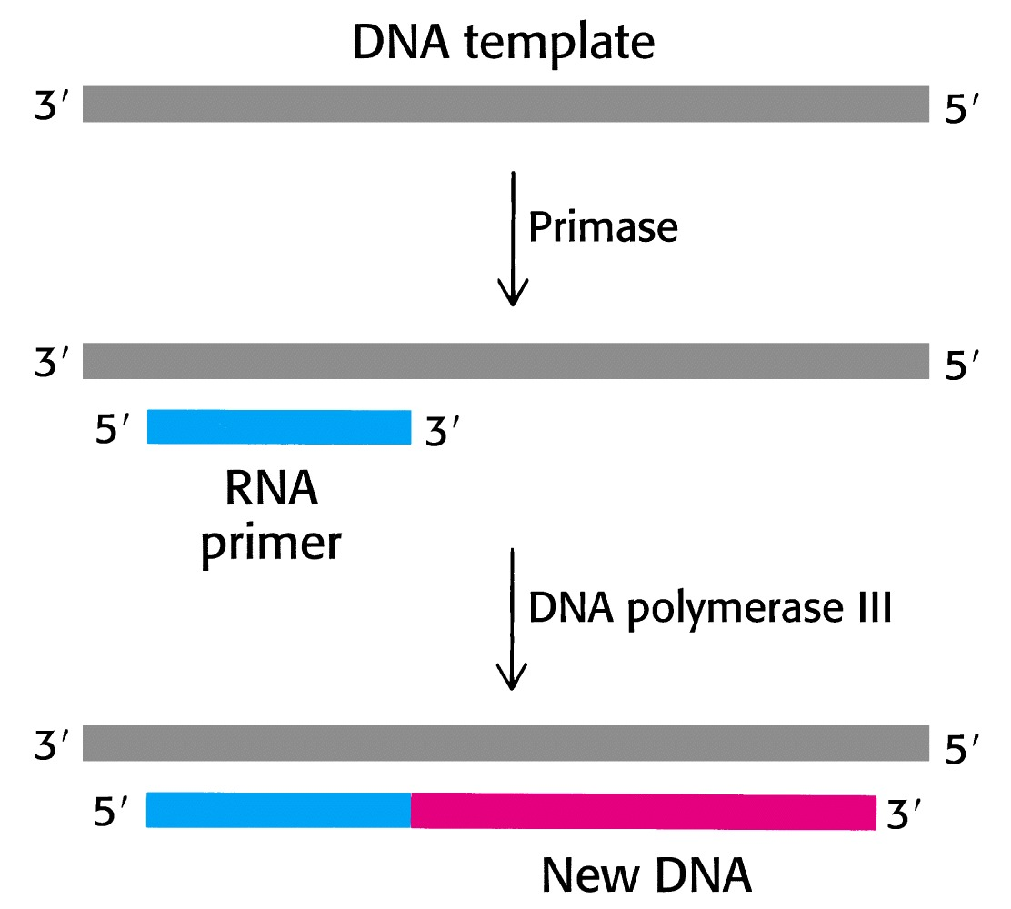
Notes:
in vivo večino polimerazne aktivnosti opravi polimeraza III, pol I pa sodeluje predvsem pri razgrajevanju začetnih oligonukleotidov in pri zapolnjevanju vrzeli. Pol II predvsem popravlja napake. Pri podvajanju sodeluje >20 proteinov.
Primaza je posebna RNA-pol, ki sintetizira kratko RNA (~5 b); ta se odstrani na koncu sinteze s 5’->3’ eksonukleazno aktivnostjo DNA-pol I.

Slide 35
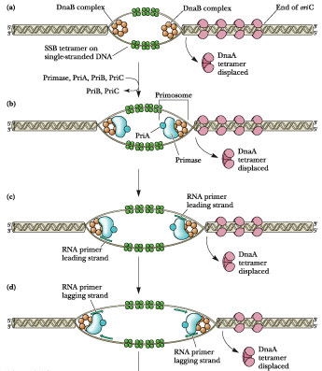
Notes:
http://web.virginia.edu/Heidi/chapter30/chp30.htm
Figure 30.17 × A representation of replisome assembly at each replication fork. (a) The “pre-priming complex” of Figure 30.16 is the starting point. (b) Protein PriA is loaded onto the primosome by the PriB and PriC proteins. Once PriA has joined DnaB, primase follows. This completes assembly of the primosome. An RNA primer is synthesized at each replication fork by primase, (c) one for the leading strand and (d) one for the lagging strand. Two DNA polymerase III holoenzyme complexes (e) at each replication fork carry out DNA elongation, one synthesizing the leading strand and the other the lagging strand. Primase association with DnaB is transient; once a primer has been synthesized, primase dissociates until another round of primer synthesis is necessary.

Slide 36
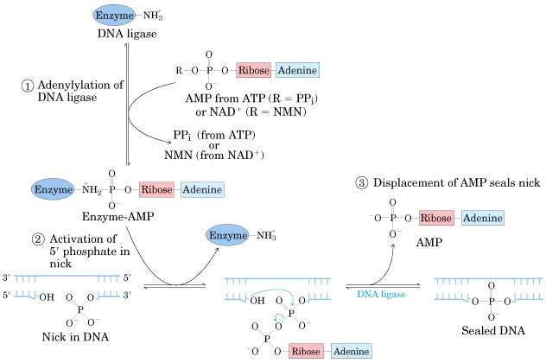
Delovanje DNA-ligaze:
povzetek reakcij

Slide 37

Notes:
mehanizem delovanja DNA-ligaze:
aktivacija encima (AMP vezan na Lys)
prenos AMP na fosfatno sk. na 5’-koncu (DNA-adenilatni kompleks)
nukleofilni napad 3’-OH skupine na aktivirani fosfor
porablja se energija hidrolize pirofosfata: 2P / 1 vez

Slide 38


DNA-pol III
EMBO Journal (1998) 17, 2436 - 2449
Notes:
model DNA-pol III: sintetizira ~1000 b/s (pol I: 10/s) z veliko natančnostjo. Holoencim ima 10 razl. polipeptidnih verig in ima maso 900 kDa (~10x več kot pol I); gre za asimetrični (zaradi različnega postopka podvajanja vodilne in zastajajoče verige) dimer.
veriga alfa: polimeraza; eta: 3’->5’ eksonukleaza; beta: obdaja DNA in s tem pospeši delovanje encima.

Slide 39


Slide 40

http://www.molbio.uoregon.edu/~pvh/dong_research.html
Notes:
gp32 = SSB iz faga T4

Slide 41



Slide 42

DNA-polimeraze pri E. coli

Slide 43


Slide 44

PNAS (2005) 102, 5096-5101
Replikacijske vilice bakteriofaga T7
gp2.5: SSB, gp4: helikaza/primaza, gp5: DNA-polimeraza, trx: tioredoksin E. coli (procesivnostni faktor)
Notes:
Model of the replication fork of phage T7. The replisome consists of DNA polymerase (gp5), the processivity factor thioredoxin (trx), the hexameric helicase/primase (gp4), and the ssDNA-binding protein (gp2.5). The leading strand is extended continuously by gp5/trx in association with gp4, whose helicase domain is responsible for unwinding the duplex DNA. The ssDNA (lagging strand) extruded behind the helicase is coated by gp2.5. The polarity of lagging-strand synthesis is aligned with synthesis of the leading strand through loop formation. Another gp5/trx, tethered to the hexameric gp4, synthesizes the replication of Okazaki fragments (O.F.) that are initiated by RNA primers (in green), which are synthesized by the primase domain of gp4. The acidic C termini of gp4 and gp2.5 are shown schematically as red tails.

Slide 45

PNAS (2005) 102, 5096-5101
Recikliranje polimeraze bakteriofaga T7
Ko sinteza doseže predhodni OF, polimeraza na zastajajoči verigi disociira z matrice, ob tem pa se konformacijsko spremeni in poveča se afiniteta njegove vezave na gp4 (1,2). Po vezavi na gp4 najde nov z.o. (4 nt RNA; vezan na primazo), pri čemer se SSB vežejo na tioredoksin vezavno domeno DNA-pol, to pa olajša vezavo DNA-pol na cink vezavno domeno primaze (4-6).
Notes:
Model for the recycling of lagging-strand DNA polymerase. The components of the T7 replisome are described in Fig. 1. (A) The lagging-strand DNA polymerase interacts with the C-terminal region of gp4 during primer delivery. The lagging-strand DNA polymerase synthesizes an Okazaki fragment (Current O.F.) until it reaches the 5′ end of the previously synthesized Okazaki fragment (Previous O.F.). At this point, the polymerase dissociates from the primer/template (number 1). Dissociation results in a conformational change in the TBD that favors its interaction with the C-terminal tail of gp4 (number 2). Before the interaction shown in step number 2, the lagging-strand DNA polymerase interacts with gp4 in no C-terminal dependent fashion as depicted in Fig. 1. A new tetraribo-nucleotide primer is synthesized by the primase domain and held by the ZBD (see C) (number 3). (B) Recycling of the lagging-strand polymerase. The flexible binding of the polymerase via the TBD to the C-terminal tail of gp4 allows it to search for a new primer located in the N-terminal region of gp4 (number 4). Flexible segments linking the catalytic core of the primase domain to its ZBD and the helicase domain (see C) allow for movement of the ZBD and bound primer to contact the approaching gp5/trx (number 5). Gp2.5 binds to the TBD to assist the union of the polymerase and the ZBD (number 6).

Slide 46
Notes:
Organization of the Escherichia coli replicase. The E. coli replisome uses twin Pol III core enzymes (orange) to copy leading and lagging strands. Sliding clamps
(dark blue) confer processivity to the Pol III core by tethering the polymerase to DNA. The clamp loader (light purple) uses the energy of ATP hydrolysis to assemble sliding
clamps on DNA at primed sites. The clamp loader crosslinks leading and lagging strand polymerases and binds to the replicative helicase (yellow). The replicative helicase
unwinds duplex DNA ahead of the replication fork and stimulates primase activity. Primase (dark purple) synthesizes short RNA primers. SSB (turquoise) prevents
secondary structure formation of single-stranded DNA.

Slide 47
Vstavljanje DNA v drsno vponko
Notes:
The clamp-loading process. The multisubunit AAA+ clamp loader uses the energy of ATP hydrolysis to assemble sliding clamps at primed sites. In the presence of ATP, the clamp loader binds to and opens a sliding clamp. The clamp loader selectively binds to primer-template junctions, which stimulates ATP hydrolysis and results in dissociation of the clamp loader from the clamp and closure of the sliding clamp around DNA. DNA polymerase is recruited to the primer-template junction by the sliding clamp assembled onto the RNA primer.

Slide 48

„model pozavne“ (trombone model)
Notes:
http://www.biol.ttu.edu/faculty/densmore/Shared%20Documents/BIOL%204320,%205320/Lectures%20for%20Exam%202/Molecular%20Lecture%20-%202.14.08.pdf

Slide 49

Notes:
http://www.biol.ttu.edu/faculty/densmore/Shared%20Documents/BIOL%204320,%205320/Lectures%20for%20Exam%202/Molecular%20Lecture%20-%202.14.08.pdf

Slide 50

Notes:
http://www.biol.ttu.edu/faculty/densmore/Shared%20Documents/BIOL%204320,%205320/Lectures%20for%20Exam%202/Molecular%20Lecture%20-%202.14.08.pdf

Slide 51
Notes:
Protein dynamics at the Escherichia coli replication fork. Leading strand synthesis is a continuous process that requires only one or a few priming events. The
lagging strand is synthesized in multiple discontinuous DNA segments called Okazaki fragments. (a) An Okazaki fragment is initiated when primase synthesizes a short RNA primer along the lagging strand. Primase dissociates from DNA upon completion of primer synthesis. (b) The g complex clamp loader uses the energy of ATP to ‘crack’ open and assemble the b-clamp at the newly primed site. The clamp loader dissociates from DNA upon completion of clamp assembly leaving b behind at the 30 primer terminus. (c) The lagging strand polymerase dissociates from b upon completion of an Okazaki fragment and cycles to the b-clamp assembled at the newly primed site. The b-clamp is left behind on the completed Okazaki fragment. (d) The lagging strand polymerase initiates DNA synthesis of the Okazaki fragment.

Slide 52



Slide 53
MICROBIOLOGY AND MOLECULAR BIOLOGY REVIEWS, Sept. 2005, p. 501–526
Notes:
Nucleotide sequences of Ter sites from the E. coli chromosome. Base pairs that interact with the Tus protein are indicated by the shaded regions. In the orientation shown for these sequences, replication forks approaching from the left are blocked, while those entering from the right are unimpeded. (tus = termination utilization substance)
Replisome of E. coli and mechanism of replication fork arrest by a Tus-Ter complex. (A) The replisome moving along the DNA template approaches Tus, and the DnaB helicase assists primase to lay down the last lagging-strand primer. (B) DnaB helicase action is blocked by Tus, and DnaB dissociates from the template. (C) DNA polymerase III (Pol III) holoenzyme completes leading-strand synthesis up to the Tus-Ter complex and (D) synthesizes the last Okazaki fragment on the lagging strand, which will eventually be ligated by DNA ligase to the penultimate fragment following removal of its RNA primer by DNA polymerase I (not shown). (E) The holoenzyme then
dissociates, leaving a Y-forked structure that is single stranded on the lagging strand near the Tus-Ter complex.

Slide 54

kromosomi z več vilicami (multiforked chromosomes)
Lewin: Genes VIII

