Slide 1
Zorenje RNA
Voet 3: poglavje 31.4
Stryer 5: poglavji 28.3 in 28.4
Krebs 3: poglavje 21

Slide 2
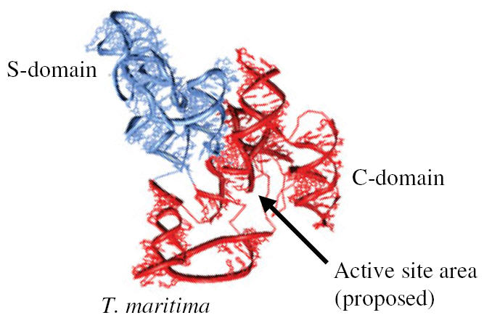
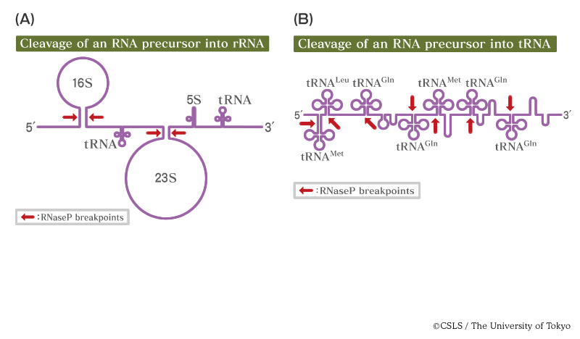
Notes:
Katalitični del RNAzeP iz T. maritima (2007).
Dva različna tipa prekurzorjev pri E. coli.

Slide 3
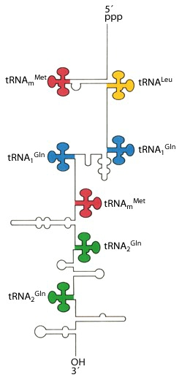
OPERON | tRNA GENES
rrnA | tRNA-Ile, tRNA-Ala
rrnB | tRNA-Glu
rrnC | tRNA-Glu, tRNA-Asp, tRNA-Trp
rrnD | tRNA-Ala, tRNA-Ile, tRNA-Thr
rrnE | tRNA-Glu
rrnG | tRNA-Glu
rrnH | tRNA-Ala, tRNA-Ile, tRNA-Asp
Pri E. coli je 7 operonov, ki zapisujejo za rRNA (tri velikosti) + za nekatere tRNA (zgoraj).
Dodatni operoni vsebujejo samo zapise za (po več) tRNA (desno).
Notes:
http://www.mun.ca/biochem/courses/3107/Lectures/Topics/tRNA.html

Slide 4
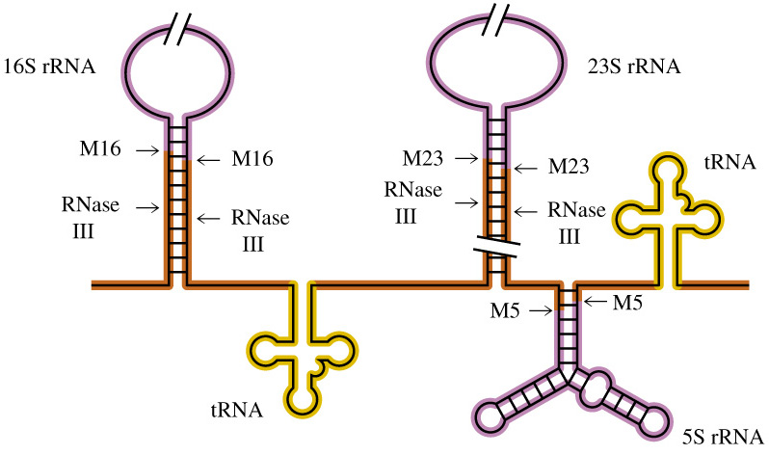
Notes:
The primary transcript contains a copy of each of the three ribosomal RNAs and may also contain several tRNA precursors. The large rRNA precursors are cleaved from the large primary transcript by the action of RNase III. The ends of the 16S, 23S, and 5S rRNAs are trimmed by the action of endonucleases M16, M23, and M5, respectively. (Slash marks indicate that portions of the rRNA primary transcript have been deleted for clarity.)
Eukaryotic rRNA are also processed from large primary transcripts that contain one copy of three or the eukaryotic ribosomal subunits, 18S, 5.8S and 28S.

Slide 5
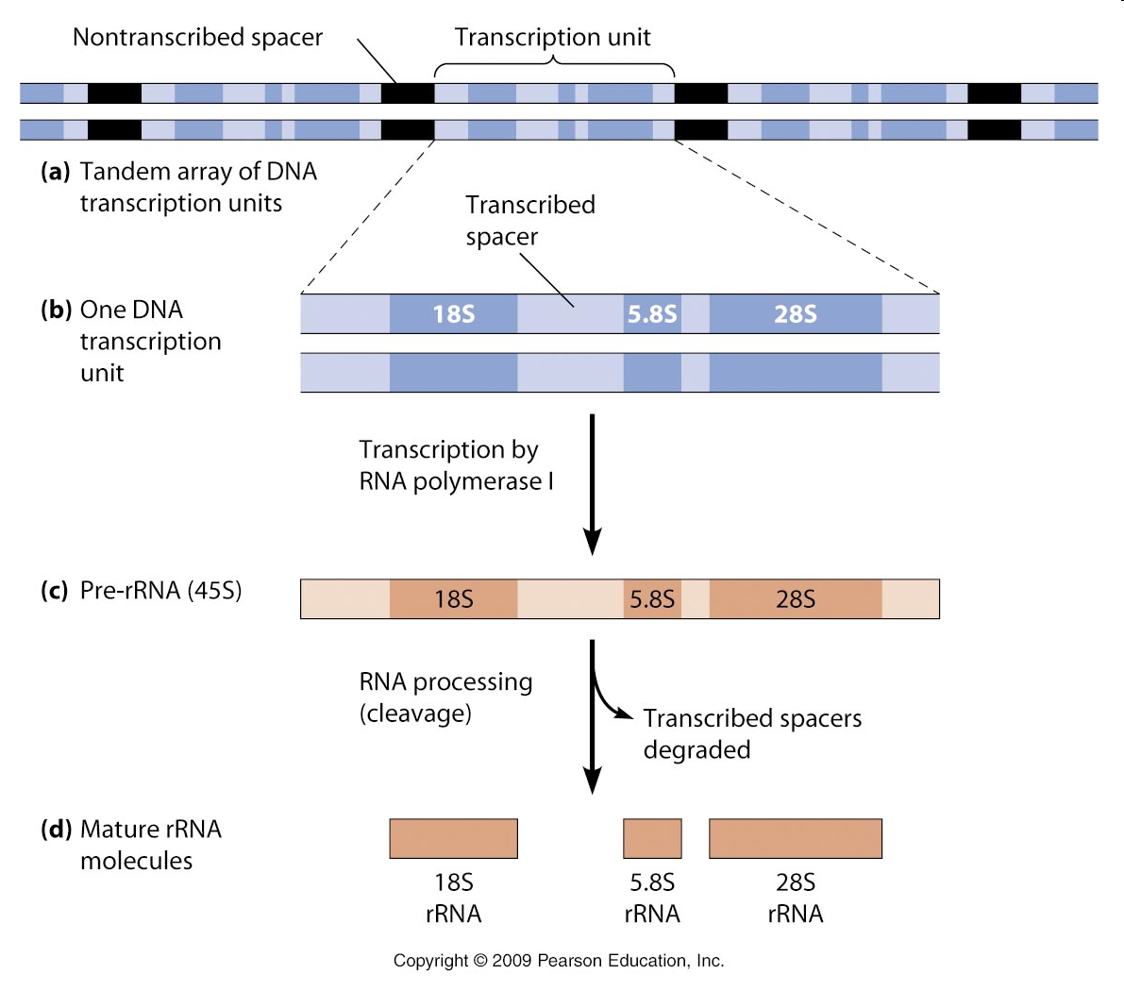
Notes:
http://www.mun.ca/biology/desmid/brian/BIOL2060/BIOL2060-21/2115.jpg

Slide 6
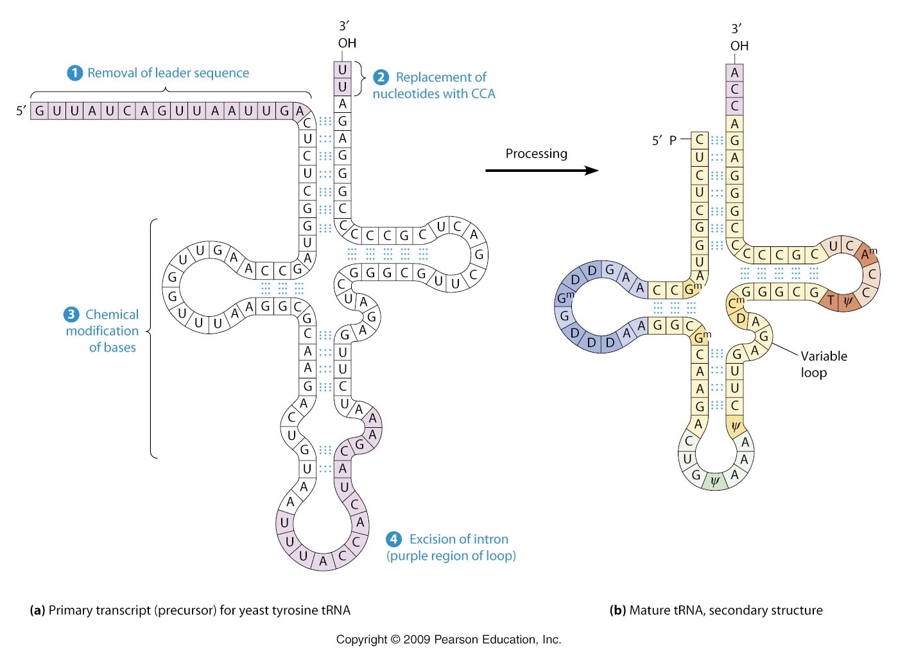
Notes:
procesiranje prekurzorja tRNA: izcep introna, odcep signalnega zaporedja, dodatek CCA – deluje več encimov
CCA se mora dodati samo pri tistih tRNA, ki tega konca nimajo zapisanega na ravni DNA. Tudi introna na antikodonski zanki nimajo vse tRNA.

Slide 7
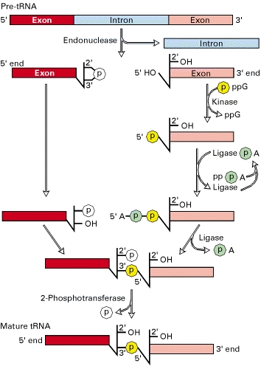
Povezovanje delov tRNA po izrezu introna
Lodish 4
Notes:
Pri kvasovkah ima intron 59 od 272 genov za tRNA. Dolgi so 14 do 60 nt in imajo zelo različna nt zaporedja. Za prepoznavanje introna je ključna sekund. struktura.
First, the pre-tRNA is cleaved at two places, on each side of the intron, thereby excising the intron. The cleavage mechanism generates a 2′,3′-cyclic phosphomonoester at the 3′ end of the 5′ exon. The multistep reaction joining the two exons requires two nucleoside triphosphates: a GTP, which contributes the phosphate group (yellow) for the 3′ → 5′ linkage in the finished tRNA molecule; and an ATP, which forms an activated ligase-AMP intermediate. The 2′-phosphate on the 5′ exon is removed in the final step. [See E. M. Phizicky and C. L. Greer, 1993, Trends Biochem. Sci. 18:31.]

Slide 8
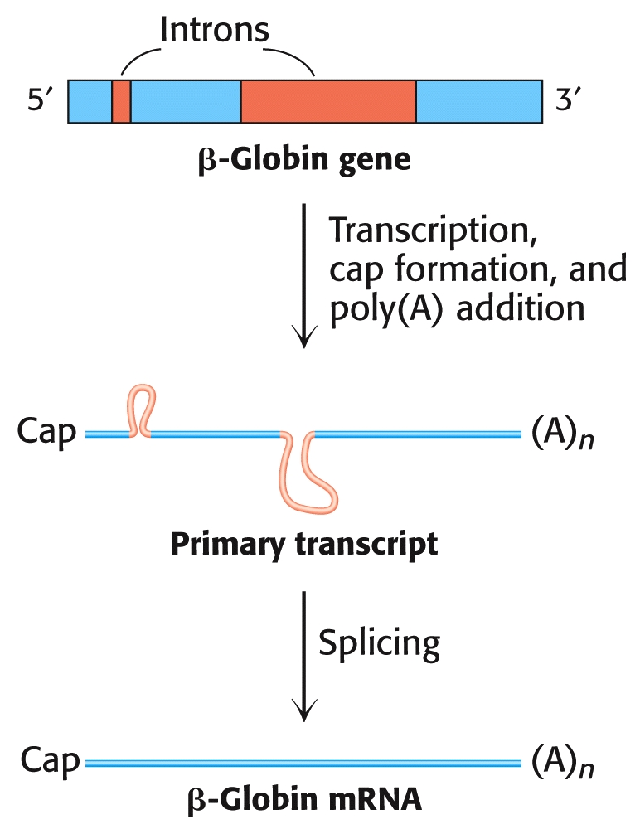

Slide 10
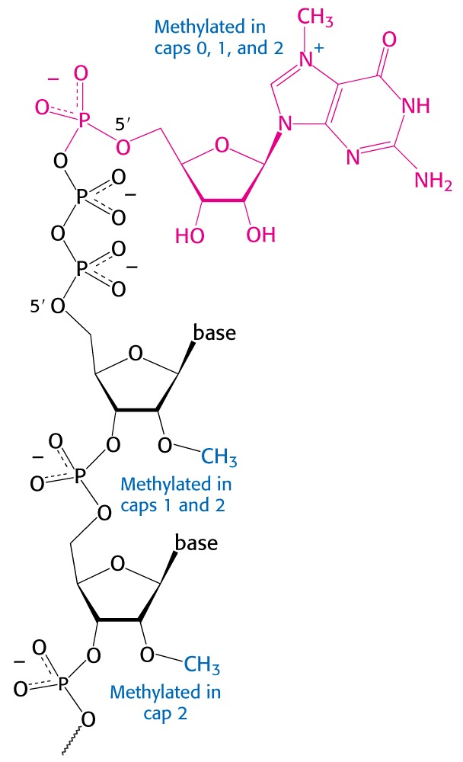
Postopek modifikacije 5‘-konca:
1. RNA terminalna transferaza odstrani končni fosfat
2. gvanililtransferaza doda GMP (iz GTP)
3. metiltransferaza doda Me na N7
4. poteče lahko še metilacija na A2 in včasih 3. baze celotni encimski kompleks imenujemo tudi CEC (capping enzyme complex) – vezan je na RNA-pol II, sicer pa gvanililtransferazo imenujejo tudi CE
Funkcije:
- stabilnost - izvoz iz jedra
- omogoča izrez 5‘-introna
- pospešuje translacijo

Slide 11
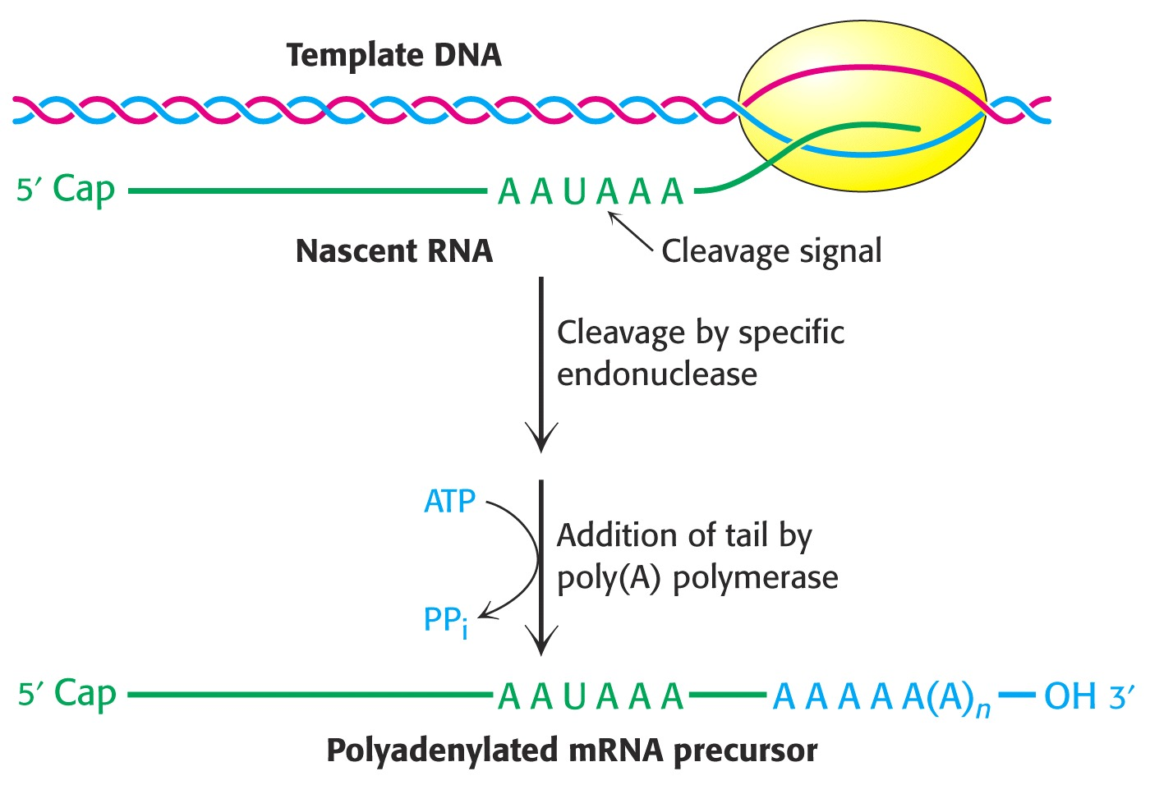
Notes:
poliadenilacija mRNA

Slide 12
CPSF: cleavage and polyadenylation specificity factor
CstF: cleavage stimulation factor F
Alberts 4
Notes:
celoten kompleks, ki preuredi 3‘-konec, ima maso ~900 kDa
PAP najprej katalizira nastanek ~10 A, po vezavi PABPII pa še nadaljnjih ~190. Dolžina je omejena na ~200. Na konec se veže PABPI, ki ščiti RNA in sodeluje pri prenosi v citoplazmo, kjer se poveže s translacijskim EF4G v krožno strukturo.

Slide 14
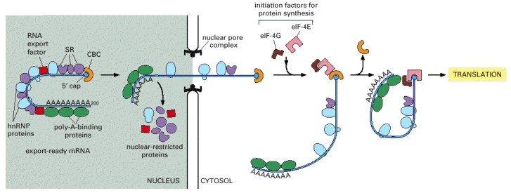
Alberts 4
Notes:
Some proteins travel with the mRNA as it moves through the pore, whereas others remain in the nucleus. Once in the cytoplasm, the mRNA continues to shed previously bound proteins and acquire new ones; these substitutions affect the subsequent translation of the message. Because some are transported with the RNA, the proteins that become bound to an mRNA in the nucleus can influence its subsequent stability and translation in the cytosol. RNA export factors, shown in the nucleus, play an active role in transporting the mRNA to the cytosol (see Figure 12-16). Some are deposited at exon-exon boundaries as splicing is completed, thus signifying those regions of the RNA that have been properly spliced.

Slide 15
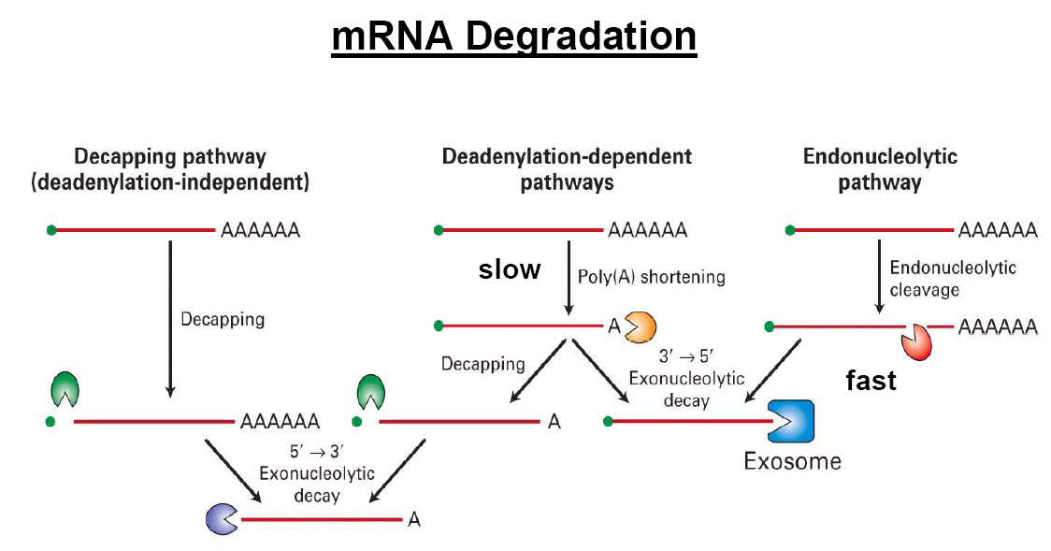

Slide 16
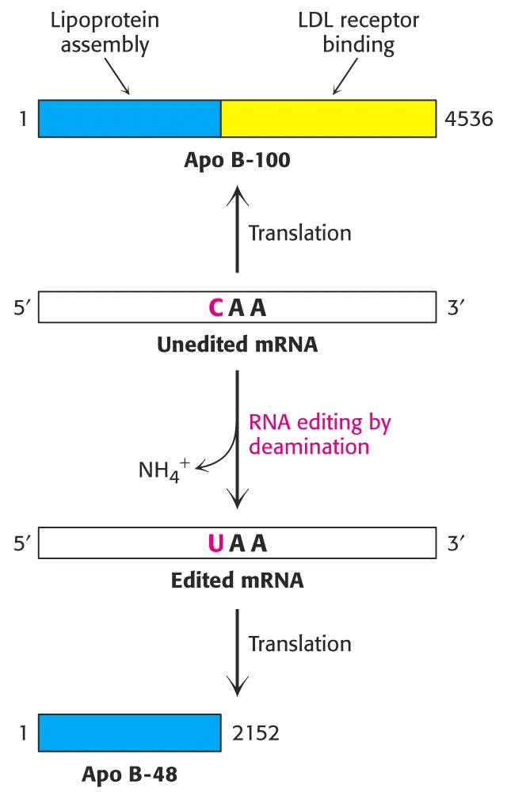
urejanje RNA

Slide 17
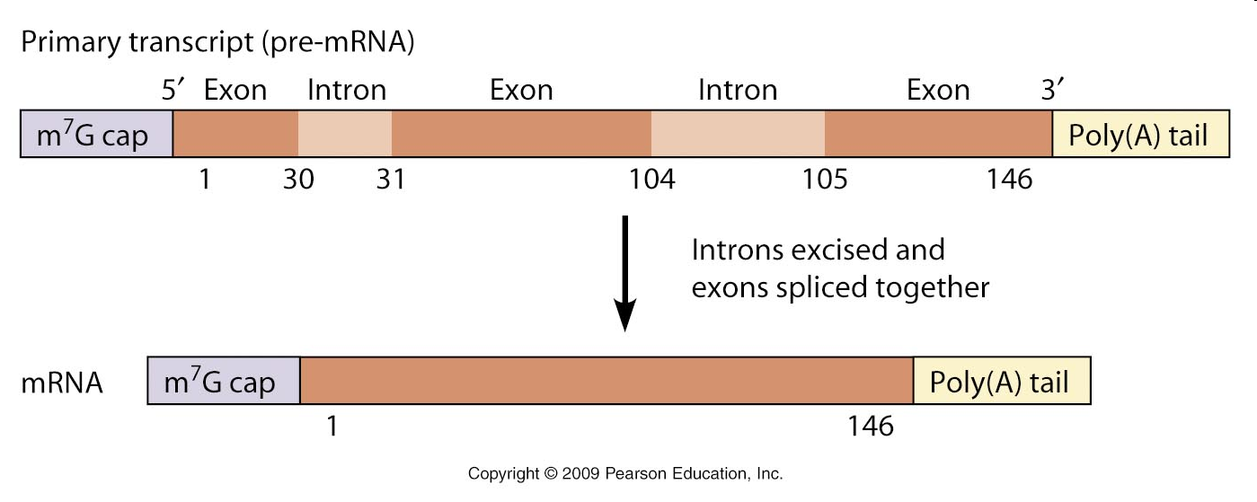
Notes:
Introne so odkrili leta 1977 pri adenovirusih, kasneje pa pri genih za rRNA/tRNA.

Slide 18
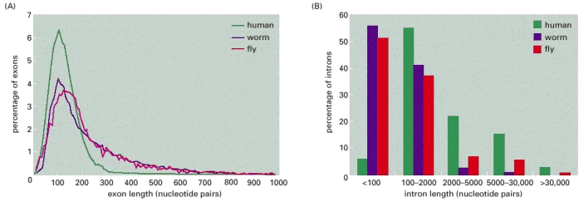
Alberts 4
Porazdelitev dolžin eksonov in intronov pri evkariontih

Slide 19
Notes:
mRNA: konsenzna zaporedja na stiku intron-ekson pri vretenčarjih

Slide 20
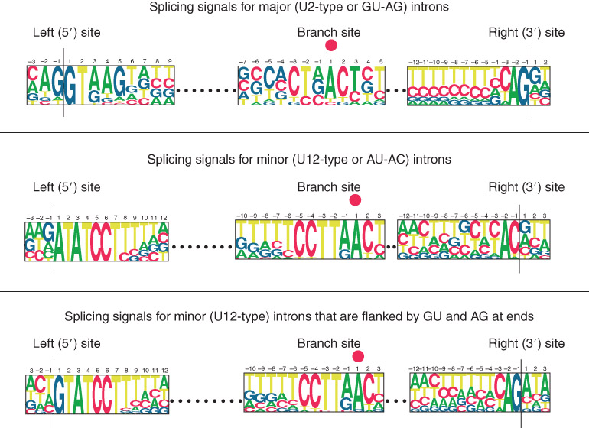

Slide 21
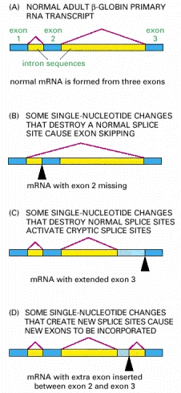

Slide 22
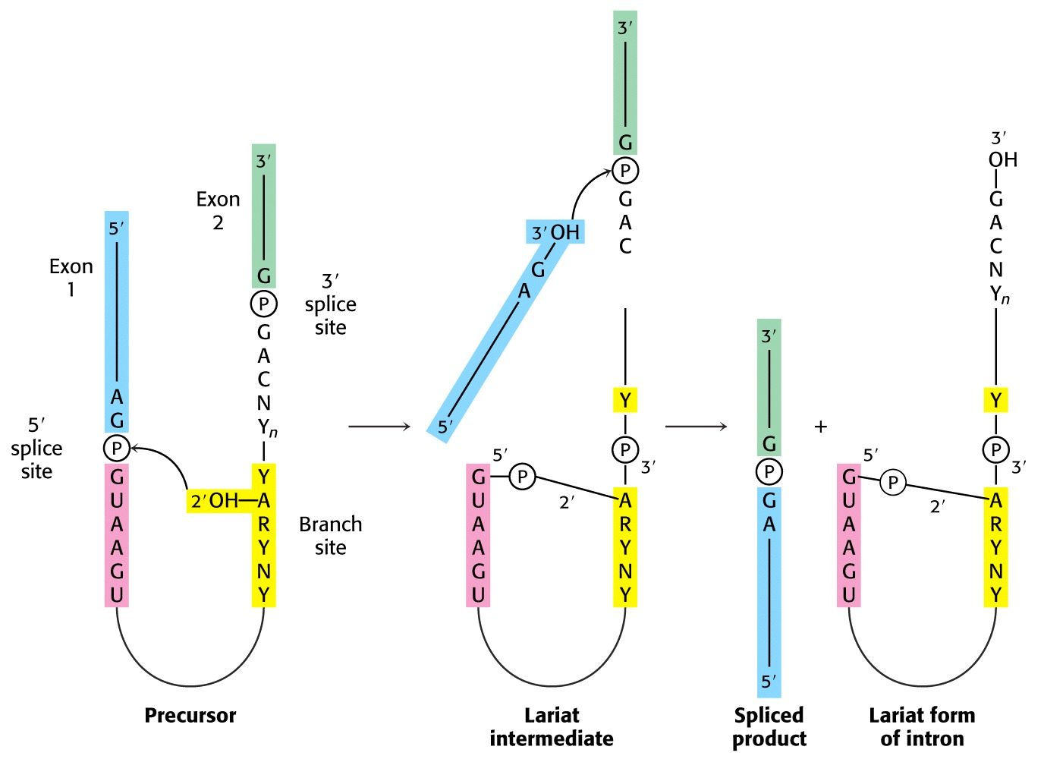
Notes:
mehanizem izrezovanja intronov pri prekurzorjih mRNA

Slide 23
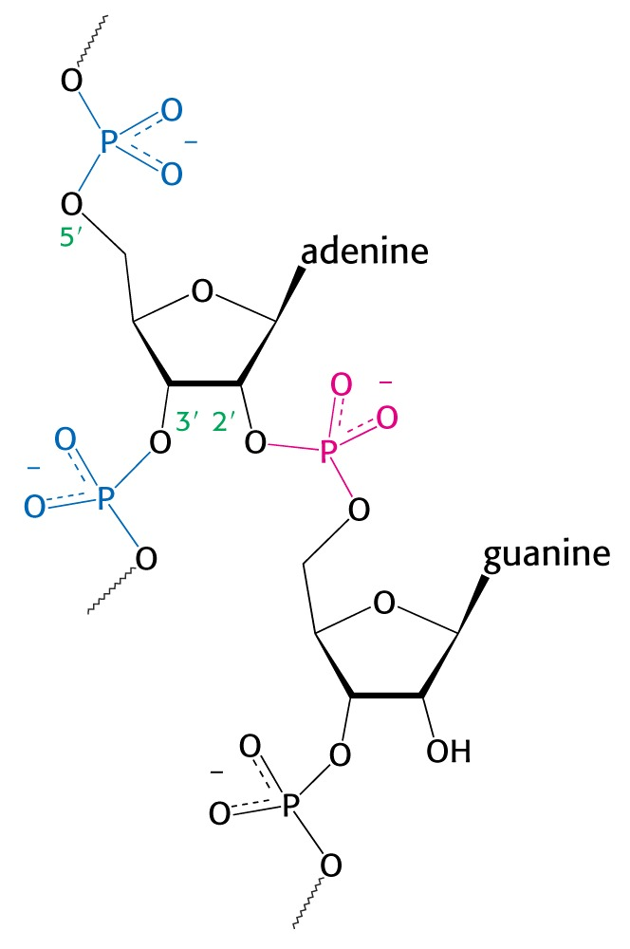

Slide 24
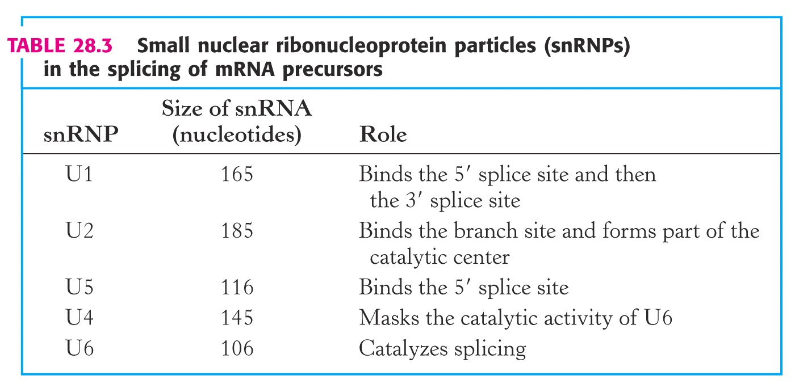

Slide 25
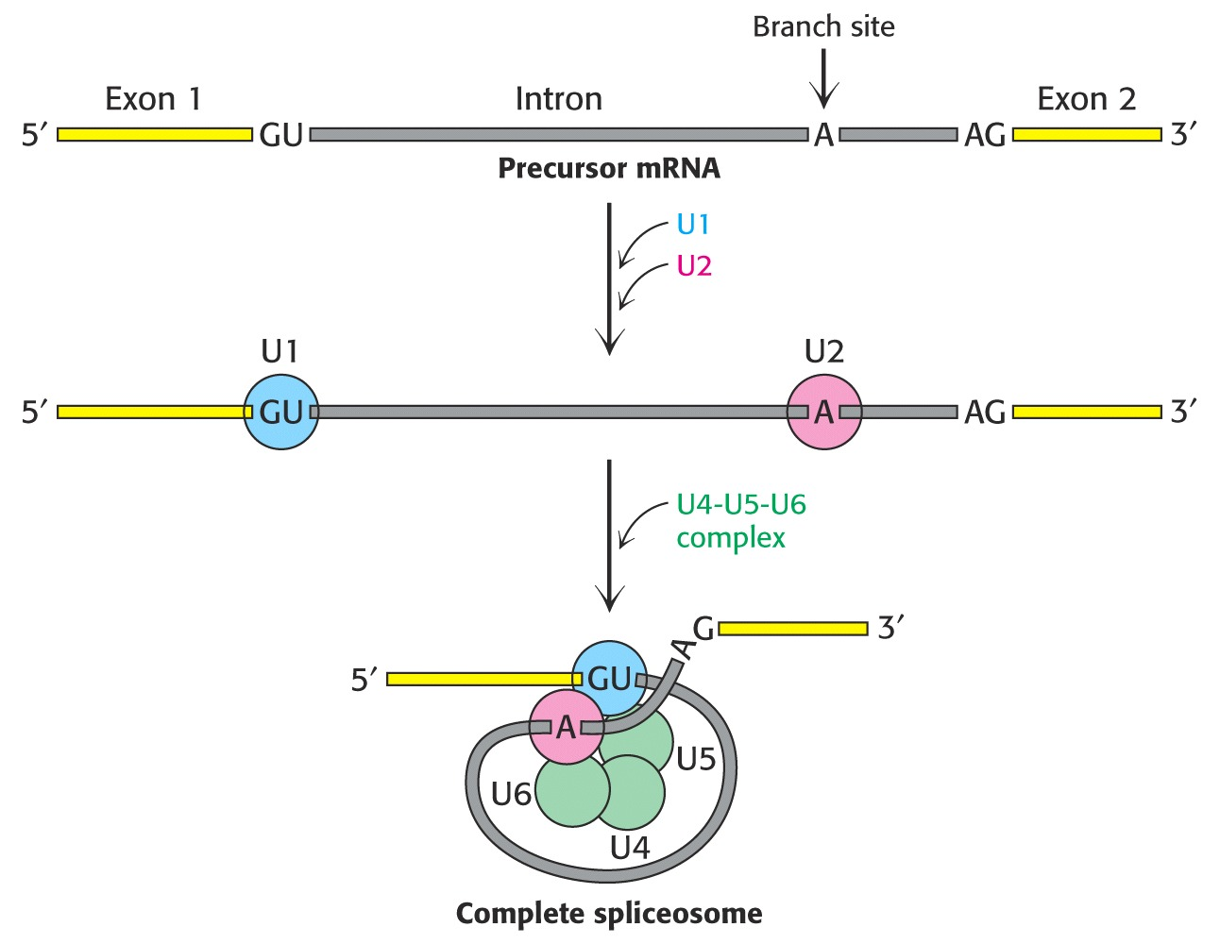
Notes:
sestavljanje spliceosoma

Slide 26
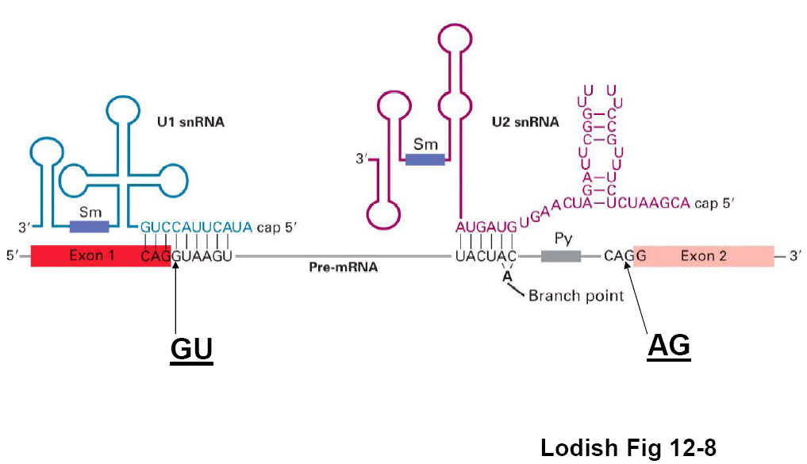

Slide 27
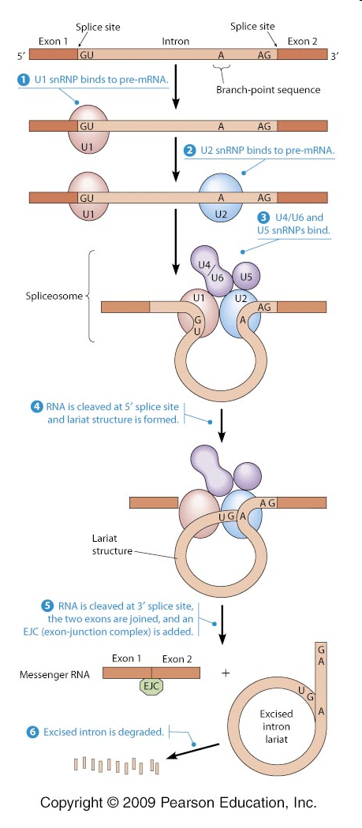
Notes:
http://www.mun.ca/biology/desmid/brian/BIOL2060/BIOL2060-21/2124.jpg
In a stepwise fashion, the pre-mRNA assembles with the U1 snRNP, U2 snRNP, and U4/U6 and U5 snRNPs (along with some non-snRNP splicing factors), forming a mature spliceosome. The pre-mRNA is then cleaved at the 5prime splice site and the newly released 5prime end is linked to an adenine (A) nucleotide located at the branch-point sequence, creating a looped lariat structure. Next the 3prime splice site is cleaved and the two ends of the exon are joined together, releasing the intron for subsequent degradation.

Slide 28
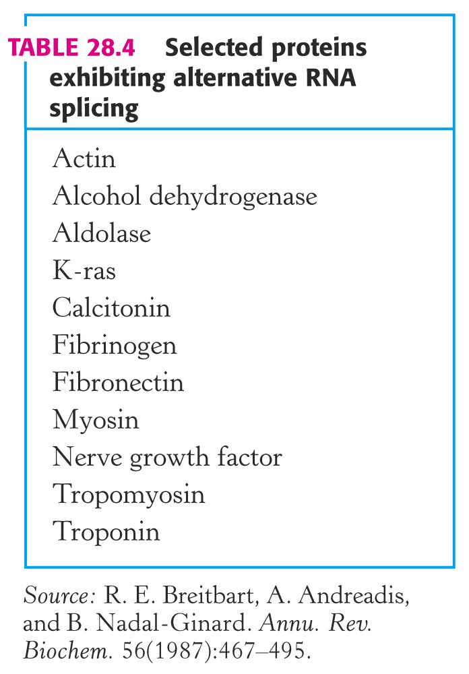
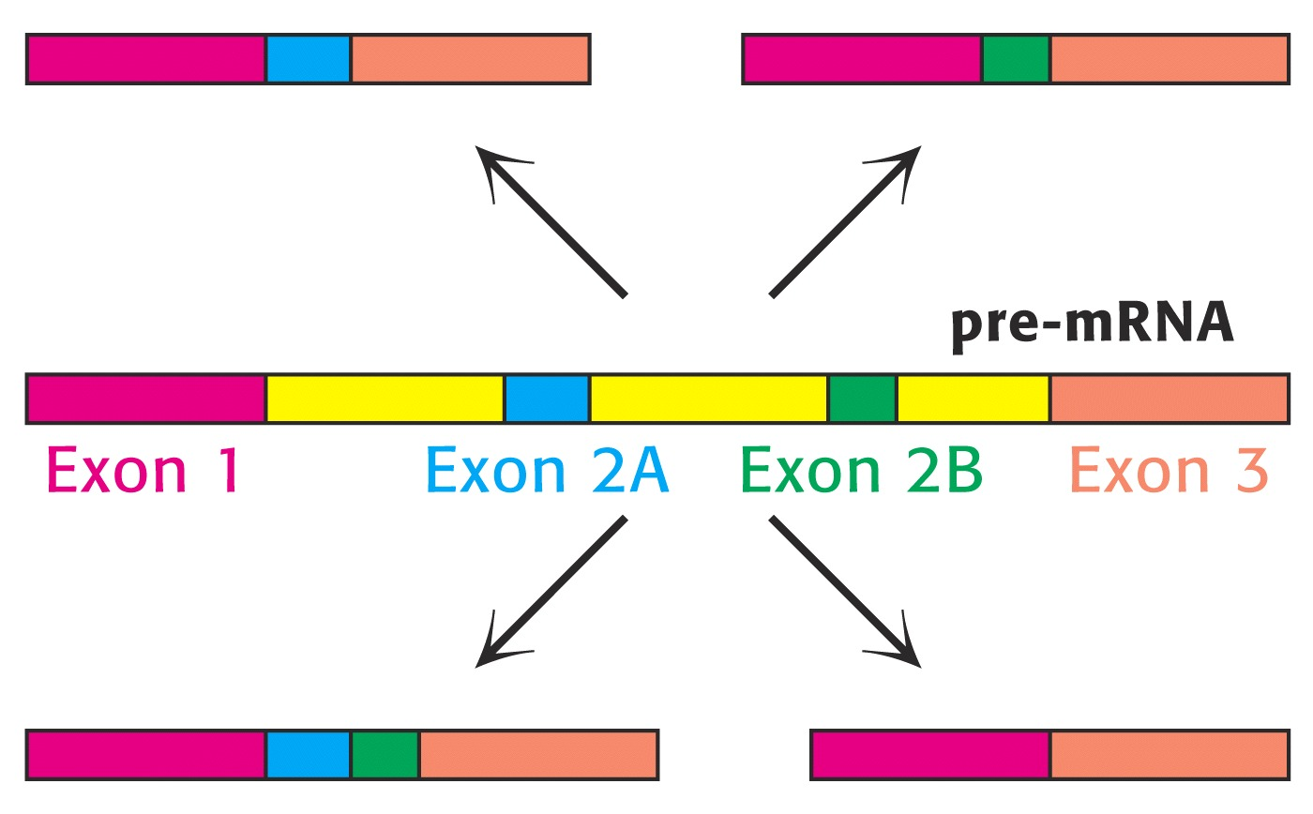

Slide 29
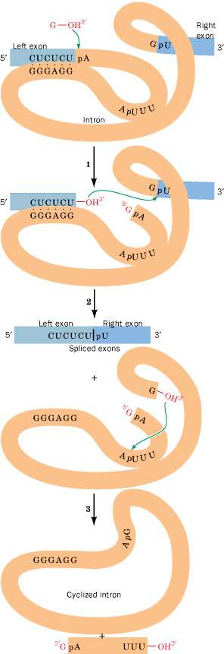
Samoizrezovalni introni tipa 1 pri
migetalkarju Tetrahymena:
* napad –OH skupine prostega G na fosfat na 5‘-koncu introna
* skupina –OH na 3‘-koncu zgornjega eksona napade 5‘-končni fosfat spodnjega eksona, pri čemer se sprostijo intron in spojena eksona
* skupina –OH na 3‘-koncu introna napade razvejitveno mesto v intronu, tako da nastane ciklični intron in odcepljen 5‘-končni fragment (~15 nt)
Notes:
self-splicing (Tetrahymena): katalitska RNA

Slide 30
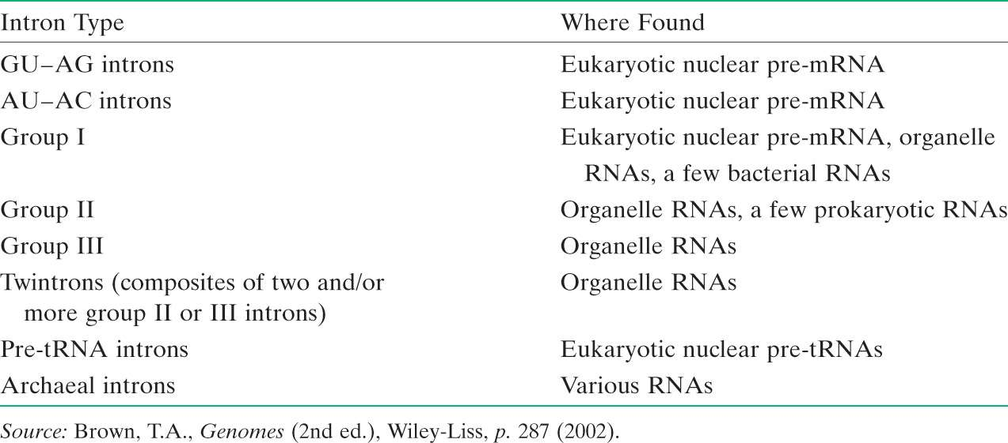
Znani tipi intronov pri evkariontih (7) in arhejah (1).

Slide 31
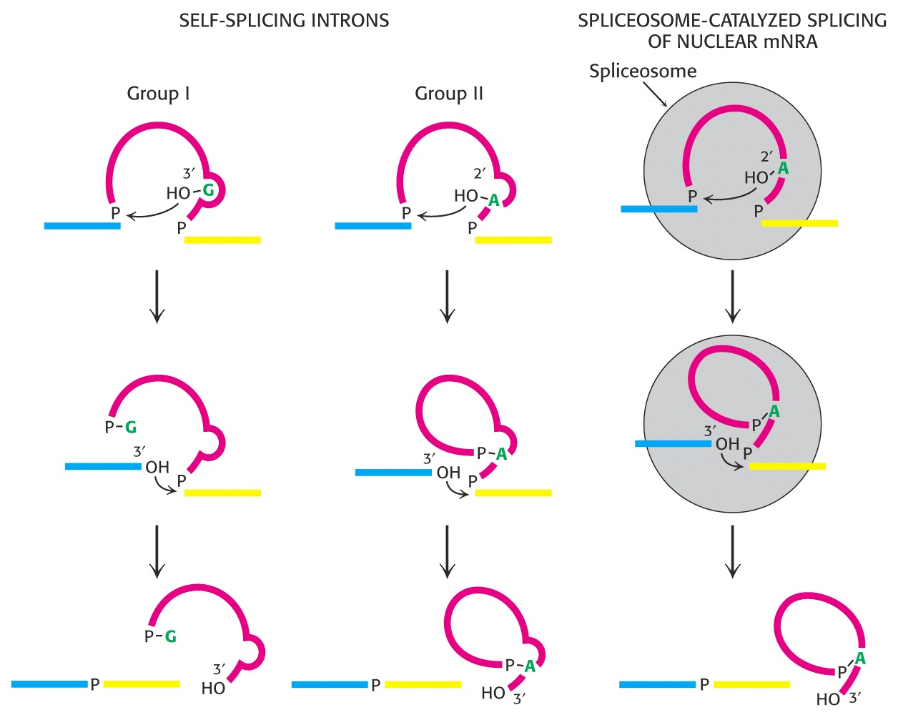

Slide 32
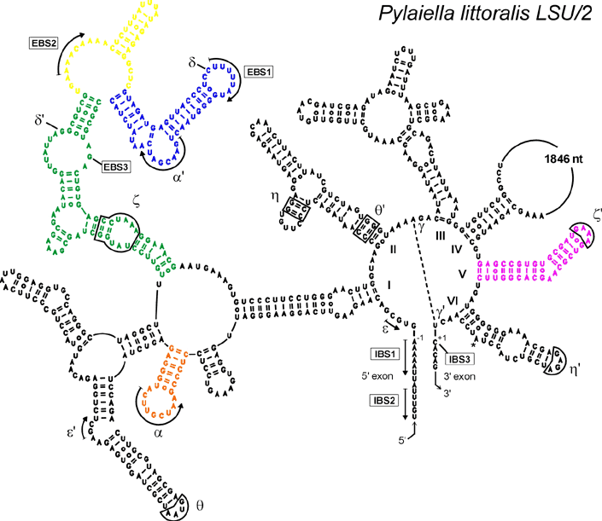
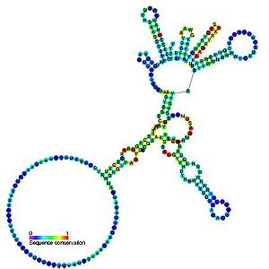
introni skupine I introni skupine II
veliki
9 sparjenih regij
2 domeni
exoG
veliki
6 značilnih domen
notranji A (razvejitveno mesto)
in vivo potrebno sodelovanje proteinov
Notes:
exoG = eksogeni G

Slide 33
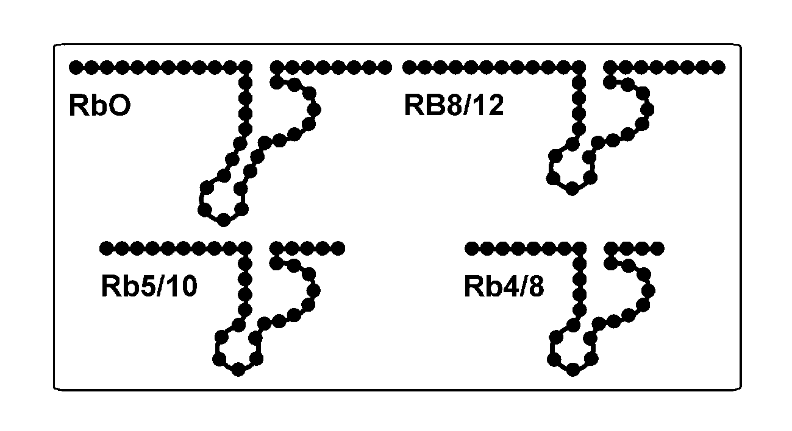

Slide 34
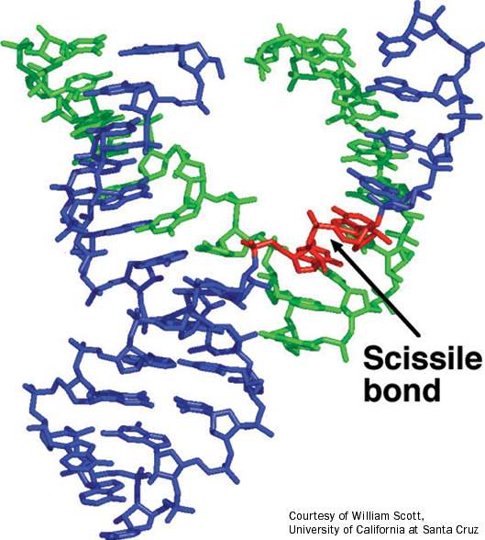
Rentgenska struktura ribocima z obliko kladiva ter shematska razlaga strukture: encim – zeleno, substrat – modro, mesto cepitve – rdeče.

Slide 35
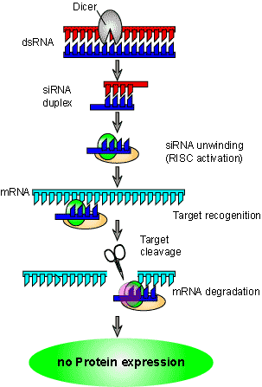

Slide 36
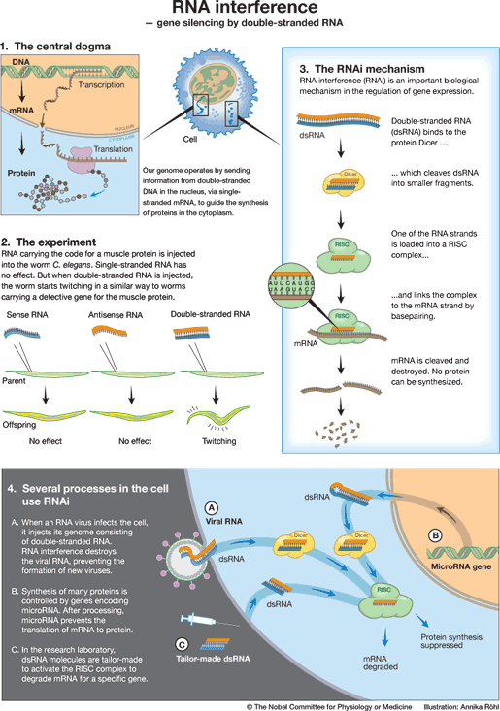

Slide 37
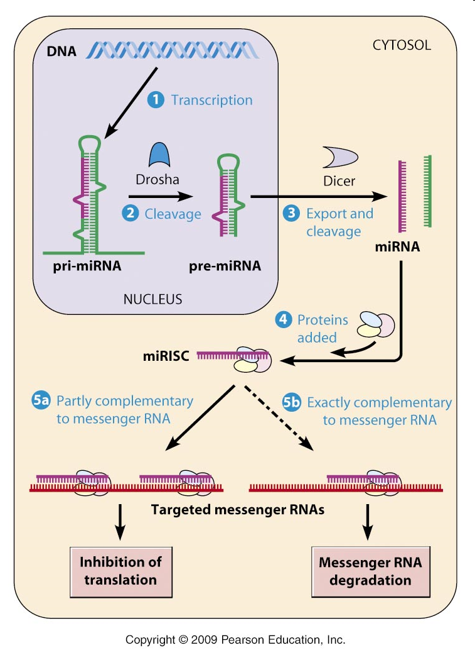
Notes:
The primary miRNAs are transcribed, form hair-pin structures and are cleaved by Drosha to make precursor microRNAs (roughly 70 nucleotides in length). The pre-miRNAs are exported to the cytoplam where they are cleaved by dicer into the 21-22 nucleotide mature microRNA's. The miRNA's form ribonucleoprotein complexes with mRNA's. If the match is exact, the mRNA is destroyed, similar to siRNA mechanisms. If the match is less-than-exact, then binding (usually of several miRNA's) inhibit translation. Genes for miRNA's seem to make up 0.5-1.0% of the total number of genes in multicellular organisms. i.e. 200-250 miRNA genes in humans.

Slide 38
RNA-stikala (riboswitch) in RNA-termometri
- znotraj celice zaznavajo razmere v okolju
- preko svoje strukture sprožajo celični odziv
- so deli verige mRNA
RNA-stikala
- zaznajo koncentracijo metabolita, katerega konc. uravnava produkt iste mRNA
- metabolit se veže na stikalo, ki s svojo strukturo spreminja raven izražanja gena
RNA-termometri
- sekund. / terc. strukturni elementi mRNA, ki lahko vklopijo/izklopijo translacijo
Zvitje RNA je pomemben proces za vlogo RNA v celici, nanj pa vplivajo dejavniki
celičnega okolja (hitrost sinteze in razgradnje, temperatura, ligandi: kovinski ioni, poliamini, RNA-vezavni proteini).
Notes:
FEBS J. (2011) DOI: 10.1111/j.1742-4658.2011.08094.x

Slide 39
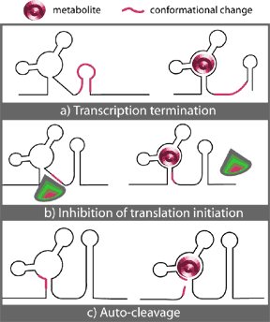
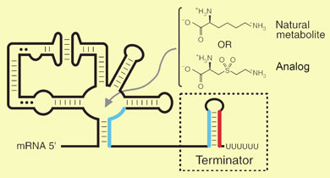
Chemistry World, 2006
Science Creative, 2011
Notes:
They gave the bacterium Bacillus subtilis a dose of L-aminoethylcysteine (AEC) - an analogue of lysine - persuading the riboswitch that no more lysine was needed by the cell. Since the bacteria cannot use AEC in place of lysine, they soon run short of this vital biochemical building block.

