Slide 1
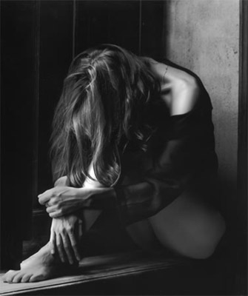
Depression in school
Author: S. D.
Mentor: M. B.

Slide 2
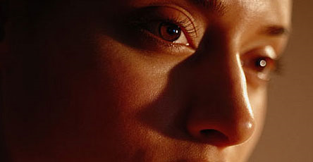
What Is Depression?
depression \di-ˈpre-shən\
Depression is a common but serious illness, and most who experience it need treatment to get better.
Synonyms for depression...

Slide 3
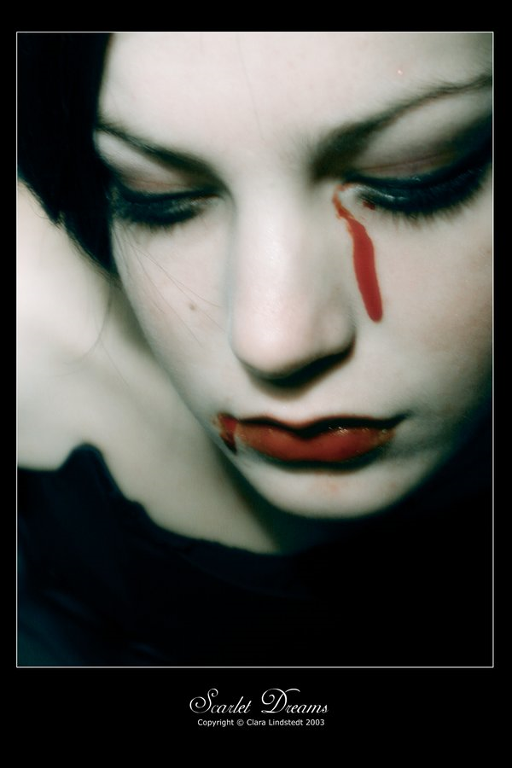
When you are depressed...
You feel sad or cry a lot and it doesn't go away.
You feel guilty for no real reason. You feel like you're no good.
Life seems meaningless.
You don't feel like doing the things you used to.
It's hard to make up your mind. You forget lots of things, and it's hard to concentrate.
Little things make you lose your temper. You overreact.
You start sleeping a lot more, or you have trouble falling asleep at night. Or you wake up really early most mornings and can't get back to sleep.
Your eating pattern changes. You've lost your appetite or you eat a lot more.
You feel restless or tired most of the time
You think about death, or have thoughts about committing suicide.

Slide 4
What are the different forms of depression?
Major depressive disorder
a combination of symptoms that interfere with a person's ability to work, sleep, study, eat, and enjoy once–pleasurable activities.
Dysthymic disorder
long–term but less severe symptoms that may not disable a person but can prevent one from functioning normally or feeling well.

Slide 5
Also...
Psychotic depression (break with reality, hallucinations, and delusions)
Postpartum depression (diagnosed if a new mother develops a major depressive episode within one month after delivery)
Seasonal affective disorder (SAD) (a depressive illness during the winter months, when there is less natural sunlight. )

Slide 6
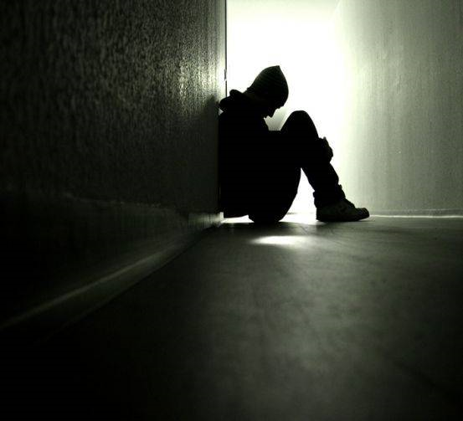
What are the signs/symptoms of depression?
Persistent sad, anxious or "empty" feelings
Feelings of hopelessness and/or pessimism
Feelings of guilt, worthlessness and/or helplessness
Irritability, restlessness
Loss of interest in activities or hobbies
Difficulty concentrating, remembering details and making decisions
Overeating, or appetite loss
Thoughts of suicide, suicide attempts
Persistent aches or pains, headaches, cramps

Slide 7
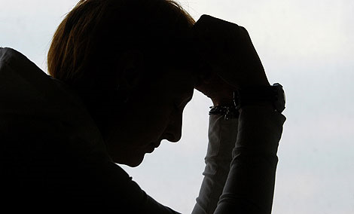
How do children experience depression?
pretend to be sick,
refuse to go to school,
worry that a parent may die.
Older children :
may get into trouble at school,
be negative and irritable,
feel misunderstood

Slide 8
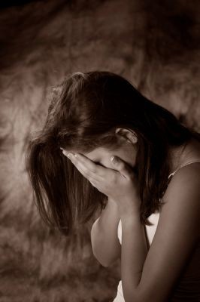
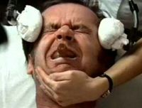
How is depression treated?
Medication
With Psychotherapy - "talk therapy"–
Electroconvulsive Therapy - "shock therapy“

Slide 9
How can I help a friend or relative who is depressed?
Debate how can you help your friend or relative to solve his depression... Would you offer him/her support? Talk to him?
Or...
Your friend is having some comments about suicide...How would you help him and how can you convince him that her/his live is worth living for?

